Slide 1
Clinica Oculistica
Università di Padova
Department of Ophthalmology
University of Padova
Aflibercept & Wet AMD
Edoardo Midena
Notes:
1

Slide 2
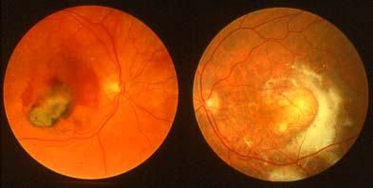
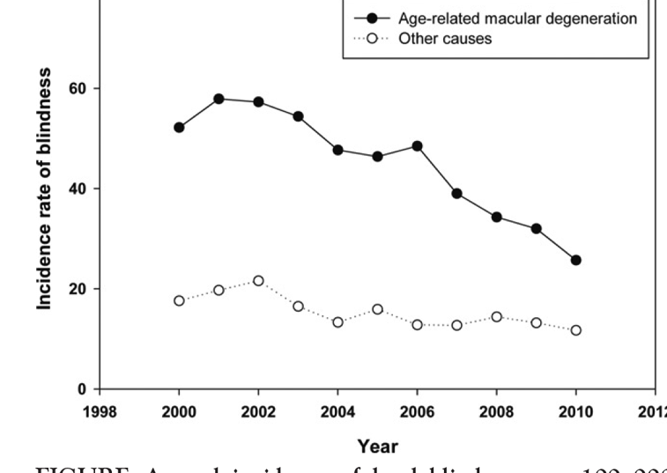
Late AMD
SB Bloch et al, AJO, 2012
Notes:
2

Slide 3
Intravitreal AntiVEGF
Efficacy and Safety
Economic and social costs
Treatment regimen : fixed vs individual
Ranibizumab
Aflibercept
Bevacizumab
Notes:
3

Slide 4
Intravitreal AntiVEGF
Undertreatment is the rule
Costly-driven
Unreported adverse events
Tachiphylaxis
Ranibizumab
Aflibercept
Bevacizumab
Notes:
4

Slide 5
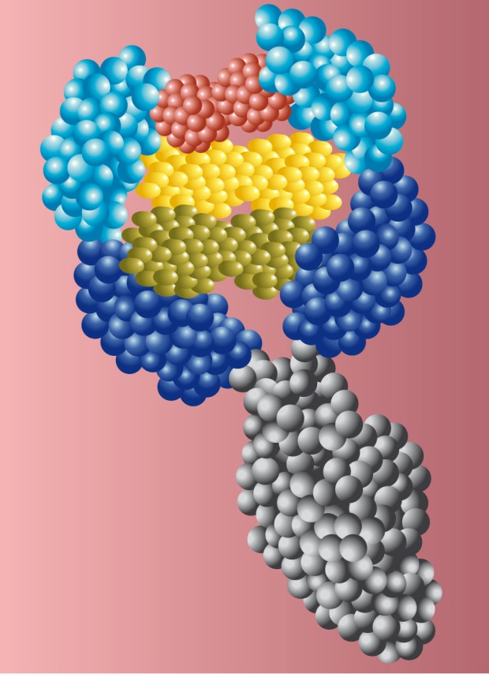
Aflibercept
Purely human protein
All VEGF isoforms and PIGF
High affinity and long lasting activity
Penetrates all retinal layers (intracellular !)
~180 Centres
1217 Patients
~180 Centres
1240 Patients
Notes:
5

Slide 6
VIEW-1
180 Centers
1217 Patients
VIEW-2
186 Centers
1240 Patients
Europe
Austria, Belgium, Czech Republic, France, Germany, Hungary, Israel, Italy, Latvia, Netherlands, Poland, Portugal, Slovakia, Spain, Sweden, Switzerland, UK
North America
USA, Canada
Asia-Pacific
Australia, India, Japan, South Korea, Singapore
Latin America
Argentina, Brazil, Colombia, Mexico
Notes:
6
6

Slide 7
Study Design
Multi-center, active controlled, double masked trial VIEW 1 N=1217; VIEW 2 N=1240
Patients randomized 1:1:1:1
Intravitreal Aflibercept Injection
Ranibizumab
2 mg q4 wks
0.5 mg q4 wks
2 mg q8 wks*
0.5 mg q4 wks
Primary endpoint: Maintenance of Vision
Dosing through Week 48 Modified quarterly dosing through Week 92#
Key secondary endpoint: Mean change in BCVA
*After 3 initial monthly doses
# With additional evaluation visits

Slide 8
Study Endpoints
Proportion of patients who maintained BCVA (%) (losing <15 ETDRS letters from baseline) at Week 52
PRIMARY ENDPOINT
Mean change in BCVA as measured by ETDRS letter score from baseline
Proportion of patients who gained at least 15 letters of BCVA from baseline
KEY SECONDARY ENDPOINTS
BCVA: Best-Corrected Visual Acuity
ETDRS: Early Treatment Diabetic Retinopathy Study
Notes:
8
8

Slide 9
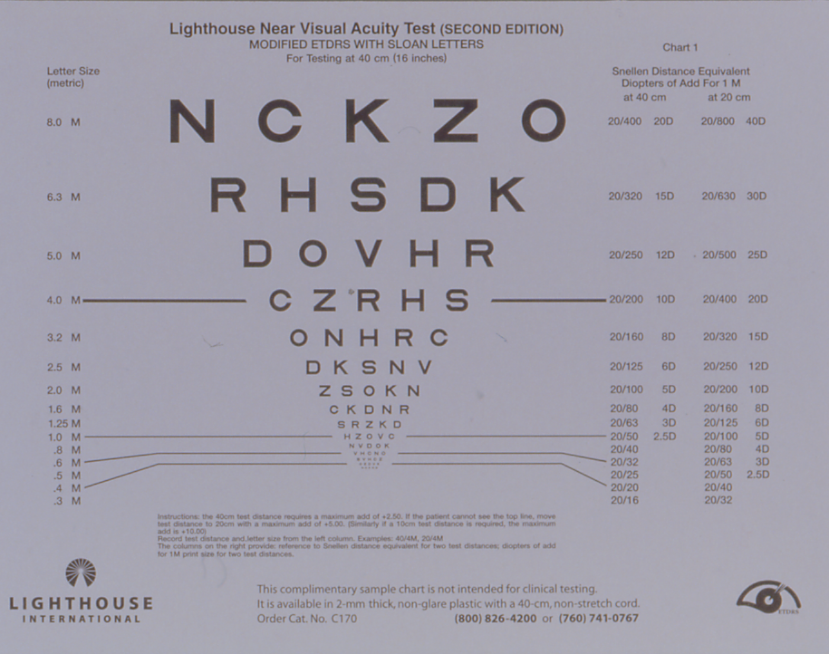
Study Endpoints
PRIMARY ENDPOINT
KEY SECONDARY ENDPOINTS
BCVA: Best-Corrected Visual Acuity
ETDRS: Early Treatment Diabetic Retinopathy Study
Notes:
9
9

Slide 10
Retinal Thickness
Notes:
10
10

Slide 11
VIEW Studies Baseline Demographics
RBZ 0.5q4 0.5 mg q4 wks
AFL 2q4 2 mg q4 wks
AFL 0.5q4 0.5 mg q4 wks
AFL 2q8 2 mg q8 wks
n (full analysis set)* | 595 | 613 | 597 | 607
Mean Age years (SD) | 75.6 (8.7) | 75.9 (8.4) | 76.5 (8.5) | 75.8 (8.8)
Gender
Women # (%) | 341 (57.3%) | 370 (60.4%) | 314 (52.6%) | 353 (58.2%)
Men # (%) | 254 (42.7%) | 243 (39.6%) | 283 (47.4%) | 254 (41.8%)
Race # (%)
White | 509 (85.5%) | 521 (85.0%) | 510 (85.4%) | 504 (83.0%)
Asian | 60 (10.1%) | 70 (11.4%) | 66 (11.1%) | 73 (12.0%)
Black or African American | 2 (0.3%) | 1 (0.2%) | 1 (0.2%) | 3 (0.5%)
American Indian/Alaskan Native | 2 (0.3%) | 0 | 2 (0.3%) | 1 (0.2%)
Native Hawaiian/Pacific Islander | 1 (0.2%) | 0 | 0 | 1 (0.2%)
Multiple | 0 | 0 | 0 | 1 (0.2%)
Not reported | 21 (3.5%) | 21 (3.4%) | 18 (3.0%) | 24 (4.0%)
* No imputation was performed for missing data
AFL, intravitreal aflibercept; RBZ, ranibizumab

Slide 12
VIEW Studies Baseline Disease Characteristics
RBZ 0.5q4 0.5 mg q4 wks
AFL 2q4 2 mg q4 wks
AFL 0.5q4 0.5 mg q4 wks
AFL 2q8 2 mg q8 wks
n (full analysis set)* | 595 | 613 | 597 | 607
ETDRS BCVA letter score (SD) Snellen Equivalent | 53.9 (13.4) 20/80 | 54.0 (13.6) 20/80 | 53.6 (13.8) 20/80 | 53.6 (13.5) 20/80
Lesion Type: # (%)
Predominantly Classic | 152 (25.5%) | 159 (25.9%) | 161 (27.0%) | 159 (26.2%)
Minimally Classic | 205 (34.5%) | 217 (35.4%) | 200 (33.5%) | 216 (35.6%)
Occult | 231 (38.8%) | 233 (38.0%) | 234 (39.2%) | 228 (37.6%)
Missing | 7 (1.2%) | 4 (0.7%) | 2 (0.3%) | 4 (0.7%)
Lesion Size (mm², mean ± SD) | 7.5±5.6 | 7.9±5.8 | 7.5±5.2 | 7.6±5.6
Retinal Thickness (μm ± SD) | 321±109.7 | 325±112.6 | 320±111.6 | 334±118.2
* No imputation was performed for missing data
AFL, intravitreal aflibercept; RBZ, ranibizumab

Slide 13
VIEW Studies Patient Disposition
RBZ 0.5q4 0.5 mg q4 wks
AFL 2q4 2 mg q4 wks
AFL 0.5q4 0.5 mg q4 wks
AFL 2q8 2 mg q8 wks
Randomized | 609 (100%) | 617 (100%) | 615 (100%) | 616 (100%)
Completed Week 52 | 560 (92.0%) | 574 (93.0%) | 551 (89.6%) | 560 (90.9%)
Completed Week 96 | 519 (85.2%) | 529 (85.7%) | 502 (81.6%) | 513 (83.3%)
Discontinuation before Week 52 | 49 (8.0%) | 43 (7.0%) | 64 (10.4%) | 56 (9.1%)
Discontinuation before Week 96 | 90 (14.8%) | 88 (14.3%) | 113 (18.4%) | 103 (16.7%)
Withdrawal of consent | 34 (5.6%) | 41 (6.6%) | 34 (5.5%) | 35 (5.7%)
Protocol deviation | 5 (0.8%) | 2 (0.3%) | 3 (0.5%) | 1 (0.2%)
Adverse event | 16 (2.6%) | 21 (3.4%) | 31 (5.0%) | 26 (4.2%)
Discontinuation due to death | 11 (1.8%) | 10 (1.6%) | 16 (2.6%) | 15 (2.4%)
Lost to follow-up | 14 (2.3%) | 8 (1.3%) | 9 (1.5%) | 15 (2.4%)
Lack of efficacy | 1 (0.2%) | 0 | 4 (0.7%) | 3 (0.5%)
Other | 11 (1.8%) | 8 (1.3%) | 21 (3.4%) | 9 (1.5%)
AFL, intravitreal aflibercept; RBZ, ranibizumab
* 11 patients discontinued study medication in addition: 6 RBZ q4, 0 VTE 2q4, 3 VTE 0.5 q4 and 2 VTE 2q8

Slide 14
VIEW Studies Treatment Schedule
 | Day 1 | Week 4 | Week 8 | Week 12 | Week 16 | Week 20 | Week 24 | Week 28 | Week 32 | Week 36 | Week 40 | Week 44 | Week 48 | Week 52 | Week 56 | Week 60 | Week 64 | Week 68 | Week 72 | Week 76 | Week 80 | Week 84 | Week 88 | Week 92 | Week 96
RBZ
0.5 mg q4 wk
AFL
2 mg q4 wk
AFL
0.5 mg q4 wk
AFL
2 mg q8 wk
Primary
Endpoint
Final Visit
Solid = injection; Outline = sham ; Hatched = modified quarterly dosing
AFL: intravitreal aflibercept; RBZ: Ranibizumab
Notes:
14
{Note: the slide builds to illustrate the two phases of the study – the primary phase (baseline to week 52) and the follow-up phase (week 52-96). This version focuses on 52 weeks}
During the primary phase of the study, from baseline to week 52, patients were treated proactively according to the assigned treatment schedule.
From Week 52 onwards, patients started a reactive (modified quarterly dosing) treatment.

Slide 15
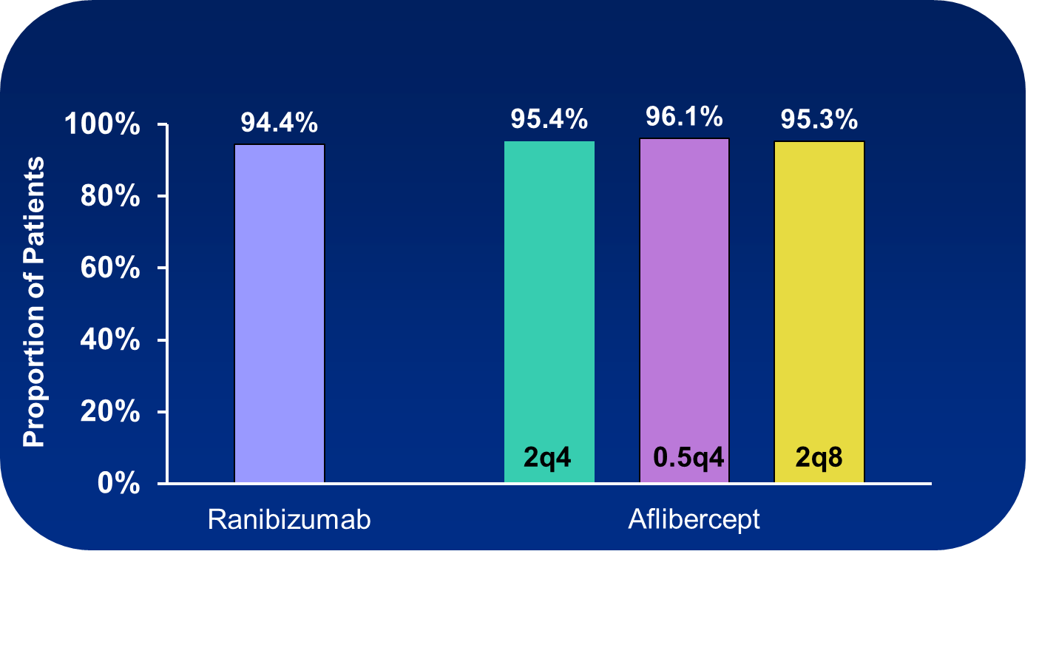
VIEW Studies: Primary Endpoint Maintenance of Vision at 52 Weeks
All dose regimens of aflibercept were numerically better and statistically non-inferior to ranibizumab
<15 letters lost compared to baseline; LOCF; PPS: Rq4 n=538; 2q4 n=559; 0.5q4 n=538; 2q8 n=535;
Notes:
15

Slide 16
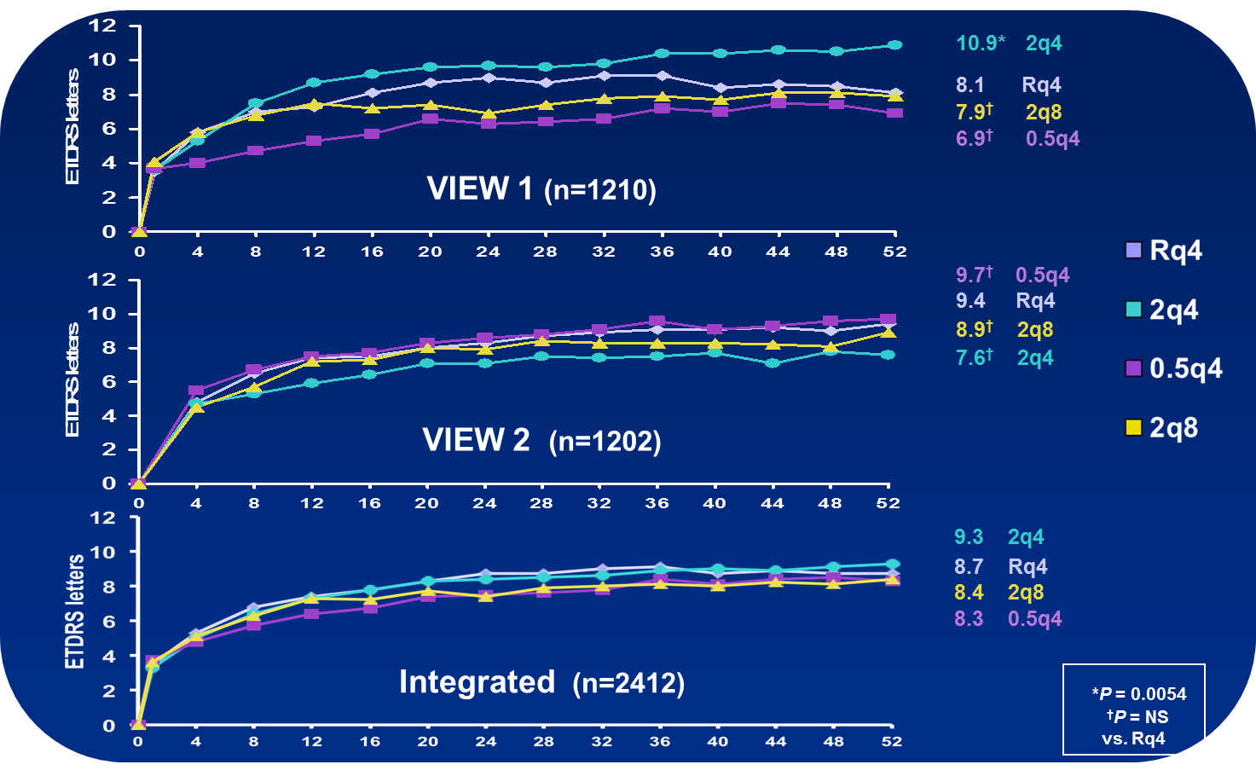
VIEW Studies: Mean Change in Visual Acuity Baseline to Week 52
LOCF; Full analysis set;
Notes:
16

Slide 17
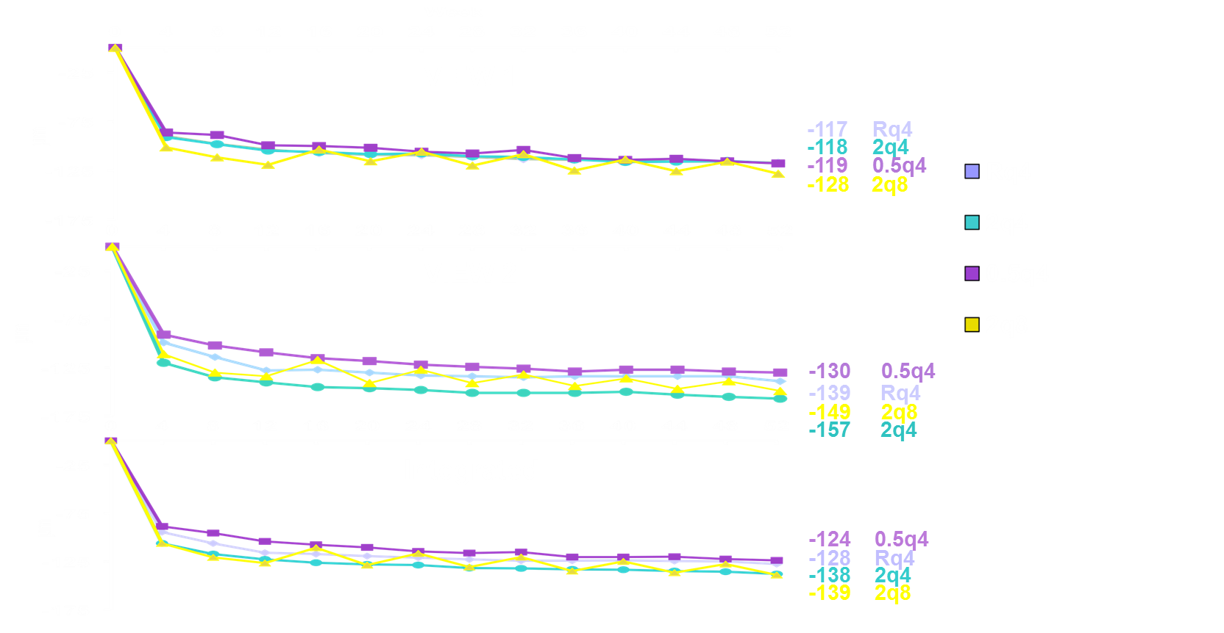
VIEW Studies: Mean Change in Retinal Thickness Over 52 Weeks
LOCF; Full Analysis set; VIEW 1: OCTs mandatory at BL, weeks 4, 12, 24, 36, 52; VIEW 2: OCTS mandatory at all visits
Notes:
17

Slide 18
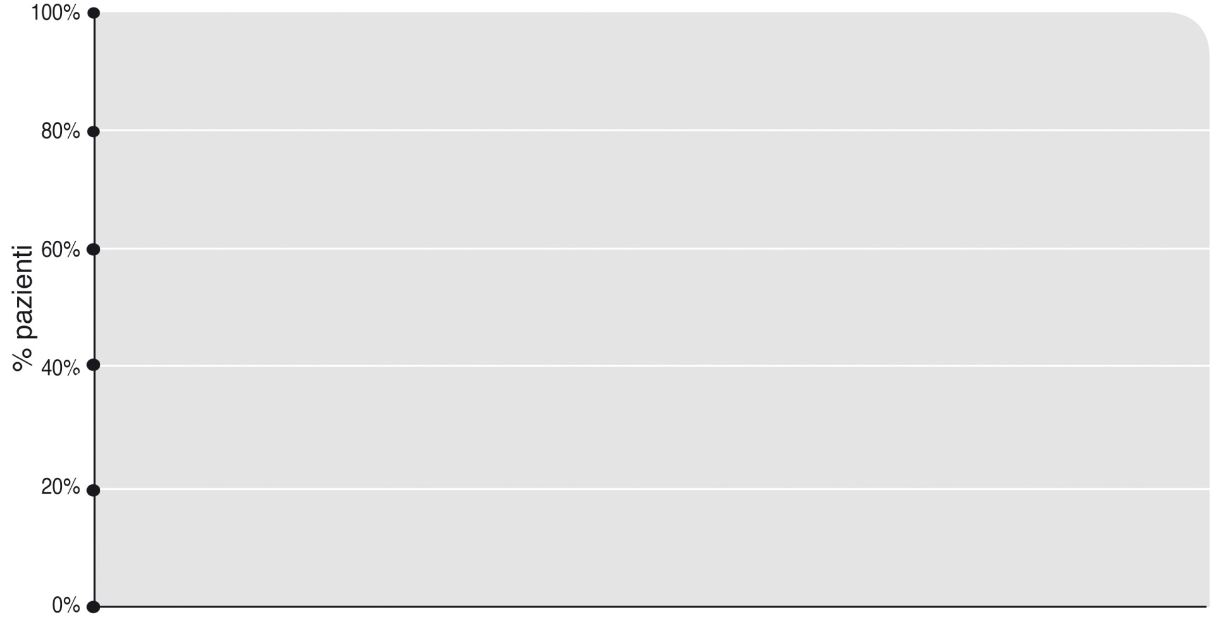
View Studies
Visual Acuity at 52 weeks
94,4%
95,4%
96,1%
95,3%
12 injections
7 injections
2q4
0,5q4
2q8
Ranibizumab
Aflibercept

Slide 19
VIEW Studies: Follow-up Phase Treatment Schedule
RBZ
0.5 mg q4
AFL
2 mg q4
AFL
0.5 mg q4
AFL
2 mg q8
Primary
Endpoint
Final Visit
Solid = injection; Outline = sham ; Hatched = modified quarterly dosing
AFL: intravitreal aflibercept; RBZ: Ranibizumab
Notes:
19

Slide 20
VIEW Studies: Follow-up Phase Retreatment Criteria
Proactive Component
12 weeks have elapsed since the previous injection
Reactive Component
New or persistent fluid as indicated by OCT, or increase in central retinal thickness of ≥100 μm compared to the lowest previous value as measured by OCT, or
Loss of ≥5 ETDRS letters from the best previous letter score in conjunction with recurrent fluid as indicated by OCT, or
New onset classic neovascularization, or
New or persistent leak on FA, or new macular hemorrhage

Slide 21
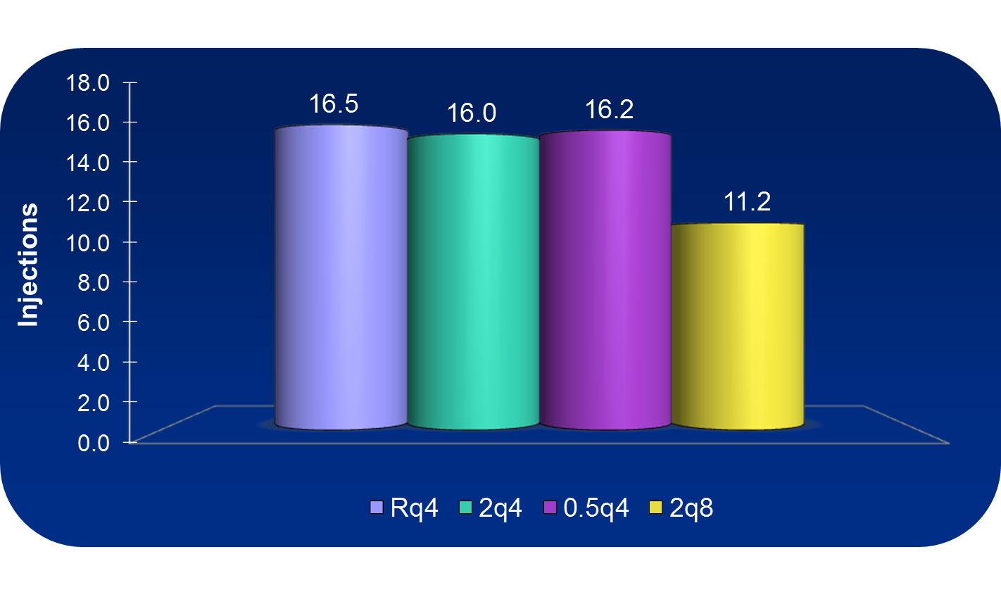
VIEW Studies Total Injections Through Week 96
SAF; Integrated: Rq4 n=595; 2q4 n=613; 0.5q4 n=601; 2q8 n=610;

Slide 22
View Studies (Follow-up Phase).
> 90% of treated eyes maintain VA at 96 weeks
Week 52
Week 96
94%
95%
96%
95%
92%
92%
91%
92%
2q8
2q8
Ranibizumab
Aflibercept
Ranibizumab
Aflibercept
<15 letters lost
*Compared to baseline; LOCF; PPS (weeks 0-52):
Rq4 n=538; 2q4 n=559; 0.5q4 n=538; 2q8 n=535 FAS (weeks 52-96): Rq4 n=595; 2q4 n=613; 0.5q4 n=597; 2q8 n=607

Slide 23
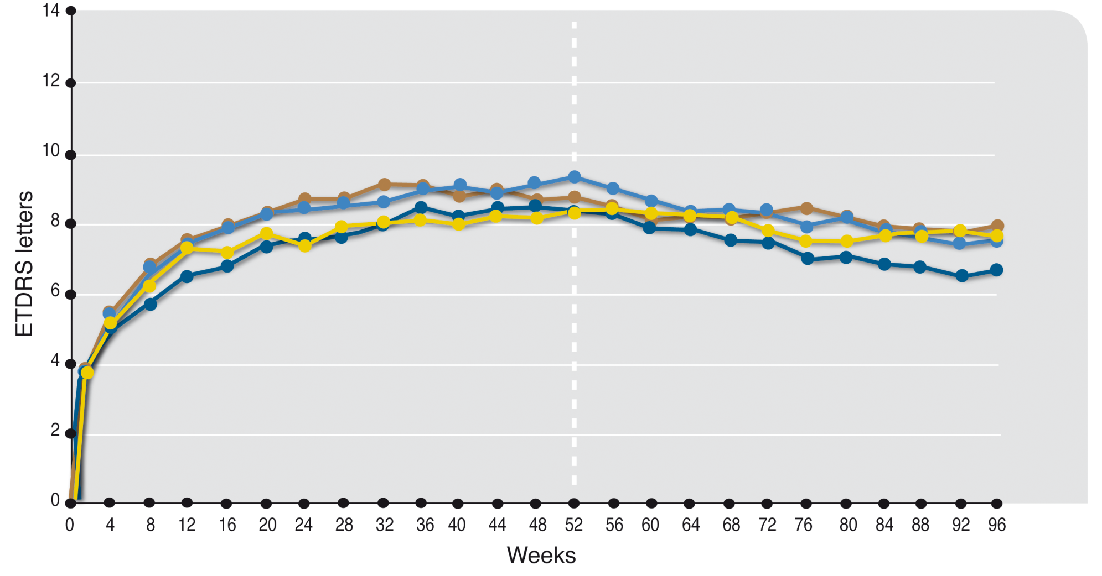
View Studies (Follow-up Phase)
Mean VA Change
Follow-up Phase
7.9
7.6
7.6
6.6
9.3
8.7
8.4
8.3
Rq4
2q4
0.5q4
2q8

Slide 24
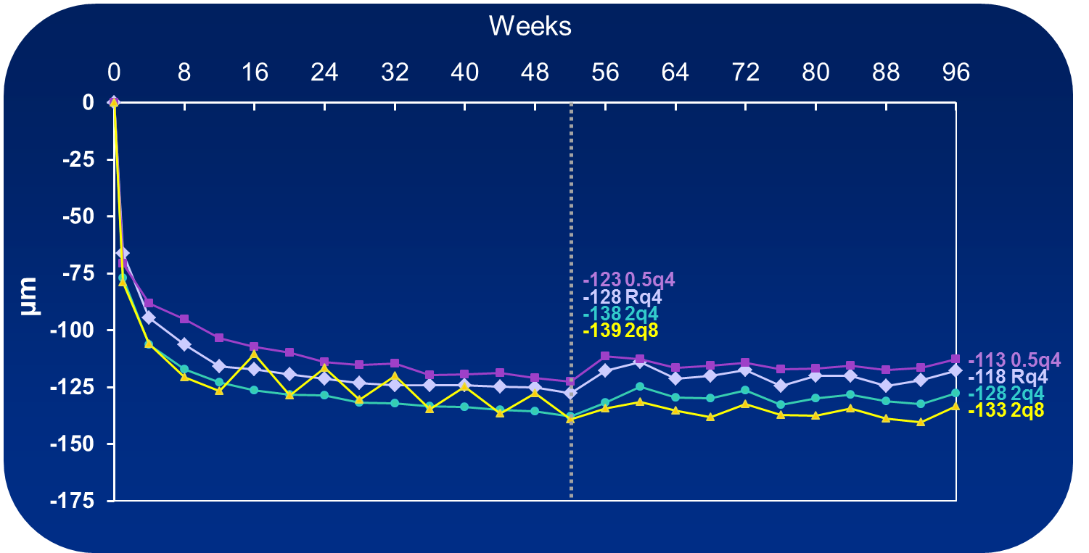
VIEW Studies: Mean Change in Central Retinal Thickness to Week 96
LOCF; Full analysis set; VIEW 1: OCTs mandatory at baseline, weeks 4, 12, 24, 36, and all visits weeks 52-96; VIEW 2: OCTs mandatory at all visits
Notes:
24

Slide 25
VIEW Studies Adverse Events Over 96 Weeks
RBZ 0.5q4
AFL 2q4
AFL 0.5q4
AFL 2q8
All AFL
N (safety analysis set) | 595 | 613 | 601 | 610 | 1824
Any AE (%) | 567 (95.3) | 587 (95.8) | 566 (94.2) | 591 (96.9) | 1744 (95.6)
Non-ocular (systemic) | 494 (83.0) | 522 (85.2) | 501 (83.4) | 519 (85.1) | 1542 (84.5)
Ocular (study eye) | 486 (81.7) | 475 (77.5) | 467 (77.7) | 483 (79.2) | 1425 (78.1)
Injection-related | 297( 49.9) | 276 (45.0) | 276 (45.9) | 287 (47.0) | 839 (46.0)
Any SAE (%) | 170 (28.6) | 158 (25.8) | 168 (28.0) | 177 (29.0) | 503 (27.6)
Non-ocular (systemic) | 146 (24.5) | 131 (21.4) | 152 (25.3) | 154 (25.2) | 437 (24.0)
Ocular (study eye) | 26 (4.4) | 22 (3.6) | 19 (3.2) | 24 (3.9) | 65 (3.6)
Any AE causing discontinuation of study drug | 21 (3.5) | 26 (4.2) | 39 (6.5) | 30 (4.9) | 95 (5.2)
Any death | 16 (2.7)ª | 13 (2.1) | 19 (3.2) | 20 (3.3) ^{b} | 52 (2.9)
AFL, intravitreal aflibercept; RBZ, ranibizumab
a In VIEW 1, one additional death due to CVA and atrial fibrillation occurring 122 days after last visit was only recorded on the End of Study CRF page
b In VIEW 2, one additional death due to lung cancer >60 days after the last visit was only recorded in the GPV database

Slide 26
View 1 and 2 Subanalysis
from 52 to 96 weeks
reactive vs proactive treated eyes
no or limited recovery in reactive eyes
when VA is lost
CRT changes are unrelevant
is reactive appropriate ?
M Goldsteinet al, IOVS, 2013, ARVO E-Abs 3171
Notes:
26

Slide 27
View 1 and 2 Subanalysis (52 wks)
Age
Baseline BCVA
Lesion type and size
CRT
HC Ho, ARVO, 2014
Notes:
27

Slide 28
View 1 and 2 Subanalysis (52 wks)
HC Ho, ARVO, 2014
Notes:
28

Slide 29
View 1 and 2 Subanalysis
(up to 96 wks/ # of injections)
BCVA (±)
Lesion size (+)
CRT (+)
Retinal fluid (+)
HC Ho, ARVO, 2014
Notes:
29

Slide 30
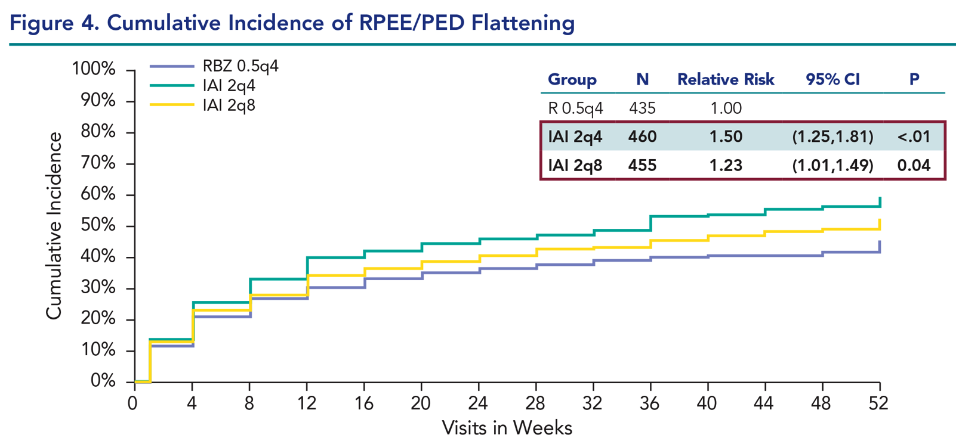
View 1 and 2 Subanalysis (52 wks)
C Shah & N Saroy , ARVO, 2014
Notes:
30

Slide 31
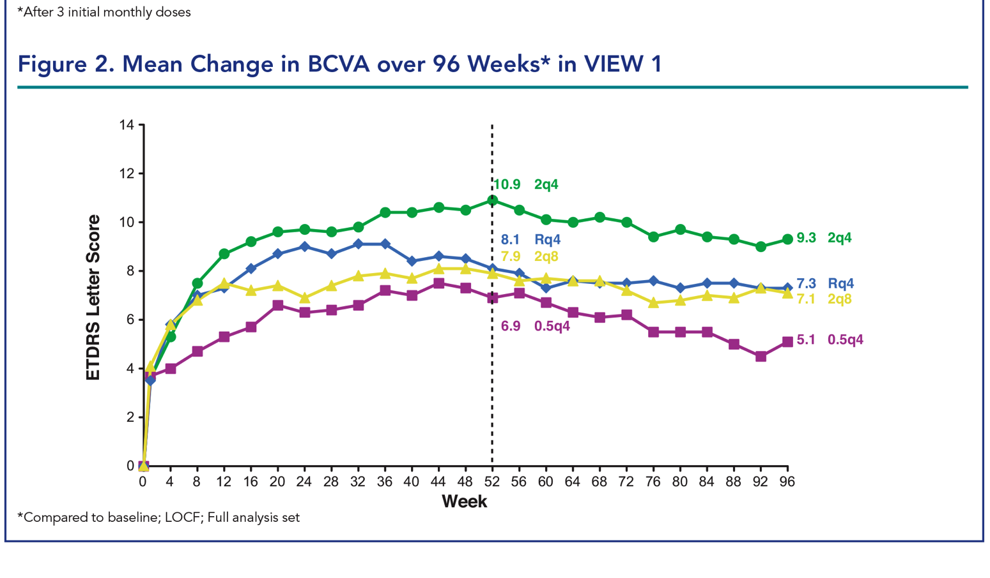
Extension Studies
DM Marcus , ARVO, 2014
Notes:
31

Slide 32
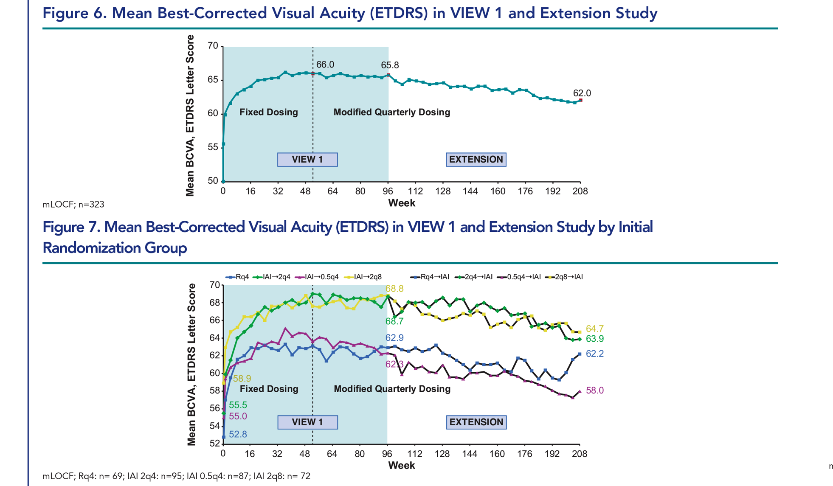
DM Marcus, ARVO, 2014
Notes:
32

Slide 33
VIEW Studies Conclusions
The efficacy and safety of aflibercept 2 mg every other month was comparable to that of ranibizumab 0.5mg dosed monthly
Following 52 weeks proactive treatment, efficacy was largely maintained for the remainder of the study using a modified quarterly retreatment schedule
A large proportion of patients remained stable with quarterly dosing

Slide 34
VIEW Studies Conclusions
These findings support the use of aflibercept 2 mg every other month without the need for intervening monitoring visits
After 52 weeks, it may be possible to extend to a quarterly treatment interval based on patients’ individual visual and anatomic outcomes

Slide 35
Intravitreal Anti VEGF
Use drugs appropriately !
Resistant (“Recalcitrant”)
Recurrent
Tachiphylaxis
Notes:
35

Slide 36
Tachiphylaxis
> 10% non responders
immunization (blood !!) against Tx:
Naïve: 0%
<10 injections: 11.1%
> 10 iniections: 21.7%
N Leveziel et al, IOVS, 2013, ARVO E-Abs 3170
Notes:
36

Slide 37
Intravitreal Anti VEGF
Long term efficacy vs macular atrophy
Superior systemic safety profile
(CVA , “fragile” populations)
Limit number of injections
Limit number of controls
Notes:
37

