Slide 1



AMD management: what changes with a new player?
Sobha Sivaprasad

Slide 2
Disclosures
Research grants, travel grants, speaker fees and advisory board member of:
Novartis, Bayer, Allergan, Roche.

Slide 3
Overview
Current treatment option for neovascular AMD – ranibizumab and bevacizumab
Real-life experience
New player- aflibercept

Slide 4
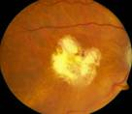

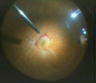
Choroidal Neovascularisation
Laser Photocoagulation
Anti-VEGF therapy
Photodynamic Therapy
destruction
Surgical excision
modulation
Transpupillar Thermotherapy
Radiotherapy
Schmidt-Erfurth and Pruente, 2007
Notes:
Choroidal Neovascularisation
Further to the previous slide this slide shows the two ways of dealing with CNV in terms of either destructive (lasers/surgery) or modulatory (anti-VEGF therapy) treatments
References
Schmidt-Erfurth and Pruente. Management of neovascular age-related macular degeneration. Prog Retin Eye Res. 2007; 26(4): 437-51

Slide 5
VEGF-A and neovascular AMD
Initiating
stimuli
VEGF imbalance
Subretinal
fibrosis
Disruption of retina
Pro-inflammatory
Pathologic
neovascularization
Increased
Permeability
Anti-VEGF treatment targets the protein responsible for the hallmarks of neovascular AMD
In neovascular AMD, blockage of pathologic VEGF-A does not block stimuli
Lee et al., 2005
Ng et al., 2006
Notes:
Hypoxia – only in pathological vascularisation; disruption of retina:
Subretinal fibrosis

Slide 6
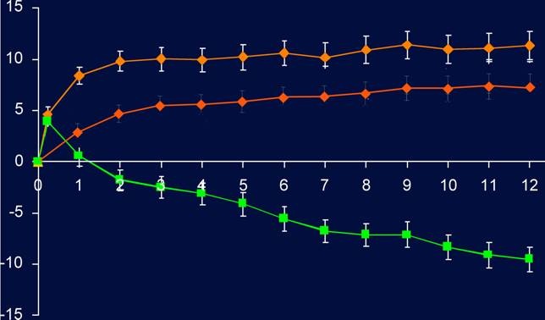
Ranibizumab trials – Mean changes in visual acuity
ANCHOR
MARINA
+11.3
+7.2
20.8
letter
difference*
ETDRS letters
17.6
letter
difference*
–9.5
-10.4
Month
Monthly injections (0.5mg)
Brown et al., 2006
Rosenfeld et al., 2006
Notes:
Ranibizumab trials – Mean changes in visual acuity
The ANCHOR and MARINA trials demonstrated both maintenance and improvement of vision compared with verteporfin or sham injection
Brown, D.M., Kaiser, P.K., Michels, M., Soubrane, G., Heier, J.S., Kim,R.Y., Sy, J.P., Schneider, S., for the ANCHOR Study Group., 2006. Ranibizumab versus verteporfin for neovascular age-related macular degeneration. N. Engl. J. Med. 355, 1432–1444
Rosenfeld et al., for the MARINA Study Group, 2006.Ranibizumab for neovascular age-related macular degeneration. N.Engl. J. Med. 355, 1419–31

Slide 7
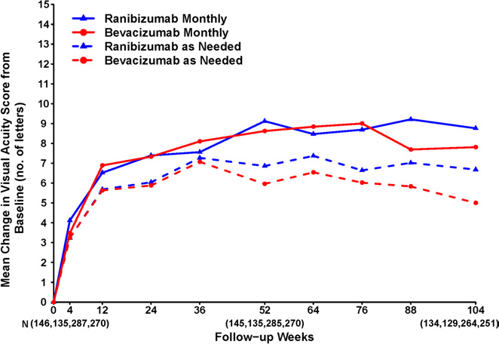
CATT 2 year results

Slide 8
Real-life results do not match VA improvements seen in clinical trials
Study | Description | Number of patients enrolled | Mean VA change from baseline to Year 1
AURA¹ | Retrospective, non-interventional, observational, multicentre study | 474 (UK) | 6.0*
Medisoft² | Multicentre, national nAMD database study | 11,135 | 2
ANCHOR³ | Multicentre, 2-year, double‑blind study | 423 | 11.3†
MARINA⁴ | Multicentre, 2-year, double‑blind study | 716 | 7.2†
*UK-based patients. †Patients receiving 0.5 mg ranibizumab. ‡Treatment-naive patients.
ETDRS, Early Treatment Diabetic Retinopathy Study; F-U, follow-up; nAMD, neovascular age-related macular degeneration; VA, visual acuity.
Holz FG et al. EURETINA September 2013.
Writing Committee for the UK Age-Related Macular Degeneration EMR Users Group. Ophthalmology 2014; 121: 1092–1101.
Brown DM et al. N Engl J Med 2006; 355: 1432–1444.
Rosenfeld PJ et al. N Engl J Med 2006; 355: 1419–1431.
Pushpoth S et al. Br J Ophthalmol 2012; 96 (12): 1469–1473.

Slide 9
AURA Study Design
Retrospective, noninterventional, observational, multicentre study conducted in Canada, France, Germany, Ireland, Italy, the Netherlands, United Kingdom, and Venezuela
  Data from patients’ medical records and results from examinations/
  assessments performed during routine clinical practice were evaluated
  >100 centres included
  Target enrolment = 444 patients per country
Retrospective
FPFV = Jan 1, 2009
LPFV = Aug 31, 2009
LPLV = Aug 31, 2011
Sep 31, 2012
Start of anti-VEGF therapy with ranibizumab
Follow-up (2.5 years)
Data collection
FPFV, first patient first visit; LPFV, last patient last visit; LPLV, last patient last visit; VEGF, vascular endothelial growth factor.

Slide 10
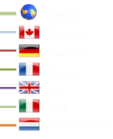
Changes From Baseline VA Declined Following an Initial Improvement*
In all countries, mean VA declined following an initial improvement
Mean letter change in VA score from baseline (LOCF)
Months
*Effectiveness set (all patients who ≥1 VA assessment for treated eye at baseline and ≥1 post-baseline assessment of VA for the treated eye).
Notes:
[15913_TAB-DAT-LOCF_2013-05-24] Table 14.2 / 10: Visual acuity final score difference to baseline LOCF by country – EFF, p. 157-169

Slide 11
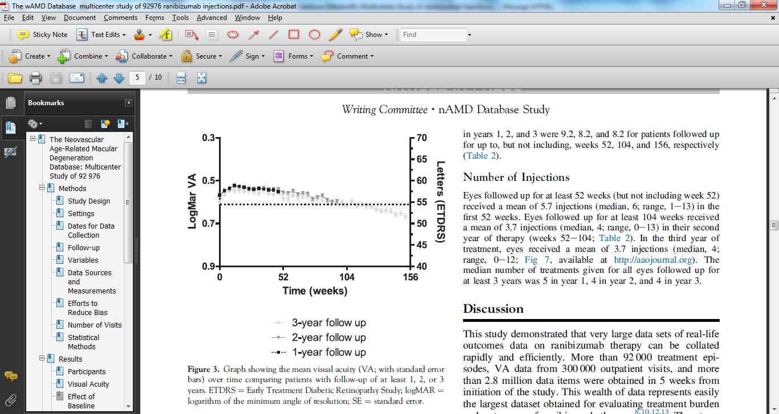
MEDISOFT ‘real-life’ Lucentis data demonstrates disadvantages of a reactive treatment regime
Within 3 years of starting therapy all of
initial VA gains are lost

Slide 12
Anti VEGF A monotherapy
Good clinical trial results
Real-life results remain suboptimal
Optimal dosing frequency and duration of therapy unknown
Prolonging the natural history to fibrosis/ atrophy.

Slide 13
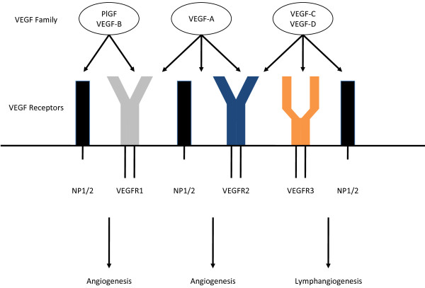
VEGF FAMILY
Sun W. B J Hematol Oncol. 2012; 5: 63.

Slide 14
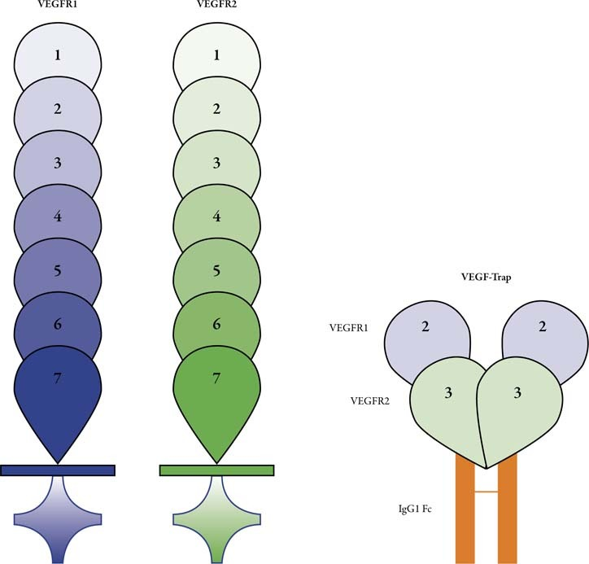
Aflibercept –recombinant fusion protein

Slide 15
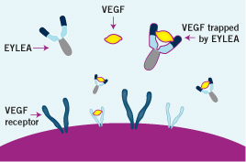
VEGF-R DECOY

Slide 16
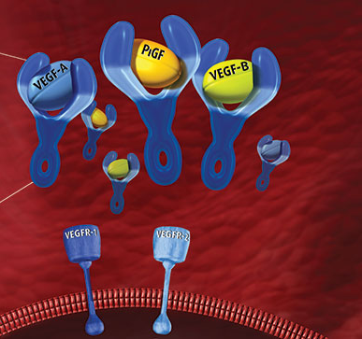
Multi-ligand target

Slide 17
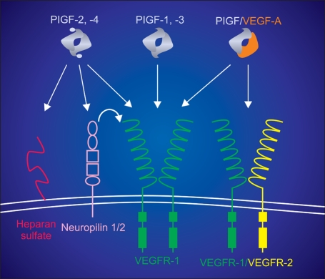
PLGF
De Falco S.
Exp Mol Med. 2012 ;44(1):1-9.
Notes:
Schematic representation of binding properties of PlGF isoforms and PlGF/VEGF heterodimer. The possible dimers formed by PlGF monomer (gray) are represented. In the case of PlGF isoforms 2 and 4, the heparin-binding domain is represented by additional filled oval. For the heterodimer, the VEGF moiety is in orange. For VEGF receptors (green VEGFR-1, yellow VEGFR-2) the seven Ig-like domains are represented as half ovals, whereas filled rectangles represent the intracellular TK domains. The extracellular Neuropilins receptor 1 and 2 domains are represented as vertical ovals (domains ai, a2), square (b1, b2) and an horizontal oval (domain c) (Mamluk et al., 2002). Heparan sulfate is represented in red.

Slide 18
VEGF-B
The role of VEGF-B in endothelial angiogenesis is not fully understood.
As with VEGF-A and PLGF, VEGF-B also binds VEGFR-1
Not a classical pro-angiogenic agent
Blood vessel survival factor (endothelial cell mitogen)
A role in cell adhesion and migration has also been proposed.
Olofsson B Proc Natl Acad Sci U S A. 1998 Sep 29; 95(20):11709-14.

Slide 19
Unique Binding Mechanism of Eylea®
“Two hands on a ball”
Eylea®
VEGF
VEGF
Bevacizumab
VEGF
VEGF
Ranibizumab
VEGF
VEGF
VEGF
VEGF
Affinity maturation
Two ranibizumab molecules can bind each VEGF dimer
VEGF
VEGF
1:1 stoichiometric binding
Bevacizumab can “daisy-chain” or “paper-doll” with VEGF leading to large, multimeric conglomerates
VEGF
VEGF
VEGF
VEGF
VEGF
VEGF
VEGF
VEGF
VEGF
VEGF
VEGF
VEGF
VEGF
VEGF
VEGF
VEGF
VEGF
VEGF
Notes:
Key Points
In vitro, aflibercept forms homogeneous 1:1 binding complexes with VEGF. In contrast, bevacizumab:VEGF complexes are heterogeneous and multimeric. ¹
Platelet aggregometry and 14C-serotonin assays showed that preformed equimolar Bev:VEGF complexes plus heparin activated platelets, while aflibercept:VEGF complexes did not. ¹
McDonald et al. 2012 ARVO presentation

Slide 20
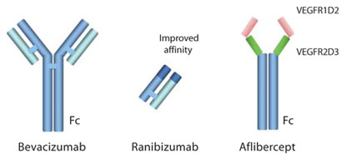
Differences in Anti-VEGF agents
 | Ranibizumab | Bevacizumab | Aflibercept
Molecule | Fab | Full –sized Mab | Fusion protein
Binds | VEGF -A | VEGF-A | VEGA-A, B and PIGF
Fc | No | Yes | Yes
Mol wt | 48kDa | 149kDa | 115kDa
Intravitreal VEGF binding activity (Mathematical model) | 30 days | 27-38 days | 83 days

Slide 21
Why is VEGF Trap more potent?
onsequence of its higher affinity for human VEGF
VEGF-Trap may be able to more completely block the human VEGF derived from the implanted human tumors.
May be because of its ability to bind VEGF family members other then VEGF A, such as placental growth factor and VEGF B
Therefore, a more complete blockade of neovessels than just a disruption.

Slide 22

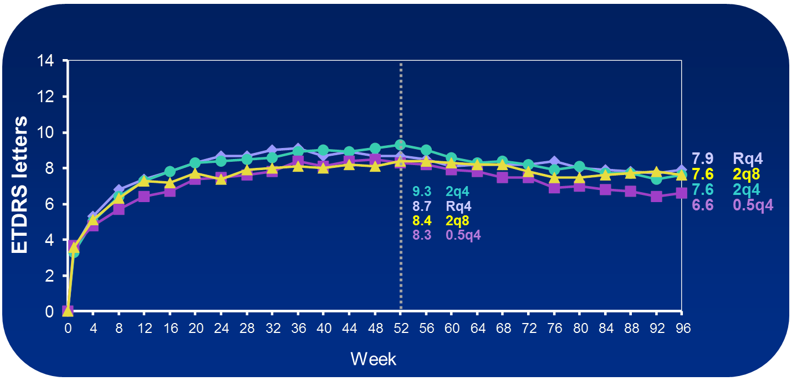
VIEW Studies: Mean Change in
Visual Acuity Baseline to Week 96
Notes:
22

Slide 23
Approved treatment of wet AMD
Dosing schedule | Treatment period (months) | Description
Loading dosing | 0–3 | EYLEA® treatment is initiated with one injection per month for three consecutive doses
Maintenance dosing | 4–12 | Patients receive one injection every two months
Treat-and-extend dosing | 12+ | The treatment interval may be extended based on visual and anatomic outcomes
AMD, age-related macular degeneration.

Slide 24
EFFECTIVE DRYING AGENT

Slide 25
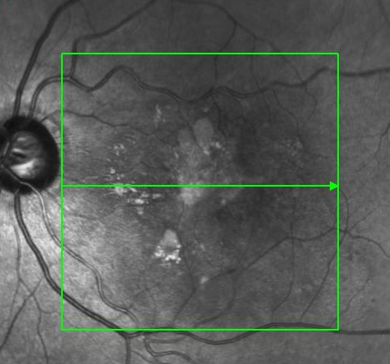
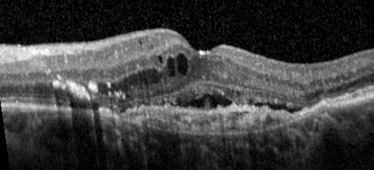
Case 1: 73-year-old male with predominantly classic CNV (LE)
History
  26 ranibizumab injections from 15-Sep-2008
  VA 41 letters on 07-Mar-2013
First EYLEA injection given

Slide 26
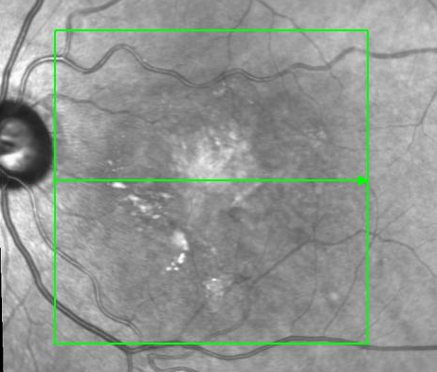
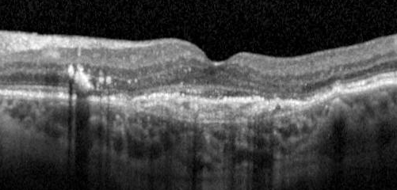
At 4-week review
  VA 40
  Followed-up without treatment

Slide 27
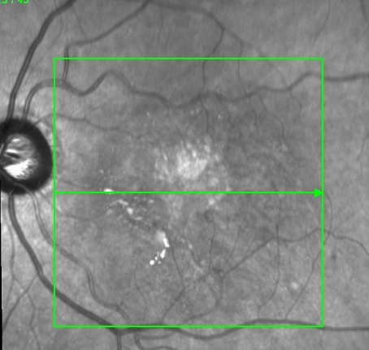
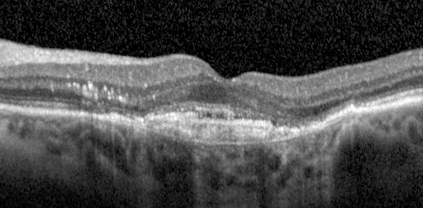
At 8-week review
  VA 41
  Minimal SRF
  Second dose of EYLEA given

Slide 28
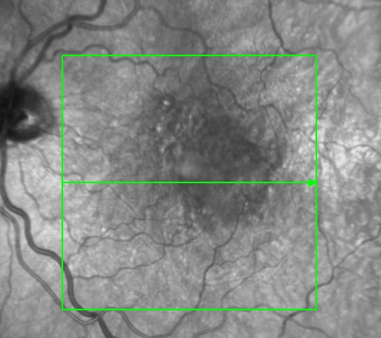
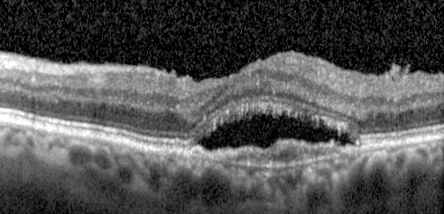
Case 2: 80-year-old male with occult CNV LE
History
  Treated with 6 consecutive ranibizumab – persistent SRF LE
  VA 43
First injection of EYLEA given

Slide 29
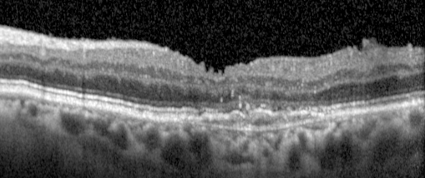
At 4-week review
  VA 43
  Second injection of EYLEA given

Slide 30
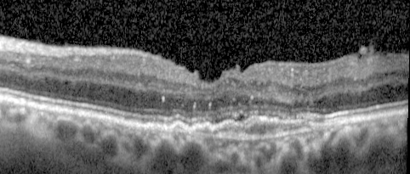
At 8-week review
  VA 45
  Third injection of EYLEA given

Slide 31
Case
Re 24 inj Lucentis from Apr 2011
ETDRS letters from 58 post lucentis
Resistant case

Slide 32
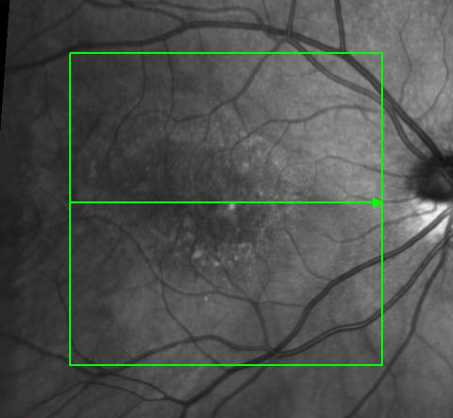
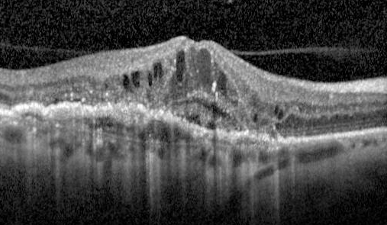
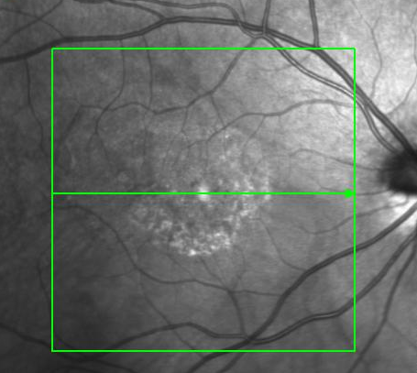
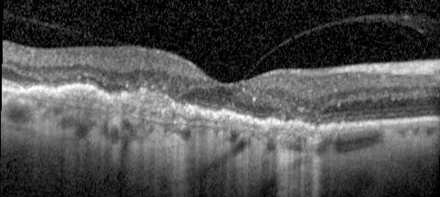
Lucentis 24 Inj VA 58
4 weeks Post Eylea VA 62

Slide 33
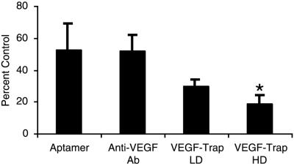
Inhibition of neuroblastoma tumors by anti-VEGF agents.
Kim E et al Proc Natl Acad Sci U S A. Aug 20, 2002; 99(17): 11399–11404

Slide 34
Escape Phenomena
Increased VEGF after anti-VEGF therapy is likely to be a host-response to neutralizing such a critical growth factor.
Increased PLGF in seen in patients on antiVEGF agents – predictive biomarker of antiangiogenic response!
Targeting PLGF will prevent tumor escape from anti-VEGF therapy

Slide 35
EFFECTIVE in PEDs

Slide 36
Case
73 year old lady referred by the Optician when patient attended for routine refraction
HT and T2DM 10 years on treatment
H/o previous laser BE for DM 2 years back
VA RE -26 letters (5/60) LE- 88 (6/6)
IOP 12 mmHg 12

Slide 37
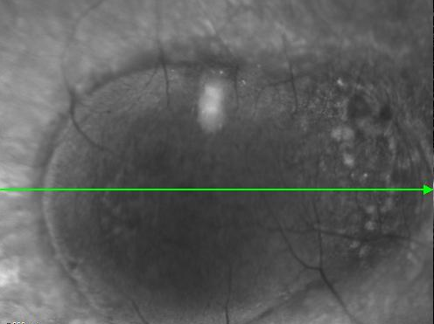
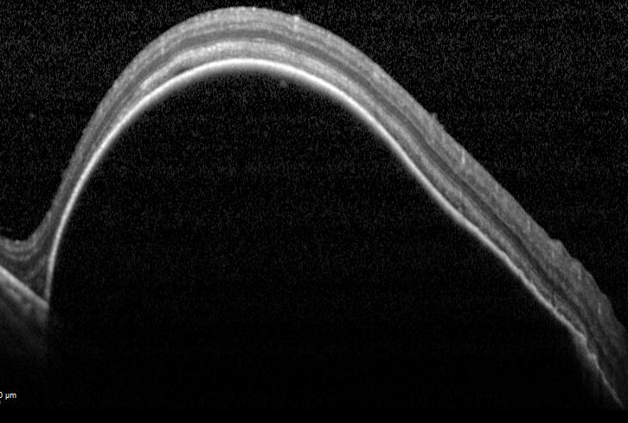
Case: RE baseline VA 26
1st treatment- Eylea
VA 26 to 39

Slide 38
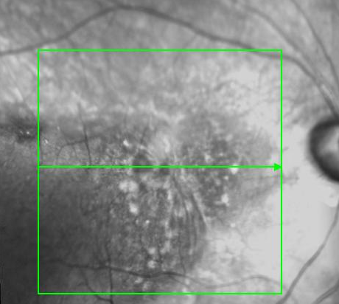
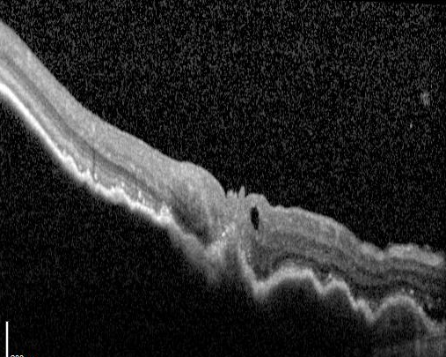
SD OCT
VA 26 to 39
Large PED with IRF

Slide 39
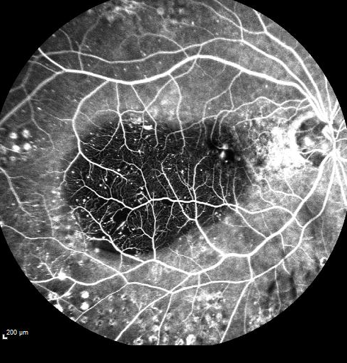
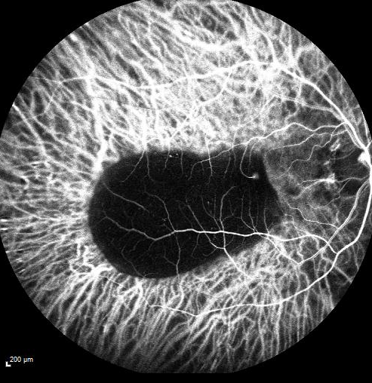
FFA ICGA

Slide 40
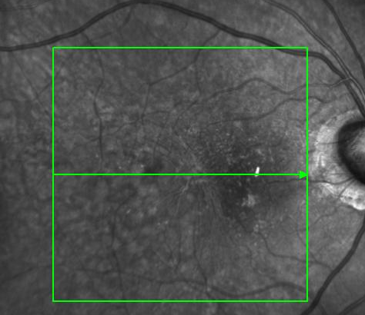
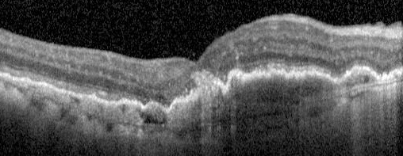
4 weeks Post Eylea X1
VA 35
Decreased height of PED

Slide 41
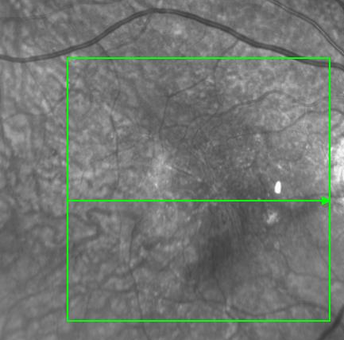
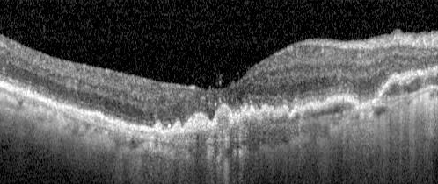
8 weeks Post Eylea X 3
VA 40
Patient on Inj Eylea RE 8 weekly

Slide 42
PED and VEGF-R
UNCLEAR
VEGF receptor 2 (VEGFR2) is primarily expressed in nonvascular photoreceptors and ganglion cells.
VEGF receptor 1 (VEGFR1) is expressed in vascular endothelial cells and pericytes.
Cao R Proc Natl Acad Sci U S A. 2010 Jan 12;107(2):856-61
VEGF receptor 1 (VEGFR1) is a key modulator of angiogenic potential in RPE cells of the human retina
Akrami H et al. Graefes Arch Clin Exp Ophthalmol. 2011 Apr;249(4):537-46

Slide 43
RPE barrier and PIGF
PlGF-1 and VEGFR-1 pathway regulation of the external epithelial hemato-ocular barrier. A model for retinal edema.
Miyamoto N et al. Ophthalmic Res. 2008;40(3-4):203-7.
Notes:
VEGF is considered as an important factor in the pathogenesis of macular edema. VEGF induces the rupture of the blood retinal barrier and may also influence the retinal pigment epithelial (RPE) outer retinal barrier. The aim of this work was to analyze the influence of the VEGF receptor pathways in the modulation of the RPE barrier breakdown in vitro and in vivo. The ARPE19 human junctions in culture are modulated by VEGF through VEGFR-1 but not through VEGFR-2. PlGF-1, that is a pure agonist of VEGFR-1, is produced in ARPE-19 cells under hypoxic conditions and mimics VEGF effects on the external retinal barrier as measured by TER and inulin flux. In vivo, the intravitreous injection of PlGF-1 induces a rupture of the external retinal barrier together with a retinal edema. This effect is reversible within 4 days. VEGF-E, that is a pure agonist of VEGFR-2, does not induce any acute effect on the RPE barrier. These results demonstrate that PlGF-1 can reproduce alterations of the RPE barrier occurring during diabetic retinopathy.

Slide 44
Heterogeneity of response
20% of the patients will require 4 weekly aflibercept.
No predictive factors identified.
Non-responders to Aflibercept exists.
Poor responder
Good responder
Unknown angiogenic driver.

Slide 45
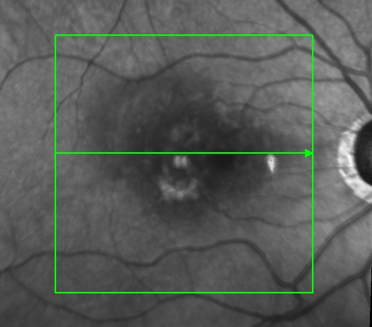
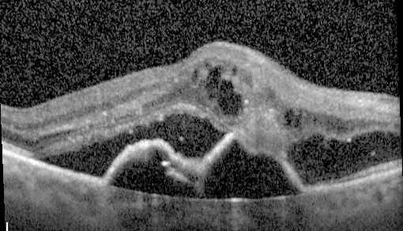
Case
81 year old lady with RAP RE
Developed intense vitritis RE following 2nd and 3rd dose of Lucentis
Treated with IVTA subsequently
VA- 59

Slide 46
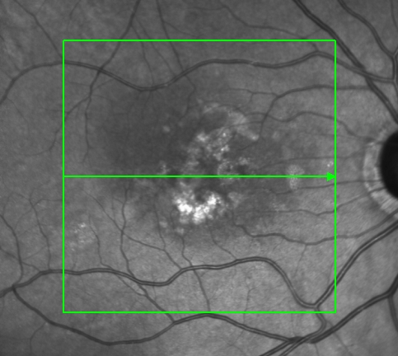
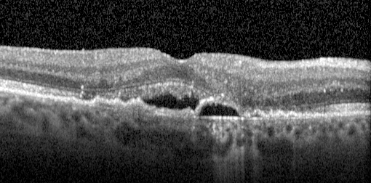
4 week review following 1st Eylea
VA - 80
Patient not keen on repeat treatment

Slide 47
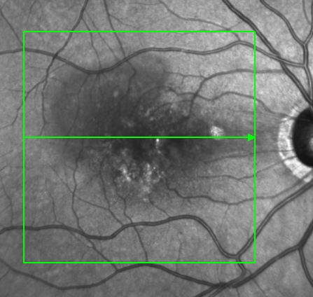
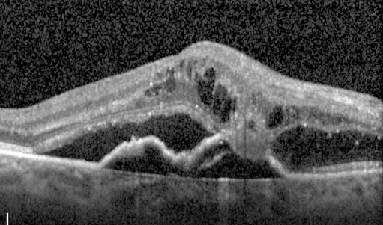
8 week review following 1st Eylea
VA – 69
Treated with Inj Eylea

Slide 48
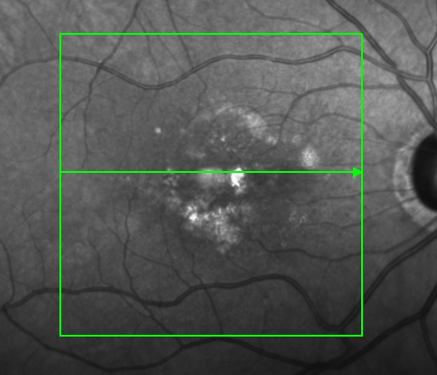
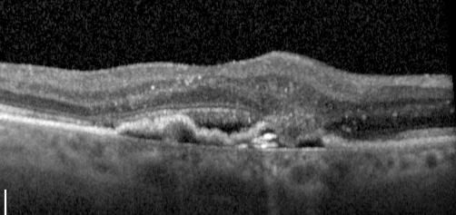
12 week review
VA – 76
Treated with Inj Eylea

Slide 49
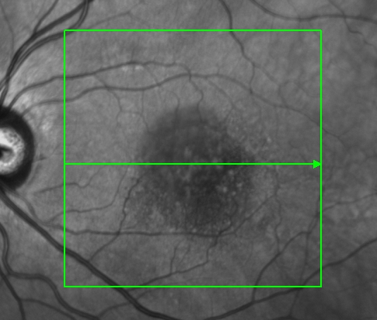
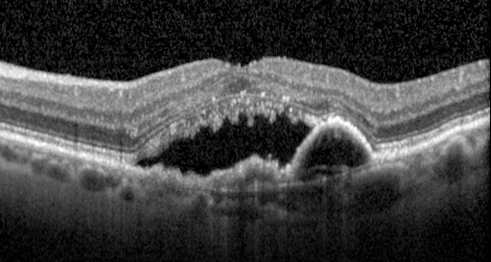
Case: 76 year old lady with occult CNV
History
  30 previous ranibizumab injections (LE)
  VA 55
First injection of EYLEA given

Slide 50
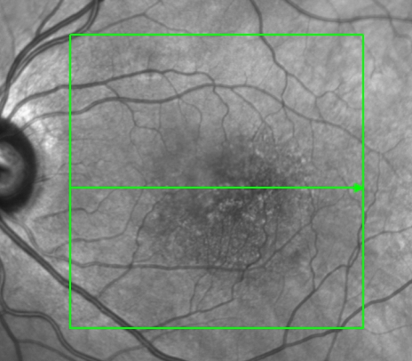
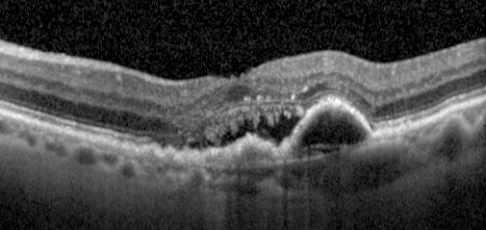
At 4-week review
  VA 54
  Second injection of EYLEA given

Slide 51


At 8-week review
  VA 57
  Third injection of EYLEA given

Slide 52


At 12-week review
  VA 51
  Fourth injection of EYLEA given

Slide 53
Case
69 year old male under the AMD clinic since 18 months on Inj Lucentis X 12 RE
VA RE 63 LE 88 (6/6)

Slide 54


Inj Lucentis X 12
VA 63
Commenced on Inj Eylea RE

Slide 55


Inj Eylea X1 4 week review
VA - 64
2nd dose of Eylea given RE

Slide 56


Inj Eylea X 4 consecutive
VA 60
Pt observed

Slide 57
Safety of Aflibercept
Systemic aflibercept after intravitreal aflibercept injection = 0.019µg/ml
Current evidence suggests that hypertension is a pharmacodynamic effect of anti-angiogenic agents in cancer therapy.
Predictive factor for oncologic response.
Target HT response is – 2.91µg/ml

Slide 58
Conclusions
Aflibercept is effective and safe in patients with wet AMD
Provides choice for our patients.
Cost-effective as per NICE TA 294.
Useful in treatment naïve and switch patients.
More studies (clinical and lab) are required.

Slide 59
Published papers- References:
Chang et al. Intravitreal Aflibercept for Treatment- Resistant Neovascular Age-Related Macular Degeneration. Ophthalmology 2013. Published online first.
Kumar N et al. Visual and Anatomical Outcomes of Intravitreal Aflibercept in Eyes With Persistent Subfoveal Fluid Despite Previous Treatments With Ranibizumab in Patients With Neovascular Age-Related Macular Degeneration. RETINA. March 2013. doi: 10.1097/IAE.0b013e31828e8551. Abstract available at: http://journals.lww.com/retinajournal/Abstract/publishahead/Visual_and_Anatomical_Outcomes_of_Intravitreal.98732.aspx
Cho et al. Aflibercept for exudative AMD with persistent fluid on ranibizumab and/or bevacizumab. Br J Ophthalmol 2013;0:1–4. doi:10.1136/bjophthalmol-2013-303344
Yonekawa et al. Conversion to Aflibercept For Chronic Refractory Or Recurrent Neovascular Age-Related Macular Degeneration. Am J Ophthalmol. 2013. http://dx.doi.org/10.1016/j.ajo.2013.03.030
Ho et al. Short-Term Outcomes of Aflibercept for Neovascular Age-Related Macular Degeneration in Eyes Previously Treated With Other Vascular Endothelial Growth Factor Inhibitors. Am J Ophthalmol 2013. http://dx.doi.org/10.1016/j.ajo.2013.02.009
Patel KH et al. Rapid response of retinal pigment epithelial detachments to intravitreal aflibercept in neovascular age-related macular degeneration refractory to bevacizumab and ranibizumab. Eye advance online publication 5 April 2013; doi: 10.1038/eye.2013.31. Available at: http://www.nature.com/eye/journal/vaop/ncurrent/full/eye201331a.html
Bakall et al. Aflibercept Therapy for Exudative Age-related Macular Degeneration Resistant to Bevacizumab and Ranibizumab. Am J Ophthalmol 2013.

