Slide 1

Clinica: un alternativa ai dubbi del PSA
Massimo Lazzeri
Istituto clinico Humanitas – Humanitas University - Milano

Slide 2
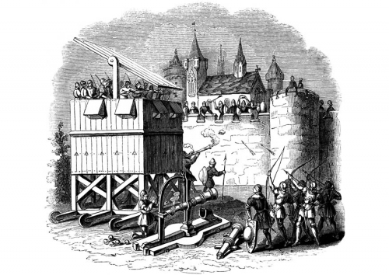
PSA testing: under siege
Notes:
In the last years PSA has been under siege.

Slide 3

“I never dreamed that my discovery four decades ago would lead to such a profit-driven public health disaster”
R.J. Ablin
Notes:
In the mid of 2012 RJ Ablin, the biochemist who discovered the PSA, release a “dramatic” interview to NYT. He said: “I never dreamed that my discovery four decades ago would lead to such a profit-driven public health disaster”

Slide 4




Slide 5

Current MaleWestern Population: baby boomers
Forte dei Marmi 1968

Slide 6
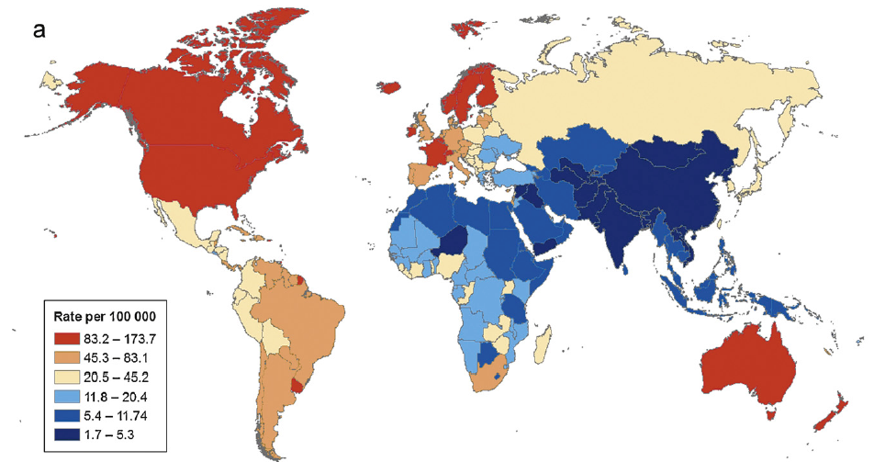
Worldwide Incidence
Center M et al Eur. Urol., 2012: 1079

Slide 7
Question: Why should we detect Prostate cancer?

Slide 8
Facts, Statistics and Interpretations

Slide 9

Ideal biomarker
Notes:
As you know an ideal biomarkers is a balance between idealism and realism. It should be: … (please read the slide box contents)

Slide 10
An ideal clinical PCa biomarker
Notes:
For prostate cancer the ideal biomarker should be: (please read the slide box contents)

Slide 11
and …
Notes:
However, it is not enough. An ideal biomarker should be a complete biomarker: it mean it has to serve also for prediction, prognosis and follow-up

Slide 12
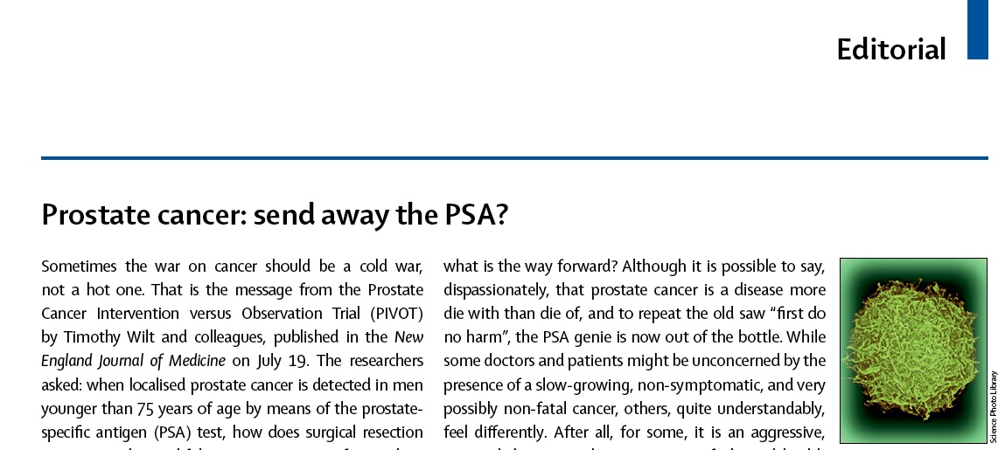
Is PSA an ideal biomarker?
The Lancet, July 2012
PSA: low sensitivity – low specificity

Slide 13
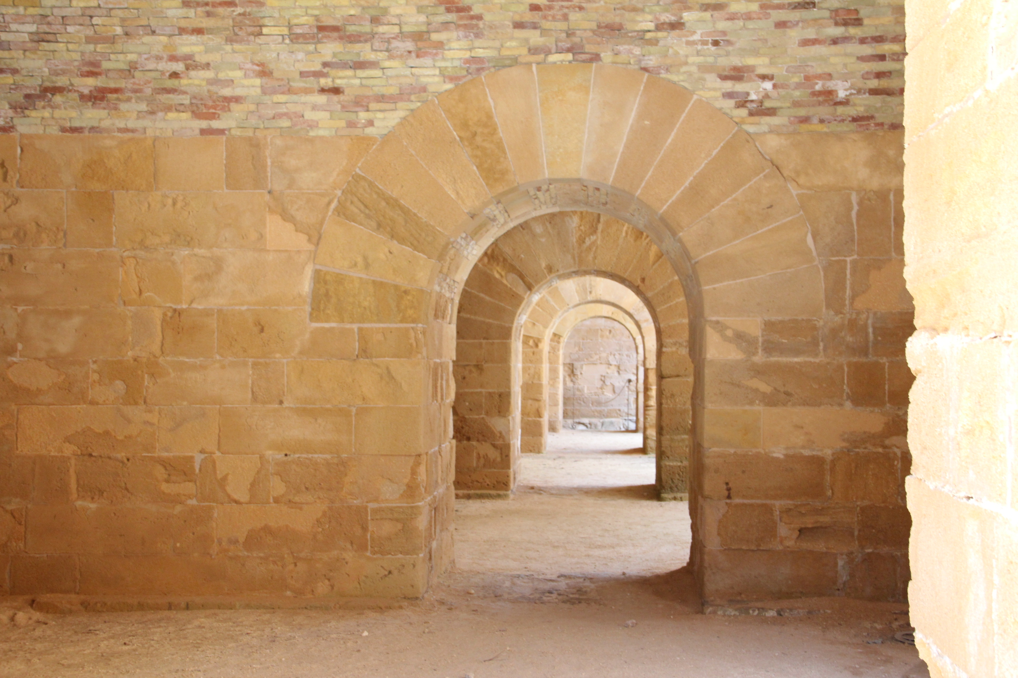
PHI
PCA3
k4S

Slide 14
Prostate cancer and new biomarkers
%-2proPSA = {([-2proPSA]/10)/fPSA)}
PHI (Φ orϕ) : {([-2proPSA/fPSA] x √PSA) }

Slide 15
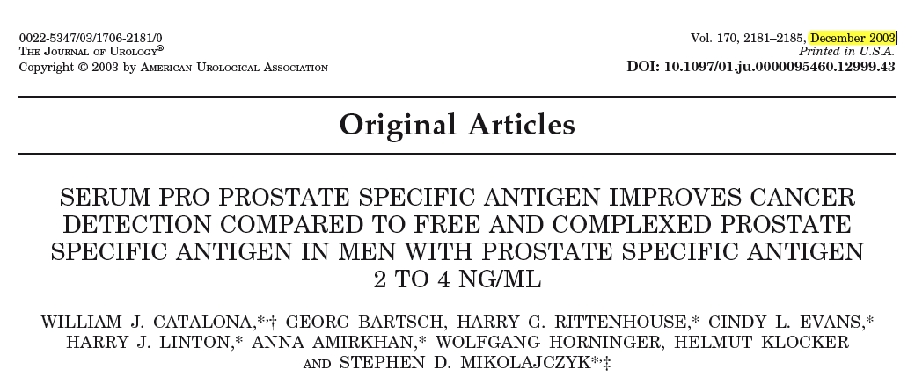
Retrospective analysis of 1,091 serum men from prostate cancer screening studies at 2 sites who had undergone prostate biopsy
PSA 2 to 4 ng/ml: benign 320, cancer 235
PSA 4 to 10 ng/ml: benign 315, cancer 221

Slide 16
Conclusion
The %pPSA significantly improved specificity for cancer detection and decreased the number of unnecessary biopsies (19%) in the PSA 2 to 4 ng/ml range.
This relative improvement of %pPSA compared to % free PSA and complexed PSA was maintained throughout the PSA range of 2 to 10 ng/ml.

Slide 17
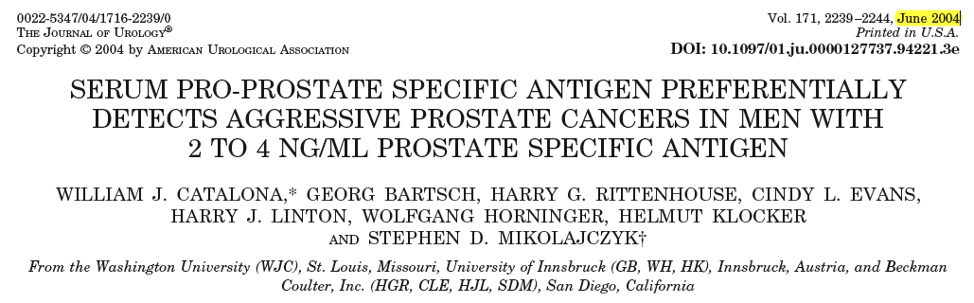
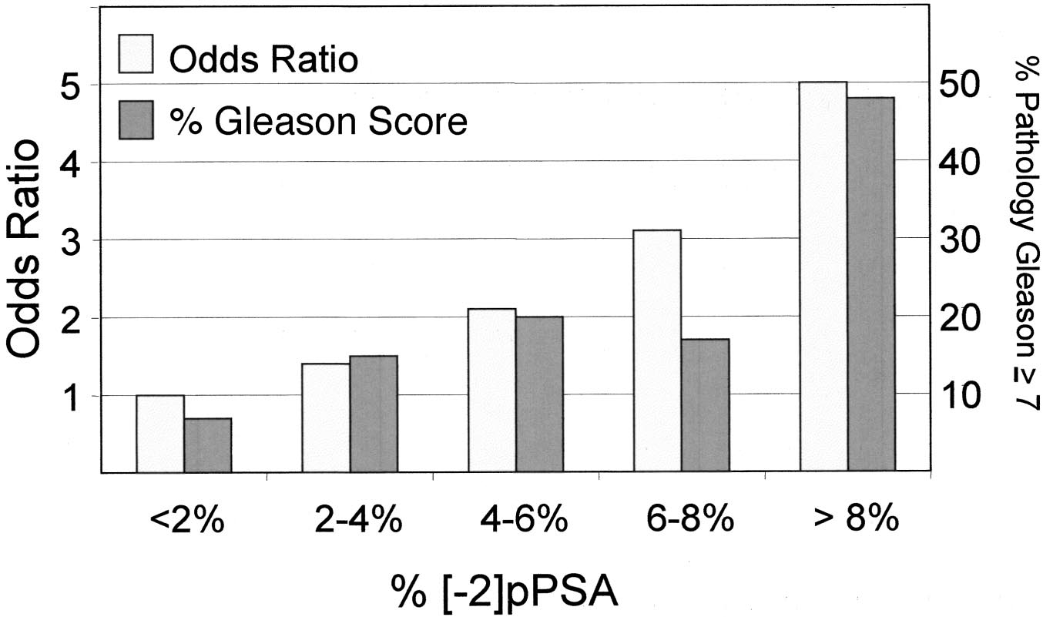
The same population of
Catalona JU, 2003

Slide 20
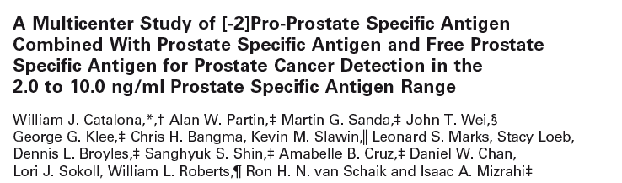

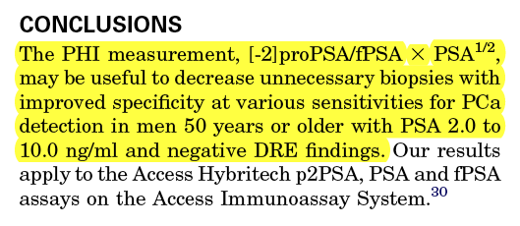
2011

Slide 21
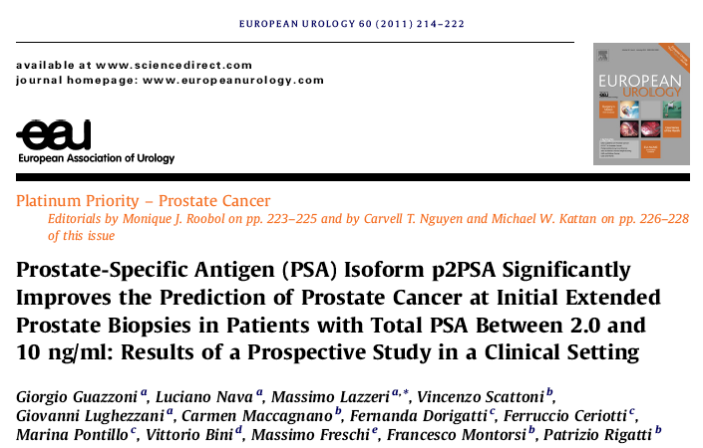
2011
single centre

Slide 22

VALIDATION
The only real validation of a prediction biomarker model (PROSTATE CANCER AT BIOPSY) needs a confirmation by a completely independent set of prospective observations collected on a different set of patients from different centers by different investigators.
Anscombe, F. J. (1967). Journal of the Royal Statistical Society Series B 29, 1–52.

Slide 23
PROMETHEUS project

Slide 24





PROMETHEUS project
Country | N. patients
Italy | 328
Germany | 302
France | 185
Spain | 142
UK | 69
Total | 1026

Slide 25
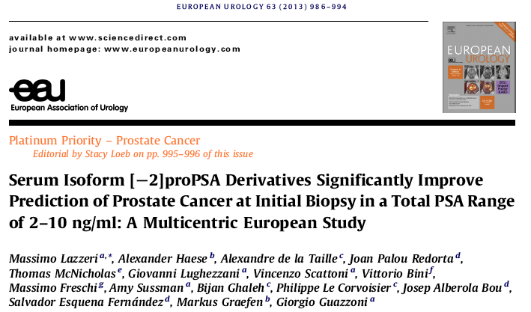

Slide 27
Results: Patients’ Baseline Characteristics
 | Overall | No Cancer | Cancer | p-value
# patients | 646 | 382 (59.1%) | 264 (40.1%) | -
Age (yrs) | 64.2±7.5 | 63.3.±7.9 | 65.6.±6.8 | <0.001*
Caucasian | 620 (96.0%) | 367 (96.1%) | 253 (95.8%) | 0.879°
Gleason score
<7 | NA | NA | 125 (47.3%) | -
≥7 | NA | NA | 139 (52.7%) | -
Positive DRE | 116 (18.0%) | 59 (15.5%) | 56 (21.4%) | 0.075°
Prostate Vol (ml) | 50 (37-67) | 56 (43-73) | 42 (32-58) | <0.001†
BPH volume (ml) | 26 (16-42) | 31 (20-45) | 20 (13-30) | <0.001†
Number of cores | 12 (12-14) | 12 (12-12) | 12 (12-14) | 0.895†
Total PSA (ng/ml) | 5.8 (4.3-7.7) | 5.8 (4.2-7.8) | 5.7 (4.4-7.5) | 0.942†
Free PSA (ng/ml) | 0.9 (0.6-1.2) | 1.0 (0.7-1.3) | 0.7 (0.6-1.0) | <0.001†
%fPSA | 0.16 (0.11-0.20) | 0.17 (0.13-0.22) | 0.14 (0.10-0.18) | <0.001†
p2PSA (pg/ml) | 14.8 (10.3-21.1) | 14.7 (10.1-21.0) | 15.0 (10.4-21.5) | 0.678†
%p2PSA | 1.8 (1.4-2.3) | 1.6 (1.3-2.0) | 2.1 (1.6-2.6) | <0.001†
PHI | 40.8 (32.0-53.9) | 38.0 (29.5-46.7) | 48.2 (37.0-63.3) | <0.001†

Slide 28
Results: bivariate and multivariate analyses predicting the probability of PCa.
 | AUC | Bivariate analysis | Multivariate analysis
 |  |  | Base model (1) | Base model + p2PSA | Base model + %p2PSA | Base model + PHI
 |  | OR p-value | OR p-value | OR p-value | OR p-value | OR p-value
tPSA | 0.50 | 1.012 p=0.705 | 1.180 p=0.267 | 1.185 p=0.234 | 1.206 p=0.156 | 1.082 p=0.462
%fPSA¹ | 0.64 | 0.991 p=0.021 | 0.998 p=0.158 | 0.998 p=0.648 | 0.999 p=0.810 | 0.999 p=0.825
p2PSA | 0.51 | 1.008 p=0.368 | - | 1.073 p=0.011 | - | -
%p2PSA | 0.67 | 2.070 p=0.015 | - | - | 1.900 p=0.015 | -
PHI | 0.67 | 1.030 p=0.012 | - | - | - | 1.020 p=0.013
AUC of multivariate models (95% CI) |  |  | 0.648 | 0.712 | 0.704 | 0.712
Gain in predictive accuracy (95% CI) |  |  | - | 0.064 * | 0.056 * | 0.064 *
¹ Expressed as fPSA (pg/ml) / PSA (ng/ml) to scaling OR in a more intelligible range.
* p<0.001 (relative to the multivariate base model; DeLong method)
¹ Expressed as fPSA (pg/ml) / PSA (ng/ml) to scaling OR in a more intelligible range. * p<0.001 (relative to the multivariate base model; DeLong method)
¹ Expressed as fPSA (pg/ml) / PSA (ng/ml) to scaling OR in a more intelligible range. * p<0.001 (relative to the multivariate base model; DeLong method)
¹ Expressed as fPSA (pg/ml) / PSA (ng/ml) to scaling OR in a more intelligible range. * p<0.001 (relative to the multivariate base model; DeLong method)

Slide 29
Un-necessary biopsies and missed cancer at 90% sensitivity
Marker | Spared Bx | Missed cancer | GS 7 | GS 8 | GS 9 | 3 + 4 | 4 + 3 | > 3 positive core* | > 50% of cancer in single core*
%fPSA | 116 (17,9%) | 27 (10.2%) | 14 (5.3%) | 4 (1.5%) | 2 (0.75%) | 11 | 3 | 8 | 2
%p2PSA | 111 (17%) | 26 (9.8%) | 9 (3.4%) | 1 (0.35%) | 1 (0.35%) | 6 | 3 | 4 | 1
PHI | 100 (15,5%) | 26 (9.8%) | 3 (1.1%) | 0 (0%) | 0 (0%) | 3 | 0 | 2 | 0
7.5%
1.1%

Slide 30
Bivariate and multivariate analyses predicting the probability of PCa with Bx GS ≥7
 | AUC (95% CI) | Bivariate analysis | Multivariate analysis
 |  |  | Base model | Base model + p2PSA | Base model + %p2PSA | Base model + PHI
 |  | OR p-value | OR p-value | OR p-value | OR p-value | OR p-value
tPSA | 0.54 | 1.070 p=0.421 | 1.173 p=0.232 | 1.183 p=0.162 | 1.193 p=0.096 | 1.063 p=0.474
fPSA | 0.56 | 0.681 p=0.315 | 0.419 p=0.343 | 0.088 p=0.054 | 0.348 p=0.286 | 0.369 p=0.313
%fPSA¹ | 0.59 | 0.996 p=0.157 | 1.001 p=0.863 | 1.002 p=0.742 | 1.003 p=0.645 | 1.002 p=0.687
p2PSA | 0.54 | 1.024 p=0.097 | - | 1.070 p<0.001 | - | -
%p2PSA | 0.64 | 1.852 p<0.001 | - | - | 1.805 p<0.001 | -
PHI | 0.65 | 1.024 p=0.001 | - | - | - | 1.025 p<0.001
AUC of multivariate models |  |  | 0.596 | 0.672 | 0.669 | 0.672
Gain in predictive accuracy |  |  | - | 0.076 * | 0.073 * | 0.074*
¹ Expressed as fPSA (pg/ml) / PSA (ng/ml) to scaling OR in a more intelligible range.
* p<0.05 (relative to the multivariate base model; DeLong method

Slide 31
Conclusion
Patients with PCa have higher levels of PHI and %p2PSA.
PHI and %p2PSA are more accurate than standard reference tests at predicting PCa at initial biopsy (clinical validity).
Using PHI and %p2PSA reduces unnecessary biopsies without missing significant cases of PCa (clinical utility).

Slide 32
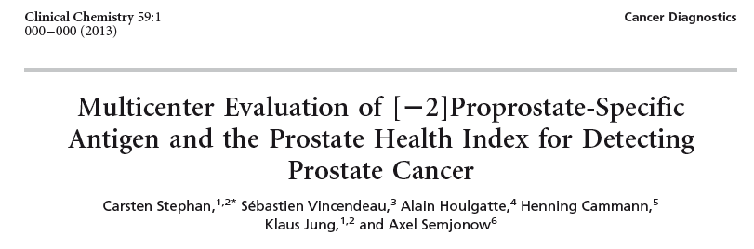
A total of 1362 patients from 4 different
study sites who had tPSA values of 1.6–8.0 g/L (668
patients with PCa, 694 without PCa) underwent 10
core biopsies.
Phi accuracy was evaluated

Slide 33
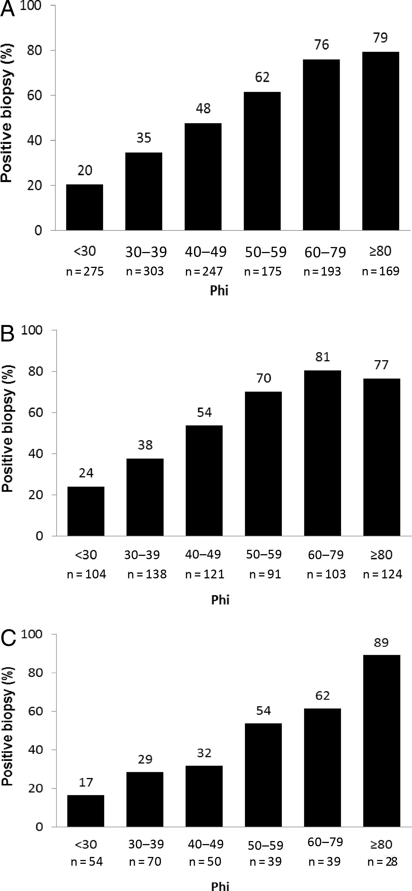
Percentage of positive biopsies for prostate cancer at various Phi ranges.
(A), All patients; (B), initial biopsy; (C), repeated biopsy.

Slide 34


Slide 35
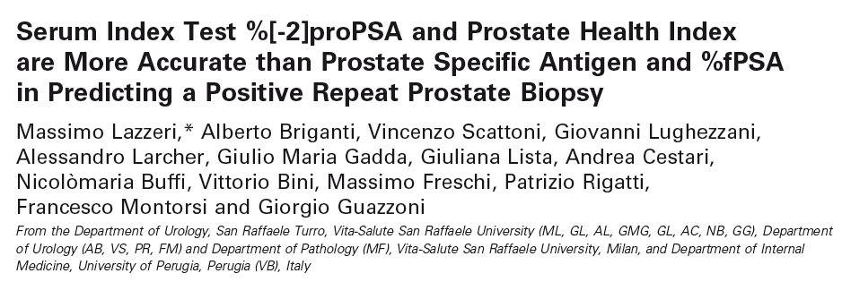
2012
PHI is more accurate of tPSA in prediction of positive repeat biopsy

Slide 36
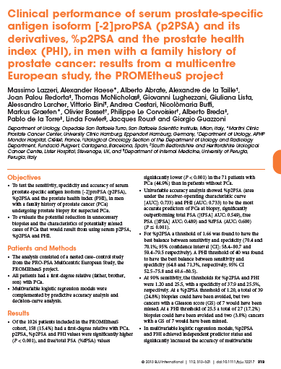
The risk of PCa is about 2.5 times higher in men with a first-degree relative (father, brother, son) diagnosed with Pca.
It is higher with:
more than one first-degree relative having Pca;
a relative diagnosed with PCa at age <60 years

Slide 37
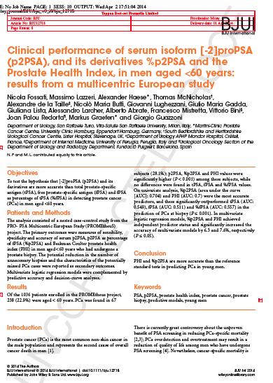
The recent AUA guidelines do not recommend routine screening for men <55 years old.
The Global Age Watch Index 2013 defined older populations as individuals
aged ≥60 years.

Slide 38
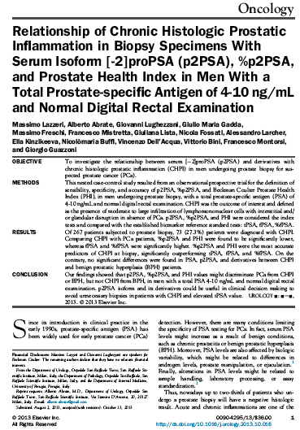
Acute and chronic inflammations are one of the most common causes of increase in serum PSA levels. Therefore, the development of novel markers capable of
accurately distinguishing between inflammation and Pca could definitely be of pivotal importance to better indicate
the need of a prostate biopsy.

Slide 39
OBESITY
BMI < 25
BMI 25-29.9
BMI ≥ 30
In obese patients, %p2PSA and PHI values are significantly and even more accurate than the currently used tests in predicting PCa and could avoid unnecessary biopsies without missing significant PCa.
Abrate et al. BJU Int, in press

Slide 40
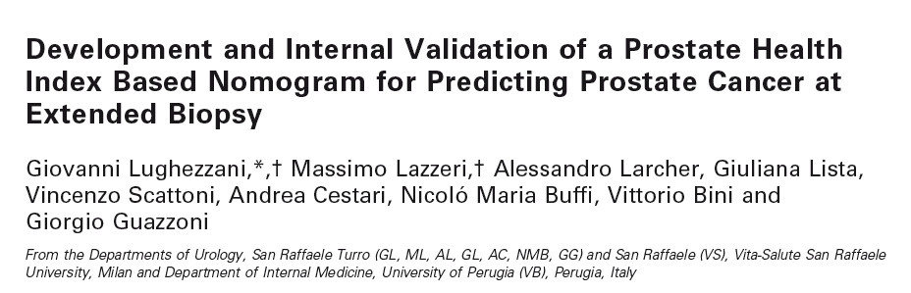

2012
Lughezzani G, Lazzeri M, Haese A, McNicholas T, de la Taille A, Buffi NM, Fossati N, Lista G, Larcher A, Abrate A, Mistretta A, Bini V, Redorta JP, Graefen M, Guazzoni G. Multicenter European External Validation of a Prostate Health Index-based Nomogram for Predicting Prostate Cancer at Extended Biopsy. Eur Urol. 2013 Dec 16. pii: S0302-2838(13)01326-2

Slide 41
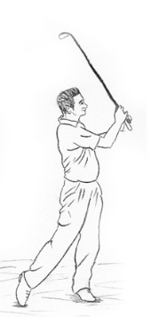
CLINICAL EXAMPLE of POSITIVE BIOPSY
Age: 65 y.o.
DRE: Unsuspicious
Rebiopsy: no
Prostate volume: 40 gr
tPSA: 5.67
PHI: 60

Slide 42
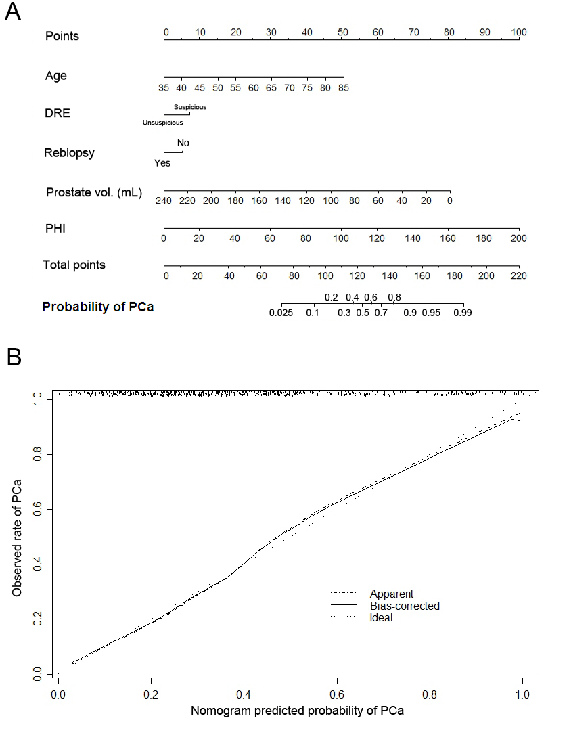
135 points

Slide 43
Ideal Pca biomarker

Slide 44
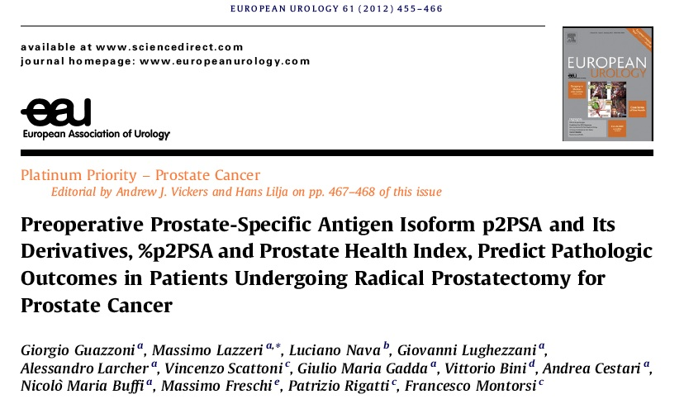
2012
The aim of this study was to test the hypothesis that phi predicts the pathologic PCa characteristics within a prospectively collected contemporary cohort of 350 patients who underwent RP for clinically localised PCa at a single high-volume institution.

Slide 45
Correlation with continuous variables

Slide 46
Correlation with continuous variables

Slide 47
PHI as predictor

Slide 48
Questions need answers

Slide 49
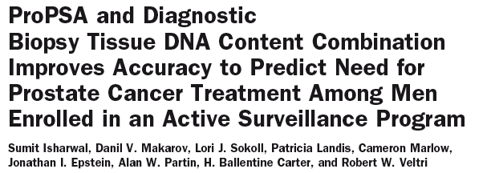
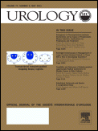
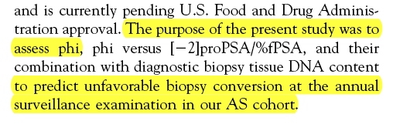
2011
2011

Slide 50
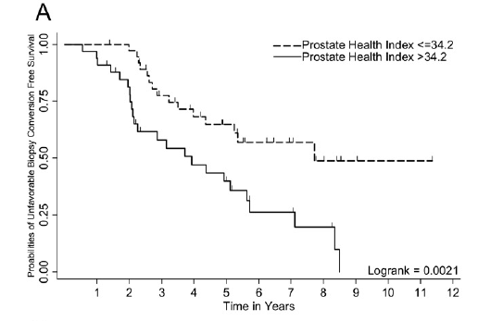
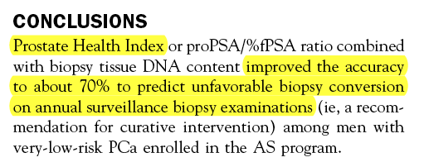

Slide 51
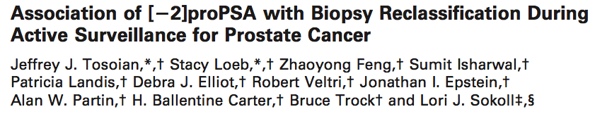
In men under AS either the baseline or longitudinal
measurement of %p2PSA or phi
were predictive of biopy reclassification based
on biopsy Gleason upgrading

Slide 52
Ideal PCa biomarker

Slide 53




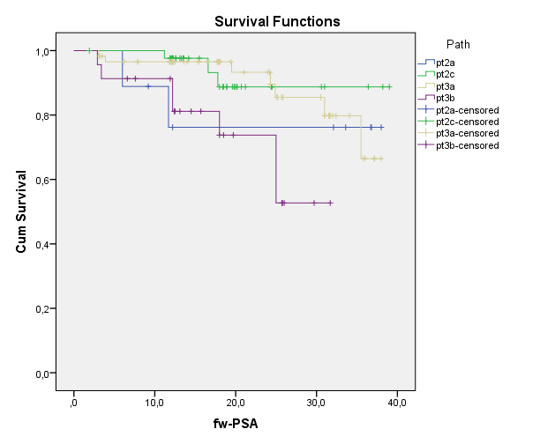
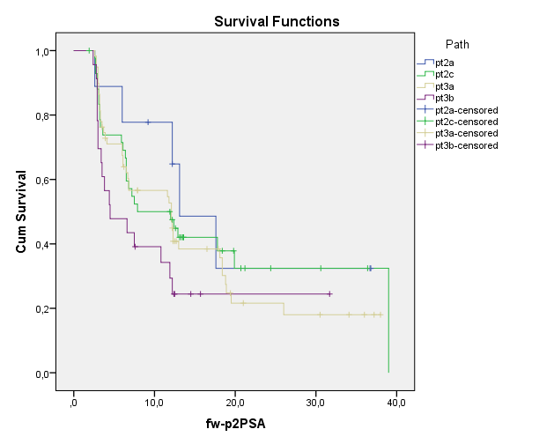
Sensitivity of [-2]proPSA as an ultrasensitive PSA surrogate for the prediction of early biochemical recurrence after radical prostatectomy: an observational cohort study
M. Lazzeri¹, G. Lughezzani¹, A. Abrate², A. Losa², A. Mistretta², N. Buffi¹, G. Lista², G. M. Gadda², A. Larcher², N. Fossati², P. Dell'Oglio², V. Bini³, F. Ceriotti⁴, G. Guazzoni¹
1. Department of Urology, Humanitas Clinical and Research Center, Humanitas University Rozzano (Milan) – Italy; 2. Division of Oncology / Unit of Urology; URI; IRCCS Ospedale San Raffaele – Milan, Italy; 3. department of Internal Medicine, University of Perugia – Italy; 4. Laboraf Ospedale San Raffaele, Milan - Italy
Introduction & Objectives
Although RP offers a high overall cancer control rate, even in appropriately selected men, up to a third undergoing radical prostatectomy will experience failure (biochemical recurrence – BCR), manifested by a rising serum PSA. The natural clinical course (no treatment) of patients with BCR is highly variable as some patients may experience rapid clinical progression to local and systemic disease, while others may pose no threat to their health. There is a need for additional tests to increase the probability of detecting clinically significant recurrent PCa at early stage in order to offer an accurate secondary therapy, reduce the side effects of late treatments and avoid unnecessary secondary therapy. The clinical sensitivity for detecting biochemical recurrence (BCR) after radical prostatectomy (RP) is directly related to the analytical sensitivity of the PSA assays, which is expressed in ng/ml. [-2]proPSA (p2PSA) assay is normally expressed in pg/mL and demonstrated superior analytical sensitivity than generally use PSA assays. It might be more sensitive than PSA for detecting early BCR in patients after RP. The objective of the study is to test the hypothesis that p2PSA is more sensitive of total PSA for early detection of BCR after RP for localized prostate cancer (PCa).
Material & Methods
The current study is an observational, on-going, prospective, cohort study in a contemporary cohort of consecutive patients with localized PCa (pT2-3/N0), who had undergone RP. Biochemical follow-up consisted of a blood sample drawn after 3-6-12 months and then every 6 months in the following two years. The primary outcome is to determine whether or not elevation of p2PSA or kinetics in rising of p2PSA significantly outperform the tPSA driven BCR defined as two consecutive values of tPSA ≥ 0.2 ng/mL. Secondary outcome is to determine whether or not results are consisting with different pathological outcome (stage, grade and margin status). Blood samples will be processed with the UniCel DxI800 Immunoassay System analyzer (Beckman Coulter Inc., Brea, CA, USA) and managed according to the criteria described by Semjonow et al. [Semjonow A, Kopke T, Eltze E, Pepping-Schefers B, Burgel H, Darte C. Pre- analytical in-vitro stability of [-2]proPSA in blood and serum. Clin Biochem. 2010; 43: 926-8]. The statistical analysis includes both Kaplan-Meier survival analysis and the McNemar test for comparison of paired frequencies, considering 0.8 pg/ml the optimal threshold for p2PSA driven BCR.
Patients at each follow-up, stratified according to the pathological stage
Patients with BCR according tPSA and p2PSA
Early p2PSA increase in patients with BCR
Total subjects |  | pT2a | pT2c | pT3a | pT3b
134 |  | 9 | 43 | 58 | 23
 |  | pT2a | pT2c | pT3a | pT3b
3 months fw-up | 134 | 9 | 43 | 58 | 23
6 months fw-up | 126 | 9 | 42 | 54 | 21
12 months fw-up | 120 | 7 | 42 | 52 | 19
18 months fw-up | 78 | 6 | 22 | 38 | 12
24 months fw-up | 49 | 5 | 9 | 28 | 7
30 months fw-up | 29 | 5 | 5 | 16 | 3
36 months fw-up | 12 | 3 | 3 | 6 | 0
Follo-up | BCR (tPSA > 0.02 ng/ml) | p2PSA > 08.pg/ml (%)
3 mo | 4 | 3 (75%)
6 mo | 1 | 1 (100%)
12 mo | 4 | 3 (75%))
18 mo | 5 | 4 (80%)
24 mo | 5 | 5 (100%)
30 mo | 2 | 1 (50%)
36 | 1 | 1 (100%)
p2PSA > 0.8 prior to BCR | N. patients | Tot. mos
6 mo | 5 | 30
12 mo | 5 | 60
18 mo | 2 | 36
24 mo | 1 | 24
Tot. (mean) | 13 | 150 (11.5)
The median follow-up was 22 months . Twenty-two (16.5%) patients showed a BCR; 18/22 had a p2PSA ≥ 0.8 pg/ml, but in four patients we failed to record a p2PSA > 0.8 pg/ml. Five patients showed a contemporary increase of PSA and p2PSA and 13 developed a p2PSA > 0.8 pg/ml before BCR. The frequencies (%) of p2PSA positive subjects (≥ 0.8 pg/ml) were significantly higher than frequencies of positive subjects identified with tPSA cut-off at 3, 6, 12 and 18 months: p<0.0001 (Fig. 1). When subjects were stratified according to stage/grade and margins (positive vs. negative), patients with pT2c-GS3+4/4+3-R1 and pT3a-R0/1 could be considered the target categories, which would benefit more from the study.
The mean survival biochemical relapse-free time was 15.8 (95%CI: 13.2-18.4) months determined with p2PSA increase, and 33.9, (95%CI: 31.9-36) months recorded instead with tPSA increase, (p<0.001).
CONCLUSION
The current preliminary findings suggest that p2PSA could be more sensitive than tPSA in detecting early BCR. Extending observational time, increasing sample size and stratifying patients into significant or indolent BCR are mandatory before considering p2PSA for clinical practice purposes.

Slide 54
Follow-up
p2PSA > 0.8 prior to BCR | N. patients | Tot. mos
6 mo | 5 | 30
12 mo | 5 | 60
18 mo | 2 | 36
24 mo | 1 | 24
Tot. (mean) | 13 | 150 (11.5)

Slide 55

Grazie

