Slide 1
Advancing research diagnostic criteria for Alzheimer's disease: implications for drug development and public health management
Jean François Dartigues
INSERM U 897 Université de Bordeaux

Slide 2
Comparative study of the prevalence of dementia in two Sicilian communities with different psychosocial backgrounds
G. Azzimondi et al Neuroepidemiology 1998
Elderly people over 75 years
Prevalence Education Social and Leisure Activities
Troina 21.9% - ++
S Agata
Di Militello 28.4% + -

Slide 3
Dementia : an unexpected triumph ? ?

Slide 4
Dementia : an unexpected trumph ?
Kovari E, Herrmann FR, Bouras C, Gold G. Amyloid deposition is decreasing in aging brains: An autopsy study of 1,599 older people. Neurology 2013
Decrease of 24% of amyloid deposition in non demented subjects between 1972 and 2006

Slide 5
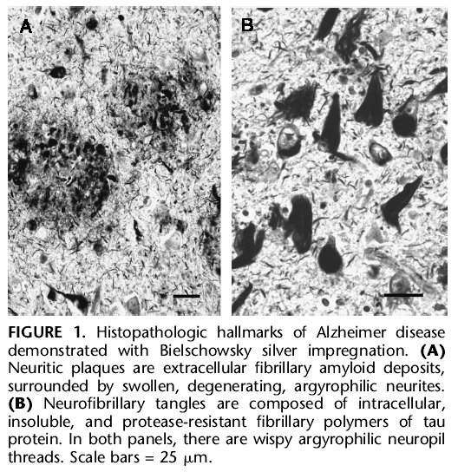
Classical diagnosis criteria for AD : clinical dementia and characteristic
histopathological lesions

Slide 6
Prevalence
Neurofibrillary pathology
1
Amyloid pathology
0.8
0.6
0.4
Entorhinal cortex
0.2
Isocortex
0
0
20
40
60
80
100
Age
From Braak H & E, 1997; Duyckaerts & Hauw, 1997

Slide 8
BIOMARKERS OF AD IN CLINICAL RESEARCH

Slide 9
Soleneuzumab trial (Lilly)
APOE4 + Group 7% PET amyloïd –
APOE4 - Group 35% PET amyloïde -

Slide 10
Biomarkers in CSF
discriminant analysis Aβ₄₂=240 + 1.18 Tau
Diagnosis
2500
2000
AD (n=150)
CON (n=100)
1500
OD (n=84)
Aβ₄₂ (pg/ml)
1000
Correctly classified by line : 86%
500
0
0
500
1000
1500
Tau (pg/ml)
* Composite Figure from Hulstaert et al.
Neurology 1999;52:1555-1562
Notes:
10
L analyse combinee des deux marqueurs a permis de determiner une ligne de reference seuil :
Ab42 = 240 +1.18 Tau
qui permet de caracteriser correctement 86% des echantillons selon l etiquette diagnostique pre-etablie par chaque centre inclus dans l etude multicentrique.

Slide 11
Résultats
Estimations résumées
Biomarqueur | N | P-value (Test de Cochran) | I2 (%) | Se [IC95%] | Sp [IC95%]
Total Tau | 12 | 0.019 | 51.6 | 0.78 [0.68-0.85] | 0.77 [0.63-0.87]
Phospho-Tau | 11 | 0.23 | 22.2 | 0.83 [0.77-0.87] | 0.67 [0.62-0.72]
AB-42 | 9 | 0.13 | 35.8 | 0.74 [0.59-0.85] | 0.75 [0.57-0.87]
AB2 + T-Tau | 6 | 0.099 | 46.0 | 0.90 [0.55-0.98] | 0.72 [0.45-0.89]
AB42/AB0 | 4 | <10⁻⁴ | 86.0 | 0.88[ 0.59-0.97] | 0.73 [0.54-0.86]
Memento – Revue systématique biomarqueurs du LCS
11

Slide 12
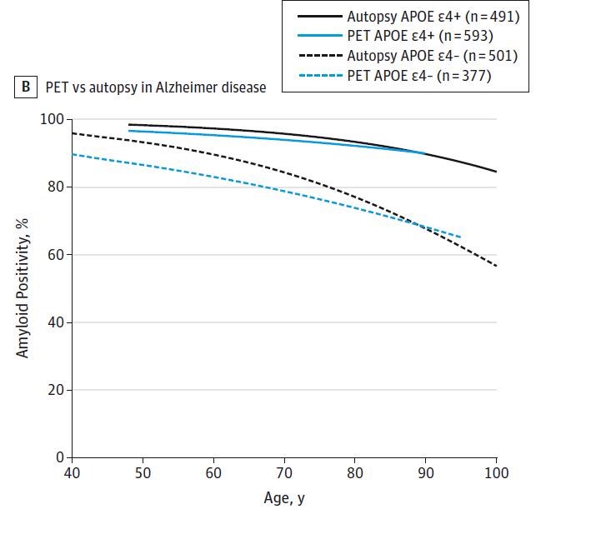
Ossenkoppele R et al, JAMA 2015

Slide 13
AMYLOID BIOMARKERS IN NORMAL PEOPLE, MCI, AD AND OTHER DEMENTIA

Slide 14
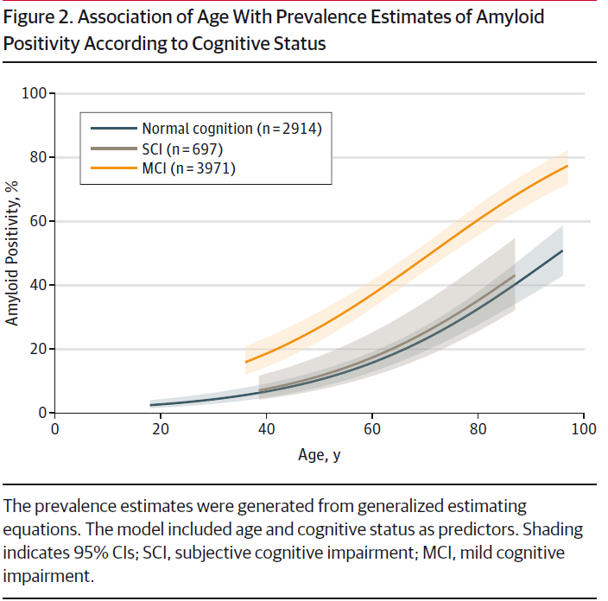
Jansen et al, JAMA 2015

Slide 15
AD, Ossenkopele, JAMA 2015
Jansen et al, JAMA 2015

Slide 16
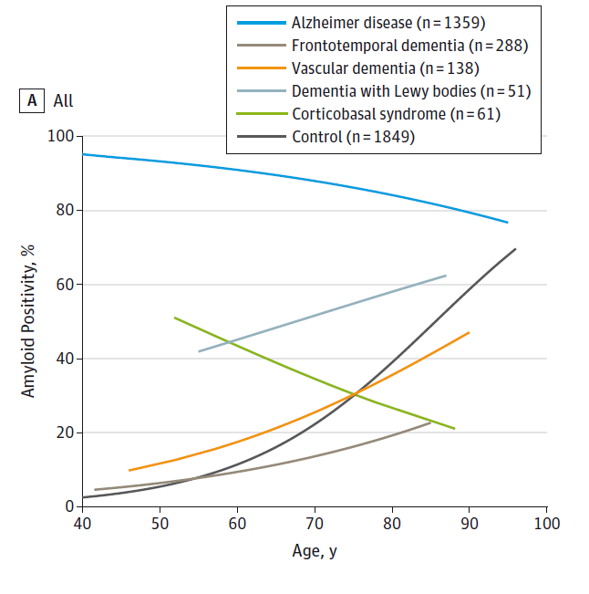
Ossenkoppele R et al, JAMA 2015

Slide 17
RESEARCH CRITERIA FOR THE DIAGNOSIS OF AD

Slide 18
Toward defining the preclinical stages of Alzheimer’sDisease:
Recommandations from the National Institute on Aging and the Alzheimer’s Association workgroup
Alzheimer’s & dementia, 2011
Notes:
18

Slide 19
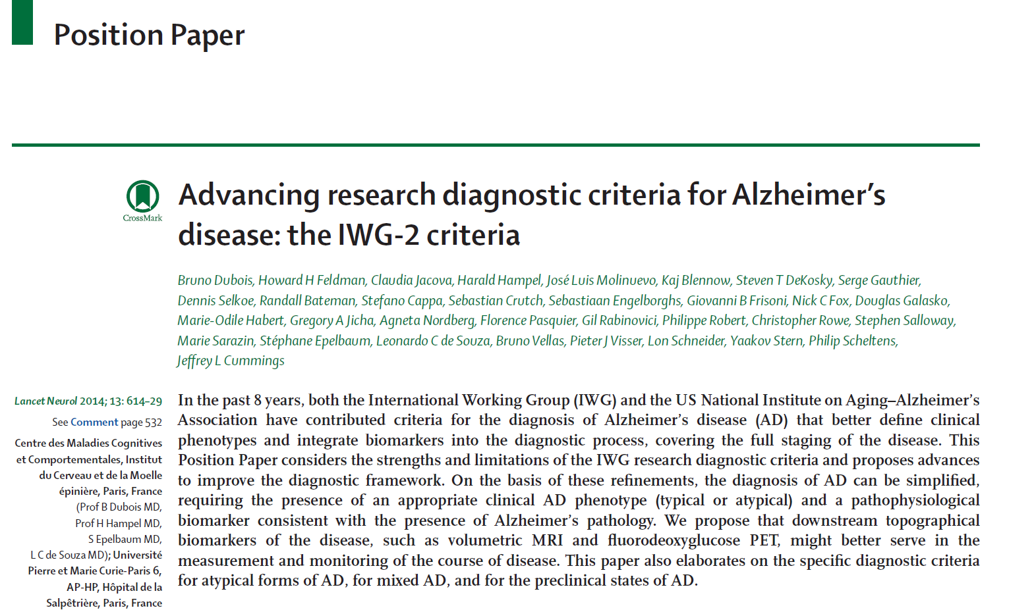

Slide 20
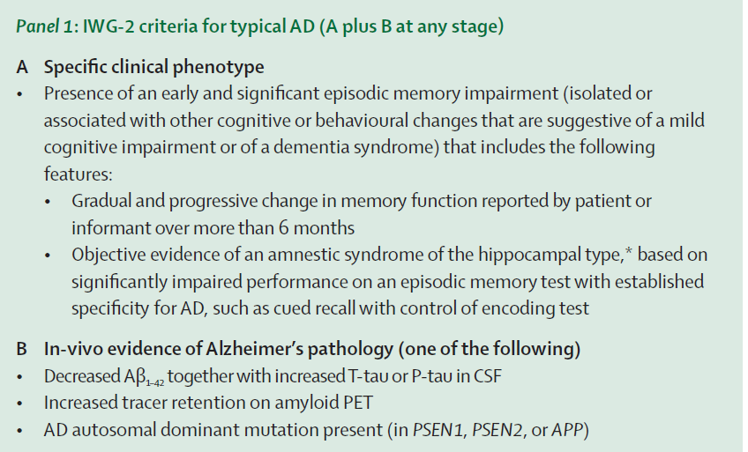

Slide 21
Amnestic syndrome of the medial temporal type identifies prodromal AD
A longitudinal study
M. Sarazin, PhD* C. Berr, PhD* J. De Rotrou, PhD C. Fabrigoule, PhD F. Pasquier, PhD S. Legrain, MD B. Michel, MD M. Puel, MD M. Volteau, PhD J. Touchon, MD M. Verny, PhD B. Dubois, MD
Neurology, 2007
ETUDE
Pré - AL

Slide 22
Comparison Préal / 3C
Auriacombe et al Neurology 2010
RL/RI 16 score SS SP PPV NPV
Préal
Total free recall < 17 91,8 76,4 89,5 71,2
Total recall < 40 79,7 89,9 74,6 92,2
3C study
Total free recall < 17 73,3 89,0 7,3 99,6
Total recall < 40 60,0 86,3 4,9 99,5

Slide 23
Comparison Préal / 3C
Incidence Préal : 7,8 % par an
Incidence 3C : 0,6 % par an
RL/RI 16 score SS SP PPV NPV
Préal
Total free recall < 17 91,8 76,4 89,5 71,2
Total recall < 40 79,7 89,9 74,6 92,2
3C study
Total free recall < 17 73,3 89,0 7,3 99,6
Total recall < 40 60,0 86,3 4,9 99,5

Slide 24
When P increases, PPV increases and NPV decreases
Notes:
24

Slide 25
BIOMARKERS OF AD IN CLINICAL PRACTICE

Slide 26
Bocchetta, M., S. Galluzzi, et al. (2015). "The use of biomarkers for the etiologic diagnosis of MCI in Europe: an EADC survey." Alzheimers Dement 11(2): 195-206 e191.
We investigated the perceived usefulness for the etiologic diagnosis of mild cognitive impairment (MCI). We surveyed availability, frequency of use, and confidence in diagnostic usefulness of markers of brain amyloidosis (amyloid positron emission tomography [PET], cerebrospinal fluid [CSF] Abeta42 and tau) and neurodegeneration (medial temporal atrophy [MTA] on MR, FDG-PET and amyloid PET
The most frequently used biomarker is visually rated MTA (75% of the 37 responders reported using it "always/frequently") followed by CSF markers (22%), FDG-PET (16%), and amyloid-PET (3%). Only 45% of responders perceived MTA as contributing to diagnostic confidence, where the contribution was rated as "moderate".
79% of responders felt "very/extremely" comfortable delivering a diagnosis of MCI due to AD when both amyloid and neuronal injury biomarkers were abnormal (P < .02 versus any individual biomarker).
Responders largely agreed that a combination of amyloidosis and neuronal injury biomarkers was a strongly indicative AD signature.

Slide 27
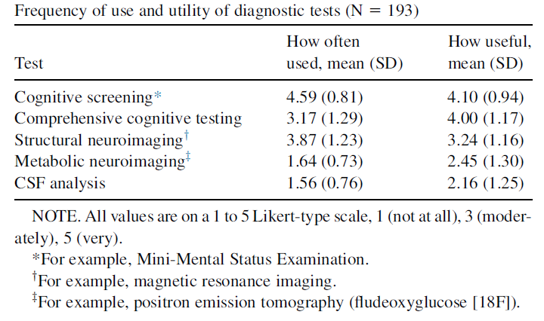
Biomarkers in clinical practice in United States. J Gooblar et al 2014

Slide 28
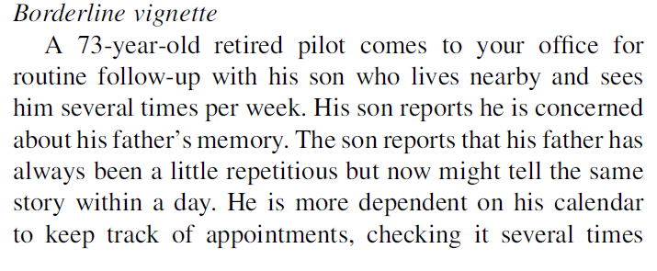
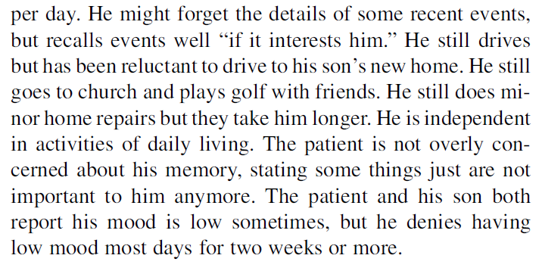

Slide 29
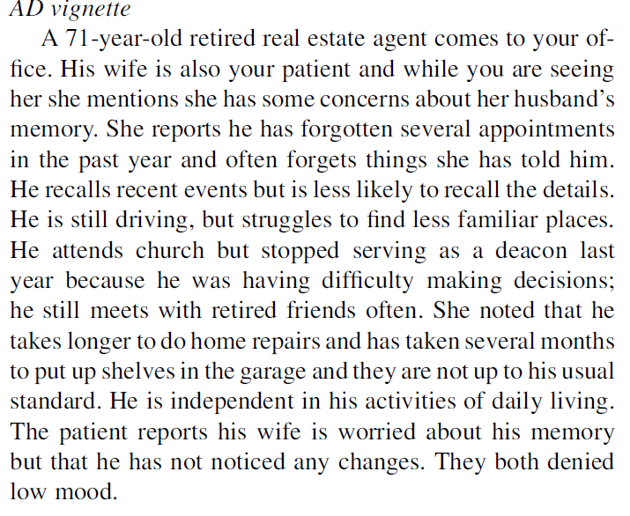

Slide 30
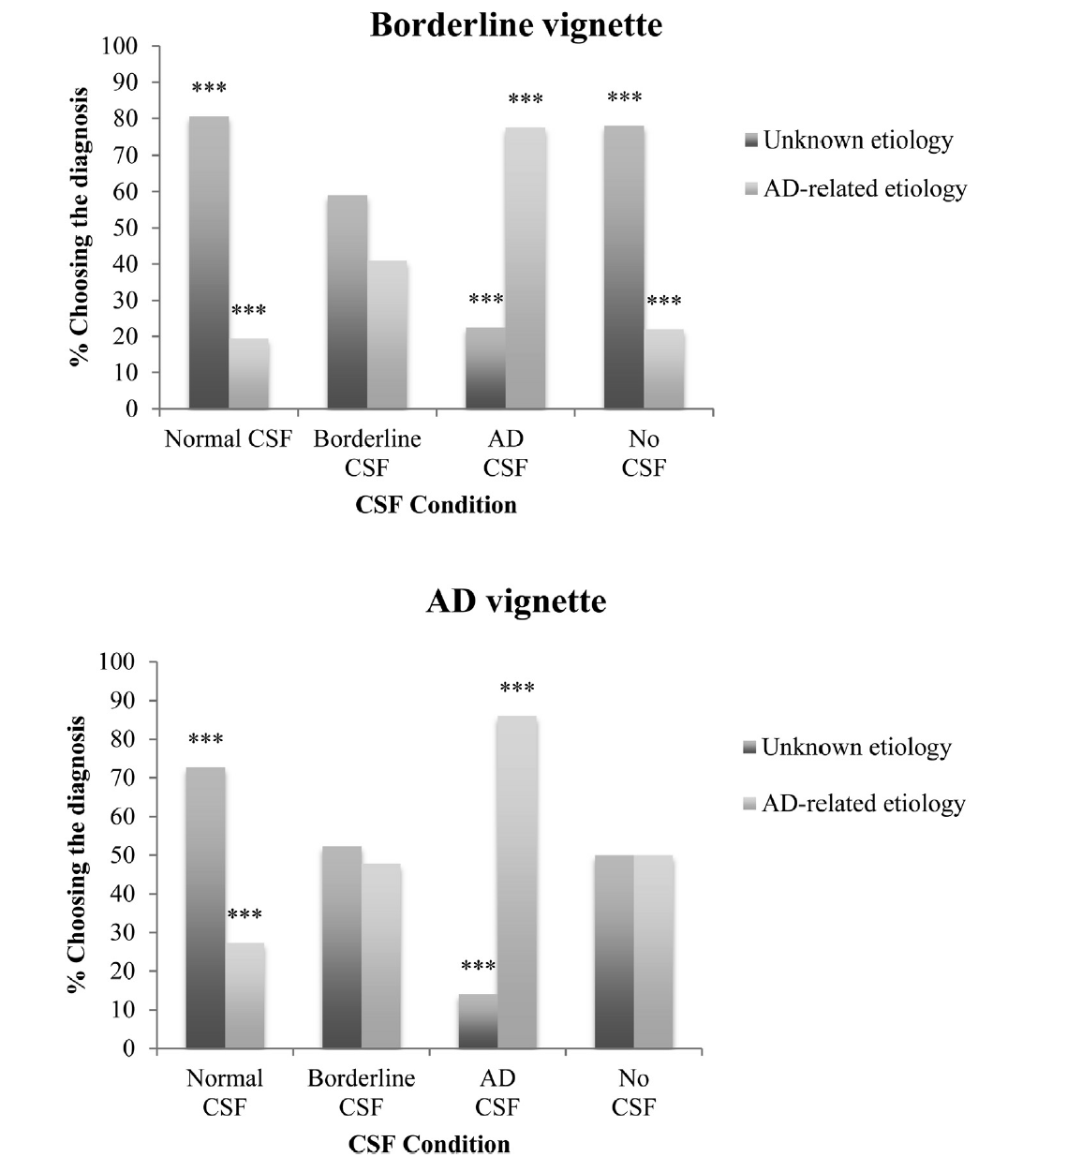

Slide 31
DIAGNOSIS OF AD IN THE GENERAL POPULATION

Slide 32
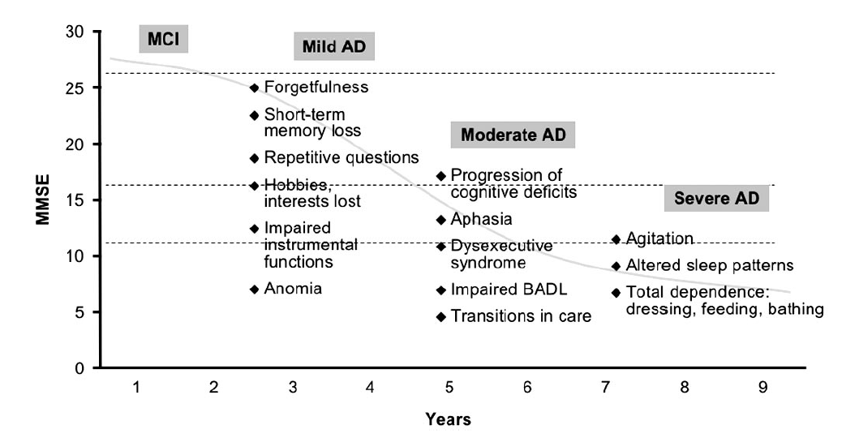
Evolution of AD according to Feldman et Woodward, Neurology 2005

Slide 33
22%* 33%* 46%* 73%*
Evolution of AD according to Feldman et Woodward, Neurology 2005
* Proportion of diagnosed cases according to Lopponen et al, (Age and Aging, 2004) and 3C

Slide 34
Recourse to specialist for the diagnosis of dementia in incident cases (3C)
  Year of Follow-up 2002 2004 2007 2010
  Proportion of recourse
  to specialist 30% 33% 30% 31%
  French Alzheimer’s
  Plan 1st 2nd 3rd

Slide 35
Reasons for lack of recourse to specialist
Lack of efficacy of antidementia drugs
Lack of time for diagnosis and management
Lack of interest for dementia, not a priority
Risk of stigma for patients and caregivers
Alzheimer’s Disease is not a disease. It is a construction of specialists and big pharma…

Slide 36
3 cohortes populationnelles françaises
1978 1988 1998 2008 2010
Paquid (65+, N=3777, T1 T3 T5 T8 T10 T13 T15 T17 T20…)
3C (65+, N=9285, T2 T4 T7 T10…)
AMI (65+, N=1000, T1, T2…)
→ Au total 14 062 personnes âgées de 65 ans et plus

Slide 37
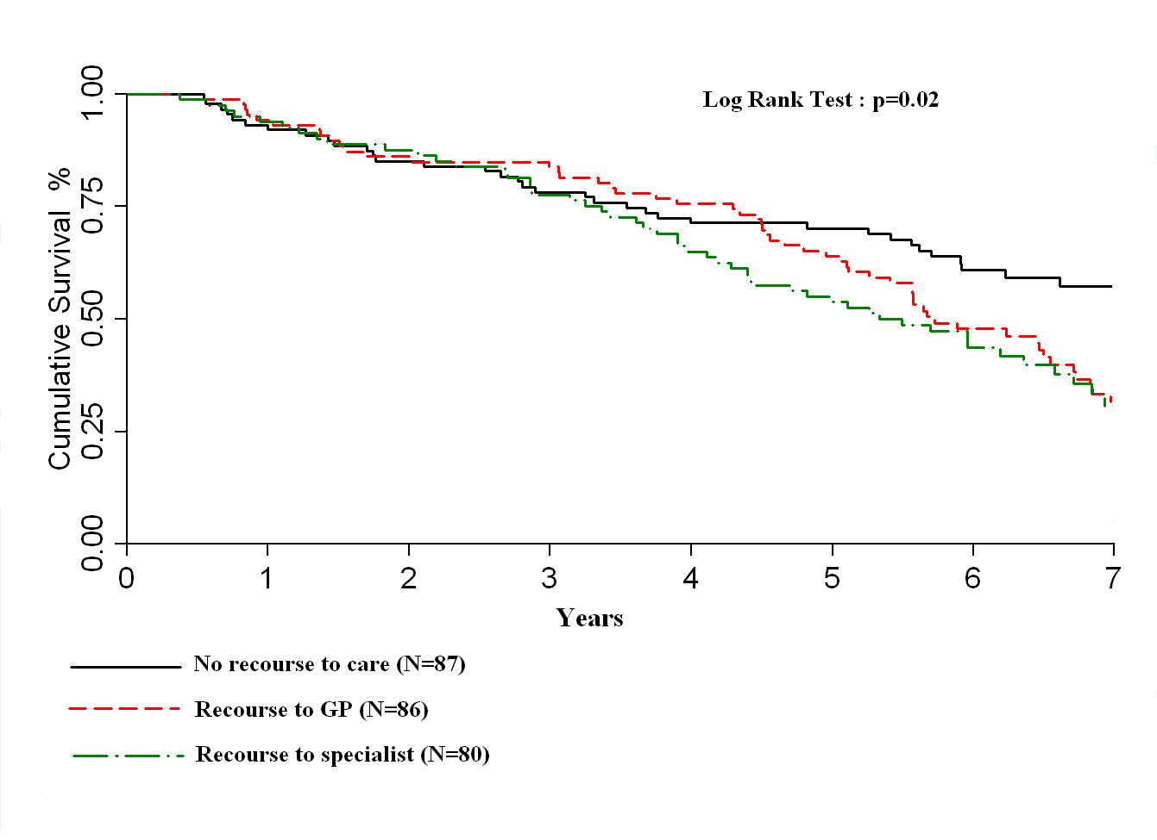
Survival of incident AD according to recourse to care. 3C study, Pimouguet et al 2015

Slide 38
Characteristics of subjects at the diagnosis of dementia according to
recourse to care (3C study, France)
 | No consultation (n=87) | Primary care consultation (n=86) | Secondary care consultation (n=80) | Global P-value
Age, mean (SD) | 79.67 (5.95) | 80.14 (5.21) | 78.79 (5.54) | 0.29
Women, n (%) | 52 (59.77) | 44 (51.16) | 46 (57.50) | 0.50
Primary level of education | 40 (45.98) | 42 (48.84) | 23 (28.75) | 0.007
Alzheimer dementia, n (%) | 62 (71.26) | 55 (63.95) | 47 (58.75) | 0.23
Diabetes, n (%) | 11 (12.6) | 10 (11.63) | 7 (8.86) | 0.73
Myocardialinfarction, n (%) | 7 (8.05) | 7 (8.14) | 5 (6.33) | 0.89
Stroke, n (%) | 4 (4.60) | 3 (3.49) | 5 (6.33) | 0.69
Depressive symptomatology, n (%) | 21 (24.14) | 19 (22.09) | 20 (25.00) | 0.88
Behavioral troubles, n (%) | 13 (14.94) | 13 (15.12) | 24 (30.00) | 0.03
Mean annual MMS decline (SD)* | 1.82 (1.59) | 1.73 (1.59) | 1.47 (1.67) | 0.36
Mean annual IADL decline (SD) * | 0.43 (1.10) | 0.66 (1.05) | 0.98 (1.21) | 0.008
*before dementia

Slide 39
Adjusted HR = 1.8 (1.3-3.0)
Cumulative incidence of entry in institution according to recourse to specialist
for incident AD. 3C study. Pimouguet et al (submitted)

Slide 40
Risk of incident BADL dependency in those who recoursed to specialist : 1.4 (0.9-2.2)
Adjusted HR = 1.8 (1.3-3.0)
Cumulative incidence of entry in institution according to recourse to specialist
for incident AD. 3C study. Pimouguet et al (submitted)

Slide 41
Mean scores of MMSE for new cases of AD in France 2009-2013

Slide 42
Reasons for lack of recourse to specialist
Valid biomarkers without treatment
Lack of efficacy of antidementia drugs
Lack of time for diagnosis and management
Lack of interest for dementia, not a priority
Risk of stigma for patients and caregivers
Alzheimer’s Disease is not a disease. It is a construction of specialists and big pharma…

Slide 43
Reasons for lack of recourse to specialist
Valid biomarkers with treatment
Lack of efficacy of antidementia drugs
Lack of time for diagnosis and management
Lack of interest for dementia, not a priority
Risk of stigma for patients and caregivers
Alzheimer’s Disease is not a disease. It is a construction of specialists and big pharma…

Slide 44
Conclusion
In spite of the development of valid biomarkers of AD, and of the capacity to detect AD even before dementia, the interest of biomarkers in clinical practice and in general population remains low.
Only efficacious treatments of AD could change this situation
However biomarkers of AD could improve inclusion and judgment criteria in drug development

