Slide 1



L’importanza della Superficie Oculare nei pazienti sottoposti ad intervento chirurgico
Ocular Surface Unit – University of Messina – Italy -
University of Messina - Italy
Dept. of Experimental Medical-Surgical Sciences
Section of Ophthalmology
NATIONAL HEALTH SERVICE EXCELLENCE CENTRE FOR THE OCULAR SURFACE DISORDERS
Head: Prof. P. Aragona
Pasquale Aragona
Milazzo, 25 Settembre 2015

Slide 2
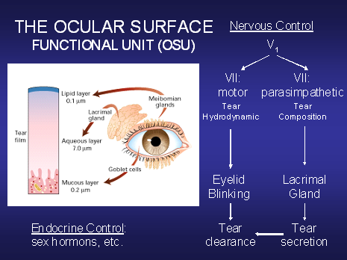
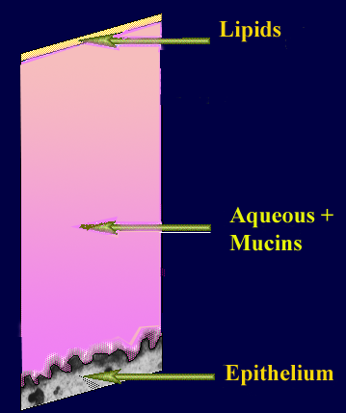
Ocular Surface System
Lids
Meibomian Glands
Cornea
Conjunctiva
Lacrimal Glands
Lacrimal Drainage
Lymphatics
TEAR FILM
Notes:
All these structures contribute to the production, distribution and maintainance, on the ocular surface, of the tear film.

Slide 3
OCULAR SURGERY
SYSTEMIC CONDITIONS
Age, Diseases (e.g. Diabetes),Therapies
TOPICAL CONDITIONS
Diseases (e.g. Dry Eye, allergy, Infections) Chronic Treatments
THE OCULAR SURFACE

Slide 4
Peri-Surgical Treatments
Disinfection
Surgical Access
Sutures
Lid weakness/incongruence

Slide 5
Ocular Surface and Surgery
Refractive
Cataract
Effect on Ocular Surface
Strabismus
Vitreo-retinal
Others

Slide 6







Key Mechanisms of Ocular Surface Damage
Blepharitis/MGD
Sex steroid hormone
imbalance
Chalasis/lid margin
irregularities
Tear film instability
Other autoimmune
diseases
Topical drugs/
preservatives
Goblet cell loss
Lipid changes
MGD
Flora changes
Eyelid
inflammation
Esterase/lipase release
Toxins
Allergy
Sjögren’s
syndrome
Cytokine release
MMP activation
Hyperosmolarity
Hyperosmolarity
Oxidation
Systemic drugs
Contact lens wear
Cell damage
Inflammation
Ocular surgery
Nerve Stimulation / Impairment
Apoptosis
Environment
LASIK/refractive
surgery
Viral/bacterial
conjunctivitis
Neurotrophic
Adapted from Baudouin C, Aragona P et al.
Ocul Surf 2013.
Notes:
Key message: The four key mechanisms of DED are tear film instability, tear hyperosmolarity, apoptosis and inflammation
The four target areas contributing to the pathophysiology of DED are tear film instability, tear hyperosmolarity, apoptosis and inflammation. These core mechanisms are primarily driven by tear hyperosmolarity and tear film instability. It is possible to enter the vicious circle of DED at any point and to complete the circle several times.
LPS, lipopolysaccharide; MGD, meibomian gland deficiency; MMP, matrix metalloproteinase

Slide 7
Hypo-Hyperstimulation
Neurogenic Inflammation
REFRACTIVE SURGERY
VII
BRAIN
POST SURGERY OCULAR SURFACE DISEASE
LG
Hypoesthesia
(neuropathic pain)
Incongruity
↓ Blink rate
↓ Globet cells
Neurotrophic kp
↓ Tear clearance ↓ Meibomian lipids
TF instability
V
Cytokines distort
sensitive information
OS
Hyperosmolarity
IFγ inhibit mucins
IL1α, IL6, IL8, IFγ and TNFα
Modified from Prof. M. Rolando - Genoa
Notes:
7

Slide 8
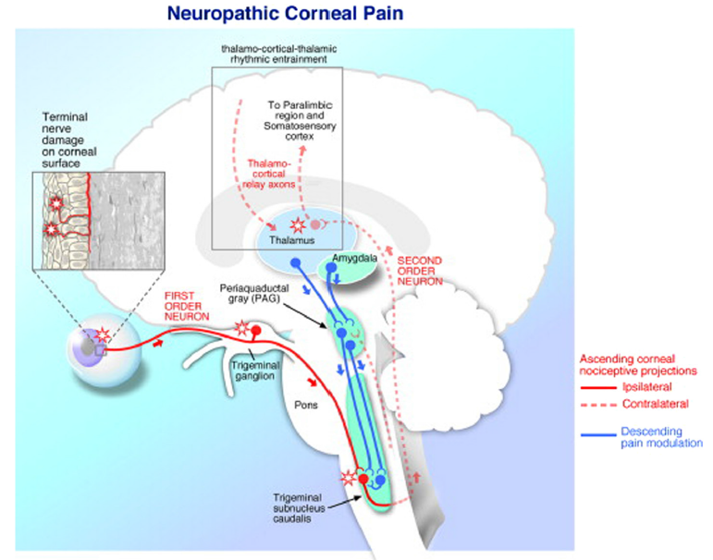

Slide 9
Lacrimal Functional Unit (LFU)
Ocular Surface
+
Innervation
+
Lacrimal Apparatus
Lacrimal Functional Unit
Neural Control
V₁
VII:
motor fibers
VII:
Parasympathetic fibers
Tears Hydrodynamics
Tear Composition
Blinking
Lacrimal Glands
Tear Clearance
Tear Secretion
International Dry Eye Workshop. Ocul Surf 2007;5:75–92.
Gipson IOVS 2007;48:4391–8.
Notes:
Messaggio principale: la malattia dell'occhio secco si può interpretare come un’alterazione dell’unità funzionale lacrimale (superficie oculare, sistema lacrimale e nervi di connessione)
La definizione del DEWS dell’unità funzionale lacrimale (LFU) è:
‘unità funzionale integrata comprendente il sistema lacrimale, la superficie oculare, le sue ghiandole accessorie, e le loro connessioni nervose responsabile del mantenimento del film lacrimale, la preservazione della trasparenza della cornea e la salute della superficie oculare.’
Gipson et al, inoltre, definisce la LFU come unità del sistema della superficie oculare, composta dalle ghiandole lacrimali (principale e accessoria), dalla superficie oculare, e dalla innervazione di connessione.

Slide 10
Corneal nociceptors
3 distinct types:
  Aδ mechanoreceptors (roughly 20%) transmitting acute pain;
  Polymodal (70%) respond to mechanical, thermal, and chemical stimuli as well as endogenous mediators.
  C-fiber (10%) are cold receptors.

Slide 11
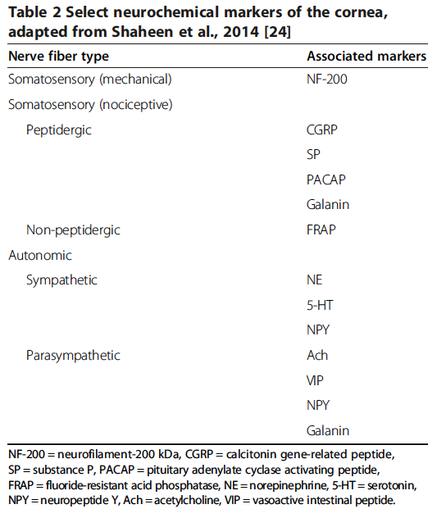
Neurochemical Markers of the Cornea

Slide 12
Pathologic sensitization of Polymodal fiber type, is likely mediated in part by transient receptor potential (TRP) receptors, including the TRP vanilloid receptor, TRPV1, which is stimulated also by tear hyperosmolarity

Slide 13
Environment
Surgery
Inflammation
Tear Hyperosmolarity
NOCICEPTIVE PAIN
SCENARIO A
SCENARIO B
Resolved Inflammation
Ongoing Inflammation
Resolved Insult
No Genetic Susceptibility
Ongoing Insult
Genetic Susceptibility
No or Transient Neuropathic Pain
Chronic Neuropathic Pain
(Peripheral/Central Sensitization)
TRANSIENT DRY EYE SYMPTOMS
CHRONIC DRY EYE SYMPTOMS

Slide 14
PATHOLOGICAL PAIN
SENSITISATION (determined by PGE₂ and PGI₂)
  reduction of the activation threshold
  increase in the response level to activating stimuli
  spontaneous activation of nociceptors
HYPERALGESIA
- rise in nociceptive response to activating stimuli
ALLODYNIA
- pain determined by not usually harmful stimuli

Slide 15
NEURONAL DAMAGE
CENTRAL
PERIPHERAL
DEAFFERENTIATING DYSESTHESIA
REDUCED SENSIBILITY
- DISCOMFORT SYMTOMS
- LACRIMAL DYSFUNCTION

Slide 17
Epithelial Cells and Inflammation
Adhesion molecules expression responsible for leukocytes tissue infiltration (ICAM-1)
Expression of MHC class II responsible for antigen presentation and T lymphocytes activation
(3) Production and release of PG, leukotrienes e cytokines (GM-CSF) that activates leukocytes and pro-inflammatory cells
(4) Production of pro-inflammatory cytokines (IL-1, 3, 6, 8, TNFalpha, MMP)
EPITHELIAL
LAB

Slide 18
INFLAMMATORY MECHANISMS IN DRY EYE
INNATE
EPITHELIAL
CELLS
Lipid changes
MILD EDE
Flora changes
Eyelid
inflammation
Esterase/lipase release
Toxins
ADVANCED
DRY EYE
DENDRITIC CELLS
Epithelial
inflammation
Golblet Cells Loss
MILD ADDE
LYMPHOCYTES
ADAPTIVE
Notes:
Two main inflammatory mechanisms, namely innate and adaptive, are involved in dry eye inflammation. The former is predominant in MGD and EDE in general, the latter in SS and ADDE. When innate mechanisms are prolonged or intense dendritic cells are activated and the homing of lymphocytes on the ocular surface is initiated. This phenomenon is the hallmark of chronic damage and is characteristic of advanced dry eye. Also forms characterized by the predominant activation of adaptive mechanisms may stimulate an epithelial response mediated by innate responses. In advanced dry eye both forms of inflammatory mechanisms are present.

Slide 19
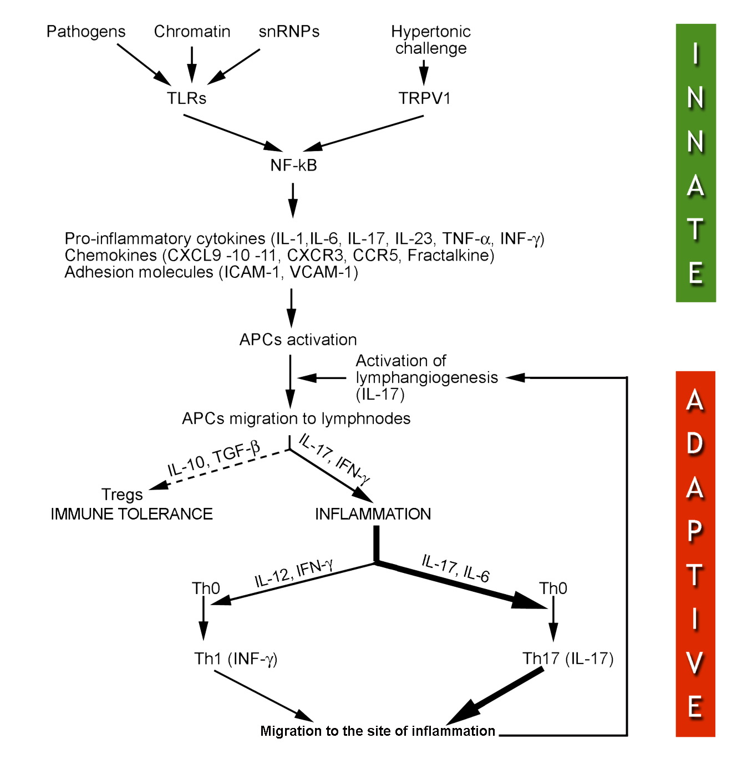
INFLAMMATORY MECHANISM IN DRY EYE DISEASE
EPITHELIAL
CELLS
DENDRITIC CELLS
LYMPHOCYTES
From Aragona P et al. In Ocular Surface Disease. Benitez J and Lemp M eds. JP Medical Publishing, London 2013

Slide 20
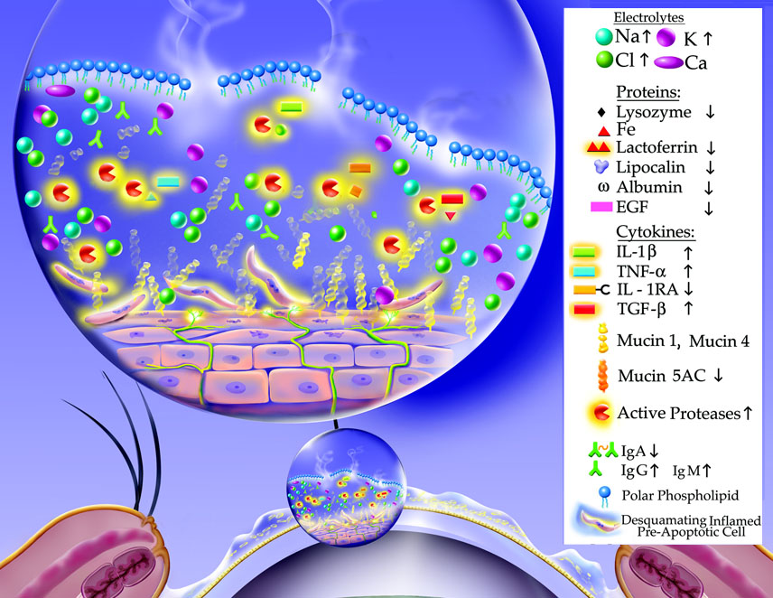
Tear Composition is Altered in Course of Dysfunctional Tear Syndrome
Mucins, proteins and lipids alterations
  Decreased concentration of soluble mucins
  Decreased concentration of anti-bacterial proteins
  Imbalance of the equilibrium between immunosoppressive cytokines and their antagonists (Solomon et al, 2001)
  Increased protease activity
    ECM and epithelial tight junctions alterations alterations
Increased Tear Osmolarity
  (Ogasawara et al, 1996)
Image from Dry Eye and Ocular Surface Disorders, 2004
Notes:
20
Changes in tear composition that accompany Dysfunctional Tear Syndrome (or dry eye disease) are probably as important in its pathophysiology are decreased tear volume.
Decreased soluble mucin concentration results in reduced tear film viscosity and thin spots, or tear break-up, after a blink cycle.
Changes in protein composition, such as decreases in concentrations of antibacterial proteins, impair the defensive function of the tear film.
The balance between immunosuppressive cytokines and their antagonists is disrupted in the tears of DTS patients and may impact the behavior of nearly all cells bathed by the tear film.
Protease activity is increased, in part due to elevated osmolarity, but also likely due to cytokine imbalance.
This can lead to breakdown of the extracellular matrix and tight junctions.
Increased osmolarity of the tear film, from the normal value of 296 mEq/L to 325 mEq/L , on average, in DTS patients, impacts many aspects of cellular physiology.
Solomon A, Dursun D, Liu Z, Xie Y, Macri A, Pflugfelder SC. Pro- and anti-inflammatory forms of interleukin-1 in the tear fluid and conjunctiva of patients with dry-eye disease. Invest Ophthalmol Vis Sci. 2001;42:2283-2292.
Ogasawara K, Mitsubayashi K, Tsuru T, Karube I. Electrical conductivity of tear fluid in healthy persons and keratoconjunctivitis sicca patients measured by a flexible conductimetric sensor. Graefes Arch Clin Exp Ophthalmol. 1996;234:542-6.

Slide 21
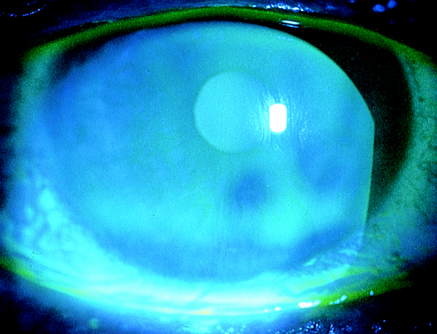
Irregular Thickness of the Precorneal Tear Film Affects the Quality of Vision

Slide 22
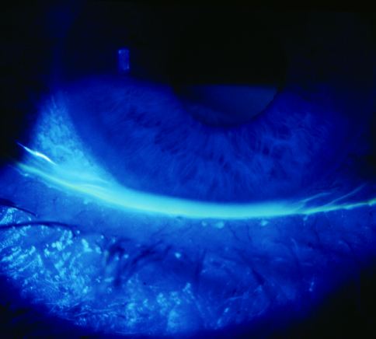
Delayed Tear Clearance
Depletion of
OS Protective Factors
Accumulation of Toxic /
Inflammatory Factors

Slide 23
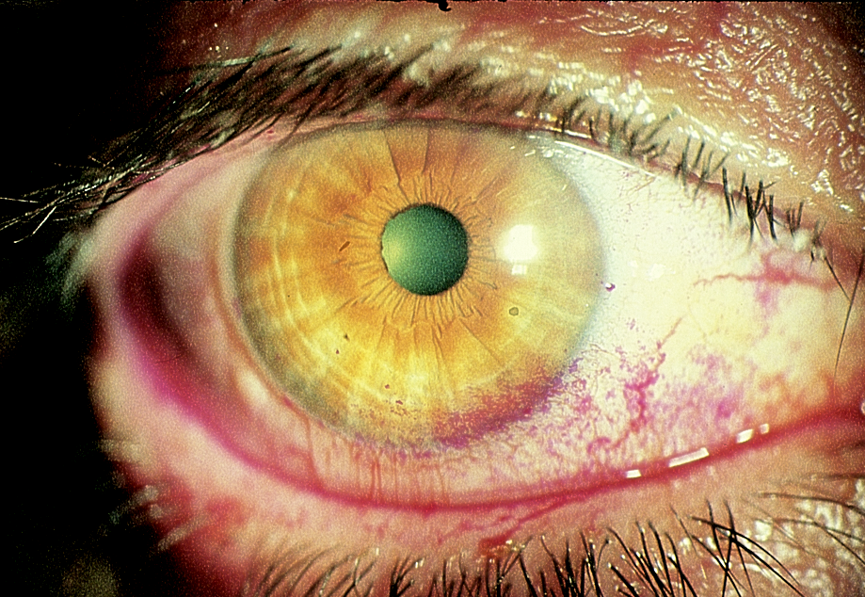
The “ Toxic Tears “ Syndrome
altered tear fluid composition
decreased tear clearance

Slide 24
TEAR FILM
Tear Film is central to the ocular surface system
Its efficiency is foundamental for Ocular Surface homeostasis
Lipids, mucins and aqueous components need to be present and harmonized each other in order to obtain a stable tear film
Therapy with tear substitutes should aim to obtain this goal

Slide 25
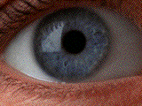
In Eyes with Tear Dysfunction
If blinking does not occur rapidly enough retinal image quality will be compromised
  Goto et al., demonstrated a drop in visual acuity of 0.3 when 16 patients with dry eye held their eyes open for only 10 seconds.
  Blurry or disturbed vision has also been reported in a number of clinical studies of patients with dry eye.
Vitali, C, Moutsopoulos, HM, Bombardieri, S. (1994) The European community study group on diagnostic criteria for Sjögren’s syndrome. Sensitivity and specificity of tests for ocular and oral involvement in Sjögren’s syndrome Ann Rheum Dis 53,637-647
Goto, E, Shimmura, S, Yagi, Y, Tsubota, K. (1998) Decreased visual acuity in dry eye patient during gazing Invest Ophthalmol Vis Sci 39(4),S539Abstract nr 2477
Lee, SH, Tseng, SCG (1997) Rose bengal staining and cytologic characteristics associated with lipid tear deficiency Am J Ophthalmol 124,736-750
Bjerrum, KB (1996) Test and symptoms in keratoconjunctivitis sicca and their correlation Acta Ophthalmol Scand 74,436-441
Toda, I, Fujishima, H, Tsubota, K. (1993) Ocular fatigue is the major symptom of dry eye Acta Ophthalmol 71,347-352

Slide 26
The aim of any ocular surgery is to restore or maintain the best vision possible
The tear film and the ocular surface contribute significantly to obtain a good vision
A good tear film is essential to the final visual outcome of surgery
Consider a treatment for the ocular surface together with other post-surgical treatments

Slide 27
SOSTITUTO LACRIMALE IDEALE:
non essere epitelio-tossico
creare un ambiente adeguato per riparazione, conservazione e turnover cellulare
ricostituire il volume del film lacrimale senza disturbi della visione
avere un lungo tempo di permanenza sulla superficie oculare
avere efficiente azione reologica
Integrare/sostituire efficacemente le componenti del film lacrimale
consentire un ammiccamento regolare

Slide 28
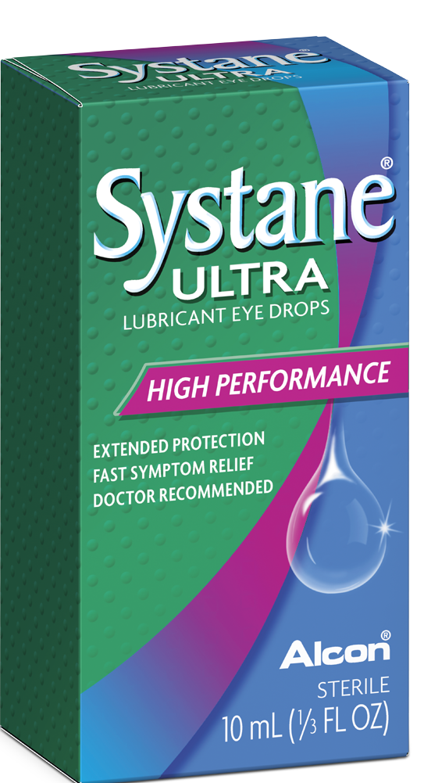
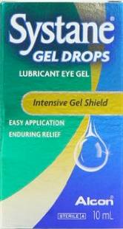
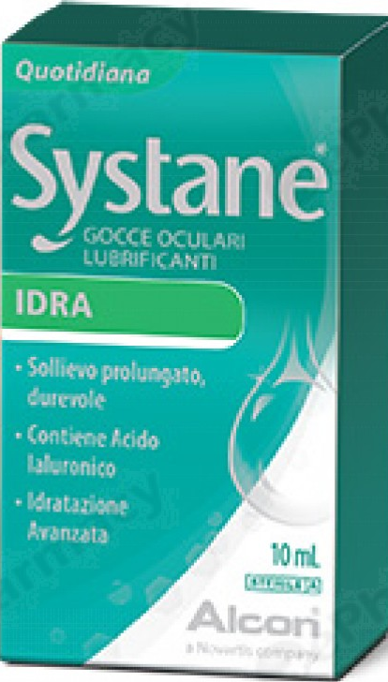
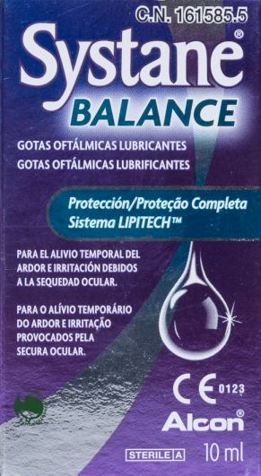
Tecnologia avanzata
Componenti attivi: Polyethylene Glycol 400, Propylene Glycol, Ialuronato di Sodio, Trigliceridi
Altri componenti: HP-Guar, acido borico, sorbitolo, cloruro di potassio, cloruro di sodio, aminometilpropanolo, acqua purificata,
Multi conservante: POLYQUAD®
UD: senza conservanti

Slide 29
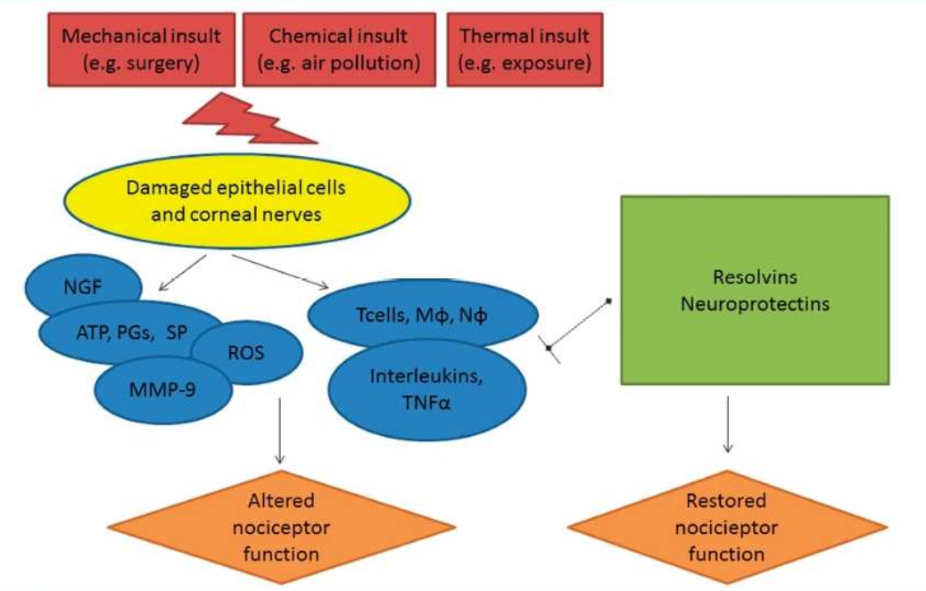
Notes:
A simplified version of the relationship between environmental insults, inflammation, and nociceptor function. Mechanical,
chemical, and thermal insults can damage corneal epithelial cells and nociceptors that results in a cascade of inflammatory
mediators including adenosine triphosphate (ATP), prostaglandins (PGs), substance P (SP), matrix metalloproteinases (MMPs),
reactive oxygen species (ROS), and nerve growth factor (NGF). In addition, there is an influx of immune cells including T cells,
macrophages (Mφ), and neutrophils (Nφ). These cells secrete a variety of cytokines (interleukins and tumor necrosis factor (TNF))
that all alter the function of nociceptors. Other mediators, including resolvins and protectins, are involved in ending the
inflammatory cascade and restoring nociceptor function. Persistent environmental stress or inflammatory responses can lead to
permanent changes in nociceptor function.

Slide 30
Danni conseguenti all’intervento
Danni conseguenti alla condizione del paziente
  Sistemiche (diabete)
  Topiche (dry eye, etc)

Slide 31
Negli interventi chirurgici fare attenzione all’innervazione (p.es. nel paziente diabetico fare attenzione all’innervazione con confocale)

