Slide 1
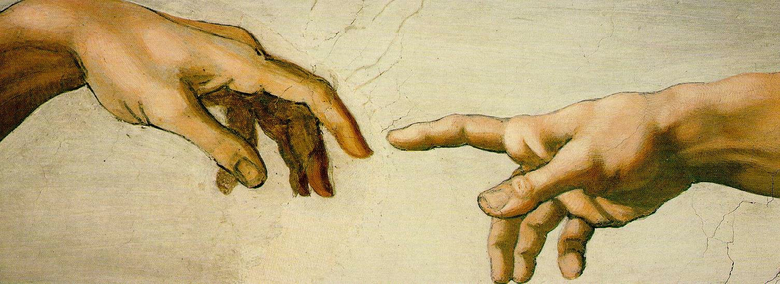
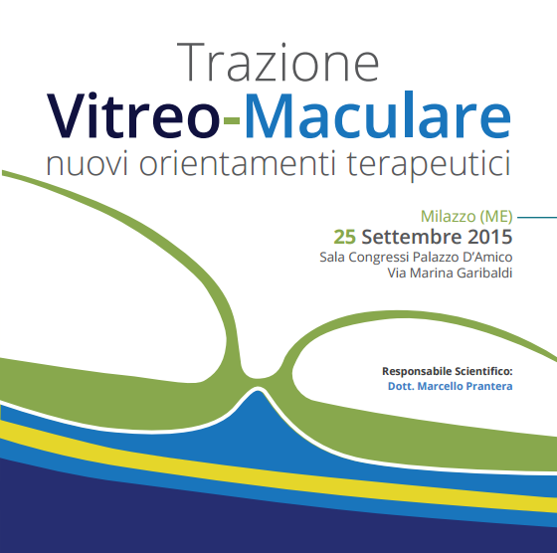
OCT e trazione vitreo-maculare: revisione della classificazione
Marinella Cirone
U.O.C. di Oculistica, P.O. "G.Fogliani"

Slide 2
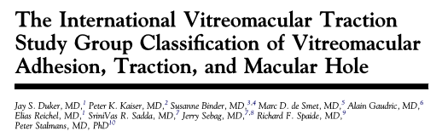
IVTS
Systematic identification, monitoring, and management of VMI diseases
Evidence based
Easy to remember
Simple
Predictive of surgical outcome
Useful
Clinically applicable

Slide 3
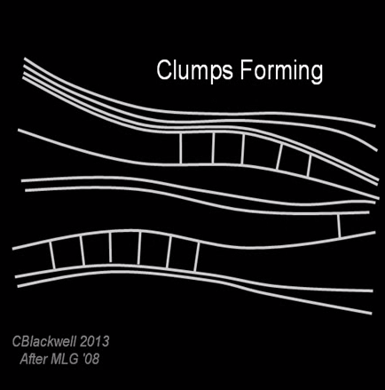
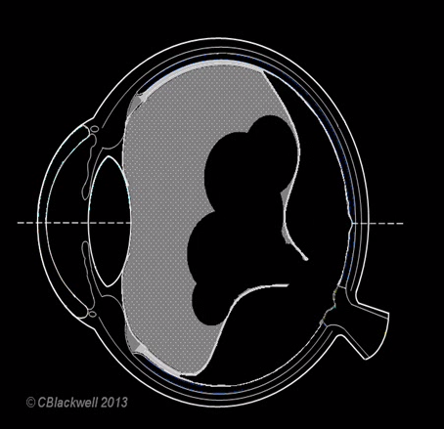
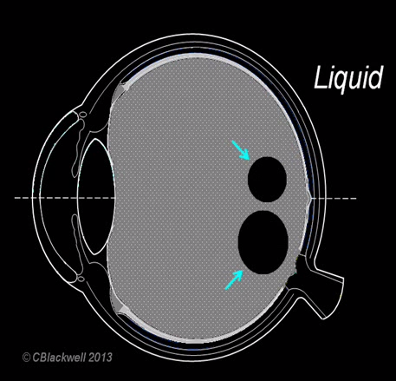
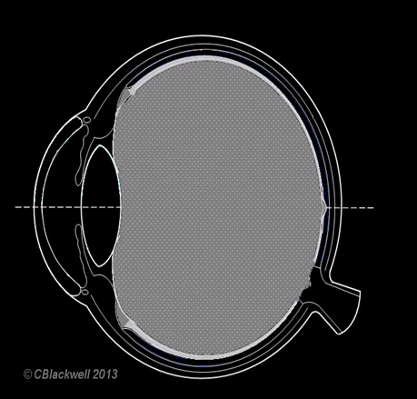
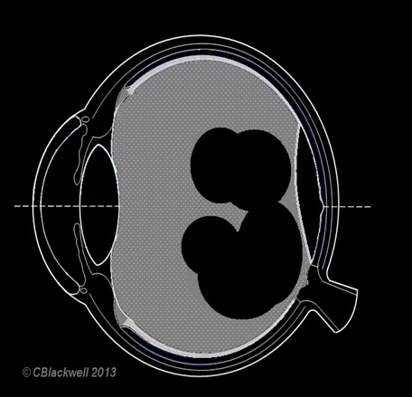
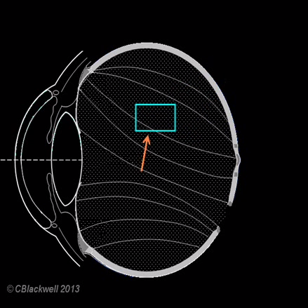

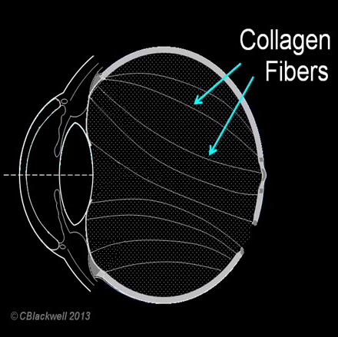

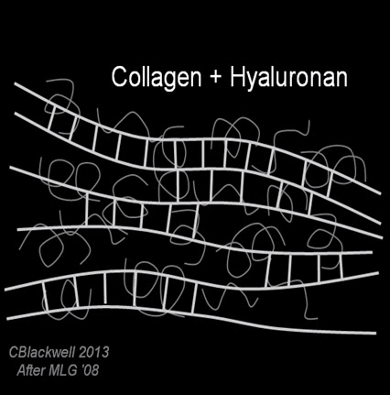
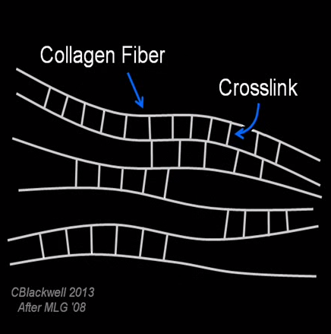
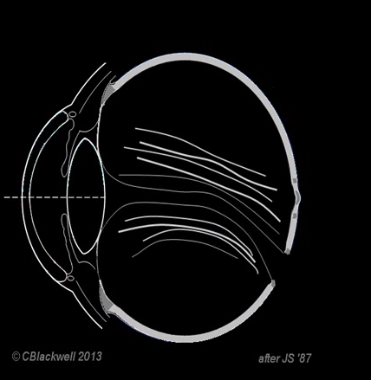

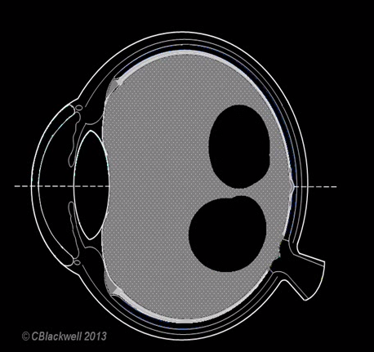


DISTACCO POSTERIORE DI VITREO
Sineresi Sinchisi
Schneider EW & Johnson MW. Clin Ophthalmol 2011;5:1151
Johnson MW. Am J Ophthalmol 2010;149:371

Slide 4
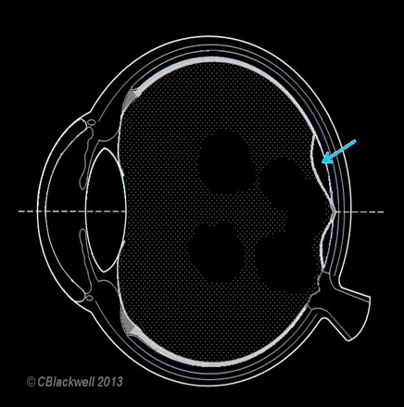
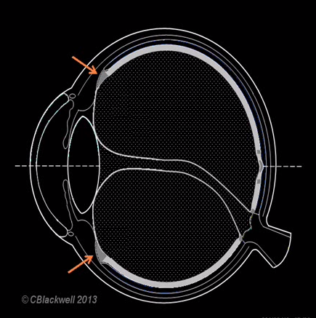
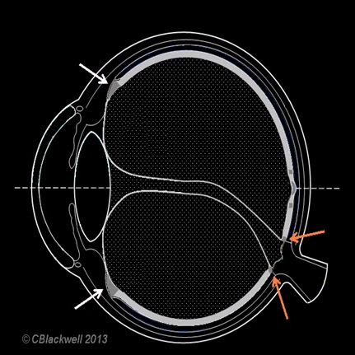
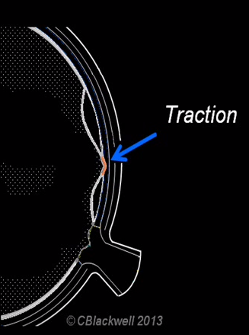


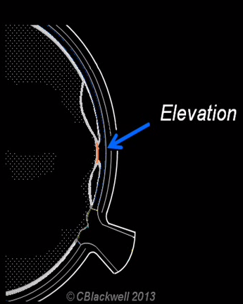
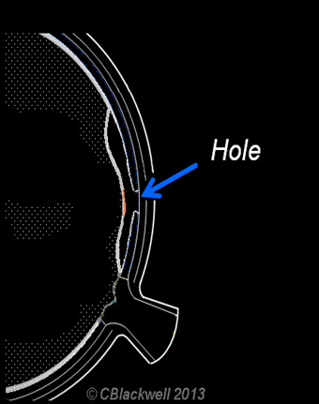
DPV ANOMALO
Patologia della VMI

Slide 5
DPV ANOMALO
Patologia della VMI
Partial vitreous detachment with persistent attachment in the macular region
Anomalous PVD
Combination of both
Liquefaction or gel contraction outpaces detachment of the vitreous cortex
Abnormal adhesion of the vitreous cortex to the ILM
OR

Slide 6
Conseguenze del DPV anomalo
Adesioni Vitreoretiniche
Macula
Disco Ottico
Base Vitreale
DPV Completo
con fibrosi
DPV Incompleto
con adesione foveale
Separazione
degli strati retinici
Adesione
Vitreomaculare
focale
DPV Incompleto con
Adesione del disco ottico
Aumentata
Trazione
Periferica
Membrane
Epiretiniche
Retinoschisi
foveale
Isolata
Concomitante
Pucker
Maculare
Trazione
Vitreomaculare
Edema
Maculare
Diabetico
AMD
Foro
Lamellare
Trazione
Vitreopapillare
Rottura
Retinica
Periferica
Patologie
Concomitanti
Foro Maculare
A tutto spessore
Emorragia
Vitreale
Distacco di
Retina

Slide 7

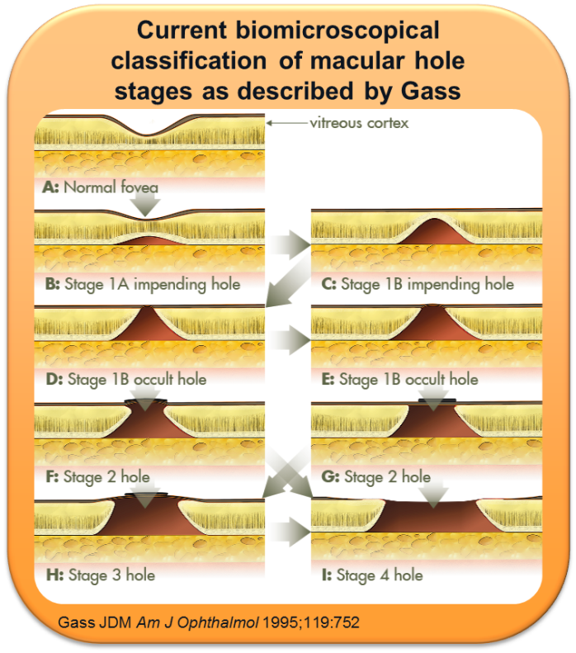
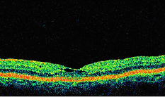
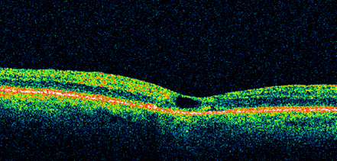

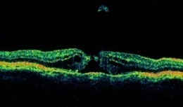
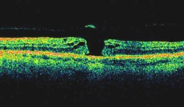
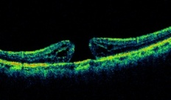
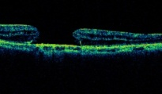
Classificazione di Gass
Classificazioni OCT
  Developed in 1988; updated in 1995
  Requires careful clinical examination
  Lack of consensus
    Hinders clinical practice, consistent reporting, and therapy evaluation
STADIO 1 - A Spot Giallo 100-200µ
STADIO 1 - B Anello Giallo 200-300µ
STADIO 2 Tutto Spessore < 400µ
STADIO 3 Foro Completo >400µ +/- Opercolo
STADIO 4 Foro Completo>400µ DPV Completo

Slide 8
The International Vitreomacular Traction Study Group Classification
of Vitreomacular Adhesion, Traction, and Macula Hole
The IVTS Group developed a unifying scheme for the definition and classification of VMI diseases
This system is:
  OCT derived
    OCT enables physicians to visualize and monitor the VMI with greater consistency and accuracy
  Evidence based
    Extensive review of the literature on diseases of the vitreoretinal interface
    Internally circulated questionnaires to compare opinions of the study group participants on definitions specified in the literature
The International Vitreomacular Traction Study (IVTS) Group is a panel of vitreoretinal
disease experts, convened to develop a consensus system for the classification of VMI diseases

Slide 9
Classificazione IVTS
Classification | Sub-classification
Vitreomacular adhesion (VMA) | Focal (≤1500 μm) or broad (>1500 μm) Isolated or concurrent with other diseases No structural abnormalities in the retina
Vitreomacular traction (VMT) | Focal (≤1500 μm) or broad (>1500 μm) Isolated or concurrent with other diseases Structural abnormalities in the retina
Full-thickness macular hole (FTMH) | Small (≤250 μm), medium (>250 μm and ≤400 μm), or large (>400 μm) With or without VMT Primary or secondary to other conditions

Slide 10
VMA
Adesione vitreo-maculare
VMA represents a specific stage of vitreous separation
  Partial detachment of the vitreous in the perifoveal area
  No retinal abnormalities
Based on anatomic characteristics, not symptomatology
  Specific visual symptoms are subjective
  May be caused by unrelated disease
The 1500 μm width cut-off has been selected for several reasons
  Known area of increased vitreous adhesion to the fovea
  Used routinely to distinguish focal from broad VMA in the published vitreoretinal literature and at most OCT reading centers
Unclear prognostic difference between focal and broad VMA

Slide 11
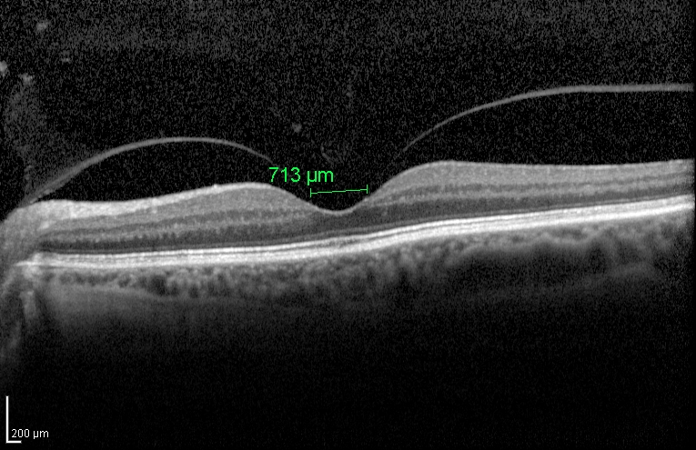
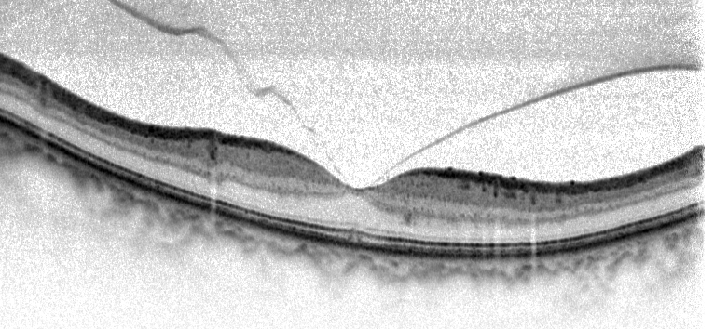
VMA
Adesione vitreo-maculare
FOCALE

Slide 12
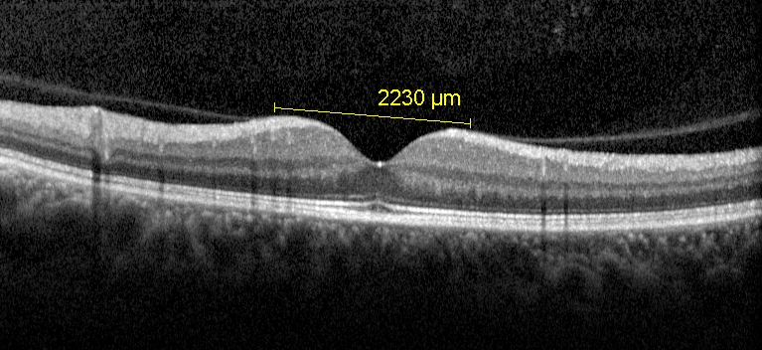
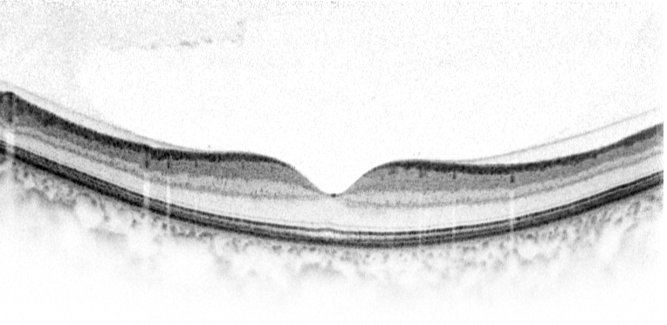
VMA
Adesione vitreo-maculare
estesa

Slide 13
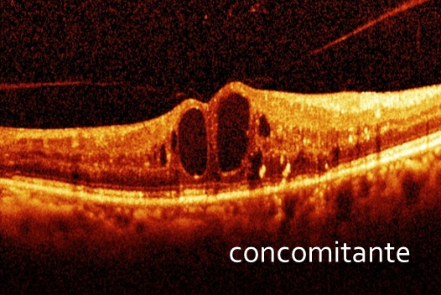
VMA
Adesione vitreo-maculare
    AMD
    Retinal vein occlusion
    Diabetic macular edema

Slide 14
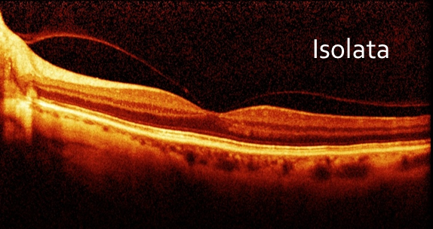
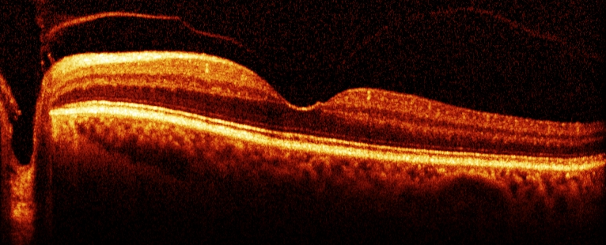
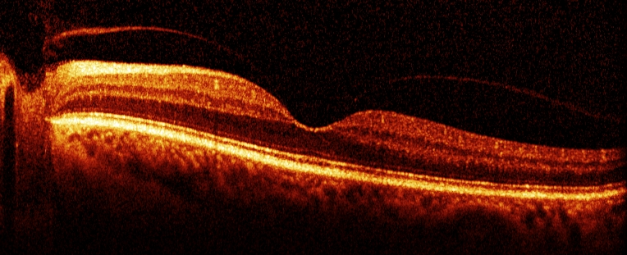
VMA
Adesione vitreo-maculare

Slide 15
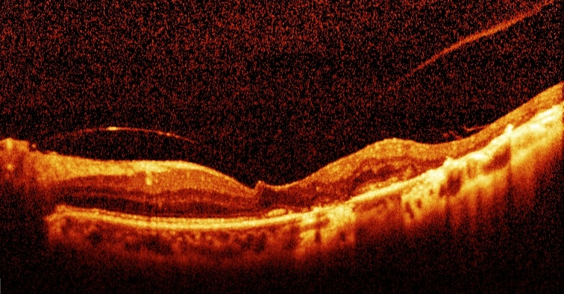
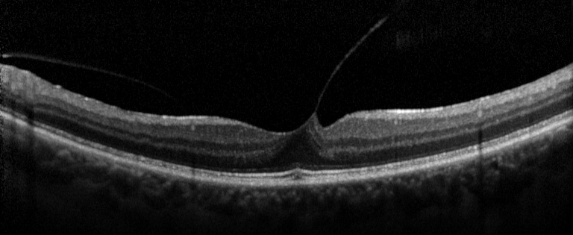
VMT
Trazione vitreo-maculare
The progression of PVD can lead to periods of excessive traction on the macula, typically resulting in reduced or distorted vision
  Anatomic changes in the contour of the foveal surface
  Intraretinal pseudocyst formation
  Elevation of the fovea from the RPE
  Combination of the above

Slide 16
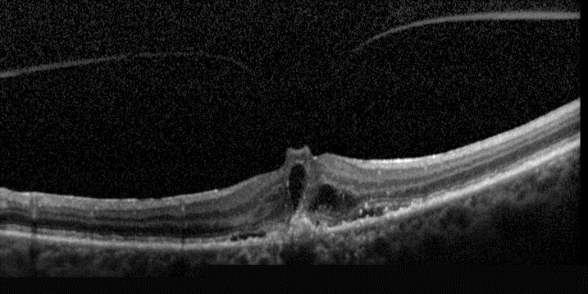
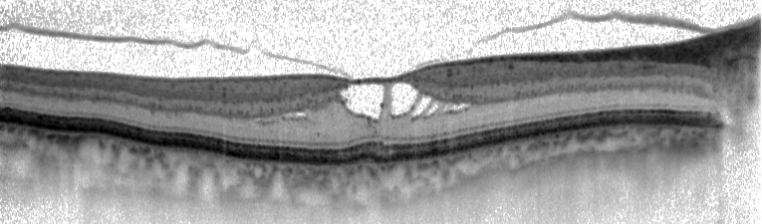
VMT
Trazione vitreo-maculare
The progression of PVD can lead to periods of excessive traction on the macula, typically resulting in reduced or distorted vision
  Anatomic changes in the contour of the foveal surface
  Intraretinal pseudocyst formation
  Elevation of the fovea from the RPE
  Combination of the above

Slide 17
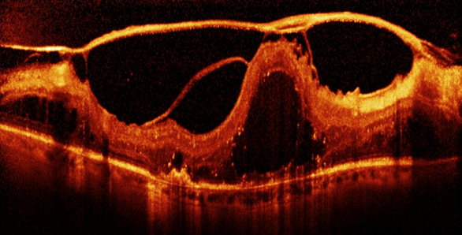
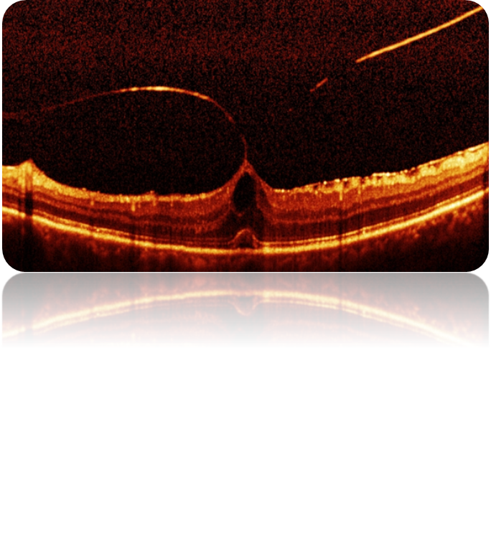
VMT
Trazione vitreo-maculare
The progression of PVD can lead to periods of excessive traction on the macula, typically resulting in reduced or distorted vision
  Anatomic changes in the contour of the foveal surface
  Intraretinal pseudocyst formation
  Elevation of the fovea from the RPE
  Combination of the above

Slide 18
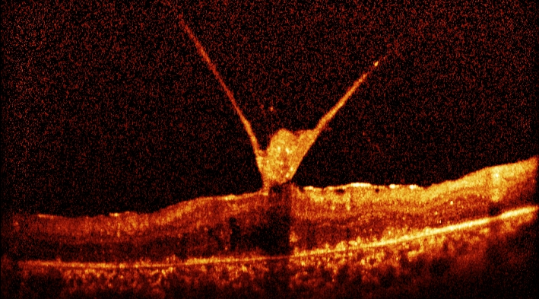
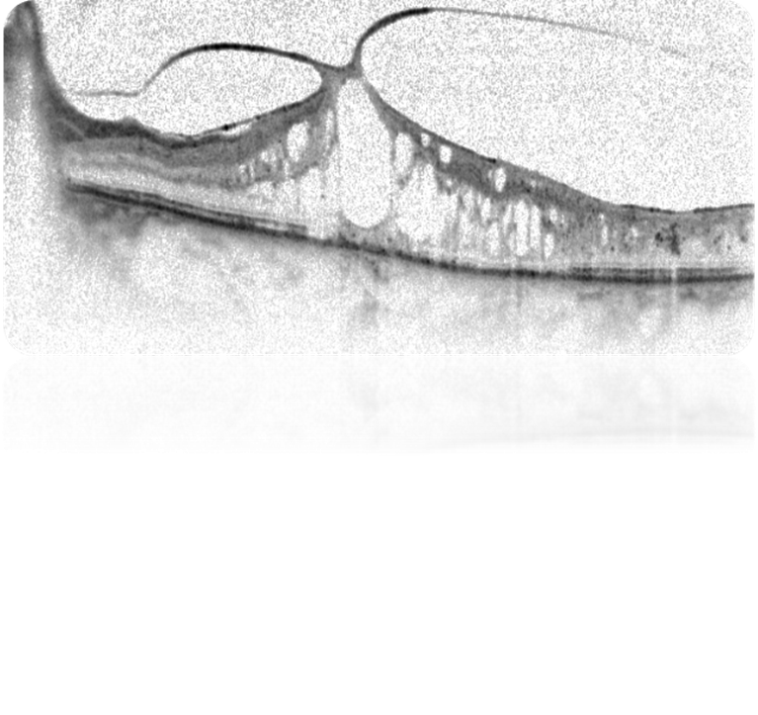
VMT
Trazione vitreo-maculare
concomitante

Slide 19
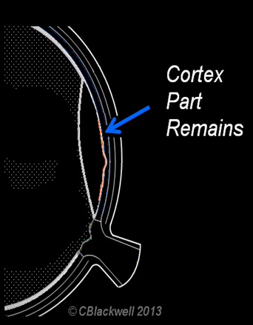

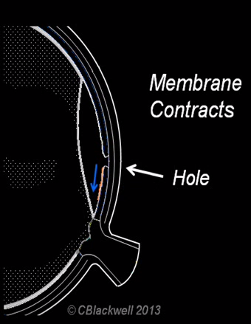


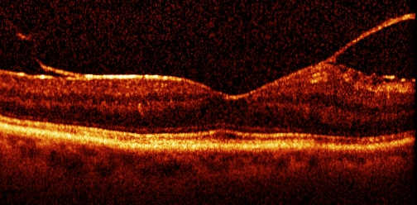
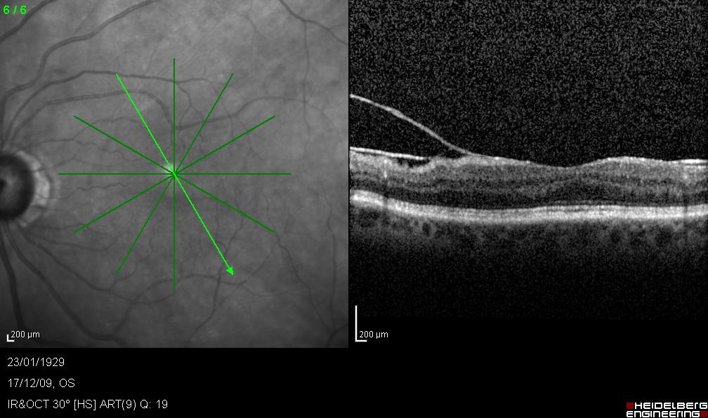
Vitreoschisi e pucker
Vitreoschisis is a condition in which, with PVD progression, residual vitreous tissue remains on the inner retinal surface
  This may proliferate to form an ERM at any stage of vitreous separation
  High incidence of apparent PVD in eyes with macular pucker

Slide 20
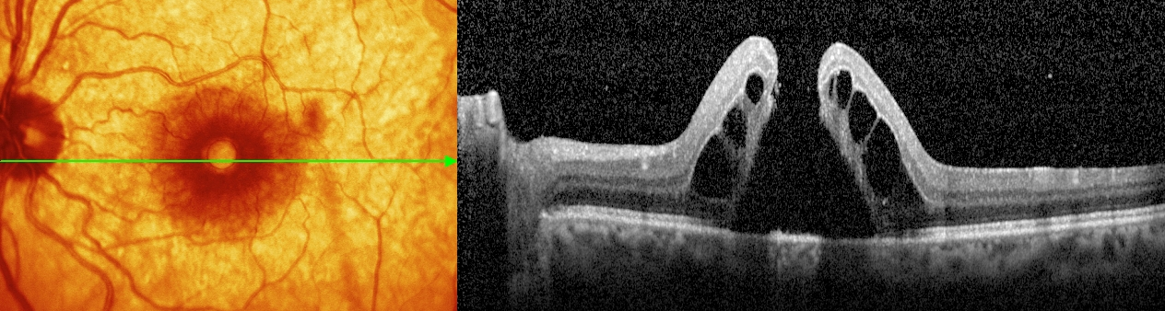
FTMH
Foro maculare a tutto spessore
Definition | Classification
Full-thickness foveal lesion that interrupts all macular layers from the ILM to the RPE | By size (horizontally measured linear width across hole at narrowest point, not ILM) Small (≤250 μm) Medium (250–400 μm) Large (>400 μm) By presence or absence of VMT By cause Primary (initiated by VMT) Secondary (directly due to associated disease or trauma known to cause macular hole in the absence of prior VMT)
Non si parla più di «stadi»
Non si parla più di foro idiopatico

Slide 21
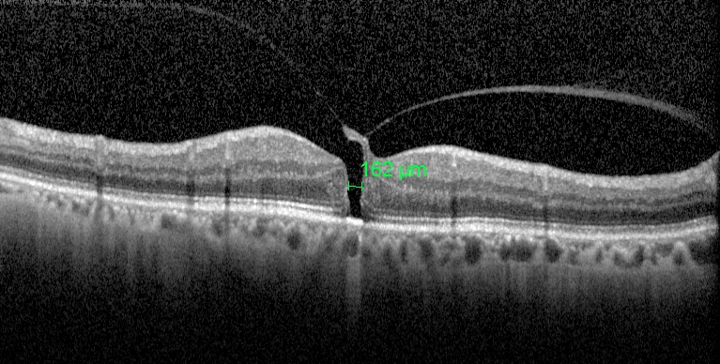
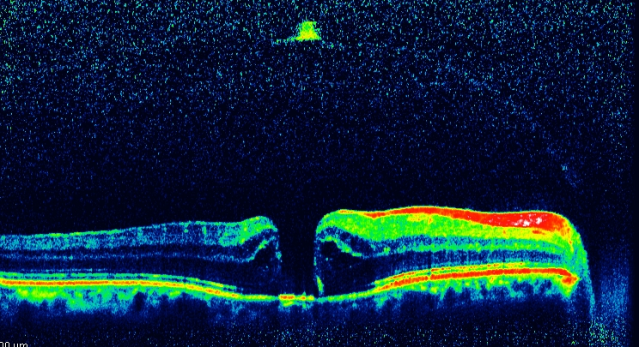

FTMH
Foro maculare a tutto spessore

Slide 22





Impending Macular Hole
A special circumstance exists when an individual develops FTMH in one eye and OCT reveals VMA or VMT in the fellow eye
  Studies show that these fellow eyes are at increased risk for development of FTMH
In the past, the finding of VMA in a fellow eye has been referred to as a stage 0 macular hole
  The term impending macular hole should be used instead to describe a case in which FTMH is observed in one eye and VMT is observed on OCT in the fellow eye
  It does not exclude the possibility of spontaneous resolution
VMA nell’occhio controlaterale di un paziente con FTMH: quell’occhio ha un rischio del 42% di andare incontro ad un foro a tutto spessore entro due anni
In assenza di VMA il rischio è pari al 3 %

Slide 23


LMH
Lamellar Macular Hole
LMH is a partial-thickness foveal defect
  It typically appears on biomicroscopy as a round or oval, well- circumscribed, reddish lesion
  Clinical detection of early LMH may be difficult using biomicroscopy alone
  Anatomic OCT-based features of LMH include the following:
    Irregular foveal contour
    Defect in the inner fovea (may not have actual loss of tissue)
    Intraretinal splitting (schisis), typically between the outer plexiform and outer nuclear layers
    Maintenance of an intact photoreceptor layer

Slide 24


Pseudoforo Maculare
Based on slit-lamp biomicroscopic examination of the macula
  Specific morphologic features are best confirmed with OCT
  An OCT with multiple foveal line scans is 100% sensitive in ruling out FTMH
Diagnosis confirmed by:
  Invaginated or heaped foveal edges
  Concomitant ERM with central opening
  Steep macular contour to the central fovea with near-normal central foveal thickness
  No loss of retinal tissue

Slide 25






Gass¹
NEW (IVTS)²
Stage 0 macular hole
VMA in contralateral eye
Stage 1 macular hole
Symptomatic VMA (or VMT)
FTMH – small (≤250 µm) or medium (>250 but ≤400 µm)
Stage 2 macular hole
Stage 3 macular hole
FTMH – medium or large (>400 µm)
Stage 4 macular hole
FTMH – No VMA can be small,
medium, large
Wender J, Jumper JM. Rev Ophthalmol. February 15, 2007.
Duker JS, et al. Ophthalmology. 2013:120(12):2611-2619.

Slide 26

The new OCT-based anatomic International Classification System for Vitreomacular Adhesion, Traction, and Macular Hole was developed to allow clinicians to speak a common language when discussing diseases of the VMI
It is purely anatomically based, without regard to symptoms or fellow eye status
Designed to be:
  Helpful in predicting therapeutic outcomes
  Useful for the execution and analysis of clinical trials
  Clinically applicable
  Easy to remember
  Simple

Slide 27


Grazie per l’attenzione

