Slide 1
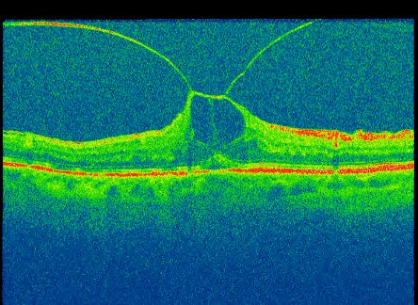
Ocriplasmin: Real world results & complications.
Richard Haynes
Bristol Eye Hospital UK

Slide 2
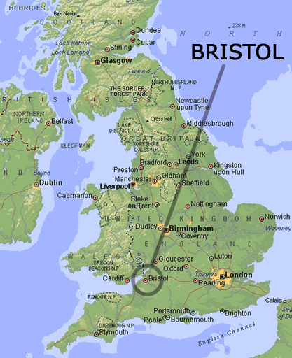

Slide 5
Declaration of Interest
Ocriplasmin Advisory Board - Alcon

Slide 6
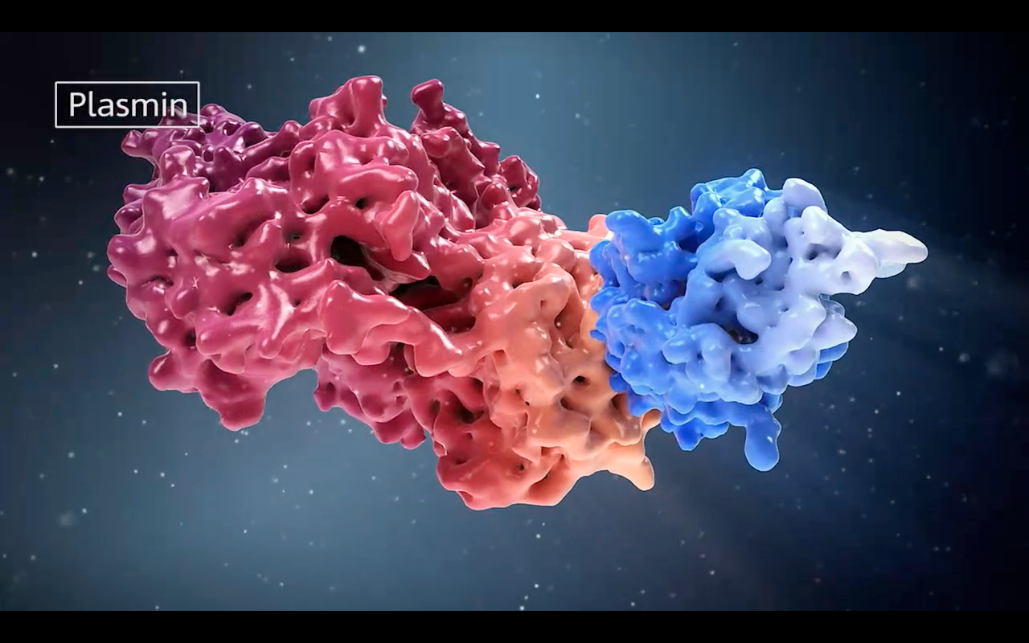
Ocriplasmin
(Jetrea)
Notes:
Recombinant engineered fragment of human Plasmin

Slide 7
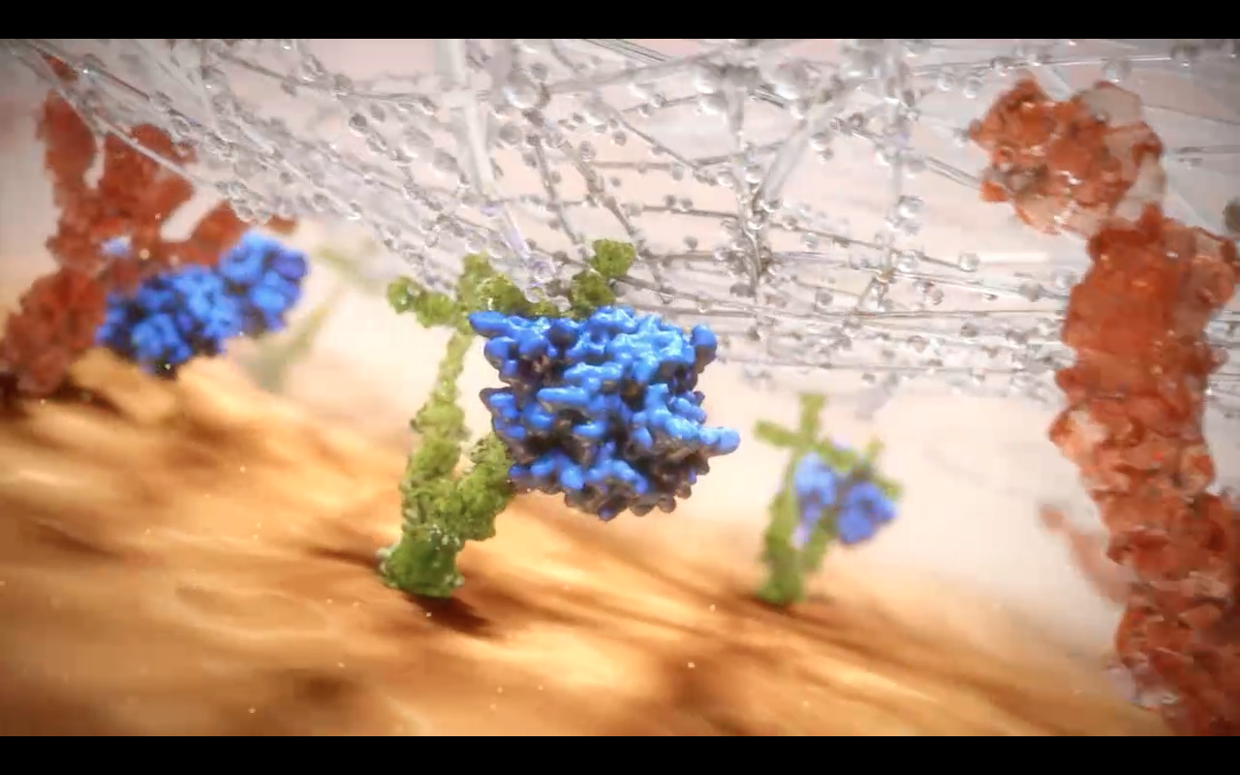

Slide 8
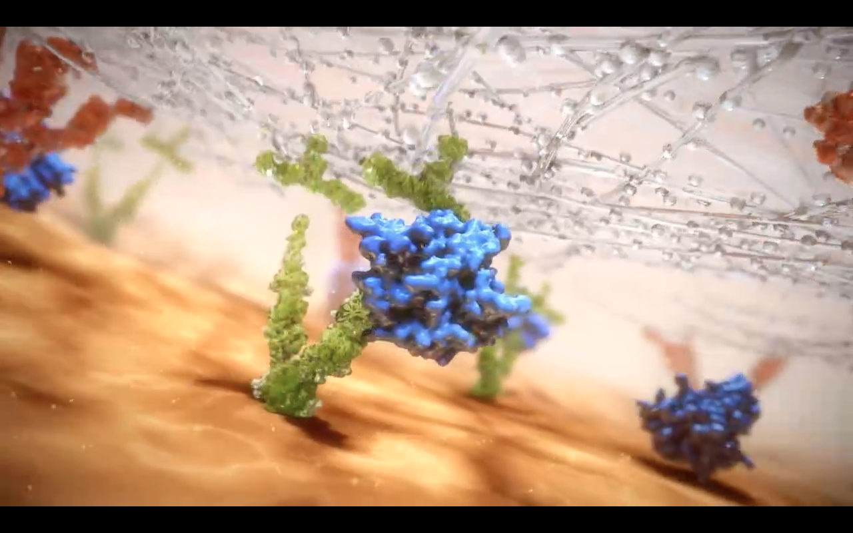

Slide 9
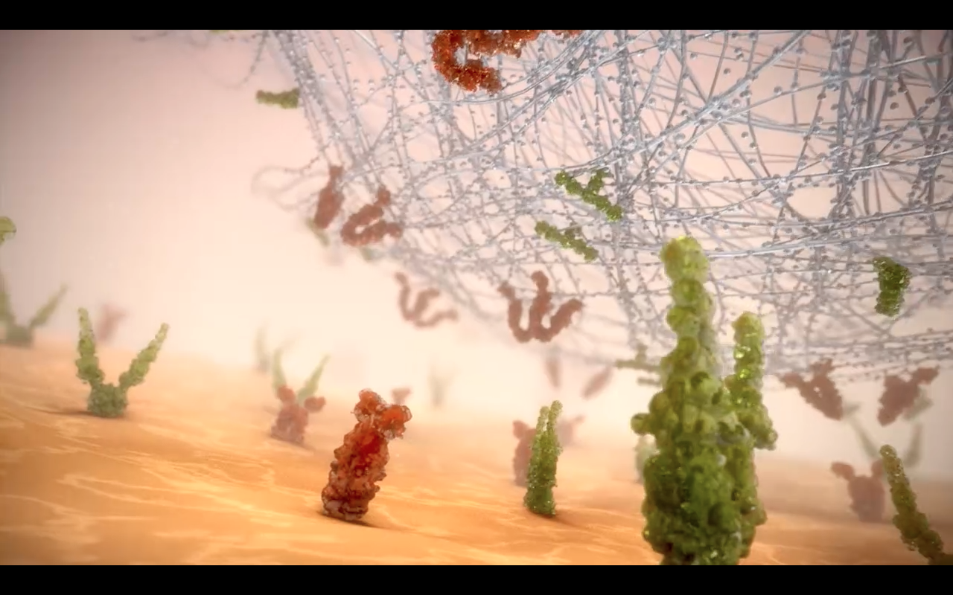
Notes:
This is how the company would like you to think of it working !

Slide 10
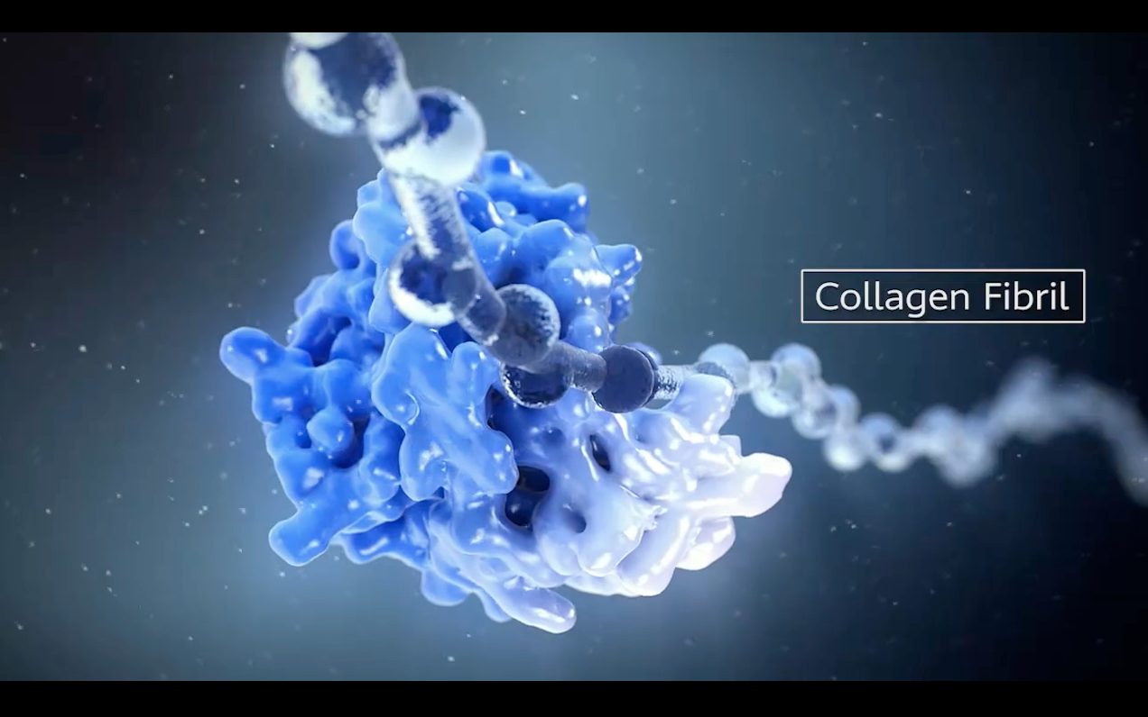
Notes:
Cuts vitreous collagen – leading to a degree of liquifaction of the gel

Slide 11
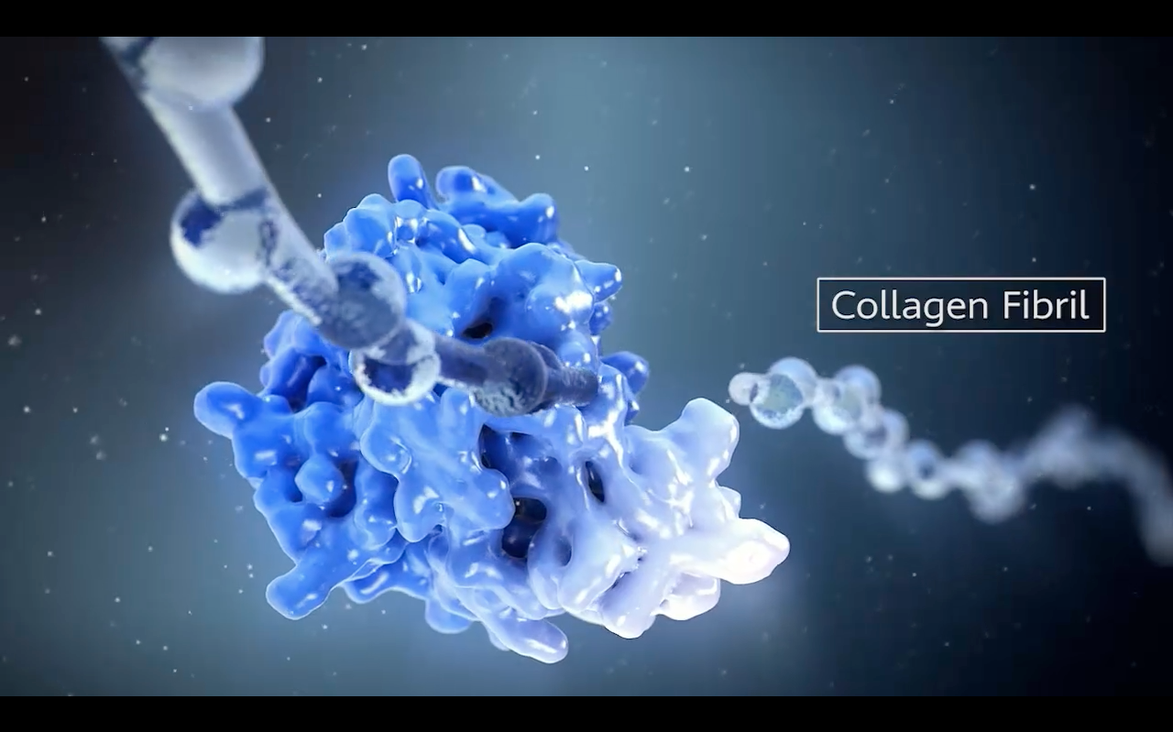
Notes:
Cuts vitreous collagen – leading to a degree of liquifaction of the gel

Slide 12
Notes:
Activates other metalloproteinases naturally present in the eye

Slide 13
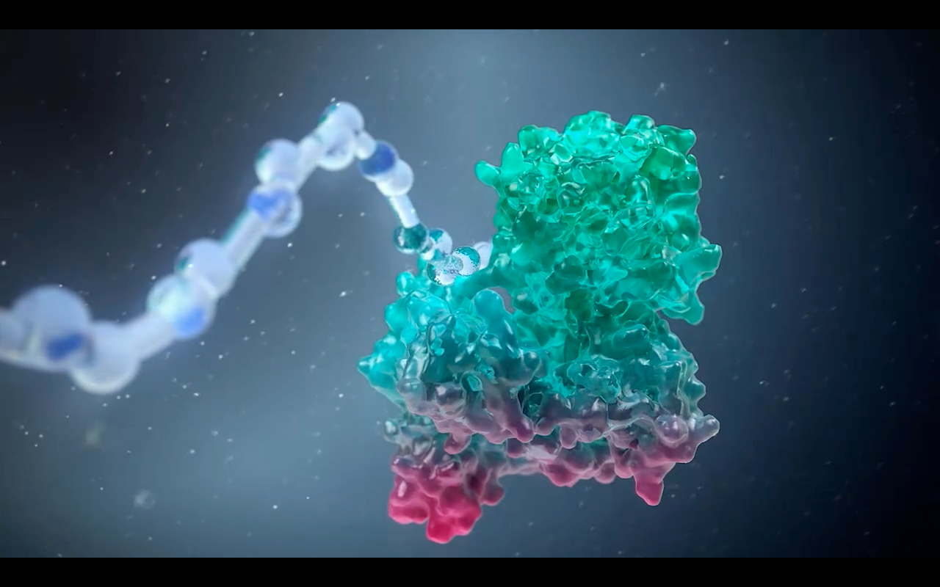
Notes:
Which go on to cleave other proteins ? Eg. Zonular fibres

Slide 14
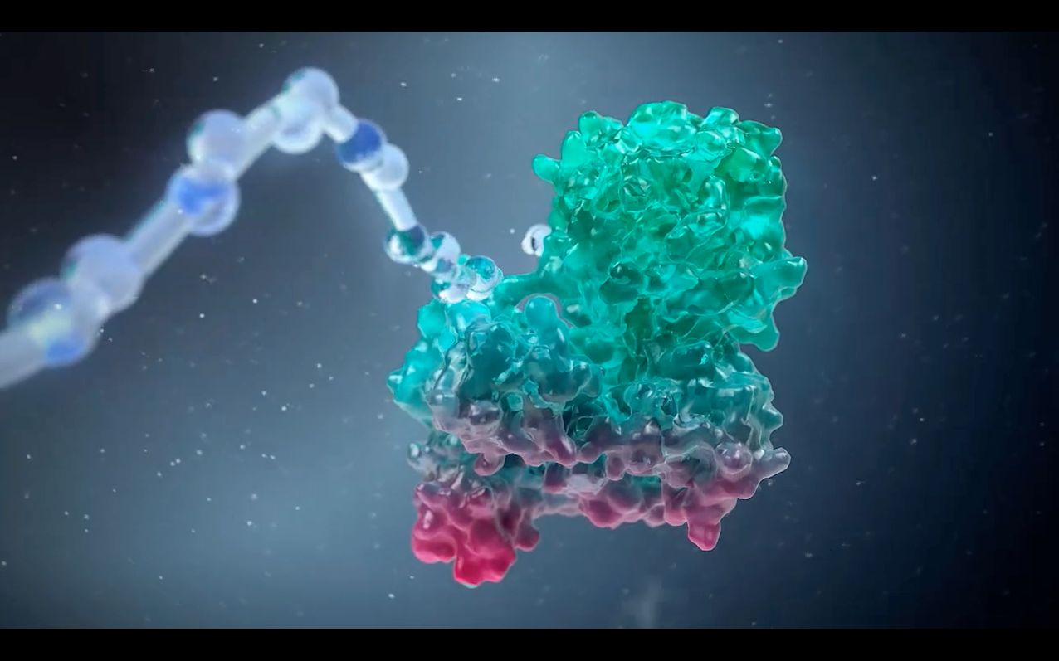
Notes:
Which go on to cleave other proteins ? Eg. Zonular fibres

Slide 15
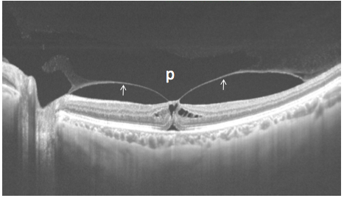
Itakura H. Ganka. 2013;55(4):321-330.
Focal VMT
This thin layer of vitreous has a lot to answer for….
VMT, MH, ERM, DMO
Notes:
Might think - so what - there’s a thin layer of vitreous so thin you can’t even see it during vity!
This slide shows that thin layer of gel (posterior wall of pocket)
Partially detached causing VMT

Slide 16
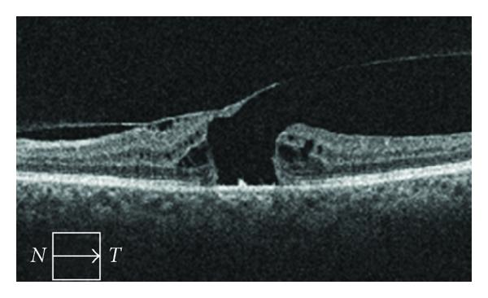
<400μm
Notes:
Important thing --- is there VMT?
i.e. vitreous traction at the edge of the hole

Slide 17
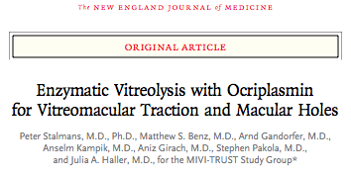
N Engl J Med 2012; 367:606-615
MIVI-006 & MIVI-007 RC Trials MIVI-TRUST study group (Microplasmin for Intravitreal Injection - Traction Release without Surgical Treatment)
^{Total of 652 eyes treated:}
^{464 with ocriplasmin}
188 with placebo + subsequent surgery if injection ineffective
^{Headline:}
VMA resolved in 26.5% Ocriplasmin (10.1% ^{placebo P<0.001).}
Macular Hole closure 40.6% Ocriplasmin (10.6% ^{placebo P<0.001).}

Slide 18
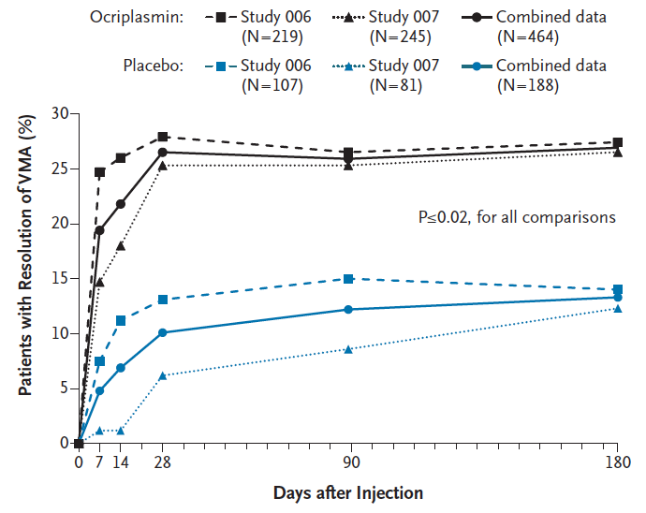
VMA resolution over time

Slide 19
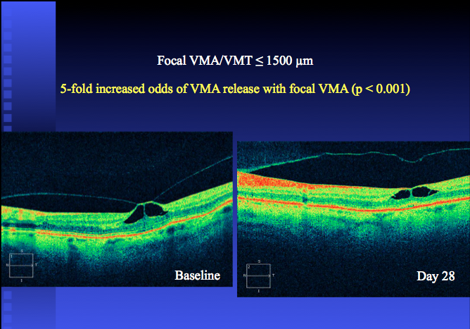
Focal

Slide 20
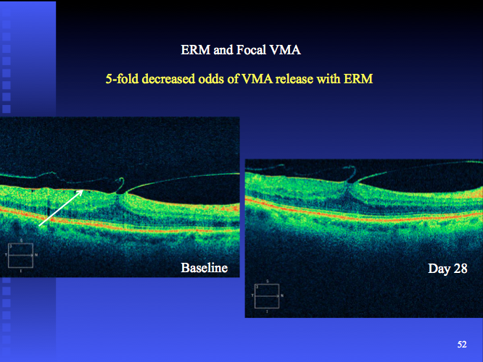
VMT

Slide 21
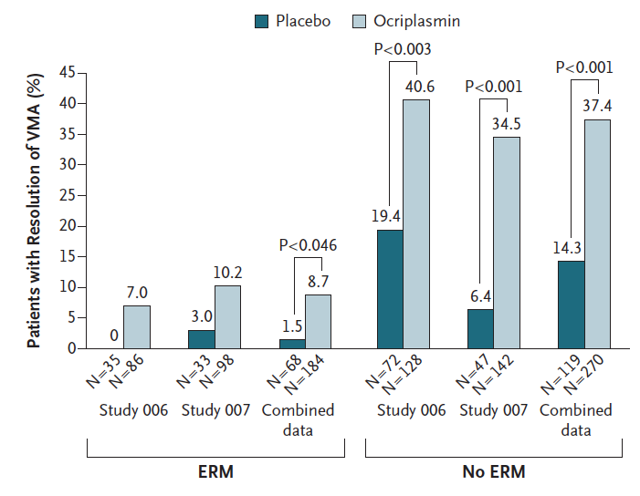
VMA resolution & ERM

Slide 22
4 Predictors of Response¹
Patients, %
Placebo
Ocriplasmin
P=0.007
P=0.009
P=0.005
P=0.098
P<0.001
Age
N=13
20
16
23
14
25
41
94
13
19
<65 yrs
<65 yrs
<65 yrs
No ERM
ERM at Baseline
No ERM
≤1500 μm
No ERM
≤1500 μm
VMA Diameter
≤1500 μm
Phakic
Lens Status
Phakic
Phakic
Phakic
1. Kupperman, B 2013 SOE
Notes:
Stalmans/2012/
pp. 609A;610

Slide 23
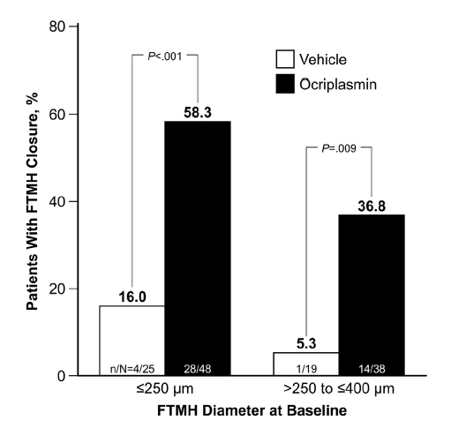
Proportion of Patients With FTMH Closure at Month 6 by Size at Baseline
PRAVIN U. DUGEL,
CARL REGILLO & DEAN ELIOTT
AJO 2015

Slide 24
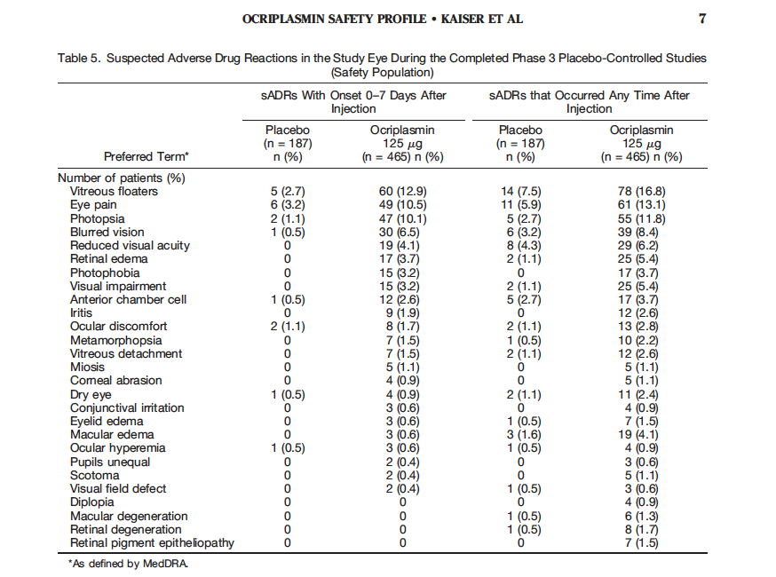

Slide 25
MIVI Trust – safety:
Retinal tears or detachment: 1.9% Ocriplasmin
4.3% placebo (P = 0.11)
HOWEVER, most of tears in placebo occurred during subsequent vitrectomy
Whereas 2 RDs in Ocriplasmin group occurred before vitrectomy = 0.4%
6.7% VMT converted to a FTMH following Ocriplasmin
9.3%¹ of MH closed by Ocriplasmin reopened – (rare following surgery)
¹AJO 2015 PRAVIN U. DUGEL, CARL REGILLO, AND DEAN ELIOTT

Slide 26
EYES THAT DID NOT ACHIEVE MACULAR HOLE CLOSURE¹
¹AJO 2015; PRAVIN DUGEL, CARL REGILLO, DEAN ELIOTT
Subsequent surgical outcomes:
Ocriplasmin group = 79% closed Placebo group = 89% closed
Not significant but weak signal suggesting possible –
impaired surgical closure following Ocriplasmin?

Slide 27
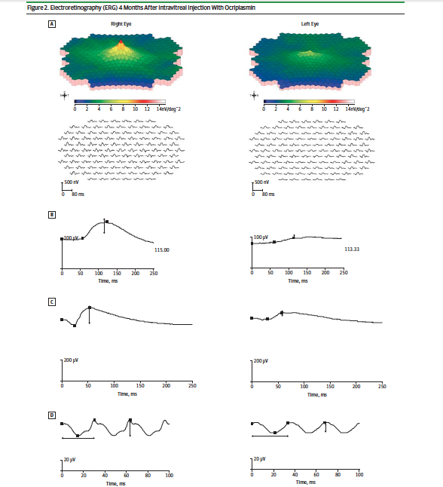
JAMA Ophthalmology April 2014, Vol 132:4

Slide 28
JAMA Ophthalmology April 2014, Vol 132:4

Slide 29
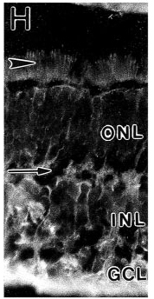
Retinal Laminin distribution
Laminin Expression in Adult and Developing Retinae. Richard T. Libby et al.
The Journal of Neuroscience, September 1, 2000, 20(17):6517–6528
Global protease activity?

Slide 30
Basal diameter

Slide 31
Basal diameter increased

Slide 32
Hole closure

Slide 33
5 months later

Slide 34
Bristol Case 2
67 year old female
Left MH – Ocriplasmin
Next day –
profound vision loss VA = PL
photophobia
complex ‘snow storm’ photopsia
RAPD

Slide 35
Bristol Case 2
Fundus • VF
Attenuation of vessels

Slide 36
Bristol Case 2
OCT – loss of ellipsoid layer
⬆Basal diameter
SRF around disc

Slide 37
Bristol Case 2
Day 15

Slide 38
Bristol Case 2
Week 4
Proceed to vitrectomy

Slide 39
Bristol Case 2
Week 6: Phaco vity + ILM peel + gas
On IOL insertion…
Full house
Keller J, Haynes RJ. Zonular Dehiscence at the Time of Combined Vitrectomy and Cataract
Surgery After Intravitreal Ocriplasmin Injection. JAMA Ophthalmol. 2015 Sep 1;133(9):1091-2.

Slide 40
Bristol Case 2
Hole closed. ERG “normal”. VA 6/15. VF recovered
Anecdotal low level evidence

Slide 41
prompted BEAVRS survey
31 consultant VR surgeons
241 cases
Incidence of side effects:
Profound visual loss
‘Snow storm’ photopsia
Dyschromatopsia
ERG changes
OCT changes
Enlargement of macular hole
Zonule dialysis
Retinal Detachment

Slide 42
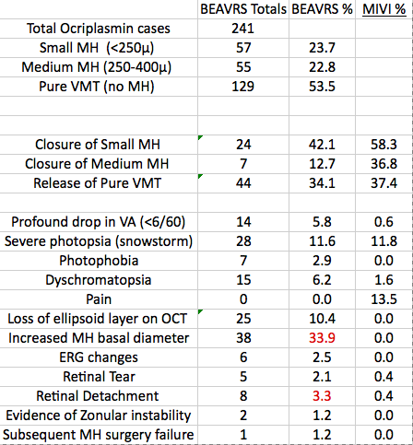
2014 BEAVRS survey
Incidence & severity
Spectral domain v Time domain OCT
8
Positive reporting bias?

Slide 43
All BEAVRS cases with a tear went on to develop an RD
(only 30-50% of naturally occurring tears cause an RD)
Does ocriplasmin increase the ease of detachment of the retina if a retinal tear develops?

Slide 44
Contrast with statements in literature:
- “Ocriplasmin seems to be a generally safe and well-tolerated”¹
- “Side effects related to ‘VMT release’ ¹
¹Retina. 2015 Jan 29. SAFETY PROFILE OF OCRIPLASMIN FOR THE PHARMACOLOGIC TREATMENT OF SYMPTOMATIC VITREOMACULAR ADHESION/TRACTION Kaiser, Kampik, Kuppermann, Girach, Rizzo, Sergott.

Slide 45
RETINA 0:1–7, 2014. SAFETY PROFILE OF OCRIPLASMIN FOR SYMPTOMATIC VITREOMACULAR ADHESION: A Comprehensive Analysis of Premarketing and Postmarketing Experiences Hahn, Chung, Flynn, Huang, Kim, Mahmoud, Sadda, Dugel.
- More circumspect
- Widespread ERG changes make ‘VMT release’ unlikely cause of side effects
- Global protease activity cause?
Qiu TG (2014) Ocriplasmin and Muller Glia. Adv Ophthalmol Vis Syst 1(1)
- Muller Glia disruption? ERG changes
(Only retinal cell capable of regeneration & ERG recovery)
Why such variation?
15 different Isoforms of Laminin – genotype may play role in susceptibility

Slide 46
So why is BEAVRS data so different?
Are UK VR surgeons so incompetent?
Positive reporting bias
Population differences?
MIVI – data excluded lattice & high myopia

Slide 47
So should we write-off Ocriplasmin?
Specific ‘niche’ indications
(Alcon itself would prefer)
Small area of VMT attachment / Small MH
Patients with aversion but not absolute contraindication to surgery
(3% RD 6.7% MH)

Slide 48
Better to think of Ocriplasmin more like a surgical intervention:
Similar side effects & risk profile to vitrectomy
(Very different to other intraocular injections like Lucentis that are relatively free of side effects)
Counsel patients on this basis

Slide 49
Grazia Thank you

