Slide 1

Dall’adaptive licensing all’adaptive reimbursement
Prof. Americo Cicchetti
Direttore dell’Alta Scuola di Manegement Sanitario
Catania, 18 Febbraio 2016

Slide 2

Problematiche relative al settore farmaceutico in Italia
La pipeline industriale è ricca di nuove soluzioni con un rilevante impatto potenziale sul budget;
I farmaci biotecnologici rappresentano oggi il 20% di quelli in commercio e il 50% di quelli in fase di sviluppo;
Prezzi dei medicinali più bassi del 15%-20% rispetto agli altri Paesi;
Dopo una prima ondata di generici ora siamo in “attesa” dei biosimilari
Sviluppo di schemi di pagamento condizionato;
Necessità di metodi per la valutazione dell’innovazione;
Revisione del sistema del tetto globale;
La sfida è la sostenibilità del sistema

Slide 3
Le sfide per il regolatorio e l’HTA nei farmaci
Regulation
Post-introduction
Innovation
Phase I / II
Phase III
Phase IV
Provision
Regulatory bodies
Reimbursement
Delisting
Technology Prospection
Gap
Help and consultancy on innovation
Horizon Scanning
Disinvestment
Health Technology Assessment
RCTs
Real world evidence generation

Slide 4
Le sfide per il regolatorio e l’HTA nei farmaci
Gestire l’incertezza
  I managed entry agreements (MEA)
Pagare in base al “valore” (VBP)
  Definire il valore (quali dimensioni?)
  Misurare il valore (quali studi, quali evidenze, quali endpoints)
  Decidere sulla base del valore (scientific uncertainty, value judgements; processi deliberativi o algoritmi; ruolo degli stakeholder, thresholds)
Accelerare introduzione di soluzioni di valore
  Adaptive licensing (Eichler et al., 2012)
  Dal prodotto alla soluzione terapeutica (il processo)
  Valutazione lungo il ciclo di vita (coverage, renewal, withdrawal)

Slide 5
Le sfide per il regolatorio e l’HTA nei farmaci
Dati real world - Health Systems
I managed entry agreements (MEA)
Value based Pricing
Adaptive licensing

Slide 6
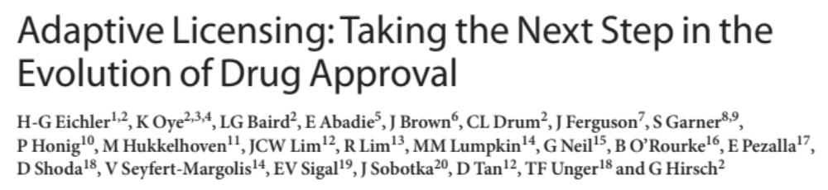
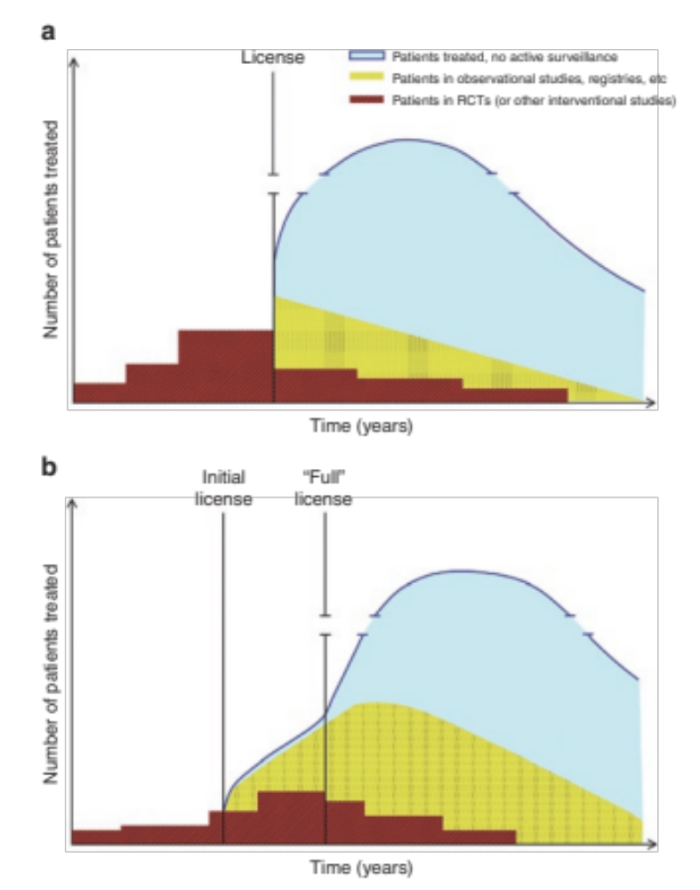
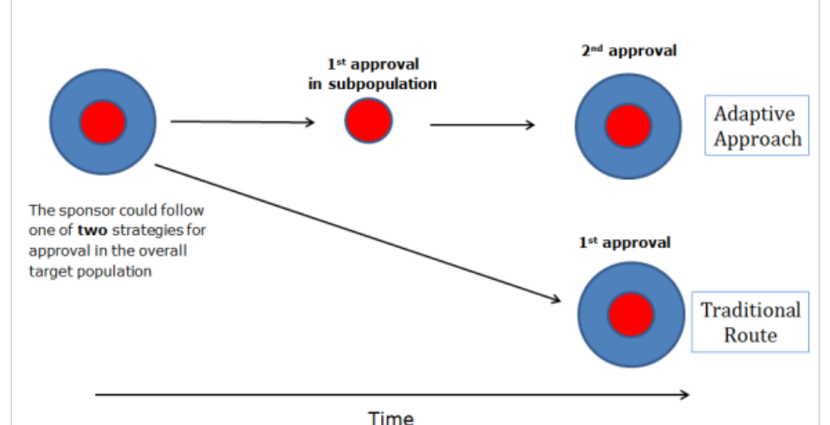

Slide 7
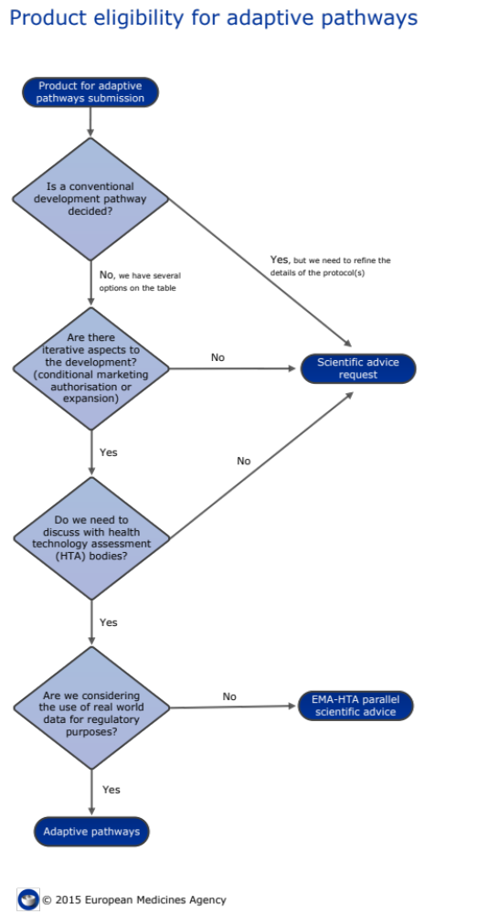
In June 2014, the Agency selected the first two medicines. The criteria used to select promising candidates for the pilot project include:
unmet medical need of patients likely to be addressed by the medicine;
early stage of clinical development to enable actionable input from relevant stakeholders;
positive prospects that regulatory requirements for expansion from a restricted indication to broader populations can be fulfilled (in terms of population or use);
potential for use of real-world data to substitute or supplement data from randomised clinical trials in fulfilling requirements for the expansion.
    http://www.ema.europa.eu

Slide 8
Dall’Adaptive licensing agli “adaptive patways” (esperienze attuali)
There are already several approaches to health technology regulation and reimbursement that harbor one or more key features of an adaptive approach. For regulators, these include:
  conditional approval processes, where a new technology is granted approval to license a product in a market conditionally on a promise or requirement to collect further evidence (Accelerated approval pathway dell’FDA basato su end-points surrogati);
  priority approval, where a technology of particular importance or need is given faster approval (FDA “fast track”);
  special approval, where temporary or specific access to therapies is given to patients for drugs that do not have or are under consideration for marketing approval (L. 648 in Italia; Autorisations Temporaires d’Utilisation in Francia, Special Access Program in Canada).

Slide 9
Considerazioni iniziali
L’approccio rivoluziona sostanzialmente il tradizionale modello regolatorio;
Assegna un ruolo chiave a nuove modalità di raccolta delle evidenze;
Implica una maggiore integrazione tra le attività regolatorie e le attività clinico-assistenziali dei sistemi sanitari;
La valutazione avviene lungo il ciclo di vita del prodotto e impone una forte sinergia con le attività di HTA riferite alle “terapie” (ruolo dei PDTA crescente);
Impone modifiche ai sistemi informativi sanitari;
Ridistribuisce i rischi finanziari tra l’industria e i payer;
Genera sfide sotto il profilo della sicurezza dei pazienti;
Viene incontro alle “speranze” dei pazienti;
…..

Slide 10

Dall’Adaptive licensing agli “adaptive pathways” (potential benefits)
Regulators - may provide a way to balance the dual (and potentially conflicting) role of regulators as gatekeepers and enablers by allowing a lifecycle approach to drug regulation;
Payers and HTA Bodies - There is a potential for efficiency gains if the different information requirements from payers and regulators are merged through an adaptive approach.
Clinicians and Care Providers - Adaptive approaches may allow for access to be linked more clearly to perceived clinical need and provide more choices for providers to help patients
Patients - Earlier access and evolving information on benefits and harms arising from adaptive licensing would, in theory, allow for better-informed decisions to be made by patients about their care
Industry (Drug and Biologics) - The combination of earlier market access, and insights on the products viability could reduce development costs and possibly speed up returns on investments for medicines.

Slide 11
Dall’Adaptive licensing agli “adaptive pathways” (un imperativo…)
Adaptive licence
Adaptive price-riembursement
Patient access

Slide 12
Dall’adaptive licensing al dynamic price and reimbursement (le sfide)
Quali dimensioni della valutazione nel “mondo reale”?
Safety, effectiveness, budget impact, CEA, ecc.)
Quali studi? Quali evidenze?
Dagli RCTs a… registri europei
Quando e quali dati devono essere disponibili?
Implicazioni istituzionali e legali (es. proprietà dei dati, consenso informato, ecc.)
Quali effetti per l’organizzazione dei sistemi sanitari?
Dai “silos” ai processi, responsabilità dei professionisti, ecc.
Quale integrazione con l’HTA e i payers?
Staffetta o o “sci paralleo”?
Chi paga?
Potenziale “cost shifting” dell’investimento

Slide 13
Cosa servirebbe?
Early dialogue
Evidence generation & registri europei
Sviluppo dell’HTA post marketing (EUNetHTA)
Managed entry schemes condivisi

Slide 14
Multi HTA Early Dialogues in EU-sponsored projects 2012 - 2015
Total number of EDs: 24 instead of the 4 initially planned in 2012
  EUnetHTA:
  2 on Medical Devices
  11 on drugs (no parallel with EMAEMA observer in some)
  SEED:
  3 on Medical Devices
  8 on drugs (4 HTA only, 4 parallel EMA-SEED)

Slide 15


Continuous improvement of EDs
through EUnetHTA and SEED
JA1
2 preparatory early dialogues
ED procedure drafted for JA2
Draft ED procedure in JA1 used for 8 ED pilots
ED survey conducted after first 6 ED pilots
Refined ED procedure produced following WP7 FtF meeting (Jan'14) based on discussion (taking into account survey results)
JA2
Revised JA2 EUnetHTA ED procedure used as the basis for SEED
ED procedure further amended (Nov’14) and progressively introduced with SEED’s 8th ED
Conducted 9 EDs to date (6 drugs / 3 medical devices)
10th ED planned in March ; additional 11th ED planned in June
SEED
JA2
1 ED ongoing (medical device in heart disease)
2 additional EDs budgeted; June and Sept 2015

Slide 16


Slide 17
1st approval
Regulation
Post-introduction
Innovation
Phase I / II
Phase III
Phase IV
Provision
Regulatory bodies
Reimbursement
Delisting
Technology Prospection
Gap
Help and consultancy on innovation
Horizon Scanning
Disinvestment
Health Technology Assessment
RCTs
Real world evidence generation

Slide 18

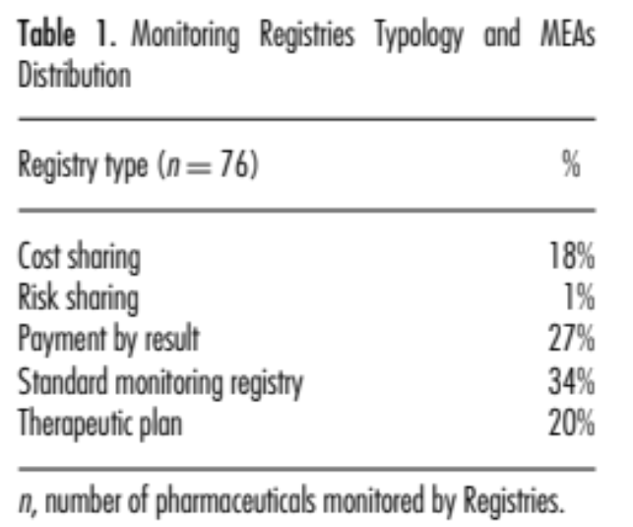
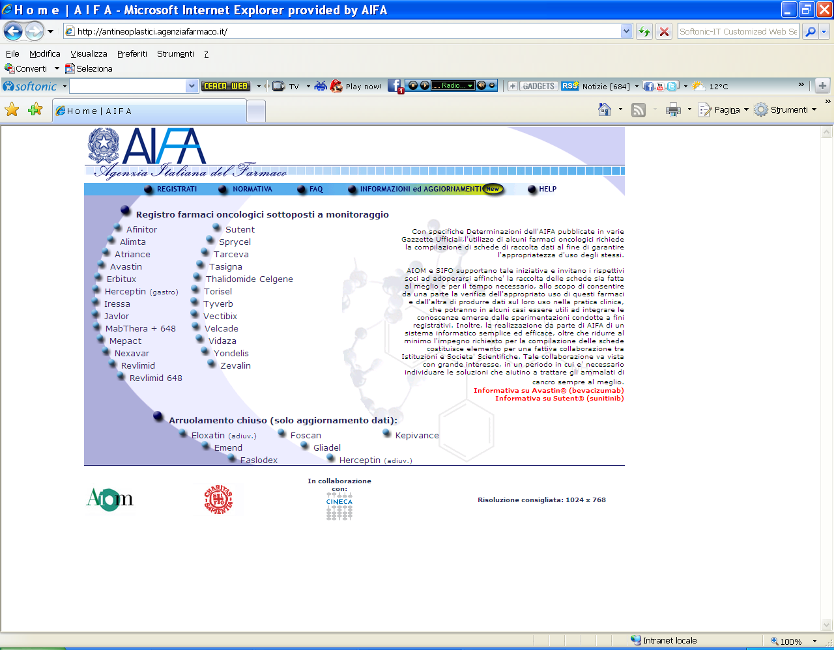
I registri di monitoraggio di AIFA

Slide 19
EDs in Joint Action 3 on HTA: 2016-2019
Work package on evidence generation
  Early Dialogues
  Quality of registries for HTA
  Pilots on Additional evidence generation
Development of a fee-for-service system?
How to meet the needs of the MedTech industry?

Slide 20

I registri europei
EU PARENT PROJECT (2012-2015)
JA3
Development of quality standards for European Registries
WP7 Coordinator: NICE (Agenas)
2019
STABLE SYSTEM FOR EUROPEAN REGISTRIES

Slide 21
JA - Joint Action 3 on HTA: 2016-2019
Work package 4 on Joint Production
  75 partners
  20 million €
  50 Joint Assessments or Collaborative Assessments
Work Package 7 on National, regional, local adaptation

Slide 22
MES Condivisi
A range of approaches:
the Italian Experience
Reimbursement (without conditions)
Managing budget impact
Managing uncertainty relating to clinical benefit and cost-effectiveness
Managing utilisation to optimize performance
Refusal
Non-Outcome based MEAs
Monitoring Registers
Outcome based MEAs
Therapeutic plan
Volume Agreements
Oncologicals
AIFA Notes
Orphan drugs
Payment by Results
Cost sharing
Antipsoriasis
Risk Sharing
Budget cap
Psoriasis
Antidiabetics
Antidiabetics
Cardiovascular
Cardiovascular
Antirheumatics

Slide 23
Cosa servirebbe?
Early dialogue
Evidence generation & Registri Europei
Sviluppo dell’HTA post marketing (EUNetHTA)
Managed entry schemes condivisi
Politica europea del farmaco

Slide 24


Slide 26

XIV Annual Meeting
Rome 17th – 21st June 2017 (Ergife Palace Hotel)
Towards an HTA eco-system: from local needs to global opportunities
Hosted by:
Italian Society of Health Technology Assessment (SIHTA)

