Slide 1

I farmaci innovativi in una prospettiva europea
Giuseppe M.C. Rosano, MD, PhD
Cardiovascular and Cell Sciences Research Institute,
St George's University of London

Slide 2
Declaration of interest
No competing interest to disclose

Slide 3
Innovative therapies
New advanced therapies (genetic, small molecules, biologicals), targeted therapies, new drug design
Mechanism of action
Effectiveness
Orphan and rare diseases

Slide 4
Emerging therapies and technologies and borderline therapeutics
Emerging therapies include:
- gene therapy, cell therapy and engineered tissues, new targeted therapies, nano-medicines, novel routes of administration and delivery systems.
Emerging technologies include:
- new development strategies (e.g. genomics or proteomics surrogates), new definitions of target populations (e.g. pharmacogenomics), new manufacturing approaches
Borderline therapeutics include:
- combination of pharmaceuticals and devices, medicinal products borderline.

Slide 5
Innovative therapies
Shall we always consider the type of drug and the mechanism of action as innovation if it does not translate into a significant benefit?

Slide 6
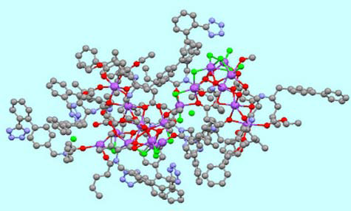
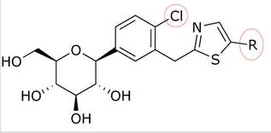
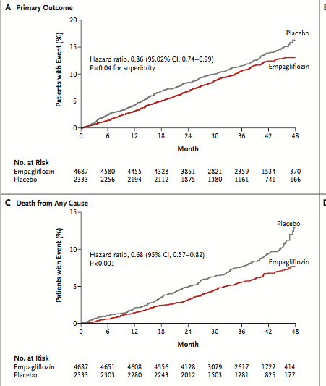
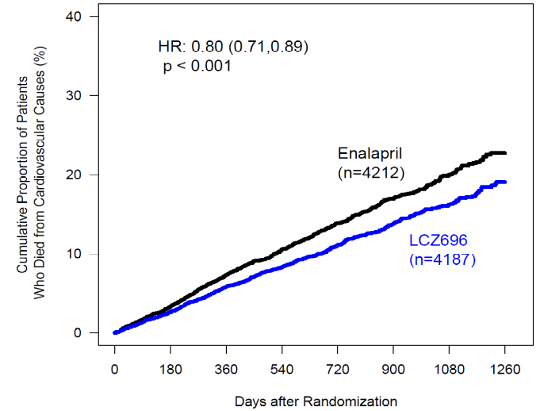
Innovative therapies
Death from CV causes
20% risk reduction

Slide 7
Strategic priorities for regulatory agencies
Address medical needs
Facilitate the development of new methods for drug development and approval
Ensure an efficient regulatory approval process
Improve the quality of information for regulatory decision making about medicines
Improve the quality of the regulatory decision making process for medicines
Strengthen post approval safety monitoring of medicines

Slide 8
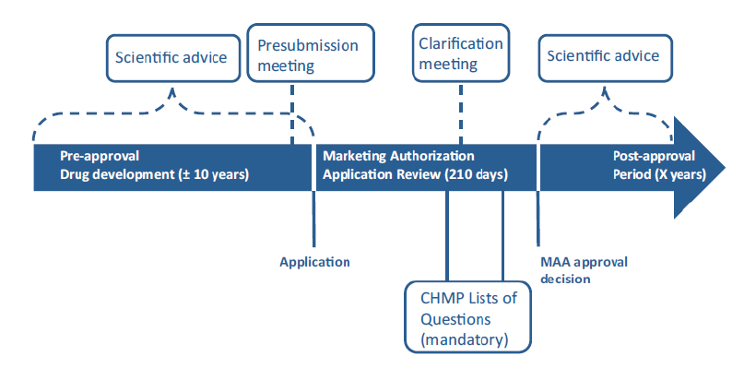
The regulatory time-frame is not a limitation to innovation

Slide 9
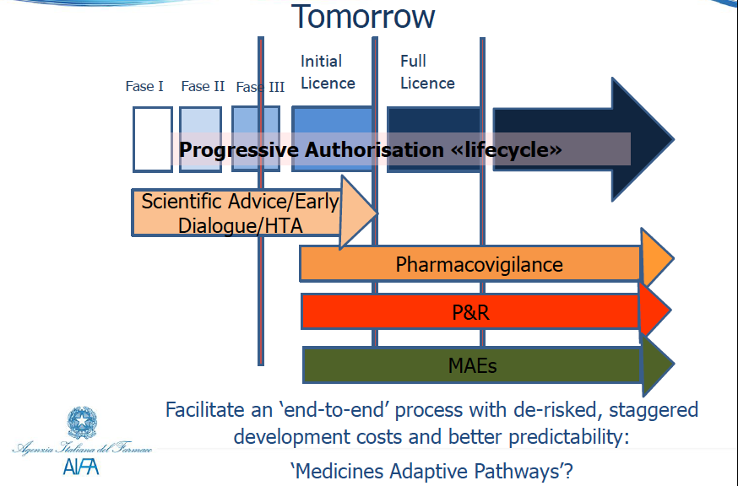
Regulatory hurdles are a limitation to innovation

Slide 10
Regulatory requirements and innovation
Requirements are different for different therapeutic areas
Some areas like oncology and some infectious diseases are given a preferential approval route while other therapeutic areas have to confront with long development programmes
Some drugs are approved on the basis of a biomarker that has been repeatedly shown to be inadequate

Slide 11
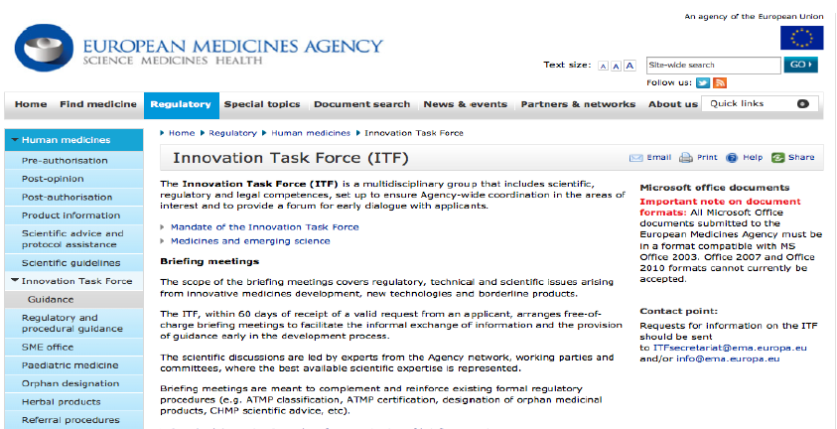

Slide 12
Innovation Task Force
The Innovation Task Force (ITF) is a multidisciplinary group that includes scientific, regulatory and legal competences.
It was set up to ensure coordination across the European Medicines Agency and to provide a forum for early dialogue with applicants.

Slide 13
ITF a platform for discussing a wide range of topics
Borderline products
Preclinical and in vitro models
Advanced therapies
“-omics”
Synthetic Biology
Biomarker Qualification
Adaptive designs
Methodologies and Statistics
Nanopharmaceuticals
Epigenetics
Notes:
In particular
Products intended for the centralised procedure
Emerging therapies and New therapies
Safety aspects
Conditional marketing authorisation
Exceptional Circumstances
In the context of WHO opinion
Significant clinical benefit for orphan drugs

Slide 14
Benefit of ITF interaction
Start the dialogue with the Agency
Facilitate knowledge exchange on innovative strategies: update on progress, address new science and question to regulators, understand concerns and prepare for possible solutions
Provide orientation on hot regulatory topics in drug development
Identify issue of particular interest to regulators in preparing for formal procedures (e.g. biomarkers qualifications, scientific advice, notes for guidance etc)

Slide 15
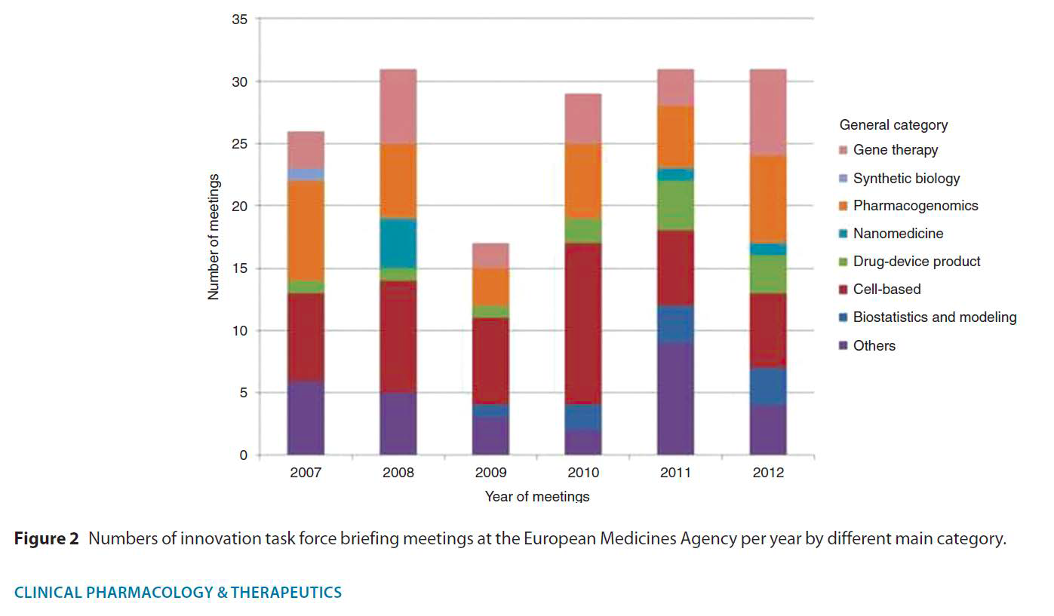
Type of innovative medicines submitted to EMA

Slide 16
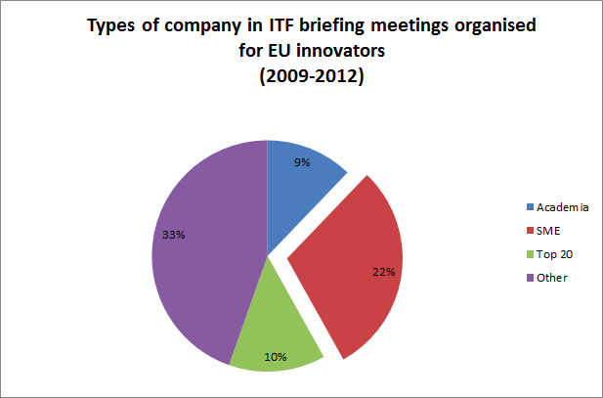
Types of companies in ITF meetings

Slide 17
    Need to improve R&D and regulatory processes for new therapies
    Biomarkers – Critical Markers of Disease
    Surrogate endpoints with adeguate pharmacovigilance
    Adequate notes for guidance with innovative designs
    Personalised Medicines
    Nanotechnology

Slide 18
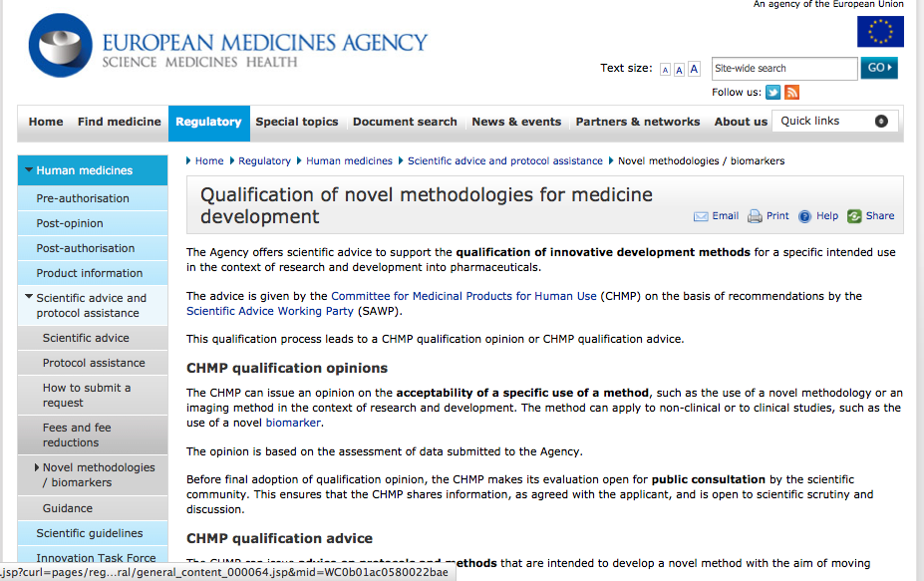

Slide 19
EMA Qualification of Novel
Methodologies for Drug Development
  Scientists in universities, consortia and companies need to discuss with regulators early to achieve a common understanding on what is needed to qualify a novel methodology in terms of regulatory approval
  The regulatory requirements should be up to date with the progress in science
  January 2009: EMA guidance on the qualification of novel methodologies including biomarkers, imaging techniques, new non-clinical models, new statistical approaches

Slide 20
ITF briefing meetings
• Objective: facilitating the informal exchange of information and guidance in the development process, complementing and reinforcing existing formal procedures
• Scope: regulatory, technical and scientific issues arising from innovative medicines development, new technologies and borderline products
• Applicants: Consortia, Networks, Public/private partnerships, Learned societies, Pharmaceutical industry, Academia
• Free of charge
• Scientific discussions led by experts from the Agency network, working parties and committees
• For pharmacogenomics, with PG Working Party

Slide 21
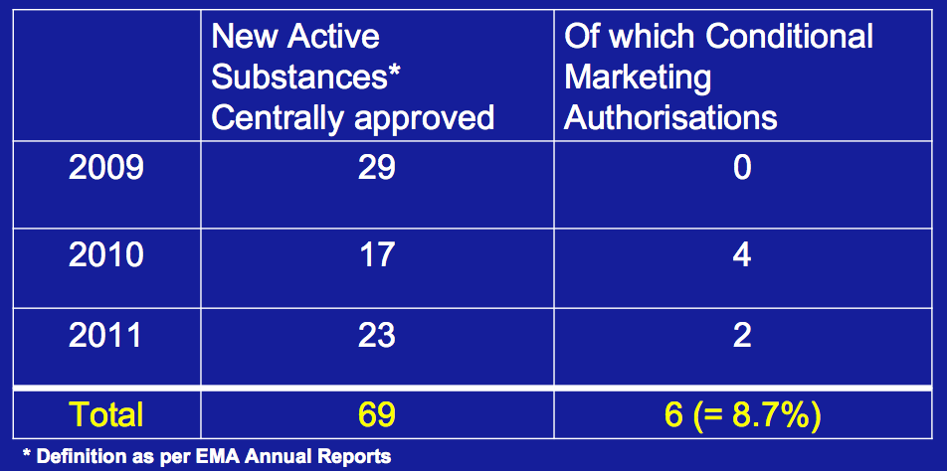
Conditional Marketing Authorisation

Slide 22
EMA path to adaptive licensing
IMI
EU-EFPIA
Conditional Marketing Authorization
New Pharmacovigilance legislation
Risk Management Plans
Periodic Safety Update Reports
Five-year renewal of MA
Compassionate use programs
Adaptive licensing pathway

Slide 23
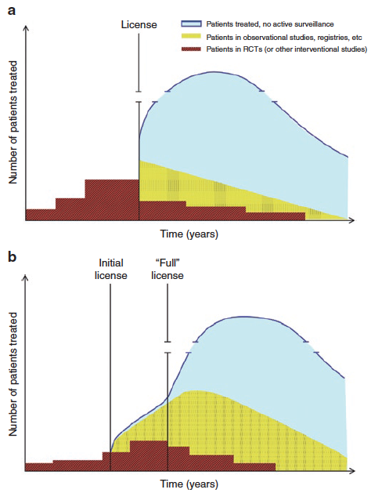
Adaptive licensing and control of SAEs

Slide 24
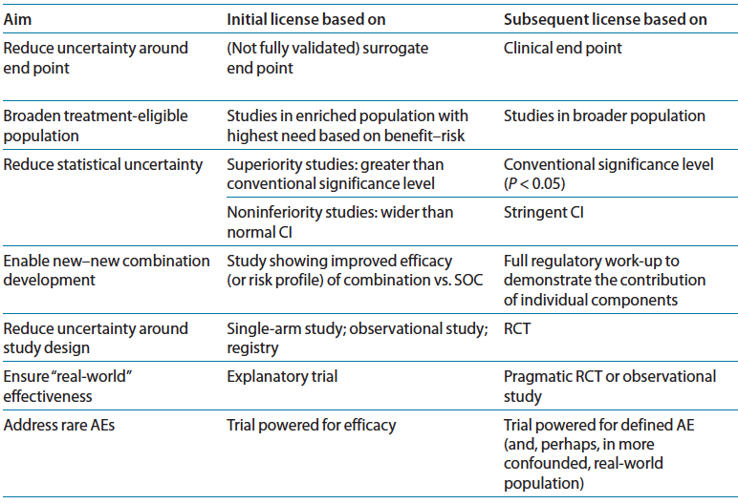
Potential design features of AL pathways
Eichler HG et al Clin Pharm Ther 2012; 91: 426-437

Slide 25
Obstacles to Adaptive Licensing
Concerns over lowering standards
Getting commitment from industry to conduct “stage n+1 studies”
Feasibility of follow-on studies after “loss of equipoise”
Alignment between regulators and payers
Ensuring appropriate prescriptions

Slide 26
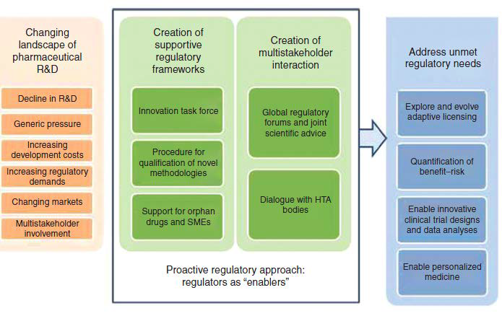
EU Regulators answers to innovation

Slide 27
Success is not when we have the product on the shelf, but when it is available to all patients that may benefit from it

