Slide 1
Neuroscienze in tribunale
Impieghi e limiti dell’approccio neuroscientifico in ambito giuridico
Massimiliano Oliveri, MD PhD
Dipartimento SPPF UNIPA

Slide 2
“Ideologies, philosophies, religious doctrines, world-models,
value systems, and the like will stand or fall depending on the
kinds of answers that brain research eventually reveals. It all comes together in the brain” (Sperry, 1981: 4)

Slide 3
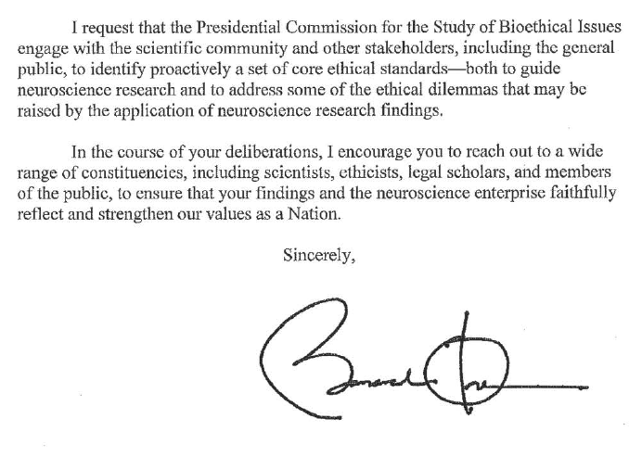

Slide 4


Slide 5
“Based on the modern understanding of neuroscience and on the
assumptions of legal concepts, I believe the following axioms:
Brains are automatic, rule governed, determined devices, while people are personally responsible agents, free to make their own decisions”

Slide 7
morality as the sets of customs and values that are embraced by a cultural group to guide social conduct

Slide 9
Traditional view of rational vs. emotional responses
Difficult moral decisions associated with response conflict, leading to a competition between “emotional” (limbic) and “cognitive” brain regions (isocortical, especially the
prefrontal cortex)

Slide 10
New view of rationale and emotional responses embedded in decision making
Emotion and cognition are nondissociable elements underlying moral motivations, and such motivations are represented within corticolimbic neural assemblies

Slide 11
PFC–limbic networks would help in attaching value to whichever behavioral options are contemplated during decision making

Slide 12
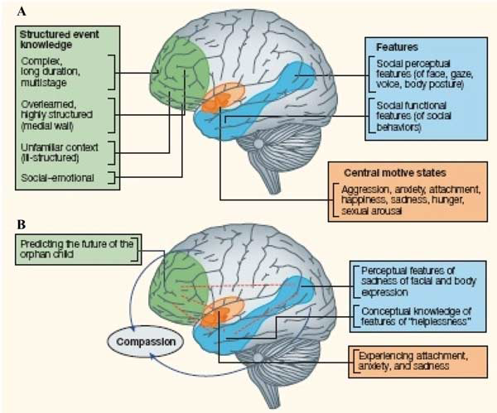
Event Feature-Emotion Complex (EFEC) framework

Slide 13
Lesion and Functional Imaging Evidence on the Neural Bases of Morality

Slide 14
Consequentialist ethics: judges the acceptability of actions based on their outcomes - killing one to save five -; model-based decision making
Deontological ethics: judges the acceptability of actions according to a set of rules; model-free decision making – desirable vs. undesirable outcomes in the past

Slide 15
Lateral and medial sectors of the orbitofrontal cortex (OFC), FPC, STS, and aTL: deontological judgments
Lesions of the PFC, serotonin and stress increase deontological judgments
Lesions of the VMPFC :these patients endorse “utilitarian” decisions in high-conflict scenarios—highly emotionally aversive choices that would nonetheless lead to greater aggregate
welfare (e.g., more lives saved)—much more
often than control subjects did.

Slide 16
The ‘somatic marker model’ suggests that moral
reasoning relies on both rational/conscious and emotional/unconscious processing in the ventromedial prefrontal cortex

Slide 17
Social Attachment and Prosocial Motivations: midbrain ventral tegmental area and ventral striatum
Role of Oxitocyn: OT is released during positive social interactions and has been shown to inhibit defensive behaviors, such as fighting, fleeing, and freezing.

Slide 18
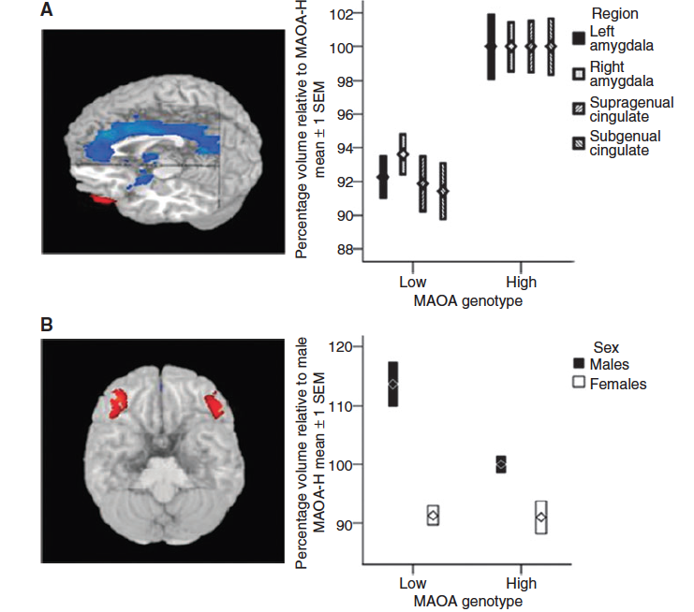
Correlation between the MAOA polymorphism and brain structure and function assessed with MRI in healthy humans

Slide 19
Testosterone/Cortisol ratio
When high testosterone is combined with low cortisol,
aggression is unmanageable and the subject could become a danger to society

Slide 20
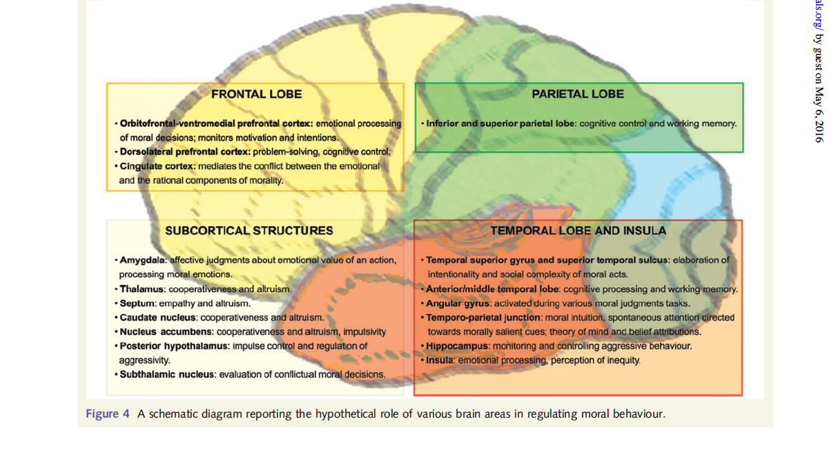
Hypothetical role of various brain areas in regulating moral behaviour

Slide 21
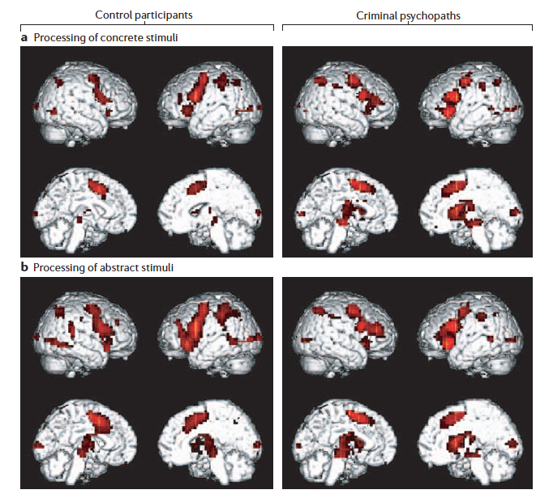

Slide 22
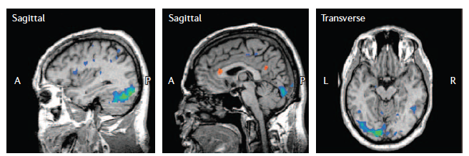

Slide 23
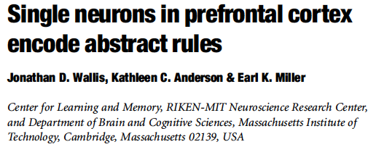

Slide 24
Behaviour-guiding rules are lost after damage to the PFC

Slide 25
The Problem of Free Will

Slide 26
The brain initiates a movement before awareness of volition

Slide 27
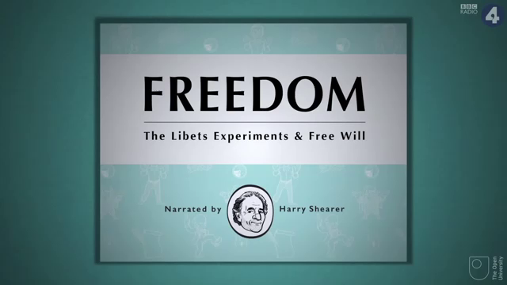

Slide 28
Cerebral initiation of a spontaneous, freely voluntary act can begin unconsciously, that is, before there is any subjective awareness that a ‘decision’ to act has already been initiated cerebrally” (Libet, Gleason et al., 1983)

Slide 29
“We are deceived at every level by our introspection.”(Crick, 1994)

Slide 30
Free will can be alternatively viewed as “the awareness that we choose to decide”

Slide 31
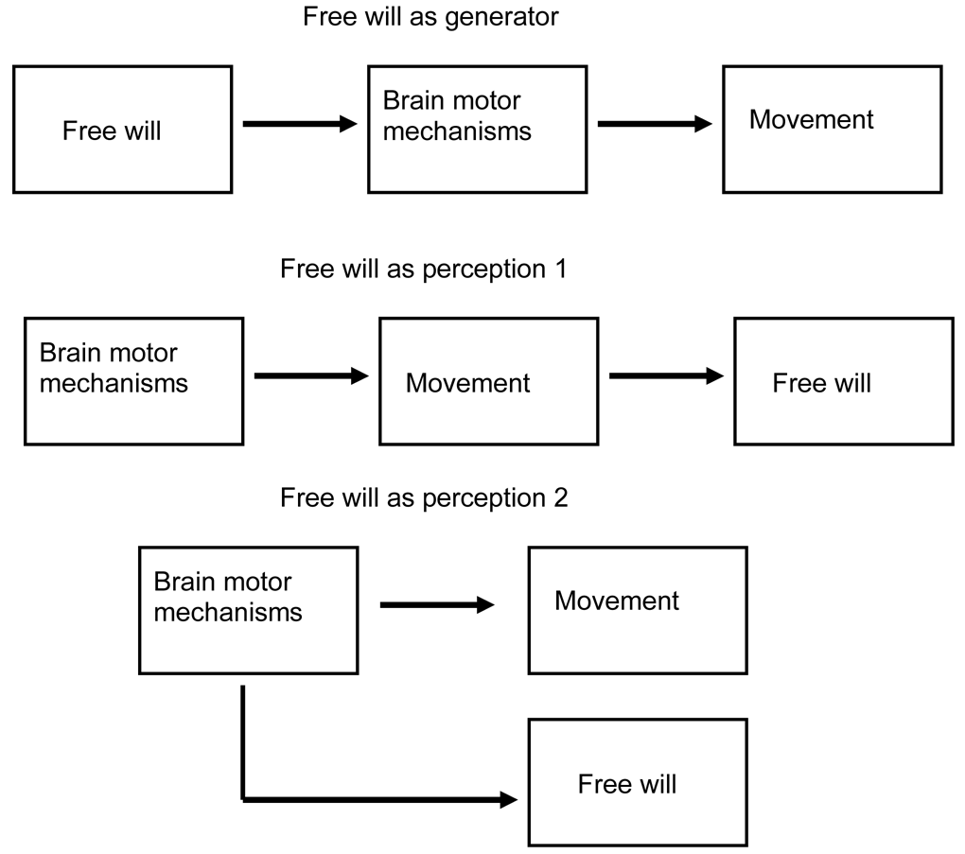

Slide 32
Criticisms of the “Libet clock” experiment

Slide 33
The movement was indeed initiated subconsciously, but subject to veto once it reached consciousness. This veto power should be considered free will

Slide 34
Intention appears to bind the movement and consequence closer together

Slide 35
To have the sense of causality of volition, the perception of choice must precede the movement. That W precedes M (using the Libet terminology) is absolutely critical for people to believe that a movement is voluntary

Slide 36
Neurologic disorders of will

Slide 37
Tics, Abulia, Alien hand syndrome

Slide 38
In schizophrenia, there is often the subjective impression of the patient that their movements are being externally (or alien) controlled.
The interval between W and M is shorter than normal in patients with schizophrenia.

Slide 39
How can there be (voluntary) movement without free will?

Slide 40
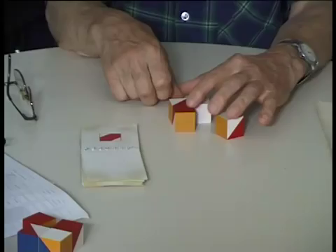

Slide 41
The DLPFC is associated with selection of either type, but the pre-SMA is specifically associated with the free selection

Slide 42
The self-initiation of movement and conscious awareness of movement appear to involve mesial motor structures

Slide 43
A local brain event becomes a quale when it accesses a more global network

Slide 44
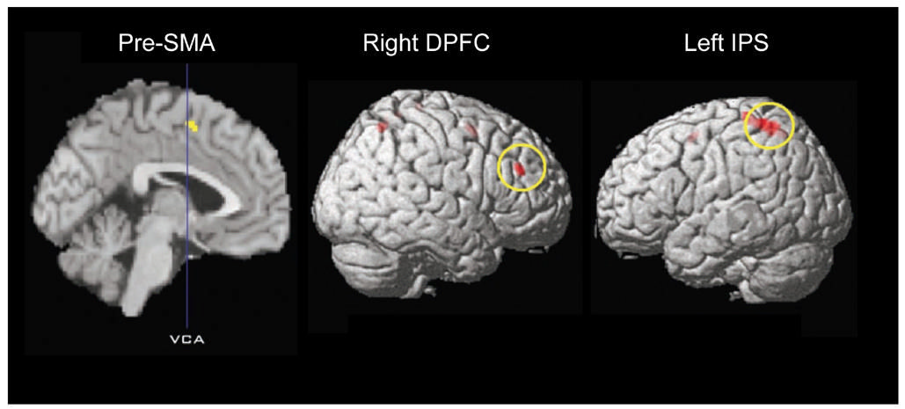

Slide 45
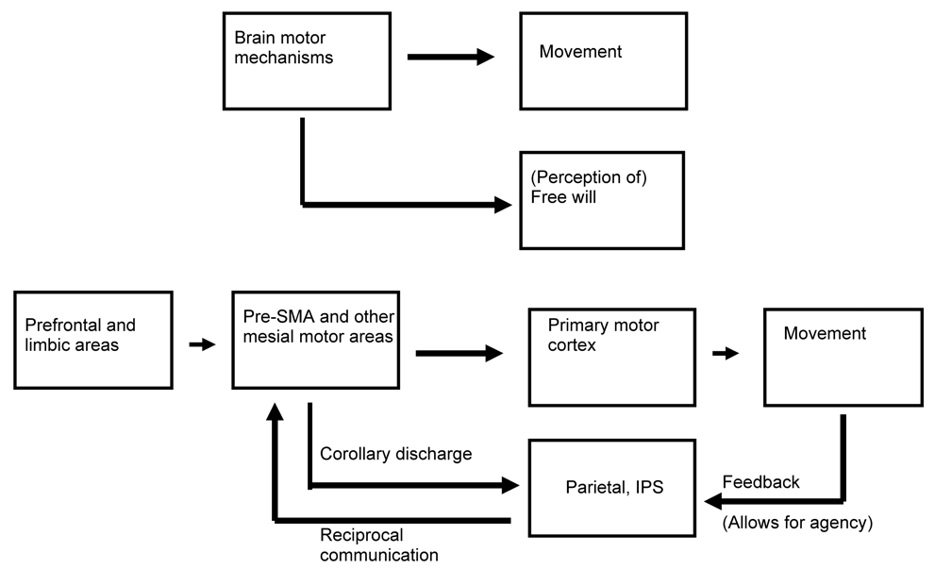

Slide 46
Consciousness tries to make logical sense of all the brain events in terms that it understands such as causality and the unidirectional nature of time

Slide 47
Free will exists, but it is a perception and not a force driving movement. If there is no free will as a driving force, are persons responsible for their behavior? This appears to be a difficult question, but it is really not. It is difficult only for the dualist
A person’s brain is clearly fully responsible, and always responsible, for the person’s behavior

Slide 48
The rules of the physical world, as specified by contemporary (orthodox quantum) theory, explain how the brain is governed in part by the brain and in part by our conscious choices, which themselves are not governed by any known laws.
There is no difficulty in reconciling the fact that an agent’s
brain is “determined” with the fact that this agent’s person is “free”: the agent’s brain is determined partly by his brain and partly by his conscious free choices, and hence the person whose actions this brain controls is likewise jointly controlled by these two factors, neither of which alone suffices.

Slide 49


Slide 50
criminal responsibility
prediction of criminal behavior
The Law and Neuroscience Project
treatment options
use of neuroscience in legal decision making

Slide 51
Can genetics or neuroimaging studies predict violence or sexual offending;
or suggest forms of ‘treatment’ to reduce the likelihood or degree of violence of a potential perpetrator?
Can they predict a defendant’s ‘treatability’;
or assist in determining whether he/she is lying, or is expressing a ‘false memory’?
Can they determine the degree to which urges are ‘resistible’, or otherwise assist in determining the level of responsibility of a perpetrator;
Or inform whether a defendant ‘intended’ to do what he did?

Slide 52
Criminal Responsibility

Slide 53
‘it wasn’t me, it was my brain’.

Slide 54
the ‘‘work’’ in the brain happens before we are consciously aware
of our mental struggles
responsibility reflects a rule, a rule that emerges out of one or
more agents interacting in a social context.
Responsibility is not in the brain; it is in the social contract.
specific brain circuits are involved in certain moral judgments. If these circuits are impaired, should such a person be excused under several insanity doctrines as incapable of knowing right from wrong?
we are the law.’’ Our view of what it means to be human is changing,
and our view of justice will likely change in conformity with it.

Slide 55
Legal Decision Making

Slide 56
Should information on the specific physical states and capacities of individuals be evaluated by the judge or by the jury?
Is such information probative or prejudicial?
Can a brain scan presented in a legal proceeding be over-accepted by a jury?
In American courts, the judge has become the ‘‘gatekeeper’’ and allows ‘‘good’’ scientific evidence into the case while preventing ‘‘bad’’ scientific evidence (as well as irrelevant evidence) from entering the case. How should a judge, trained in the law, make such a determination?

Slide 57
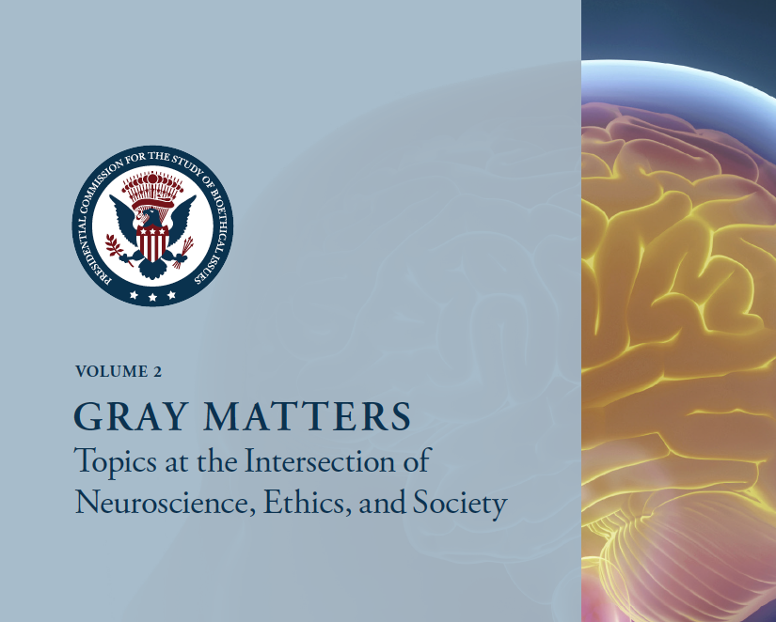

Slide 58
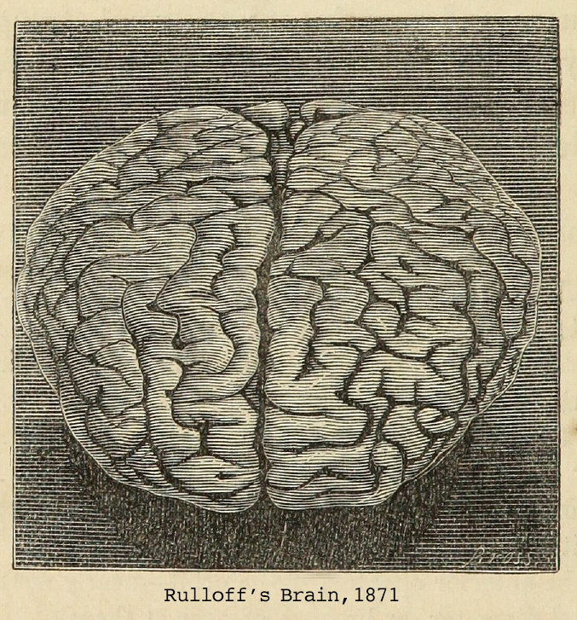

Slide 59
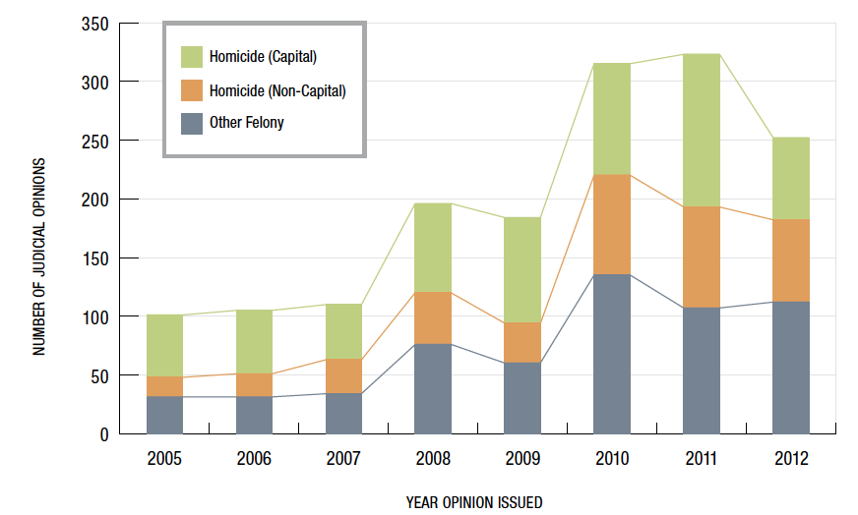

Slide 60
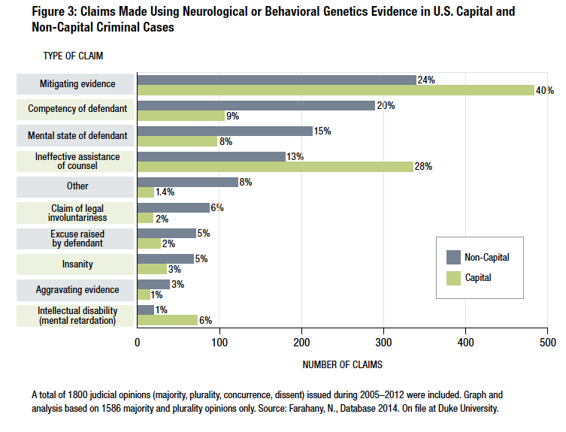

Slide 61
correlation between inclusion of the biological explanation of neurological disorder with significantly reduced sentence length and an increased number of mitigating factors listed.
members of the public are more likely to trust diagnosis of a psychiatric condition when brain imaging evidence is presented, as opposed to evidence from psychological assessments.

Slide 62
over 5 percent of murder trials and 25 percent of death penalty trials feature criminal defendants using neuroscience to argue for lesser responsibility or punishment.

Slide 63
scientists are on the sidelines of these legal developments. Researchers often decry use of poorly substantiated cognitive neuroscience and call for caution regarding its use in law.

Slide 64
Fundamental mismatch between population-based science and the individualized determination in law.
Much of neuroscience aims to make correlations and draw conclusions in the aggregate about human behavior, whereas the law is more concerned with causality and seeks to draw conclusions about individual behavior and motivation.

Slide 65
the law asks questions science is unlikely to be able to answer; whereas science answers questions that the law mostly does not pose.
Science describes things in being, while law applies artifices to determine abstract justice.

Slide 66
the mismatch between law and psychology is of a different and lesser order from that between law and biology.

Slide 67
http://www.lawneuro.org

