Slide 1

Neurobiologia del Disturbo Bipolare
Patterns strutturali e funzionali nelle differenti fasi cliniche
Mario Amore
UNIVERISTA’ DEGLI STUDI DI GENOVA
DIPARTIMENTO DI NEUROSCIENZE RIABILITAZIONE OFTALMOLOGIA GENETICA E SCIENZE MATERNO INFANTILI
SEZIONE PSICHIATRIA
8-10 June 2017 - Siracusa

Slide 2
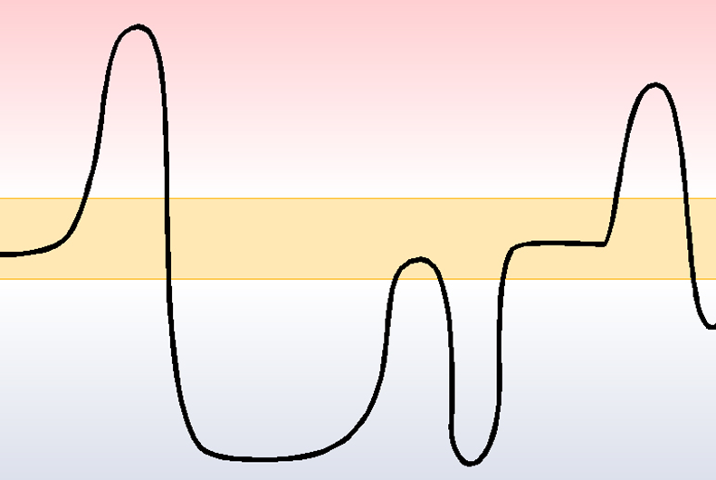
Bipolar Disorder - Clinical Features
Manic phase:
excitement of mood, ideation,
psychomotricity
Euthymia
Depressive phase:
inhibition of mood, ideation,
psychomotricity
(DSM 5, APA 2013; Kreapelin 1919; Koukopoulos and Ghaemi, 2009)

Slide 3
Bipolar Disorder – Neurobiology:
Mithocondrial dysfunctions
HPA axis dysregulations
Anatomical lesions
Inflammatory
dysregulations
Circadian system
dysregulations
Epigenomic
Factors potentially involved
in the etiology
Brain MRI hallmarks
Phenomenology

Slide 4
Bipolar Disorder – Neurobiology:
Mithocondrial dysfunctions
HPA axis dysregulations
Anatomical lesions
Inflammatory
dysregulations
Circadian system
dysregulations
Epigenomic
Factors potentially involved
in the etiology
Brain MRI hallmarks
Phenomenology

Slide 5
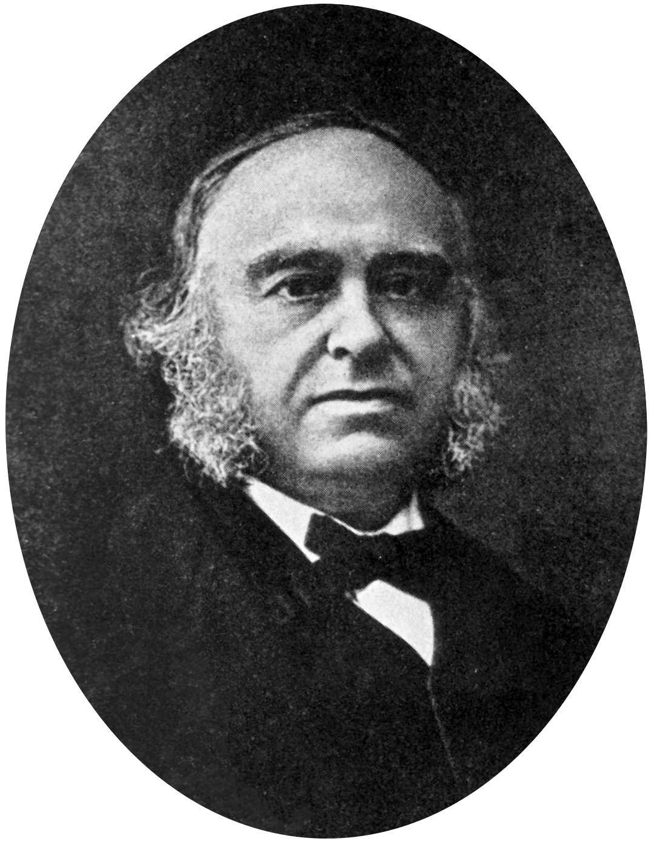

Anatomical lesions
For more than 100 years clinicians have recognized that language functions are frequently disrupted by unilateral lesions of the left emisphere (Broca, 1861)
For almost the same lenght of time clinicians have recognized that specific emotional disorders are associated with unilateral brain injury (Kraepelin, 1921; Meyer, 1904)
Some of these emotional disorders have also been lateralized or associated with lesions of one hemisphere. In 1922, Babinski noted that indifference or euphoric reactions can follow right hemisphere cerebral damage. This disorder was later termed the “indifference reaction” by Hacean (1951) , Meyer and Horenstein (1952).
Depression has frequently been associated with dominant hemisphere lesions (Starkstein, 1988)

Slide 6
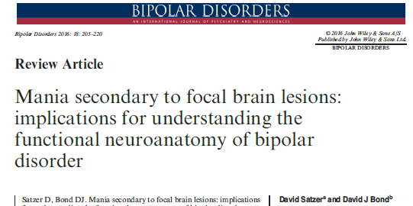
Anatomical lesions
Can secondary mania help us building an anatomical-biological mechanistic model of bipolar disorder?

Slide 7
Anatomical lesions
Lesion studies support and complement neuroimaging studies in Bipolar Disorder.
Lesion studies support an anatomical-biological mechanistic model for mania, in which manic symptoms arise from:
Deficit in the bilateral prefrontal emotion-regulating regions involved in the control of limbic structures
within the so-called «Cognitive Control Network» identifed via neuroimaging studies
Hyperactivity of left-hemisphere reward-processing brain areas
Right-emisphere limbic-brain hypoactivity or a left/right imbalance

Slide 8

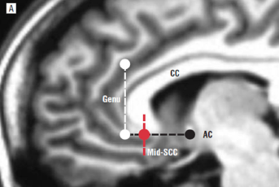
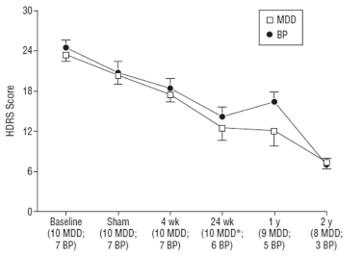
Anatomical lesions
Subcallosal CINGULATE target area

Slide 9
Anatomical lesions
Can a specific area in the brain be a «target» for therapies?
Does it really make sense to look for specific areas involved in BD if we mostly use pharmacological (anatomically aspecific) treatments?
Not just pharmacological treatment!!
Prefrontal leukotomy gained popularity in the 1930s and 1940s and was reported to reduce mania, but adverse effects overcame benefits
RECENT PSYCHOSURGICAL REBIRTH, especially the Deep Brain Stimulation (DBS)
DBS has recenlty proved efficacy in the treatment of Bipolar Depression (Holtzheimer et al., 2012, Arch Gen Psychiatry), by stimulating SUBCALLOSAL CINGULUM

Slide 10
Bipolar Disorder – Neurobiology:
Mithocondrial dysfunctions
HPA axis dysregulations
Anatomical lesions
Inflammatory
dysregulations
Circadian system
dysregulations
Epigenomic
Factors potentially involved
in the etiology
Brain MRI hallmarks
Phenomenology

Slide 11
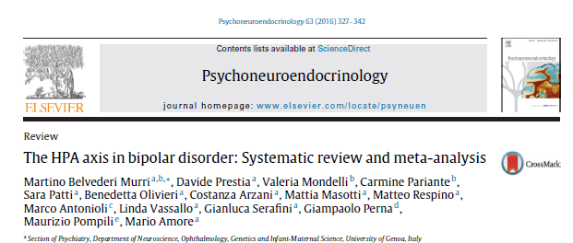
HPA-axis dysregulation
Meta-analysis and meta-regression of case-control studies examining the levels of cortisol, ACTH, CRH levels
Forty-one studies were included
Notes:
Methods: Meta-analysis and meta-regression of case-control studies examining the levels of cortisol, ACTH, CRH levels. Systematic review of stress reactivity, genetic, molecular and neuroimaging studies related to HPA axis activity in BD. Results: Forty-one studies were included in the meta-analyses. BD was associated with significantly increased levels of cortisol (basal and post-dexamethasone) and ACTH, but not of CRH. In the meta-regression, case-control differences in cortisol levels were positively associated with the manic phase (p = 0.005) and participants’ age (p = 0.08), and negatively with antipsychotics use (p = 0.001). Reviewed studies suggest that BD is associated with abnormalities of stress-related molecular pathways in sev-eral brain areas. Variants of HPA axis-related genes seem not associated with a direct risk of developing BD, but with different clinical presentations. Also, studies on unaffected relatives suggest that HPA axis dysregulation is not an endophenotype of BD, but seems related to environmental risk factors, such as childhood trauma. Progressive HPA axis dysfunction is a putative mechanism that might underlie the clinical and cognitive deterioration of patients with BD. Conclusions: BD is associated with dysfunction of HPA axis activity, with important pathophysiological implications. Targeting HPA axis dysfunctions might be a novel strategy to improve the outcomes of BD.

Slide 12
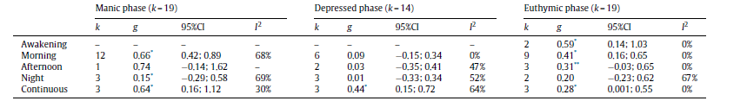
HPA-axis dysregulation
BD was associated with significantly increased levels of cortisol (basal and post-dexamethasone) and ACTH, but not of CRH. Bipolar disorder is associated with a HPA axis hyperactivity most prominent in the manic phase, but also persists in remission

Slide 13
HPA-axis dysregulation
Early in the trajectory of BD, episodes occur often secondary to stress
In time, an increased vulnerability favors recurrent affective exacerbations
HPA axis is involved in the so-called «response to stress» and does not work properly in patients with BD (Girshkin 2014, Belvederi Murri 2016)
HOW may HPA axis not work?
The Glucocorticoid Receptor (GR) seems to be the most important factor in the formulation of cortisol response
GR binds to the hormone in the cytosol and shuttles it to the nucleus where it acts as a transcription factor
GR DEPENDS ON chaperone proteins such as FKBP51
Abnormal methylation of FKBP51 has been proved to be involved in PTSD and may be involved in the comorbid BIPOLAR DISORDER
Notes:
Methods: Meta-analysis and meta-regression of case-control studies examining the levels of cortisol, ACTH, CRH levels. Systematic review of stress reactivity, genetic, molecular and neuroimaging studies related to HPA axis activity in BD. Results: Forty-one studies were included in the meta-analyses. BD was associated with significantly increased levels of cortisol (basal and post-dexamethasone) and ACTH, but not of CRH. In the meta-regression, case-control differences in cortisol levels were positively associated with the manic phase (p = 0.005) and participants’ age (p = 0.08), and negatively with antipsychotics use (p = 0.001). Reviewed studies suggest that BD is associated with abnormalities of stress-related molecular pathways in sev-eral brain areas. Variants of HPA axis-related genes seem not associated with a direct risk of developing BD, but with different clinical presentations. Also, studies on unaffected relatives suggest that HPA axis dysregulation is not an endophenotype of BD, but seems related to environmental risk factors, such as childhood trauma. Progressive HPA axis dysfunction is a putative mechanism that might underlie the clinical and cognitive deterioration of patients with BD. Conclusions: BD is associated with dysfunction of HPA axis activity, with important pathophysiological implications. Targeting HPA axis dysfunctions might be a novel strategy to improve the outcomes of BD.

Slide 14
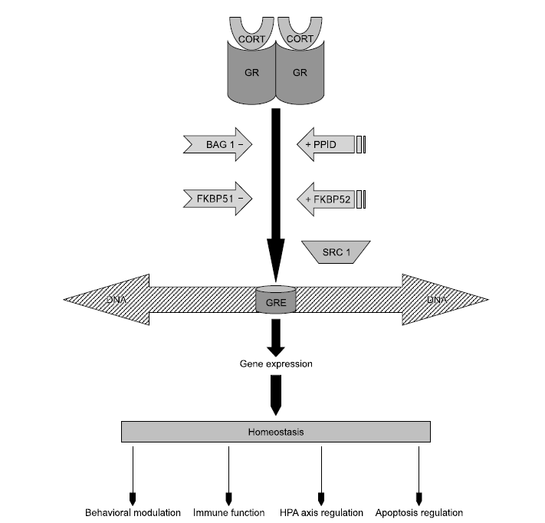

HPA-axis dysregulation
The crucial role of Glucocorticoid Receptor (GR)
Cell membrane
Murine models: prolonged exposure to glucocorticoids is known to bring about changes in DNA methylation at the FKBP5 gene; stress reprogramms gene activity by altering epigenetic modifications
Human studies: such alterations
in the Fkbp5 gene in patients with a stressor-related comorbid condition of BD, namely, post-traumatic stress disorder.
FKBP5 methylation may be one of paths through which the HPA system acting in response to stress
malfunctions in BD pathophysiology
Chaperone protein abnormally methylated?
Nucleus
Notes:
The central role of glucocorticoid receptor in the biological functions of cortisol. Cortisol (CORT) enters the cytosol by passive
diffusion and binds to the glucocorticoid receptor (GR) which is a dynamic multiprotein complex composed of an array of chaperones.
These have inhibitory as well as facilitatory actions and induce conformational change, homodimerization and translocation of the
glucocorticoid receptor. The GR homodimer shuttles to the nucleus where it binds to glucocorticoid response element (GRE) on the promoter region of the DNA resulting in gene expression. This attachment to the GRE is facilitated by steroid receptor coactivator-1 (SRC-1); the subsequent gene transcription plays diverse roles in physiological functioning. FKBP: FK506 binding protein, BAG 1: Bcl-2-associated gene product-1, PPID: petidylprolyl isomerase D.

Slide 15
Bipolar Disorder – Neurobiology:
Mithocondrial dysfunctions
HPA axis dysregulations
Anatomical lesions
Inflammatory
dysregulations
Circadian system
dysregulations
Epigenomic
Factors potentially involved
in the etiology
Brain MRI hallmarks
Phenomenology

Slide 16
Inflammatory Dysregulations
IN GENERAL
In Bipolar patients, major mood episodes of either polarity result in an inflammatory response that has been shown in several studies.
Increased levels of pro-inflammatory cytokines (IL-1beta, TNF alfa, IL6) and PCR in the peripheral blood (Uyanik et al., 2015)
Also
Treatment with mood stabilizers and resolution of acute affective exacerbations has been shown to normalize cytokines levels (Bai et al., 2014)
FOCUS ON IL-6
IL-6 is a ubiquitous inflammatory cytokine performing diverse biological actions that vary from regeneration and repair of cellular elements to augmenting the response to injury in various types of tissue damage
Several studies have documented an increase in peripheral circulating levels of IL-6 during acute mood episodes of either polarity (Munkholm et al., 2015)

Slide 17
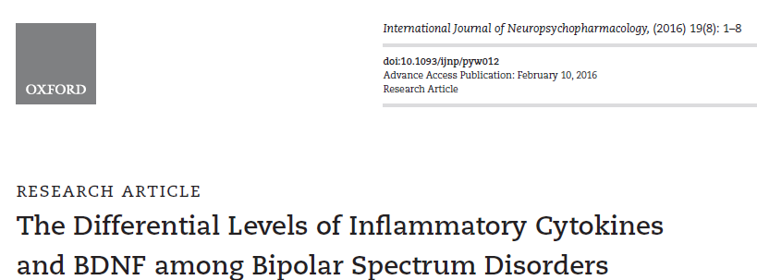
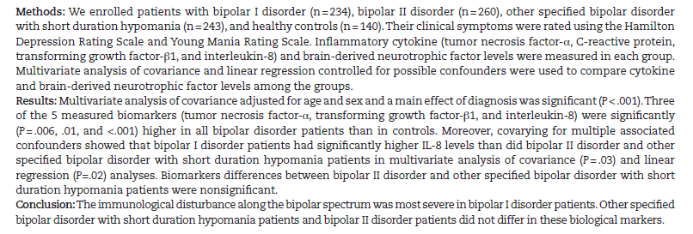
Inflammatory dysregulations
Immunological disturbance gets worse with the severity of the disease
BD type 1 mostly

Slide 18
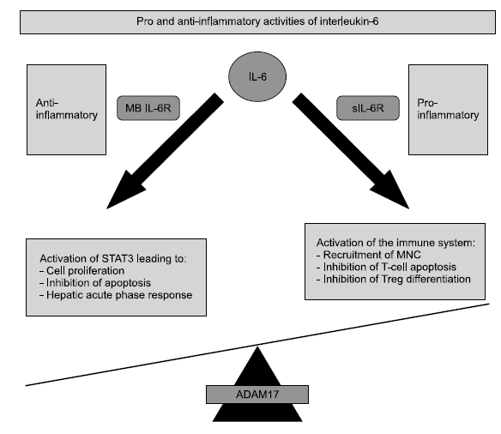
Inflammatory dysregulations: Peripheral and Central Mediators
Anti-inflammatory activities
of IL-6 include STAT3 dependent
regeneration of cells and the induction
of the hepatic acute phase response,
mediated by membrane bound IL-6R
(MB IL-6R).
Pro-inflammatory activities
of IL-6 via soluble IL-6R (sIL-6R)
include recruitment of inflammatory
cells and inhibition of regulatory T-cell
differentiation.
ADAM17 plays the key
balancing role in determining the direction of IL-6 biological actions.
ADAM17: a disintegrin and metalloproteinase
STAT3: signal
transducer and activator of transcription
It is highly likely that ADAM17 balance has a key function in inflammatory phenomena
Administration of engineered proteins blocking IL-6 are under study at preclinical level
(Muneer, 2016)
Notes:
Pro and anti-inflammatory activities of IL-6. Anti-inflammatory activities of IL-6 include STAT3 dependent regeneration of cells and the induction
of the hepatic acute phase response, mediated by membrane bound IL-6R (MB IL-6R). Pro-inflammatory activities of IL-6 via soluble IL-6R (sIL-6R)
include recruitment of inflammatory cells and inhibition of regulatory T-cell differentiation. ADAM17 plays the key balancing role in determining the direction
of IL-6 biological actions. ADAM17: a disintegrin and metalloproteinase 17, MNC: mononuclear cells, STAT3: signal transducer and activator of transcription
3.

Slide 19
Oxidative stress
In biological terms, oxidative stress can be considered as a continuing discrepant interaction between antioxidants and prooxidants with a tilt toward the latter
The result is excessive production of radical oxygen species (ROS)
UNEQUIVOCAL PROOF of increased brain oxydative damage has been revealed for neurodegenerative conditions and psychic illnesses such as schizophrenia, MDD and Bipolar Disorder
(Morris et al., 2015)
ROS regulate the destiny of neurons; take part in several cascades included the glutamatergic transmission (NMDS mediated)
(Sorce et al., 2010)

Slide 20
Bipolar Disorder – Neurobiology:
Mithocondrial dysfunctions
HPA axis dysregulations
Anatomical lesions
Inflammatory
dysregulations
Circadian system
dysregulations
Epigenomic
Factors potentially involved
in the etiology
Brain MRI hallmarks
Phenomenology

Slide 21
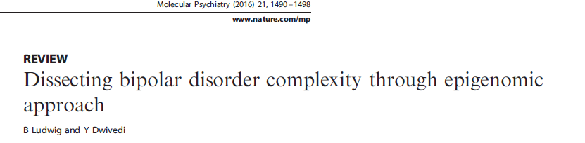
Epigenomic approach in BD
EPIGENETIC:
long-standing changes in gene expression that are regulated via transcriptional, post-trascriptional, translational and/or post-translational mechanisms (DNA methylation, histone modifications and noncoding RNAs), which does not entail any change in DNA sequence
«Today’s scientific consensus on the pathogenesis of affective disorders might be best described as genotype-dependent environmental influences on risk for an individual to be affected»
«The conventional gene-environment interaction model does not specifically include epigenetic modifications, but they might represent the underlying mechanisms of the statistical interaction»

Slide 22
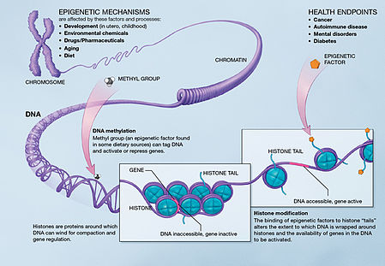

Slide 23
Bipolar Disorder – Neurobiology:
Toward an integrative working model of
bipolar disorder pathophysiology?
Mithocondrial dysfunctions
HPA axis dysregulations
Anatomical lesions
Inflammatory
dysregulations
Circadian system
dysregulations
Epigenomic
Factors potentially involved
in the etiology
Brain MRI hallmarks
Phenomenology

Slide 24
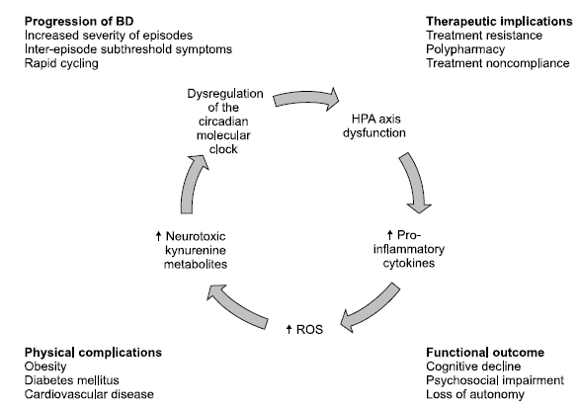
An integrative model?
Notes:
The integrative model of bipolar disorder pathophysiology. Dysfunctions in crucial bodily homeostatic systems acting in an orchestrated manner feed
into one another leading to a progressively worsening course of bipolar disorder. The result is a persistent symptomatic state, treatment resistance, psychosocial
functional deterioration and numerous physical complications. BD: bipolar disorder, HPA axis: hypothalamic-pituitary-adrenal axis, ROS: reactive
oxygen species.

Slide 25

An integrative model?
Dysfunctions in crucial bodily homeostatic systems acting in an orchestrated manner feed into one another leading to a progressively worsening course of bipolar disorder.
The result is a persistent symptomatic state, treatment resistance, psychosocial functional deterioration and numerous physical complications
Lucian Freud
Notes:
The integrative model of bipolar
disorder pathophysiology. Dysfunctions
in crucial bodily homeostatic systems
acting in an orchestrated manner feed
into one another leading to a progressively
worsening course of bipolar disorder.
The result is a persistent symptomatic
state, treatment resistance, psychosocial
functional deterioration and
numerous physical complications. BD:
bipolar disorder, HPA axis: hypothalamic-
pituitary-adrenal axis, ROS: reactive
oxygen species.

Slide 26
Bipolar Disorder – Neurobiology:
Mithocondrial dysfunctions
HPA axis dysregulations
Anatomical lesions
Inflammatory
dysregulations
Factors potentially involved
in the etiology
Circadian system
dysregulations
Epigenomic
Brain MRI hallmarks
Phenomenology

Slide 27
Bipolar Disorder – Neurobiology:
Functional Connettivity
Neuronal Variability
Resting State fMRI
DTI
Metodi di Studio
Studio dei Network
white matter structural MRI
Brain MRI hallmarks

Slide 28
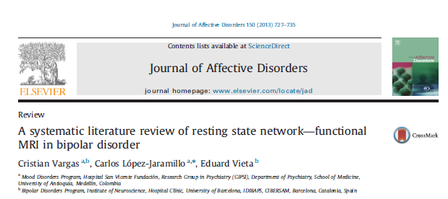
Le aree cerebrali più interessate:
1) corteccia pre-frontale mediale (mPFC),
2) corteccia cingolata anteriore preungueale (pgACC),
3) talamo dorsomediale,
4) pallido-striato,
5) amigdala,
6) corteccia parietale,
7) altre aree mesolimbiche connesse con DMN.

Slide 29
Nonostante la variabilità fra i risultati dei diversi studi (che riflette le differenze psicopatologiche fra i campioni e la complessità delle reti cerebrali), tutti mostrano differenze tra i pazienti (a prescindere dallo stato di malattia) e i controlli sani nei pattern di connettività delle aree PFC (CORTECCIA PRE-FRONTALE, soprattutto mediale) e ACC (CORTECCIA CINGOLATA ANTERIORE) con aree mesolimbiche/striatali.
supportando l’ipotesi cortico-limbica e suggerendo che la connettività può essere più complessa (variando in base a episodio timico, severità, storia o attuali sintomi psicotici).

Slide 30
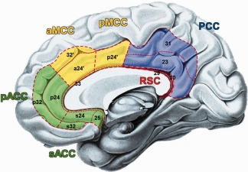
Cingulum and Bipolar Disorder
The cingulum is part of the limbic system, involved in affective regulation, integrative and cognitive functions, and seems to play a central role in the pathophysiology of BD
Anterior cingulate cortex (ACC) in Bipolar Disorder:
- volume alterations (even in the early stage of illness)
- metabolic alteration (deficit in GABA activity)
- state dependent alterations
(↑ activity in mania and ↓activity in depression)
(Fountoulakis K.N. et al., Brain Res Rev, 2008)
- Alterations in Functional Connectivity (FC) of the Prefrontal Cortex (in particular ACC) with limbic and subcortical areas (striatum, dorsomedial thalamus, amygdala and insula)
- Altered FC within the cingulum
(Vargas et al, J Affect Disord, 2013; Magioncalda et al, Hum Brain Mapp, 2015)
Sensori-motor control
Internal thoughts and mind wandering
Affective and emotional regulation
(Hoffstaedter et al, Hum Brain Mapp, 2013; Yu et al, Neuroimage, 2010)

Slide 31
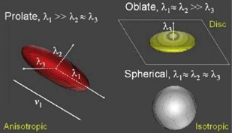
Introduction to white matter structural MRI: DTI analysis
Diffusion Tensor Imaging (DTI) : misura il movimento browniano delle molecole di acqua nel tessuto cerebrale fornendo informazioni circa la microstruttura della sostanza bianca in vivo e permettendo di valutarne l’integrità.
Le guaine mieliniche e le membrane cellulari restringono la diffusione dell’acqua perpendicolarmente alla direzione dell’assone, ragione per cui l’acqua diffonde più velocemente parallelamente all’assone stesso.
Questa dipendenza dalla direzione della diffusione è quantificata attraverso l’anisotropia.

Slide 32
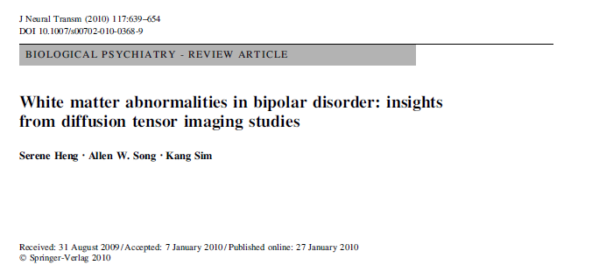
Studi DTI su BD
19 studi (2004 – 2009)
numerosità campione (min: 9 pz – max: 42 pz)
tutti studi caso controllo
età (alcuni studi su bambini e su adolescenti; età media sogg adulti: 35 anni circa – range: 18-50)
durata media di malattia (studi su esordi; in altri variabile, sino a 30 anni)
parametri DTI (1,5 oppure 3 Tesla; 6→ 64 gradient directions)
tecnica di analisi: ROI, TBSS, VBM, TG

Slide 33
Bipolar Disorder and White Matter Abnormalities
The cingulum (in particular its anterior part) is one of the most constantly altered tract in BD
(e.g. Emsell L. et al., Biol Psychiatry, 2013; Lin F. et al., J Affect Disord, 2011; Benedetti F. et al., Bipolar Disord, 2011; Versace A. et al., Mol Psychiatry, 2014; Leow A., et al., Biol Psychiatry, 2013; Wang F. et al., Br J Psychiatry, 2008; Kumar J. et al., Psychol Med, 2015; Sarrazin S. et al., JAMA Psychiatry, 2014)
Widespread white matter microstructural alterations, all major classes of tracts are implicated (FA reduction and MD-RD increase) in BD: whole BD samples regardless of the phase of illness
(Tract based spatial statistics (TBSS) approach)
Wise T. et al., Biol Psychiatry, 2015; Vederine F.E. et al.,
Prog Neuropsychopharmacol Biol Psychiatry, 2011

Slide 34
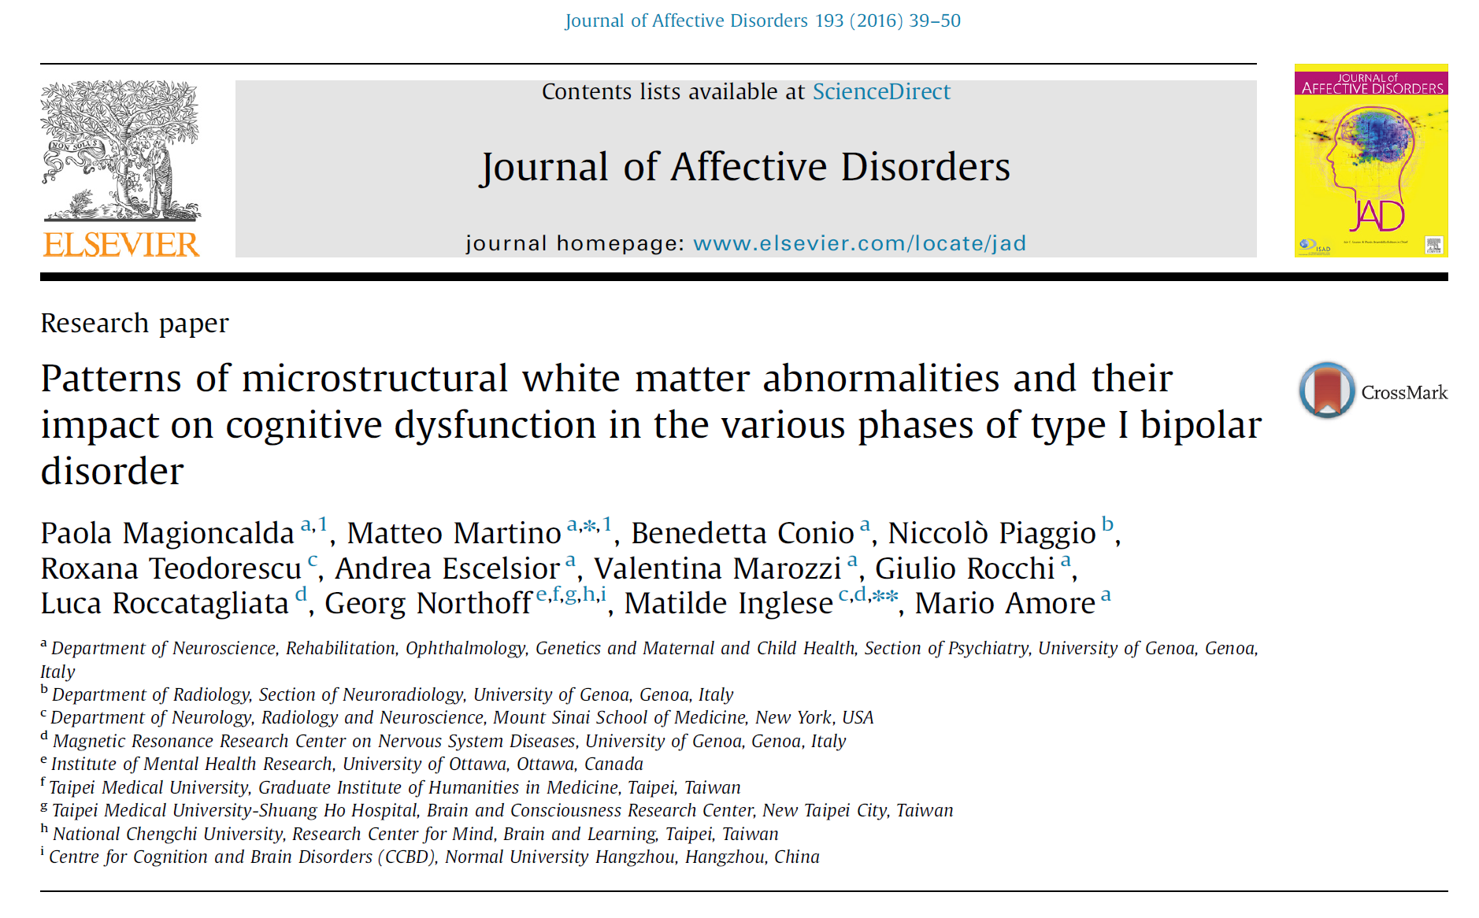
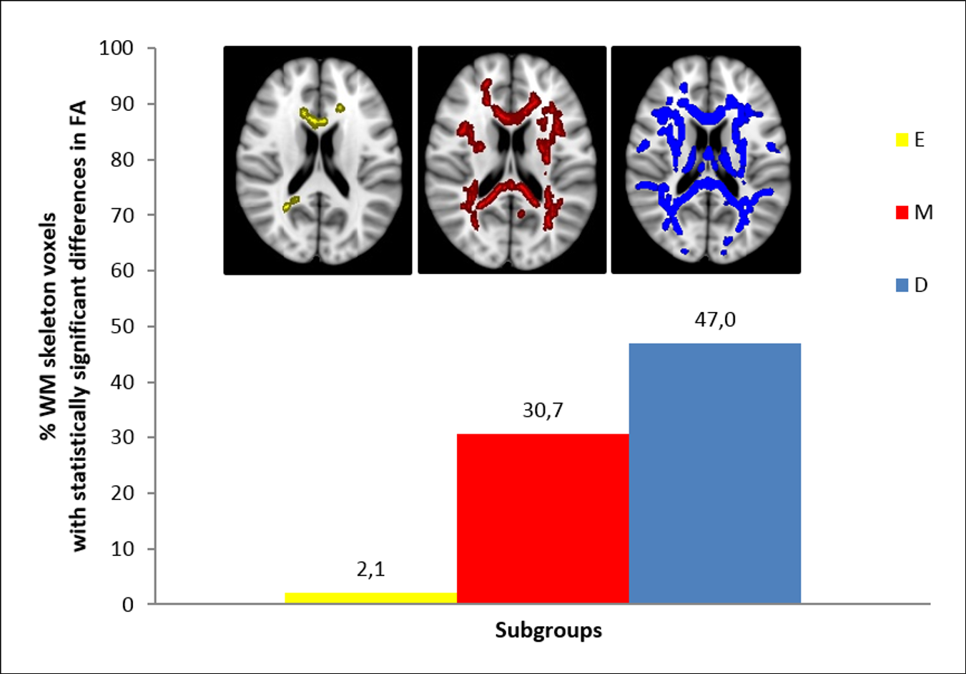
Microstructural WM alterations (midline and lateral structures) are mainly present in the active phases of BD
WM dynamic changes
across the different phases of illness?

Slide 35
A gradient of increasing WM abnormalities from the euthymic (low degree and localized WM alterations mainly in the midline structures) to the manic (more diffuse WM alterations affecting both midline and lateral structures) and, finally, to the depressive phase (high degree and widespread WM alterations)
the WM diffuse alterations correlated with cognitive deficits in BD, such as decreased fluency and increased omission errors at the continuous performance test.
The WM alterations in type I BD showed different spatial patterns in the various phases of illness, mainly affecting the active phases, and correlated with some cognitive deficits. This suggests a complex trait- and state-dependent pathogenesis of WM abnormalities in BD.

Slide 36
Introduction to resting state fMRI:
Functional Connectivity
La Resting state fMRI è un sottotipo specifico di fMRI:
L’fMRI misura la variazione dell’ossigenazione sanguigna nel tempo (segnale BOLD - Blood Oxygenation Level Dependent), legata all’attività neuronale che viene generata in uno specifico contesto sperimentale
Non è una misura diretta, ma permette di misurare i cambiamenti di segnale cerebrali causati da variazioni dell’attività neurale di un individuo
SI ASSUME CHE LE VARIAZIONI DEL SEGNALE BOLD CORRISPONDANO A VARIAZIONE DELL’ATTIVITA’ NEURONALE
Nella fMRI di tipo «resting-state» il contesto sperimentale è una condizione di «riposo» mentale in cui il soggetto mantiene lo stato di veglia senza eseguire alcun task specifico

Slide 37
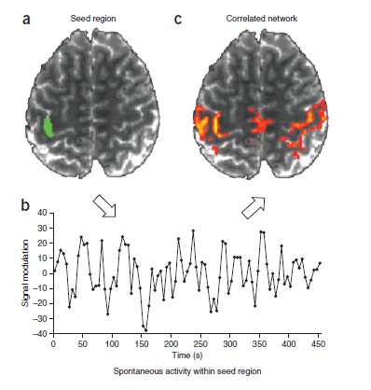
Introduction to resting state fMRI:
Functional Connectivity
Functional Connectivity (FC):
È una misura di “connettività funzionale”, quindi di “co-attivazione” tra due aree cerebrali.
FC measures the coherence and synchronization of BOLD signal changes between different brain regions (spatial structure of neuronal assemblies and networks; relationship between the activity of different brain regions)

Slide 38

Introduction to resting state fMRI:
Functional Connectivity
Perché studiare la Functional Connectivity (FC)?
Studi recenti effettuati con fMRI e PET, su soggetti umani, hanno mostrato che la maggior parte del consumo energetico cerebrale è usato per un’attività metabolica «intrinseca» non correlata a stimolazioni sensoriali o motorie o ad alcun stato comportamentale (Butzaki, 2004. Science).
Questa «attività intrinseca» sarebbe organizzata nella forma di resting state networks (RSN), che sarebbero «architetture» intrinseche di funzionamento cerebrale.
La Città Ideale

Slide 39
Cingulum, Networks and Bipolar Disorder
SALIENCE NETWORK (SN)
CENTRAL EXECUTIVE NETWORK (CEN)
SENSORI MOTOR NETWORK (SMN)
Resting state networks alterations in Bipolar Disorder
Abnormal FC in resting state networks, especially the DMN (mainly hypoconnectivity)
Little evidences with regard to the other resting state networks
- altered FC between the Anterior Cingulate Cortex and areas of Salience Network
- increased FC in the DMN in mania
- reduced FC within the CEN in psychotic BD in acute states
(e.g. Ongur et al, Psychiatry Res, 2010; Anticevic et al, Scizophr Bull, 2015; Meda et al, PNAS, 2014;
Chai et al, Neuropsychopharmacology, 2011; Baker et al, JAMA Psychiatry, 2014;
Wuj et al, J Psychiatry Neurosci, 2013)
aMCC/SACC
Insula
Salience attribution to internal/external stimuli
DLPFC
Posterior parietal cortex
Dorsal ACC
Executive functions
(task-related network)
pMCC
Sensori-motor areas
Sensorimotor functions
DEFAULT MODE NETWORK (DMN)
pACC + PCC
Temporo-parietal junctions
Internal thought
Autobiographical memory
Anticipation of future
Mind wandering
(Hoffstaedter et al, Hum Brain Mapp, 2013; Yu et al, Neuroimage, 2010)

Slide 40
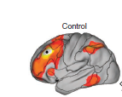
What about clinical correlates?
DMN hyperactivity, as well as reduced DMN/CEN anticorrelation, hypothetically result in excessive focus on internal mental activity (depressive rumination) and could be involved in depressive phases of the illness
Hypoconnectivity of median structures (cingolo ), could lead to imbalance between dACC (CEN) and PCC (DMN) toward a CEN hyperactivity and thus excessive focus on external stimuli (hyperactivity and other manic symptoms)
(Ongur, D.2010; Meda, S.A., et al., Proc Natl Acad Sci USA, 2014)

Slide 41
LIMITAZIONE DEGLI STUDI
Quale interpretazione dei risultati degli studi di connettività?
Quale correlazione dei dati di ipoconnettività o aumentata connettività con i dati clinici di depressione, mania, eutimia
Campioni limitati numericamente
Campioni in differenti stadi di malattia
Non specificazioni in alcuni casi del tipo di disturbo bipolare
Differenti valutazioni dell’effetto della terapia farmacologica

Slide 42
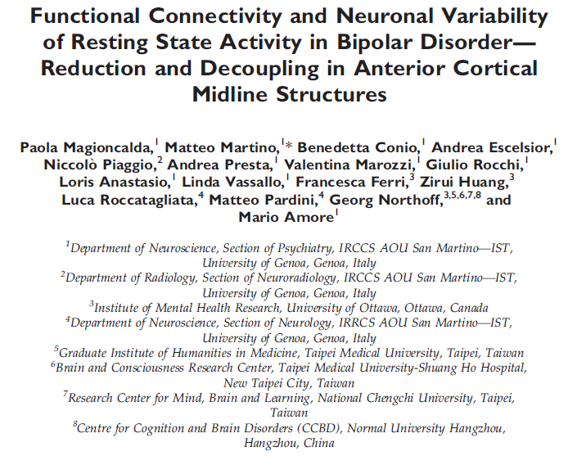
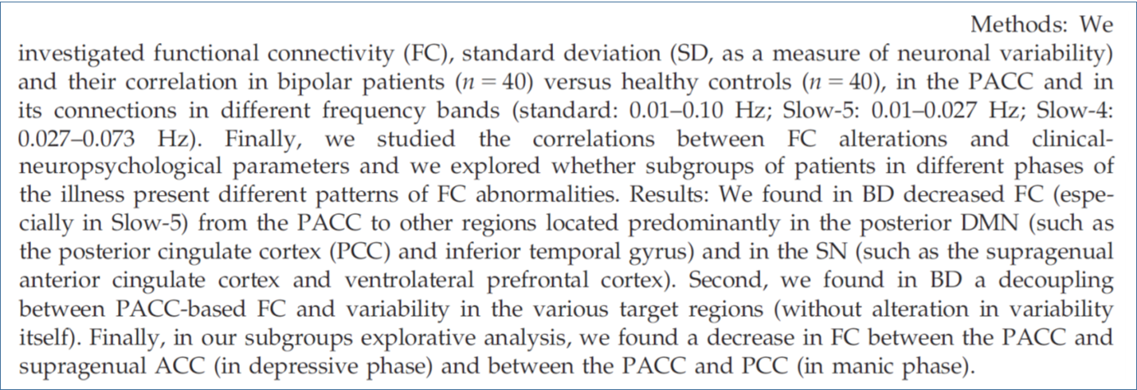

Slide 43
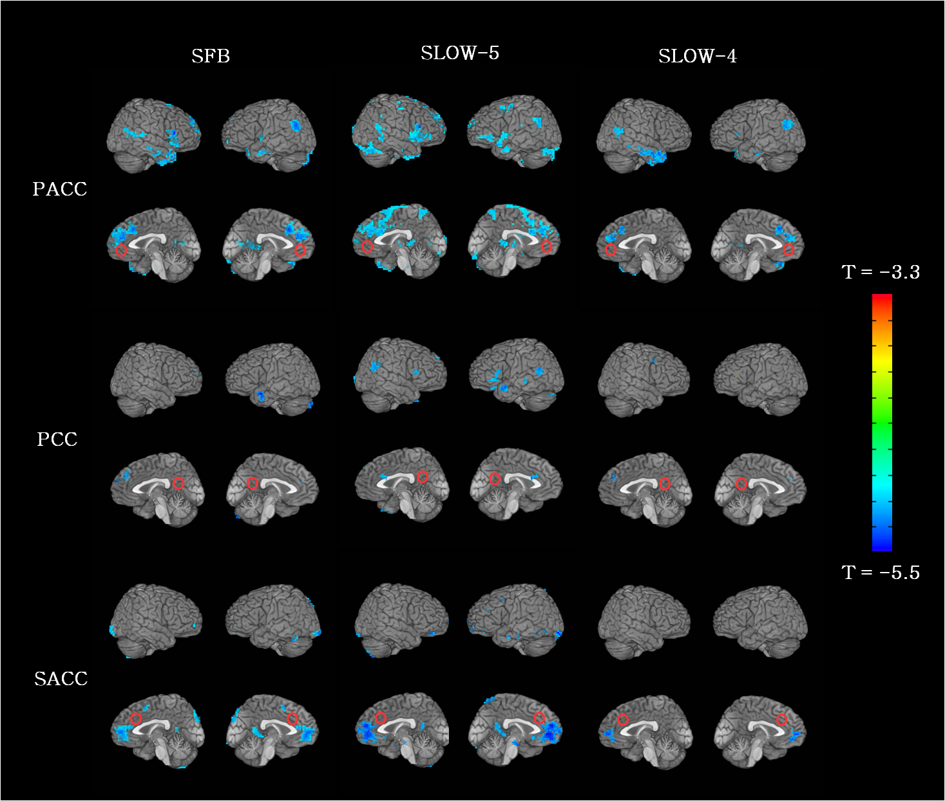
FUNCTIONAL CONNECTIVITY
in different frequency bands
Standard: 0.01 - 0.10 Hz;
Slow 5 0.01 - 0.027 Hz; Slow 4: 0.027 - 0.073 Hz
Perigenual anterior cingualre cortex (PACC) seed region
Supragenual anterior cingulate cortex (SACC) and
Posterior cingulate cortex (PCC) control seed regions
Notes:
The low-frequency oscillations in the standard frequency band (0.01-0.10Hz) (which is typically investigated in resting state fMRI studies) seem to reflect a physiological baseline of neuronal activity and is central for tonic brain activity
The standard frequency band was further subdivided into two ultra-slow frequency bands in the healthy brain with potential differentiated functions:
Slow5 (0.01-0.027Hz) shows stronger power and longer cycle duration,
representing the “spatiotemporal basement” of the brain networks
Slow4 (0.027-0.073Hz) is strongest throughout the neurotransmitters areas,
basal ganglia, thalamus and sensorimotor cortical areas, potentially playing a
role in subcortical-cortical loop communication at the network level .

Slide 44
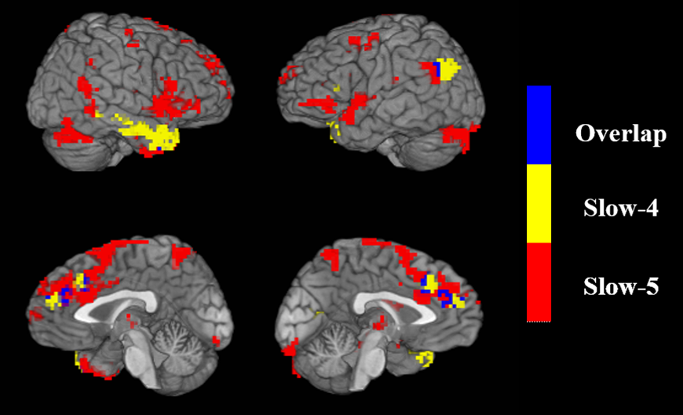
PACC functional disconnectivity (of the medial prefrontal cortex (PFC) and perigenual anterior cingulate cortex (PACC)) in the different frequency bands, as a part of anterior midline regions of DMN, could induce reduced information transfer from this region to Posterior Cingulate Cortex and SACC (Supragenual ACC)

Slide 45
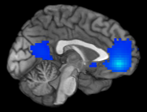
Defaul Mode Network (DMN)
PCC
PACC
Conclusions
Resting State functional disconnectivity of the medial prefrontal cortex (PFC) and perigenual anterior cingulate cortex (PACC)
Hypoconnectivity between PACC and Supragenual anterior cingulate cortex (SACC) could be associated with a deficit in the anterior DMN-SN connectivity and consequent abnormal shifting toward the DMN at the expense of CEN: increased mind wandering and depressive ruminations; and reduced salience attribution to external stimuli, resulting in volitive inhibition
The imbalance between the anterior DMN, posterior DMN and SN could induce abnormal changes in those functions associated with these networks:
Emotions, internal thoughts or mind wandering, and reward-based impulsive behavior

Slide 46
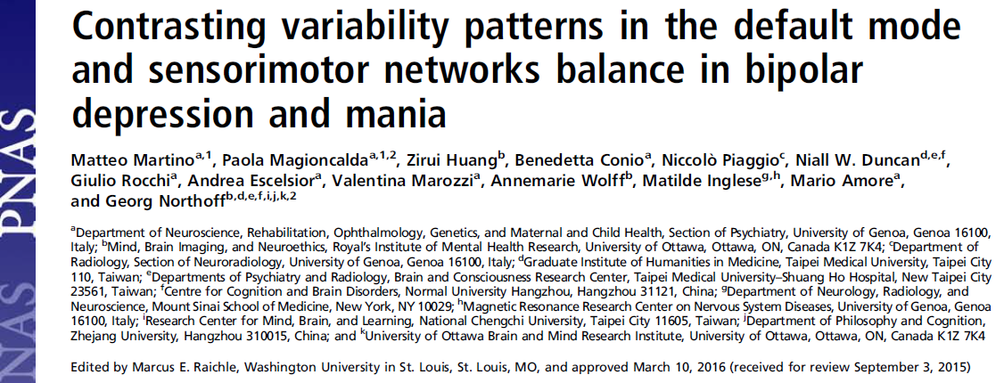
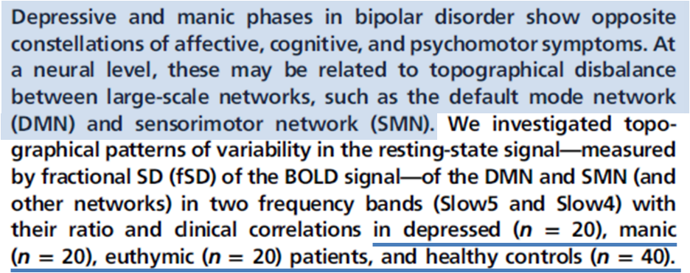

Slide 47
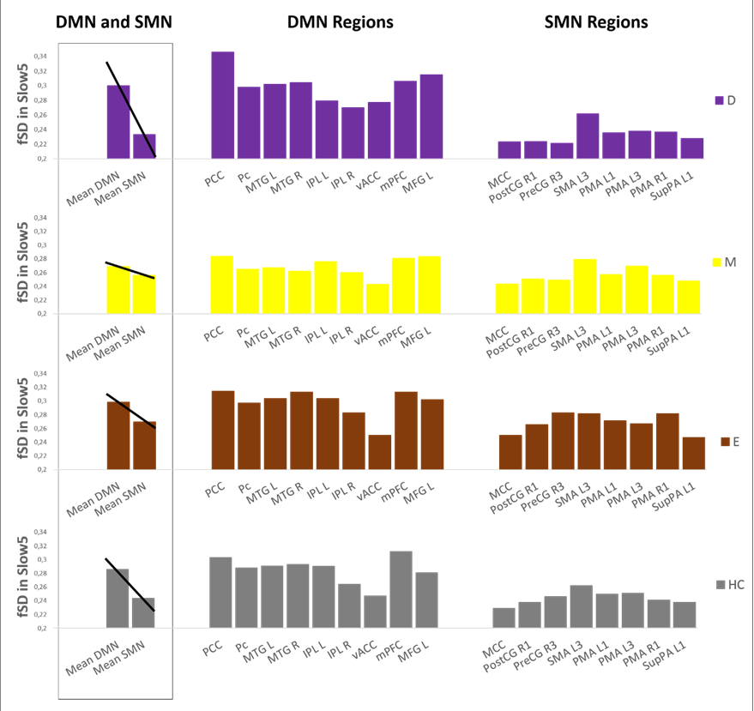
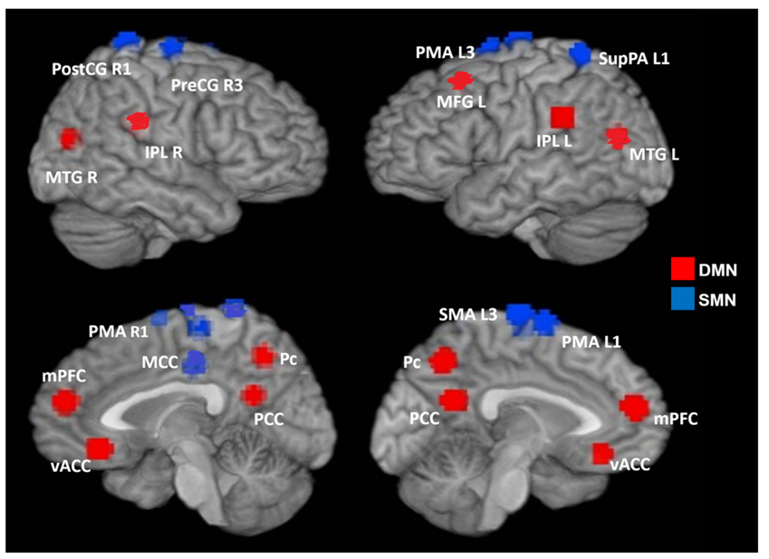
DMN/SMN values of fSD in depressed patients: increased
DMN/SMN values of fSD in manic patients: decreased

Slide 48
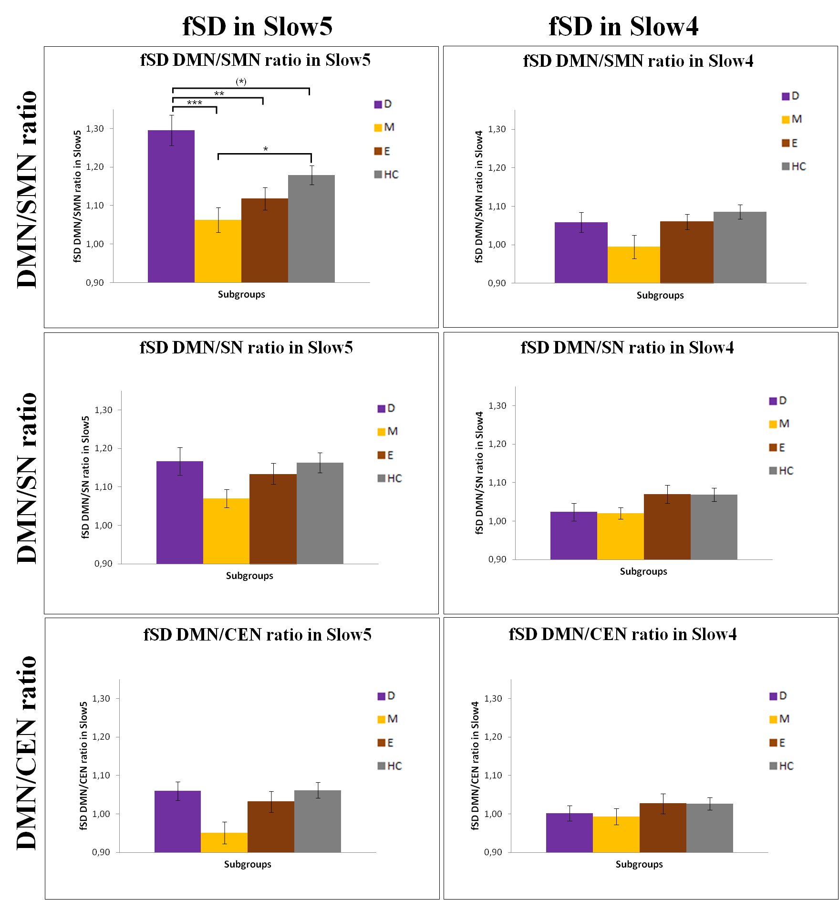
2
1
3
Il rapporto DMN/SMN è significativamente più elevato nei depressi rispetto a maniacali e sani (1 & 2)
E’ anche più elevato in sani rispetto a maniacali (3)

Slide 49
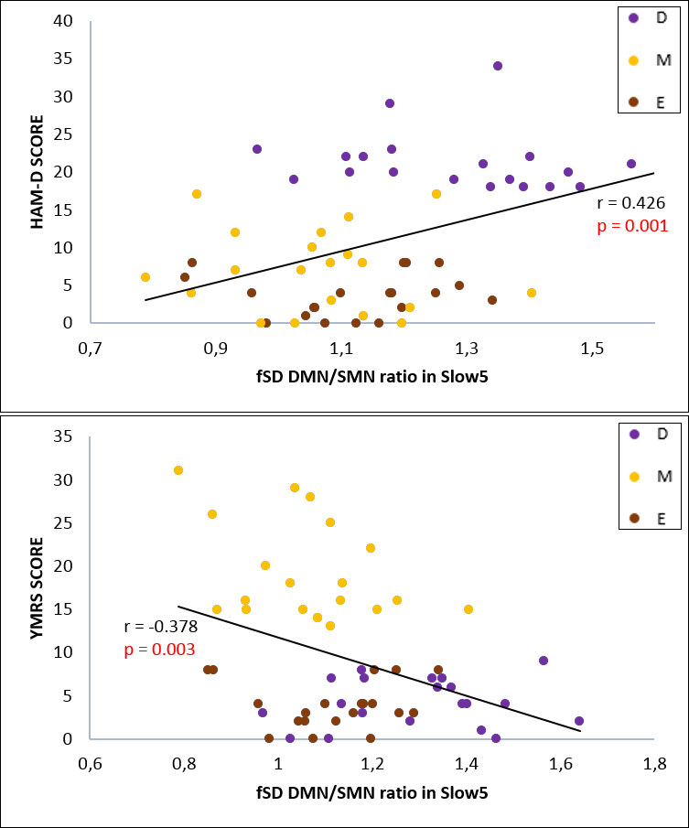
Positive correlation between depression symptoms severity and DMN/SMN ratio
Negative correlation between manic symptoms severity and DMN/SMN ratio

Slide 50
Il rapporto DMN / SMN sembra essere una bilancia tra l’espressività psicopatologica della mania e quella della depressione

Slide 51
Which are the pathophysiological features that underlie
the apparently state-dependent WM structural changes
in BD?
BD is associated with distinct inflammatory changes in the peripheral and central nervous system (increased immune-inflammatory activity with alterations in cytokines and acute-phase reactants) (Anderson and Maes, 2015)
The prolonged activation of the stress system, which can trigger acute phases of BD, is associated with an increase in pro-inflammatory factors (Proudfoot et al., 2011)
Increased levels of pro-inflammatory factors have been associated with a loss of WM integrity in healthy (Mirabell et al., 2012)
Hypothesis
immune-inflammatory changes as potential basis for
WM and connectivity alterations in BD

Slide 52
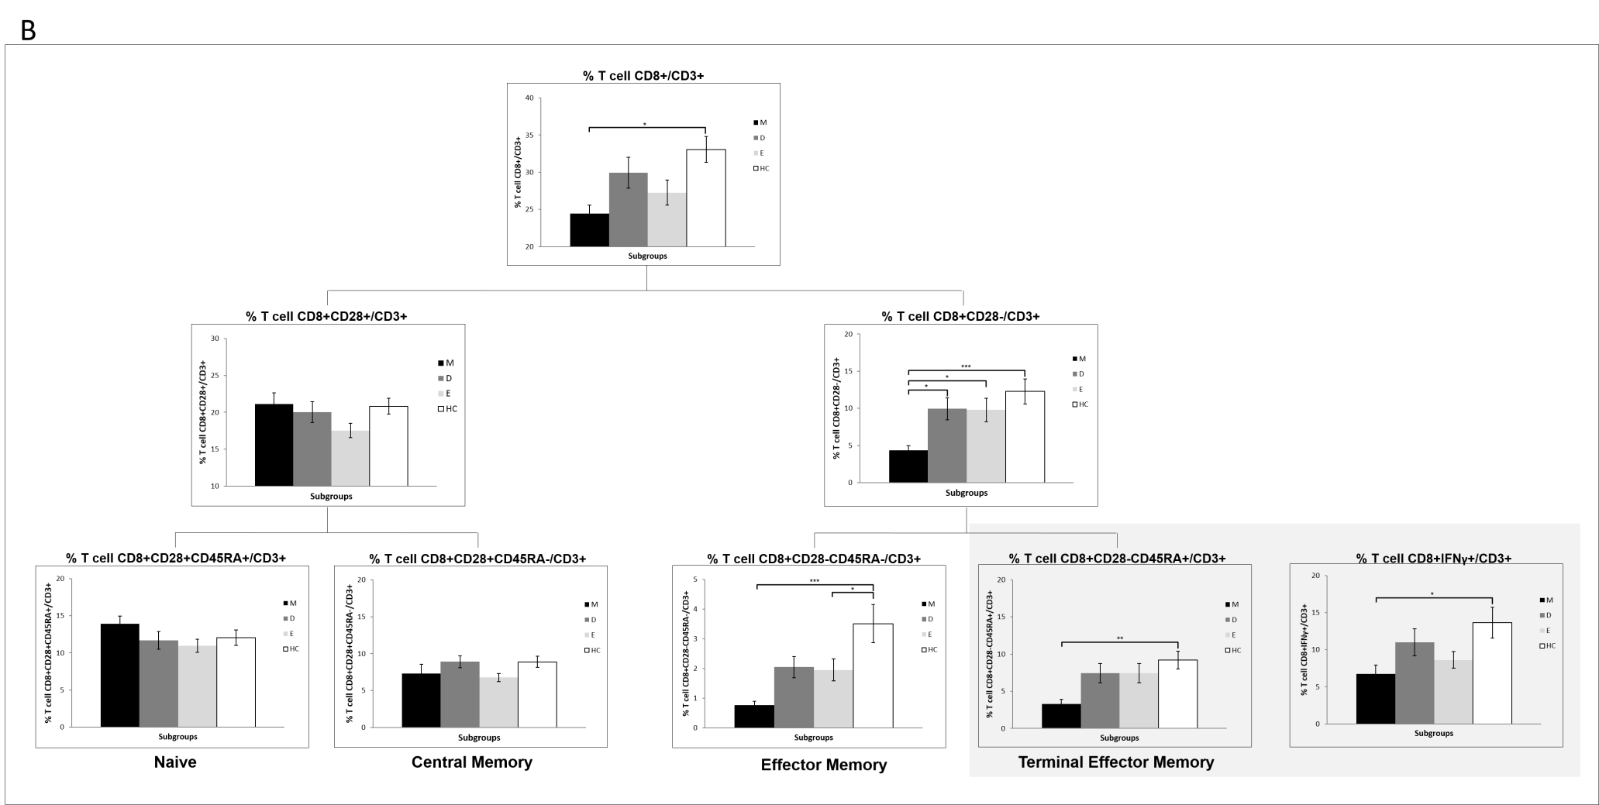
Reduction of T cells CD8+CD28- in mania
Preliminary data, submitted

Slide 53
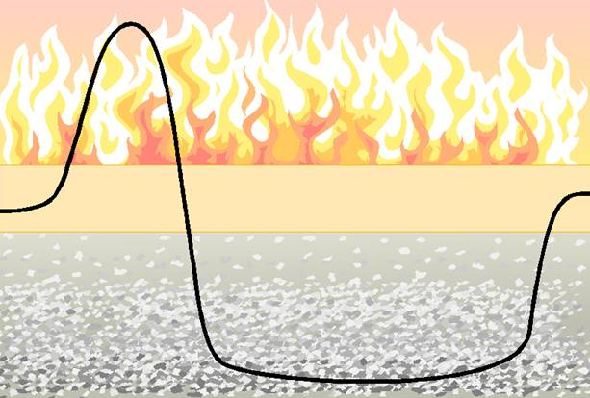
WM microstructural alterations in mania and depression (active phases) but not in euthymia
Immune-inflammatory activation in mania
Correlation of immune-inflammatory activation with WM alterations
The Primacy of Mania Hypothesis
mania is the fire and depression its ash
Manic phase
Immuno-inflammatory activation
WM damage
Euthimic phase
Immuno-inflammatory “normalization”
WM “normalization”
Depressive phase
Immuno-inflammatory “normalization”
Residual WM damage
(Koukopoulos and Ghaemi, 2009)

Slide 54




The Research Group and Acknowledgment
Amore Mario
Paola Magioncalda
Matteo Martino
Benedetta Conio
Dipartimento Di Neuroscienze Riabilitazione Oftalmologia Genetica E Scienze Materno Infantili
Sezione Psichiatria
Univerista’ Degli Studi Di Genova
Gianluigi Mancardi
Matilde Inglese
Niccolò Piaggio
Centro di Ricerca in Risonanza Magnetica per lo Studio del Sistema Nervoso
Univerista’ Degli Studi Di Genova
Gilberto Filaci
Samuele Tardito
Bruno Sterlini
Georg Northoff
Niall Duncan
Zirui Huang
Matilde Inglese
Catarina Saiote
The Leon and Norma Hess Center
for Science and Medicine
New York
and all the other researchers and collaborators of our group

Slide 55
Conclusioni
Nel disturbo bipolare abbiamo alterazione della FC che coinvolgono la comunicazione tra DMN, CEN e SN
Questi difetti di sincronia funzionale si accompagnano a deficit delle strutture della linea mediana (cingolo)
Le alterazioni strutturali della sostanza bianca sembrano essere anch’esse «fase» dipendenti
Rispetto alle fasi di malattia, in depressione vi è maggiore attività del DMN, in mania del SMN
Alle fasi di malattia corrispondono specifiche anomalie infiammatorie

