Slide 1



Schizofrenia e condizioni mediche generali:
un approccio multidisciplinare
Giuseppe Maina
SCDU Psichiatria A.O.U. San Luigi Gonzaga
Università degli Studi di Torino
Notes:
1

Slide 3
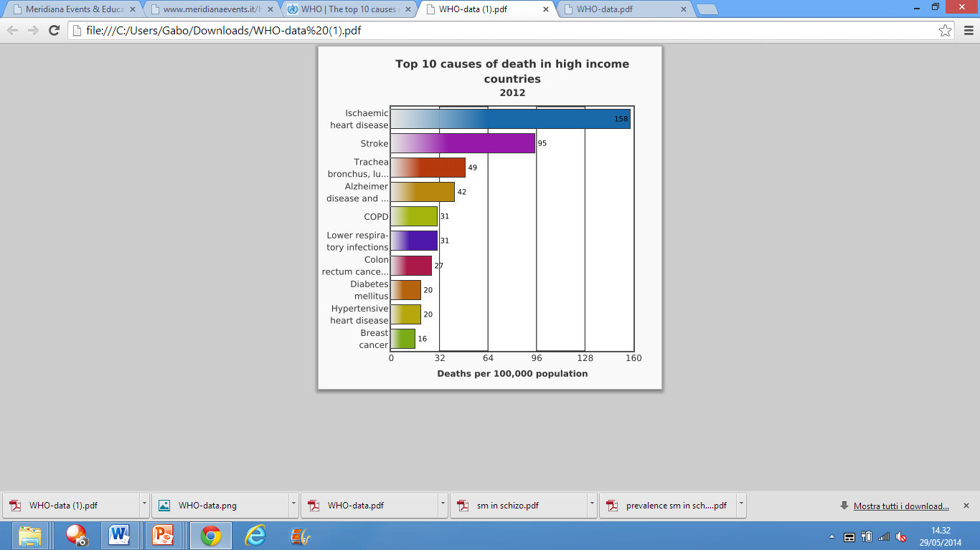
Top 10 causes of death in high income countries
2012 WHO data

Slide 4
Years of potential life lost and life expectancy in schizophrenia:
a systematic review and meta-analysis.
Hjorthøj C, Stürup AE, McGrath JJ, Nordentoft M.
1. Schizophrenia is associated with a weighted average of 14.5 years of potential life lost
2. higher for men than women
3. Loss was least in the Asian study and greatest in Africa
Lancet Psychiatry, 2017
Notes:
11 studies covering all inhabited continents (Africa n=1, Asia n=1, Australia n=1, Europe n=7, and North America n=3) that involved up to 247 603 patients.

Slide 5
Standardized Mortality Ratios for Schizophrenia by cause of death
CAUSE OF DEATH | SMR
Cardiovascular diseases | 1.79
Cerebrovascular diseases | 0.69
Digestive diseases | 2.38
Endocrine diseases | 2.63
Infectious diseases | 4.29
Genitourinary diseases | 3.70
Neoplastic diseases | 1.37
Nervous diseases | 4.22
Respiratory diseases | 3.19
Other diseases | 2.00
Saha et al, Arch Gen Psychiatry, 2007
Notes:
Review di studi sulla mortalità e schizofrenia (1980-2006). Autori australiani. Il suicidio è la causa più importante: oltre il 12%.

Slide 6
Standardized Mortality Ratios for Schizophrenia by cause of death
CAUSE OF DEATH | SMR
Cardiovascular diseases | 1.79
Cerebrovascular diseases | 0.69
Digestive diseases | 2.38
Endocrine diseases | 2.63
Infectious diseases | 4.29
Genitourinary diseases | 3.70
Neoplastic diseases | 1.37
Nervous diseases | 4.22
Respiratory diseases | 3.19
Other diseases | 2.00
Saha et al, Arch Gen Psychiatry, 2007
Notes:
Review di studi sulla mortalità e schizofrenia (1980-2006). Autori australiani. Il suicidio è la causa più importante: oltre il 12%.

Slide 7
Metabolic syndrome
Abdominal obesity
Hypertriglyceridemia
Low HDL
High blood pressure
High fasting glucose

Slide 8
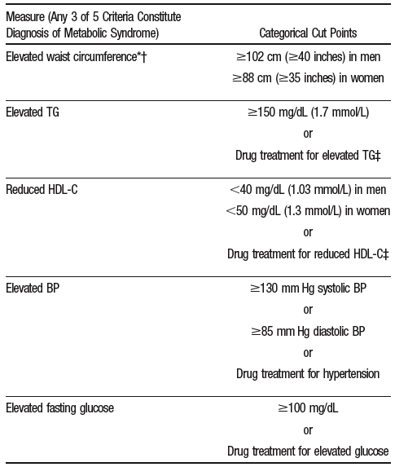
1
2
National Cholesterol Education Program (NCEP) Adult Treatment Panel (ATP) III-modified criteria
3
4
≥3 = MetS
5
Grundy et al., Circulation 2005

Slide 9
Metabolic syndrome prevalence among studied subjects with schizophrenia
p=0,002
N=699
Bener et al, Diabetes Metab Syndr 2014
Notes:
Studio caso controllo su popolazione > 20 anni (Qatar)

Slide 10
Causes of Metabolic Syndrome
Metabolic
syndrome
Individual risk factors

Slide 11
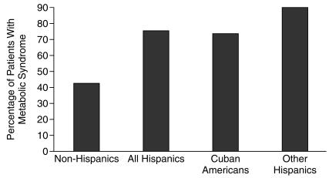

Prevalence of the Metabolic Syndrome by Ethnic Groups in Schizophrenic Patients
Martha M. Kato et al., 2004
Notes:
Studio USA in Florida.

Slide 12
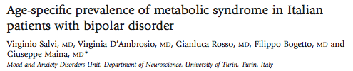
Psychiatry and Clinical Neurosciences 2011
Notes:
E’ emerso inoltre che la distribuzione della sindrome metabolica è un fenomeno età-dipendente e che, come si può vedere dal grafico, che rappresenta un confronto tra il nostro studio (in verde) e uno studio di prevalenza effettuato da Miccoli e colleghi sulla popolazione generale è interessante notare che mentre nella popolazione generale (in rosso) la sindrome metabolica aumenta gradualmente all’aumentare dell’età, nel campione di pazienti bipolari (in verde) la prevalenza risulta essere molto elevata già nelle fasce d’età piu’ giovani.

Slide 13
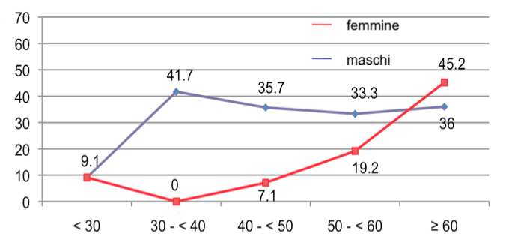
N=200
Test di Pearson: <30: p=1.000; 30-39: p=0.009; 40-49: p=0.019; 50-59: p=0.288; ≥60: p=0.458
Psychiatry and Clinical Neurosciences 2011

Slide 14
p=.043
%
Journal of Affective Disorder 2012

Slide 15
Causes of Metabolic Syndrome
Metabolic
syndrome
Individual risk factors
Psychopathology

Slide 16
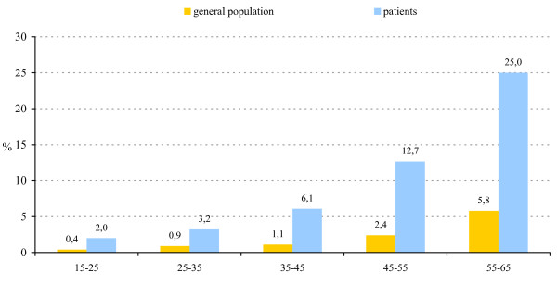
Prevalence of diabetes per age-band in patients with schizophrenia (n=415) compared to the general population.
General population
Patients
%
M. De Hert et al, Clin Pract Epidemiol Ment Health 2006
Notes:
Studio belga cross-sectional e caso-controllo

Slide 17
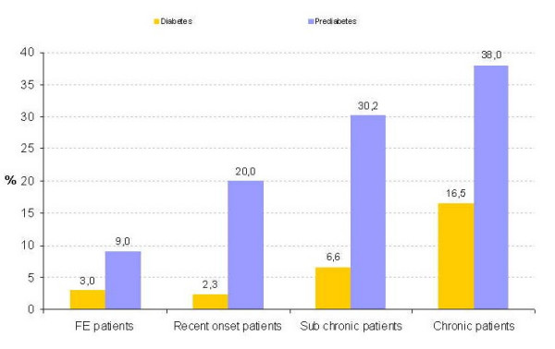
Glucose abnormalities per patient group (n=415)
Diabetes
Prediabetes
%
First-episode patients: duration of illness <1.5 years;
Recent-onset patients: duration of illness >1.5 years and <10 years;
Subchronic patients: duration of illness >10 years and <20 years;
Chronic patients: duration of illness >20 years.
M. De Hert et al, Clin Pract Epidemiol Ment Health 2006

Slide 18
Causes of Metabolic Syndrome
Pharmacologic Treatment
Metabolic
syndrome
Individual risk factors
Psychopathology

Slide 19

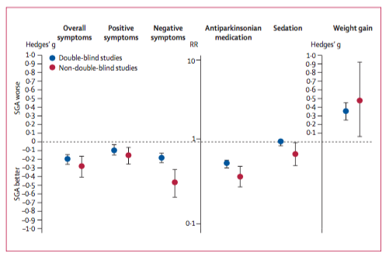
Leucht et al, Lancet 2009
Notes:
TRE PREMESSE: 1. I NUOVI AP….
Metanalisi – AAVV
Gli antipsicotici di II generazione sono una classe eterogenea di farmaci

Slide 20
New cases of diabetes in psychiatric inpatients treated with antipsychotics
%
RR=2.67
RR=1.95
Citrome et al., Psychiatr Serv. 2004;55:1006–1013
Notes:
TRE PREMESSE: 2. LE ASSOCIAZIONI…
Studio caso-controllo effettuato negli USA

Slide 21
Peso corporeo e aderenza al trattamento nella schizofrenia
Pazienti con recente mancata compliance, %*
Normali
(BMI <25 kg/m²)
(n=73)
Sovrappeso
(BMI 25-30 kg/m²)
(n=104)
Obesi
(BMI >30 kg/m²)
(n=100)
I pazienti non soddisfatti del proprio peso corporeo avevano una probabilità
doppia di mancata compliance (OR=2,07)
Weiden PJ et al. Schizophr Res. 2004;66(1):51-57.
Notes:
TRE PREMESSE: 3. ADERENZA….
Data were drawn from a self-administered questionnaire mailed to people with a self-identified diagnosis of schizophrenia
Of the 304 respondents, 95 (37%) were categorized as nonadherent
Obese respondents were more than twice as likely than those with normal BMIs to be nonadherent (OR=2.5)
Patients who were not satisfied with their weight were twice as likely to be nonadherent (OR=2.07)
Reference
Weiden PJ, Mackell JA, McDonnell DD. Obesity as a risk factor for antipsychotic noncompliance. Schizophr Res. 2004;66(1):51-57.

Slide 22
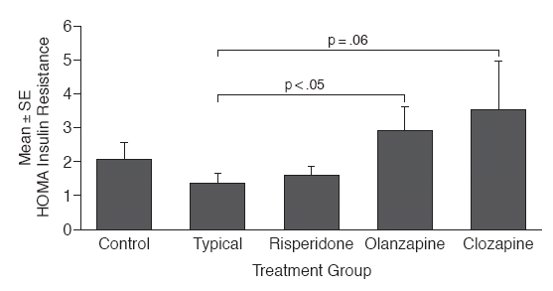
Incidence of insulin resistance with antipsychotics
Newcomer et al., Arch Gen Psychiatry. 2002;59:337-45
Notes:
Studio caso-controllo effettuato negli USA

Slide 23
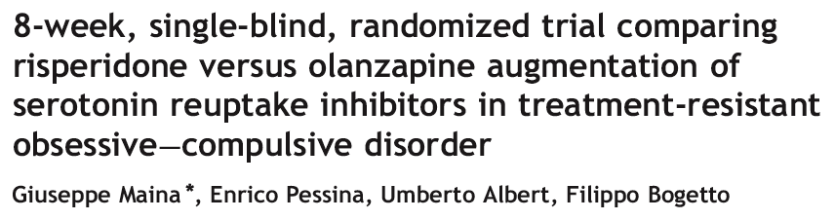
p = 0.010
Mean increase in kg
Eur Neuropsychopharmacol 2008;18:364-72

Slide 24
Effects of Olanzapine and Ziprasidone on glucose tolerance in healthy volunteers
29 healthy male volunteers
p < 0.001
ml/h/kg
Sacher et al., Neuropsychopharmacology 2008;33:1633–1641
Notes:
Studio austriaco che ha valutato gli effetti della somministrazione di olanzapina e ziprasidone sulla tolleranza al glucosio in pazienti sani
24

Slide 25
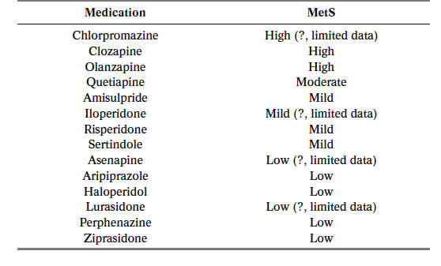
Approximate relative likelihood of metabolic disturbances with AP medications
De Hert et al., World Psychiatry 2011

Slide 26
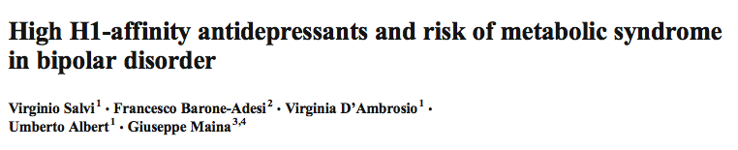
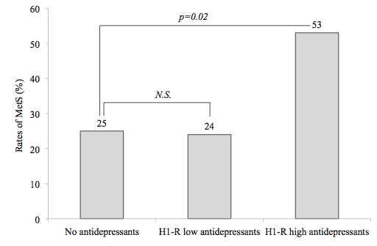
N=294
Low H1-affinity AD: SSRIs, SNRIs, reboxetine, bupropion, CMI
High H1-affinity AD: amitriptyline, imipramine, nortriptyline, trimipramine, mirtazapine
Psychopharmacology, 2015
Notes:
Studio cross-sectional
294 patients with bipo- lar disorder were consecutively recruited. MetS was diag- nosed according to NCEP ATP-III modified criteria. Antide- pressants used by the patients were classified according to the usual nomenclature (SSRI, TCA, SNRI, and other antidepres- sants) and a pharmacodynamic classification taking into ac- count histamine 1-receptor (H1-R) affinity.
Results Use of antidepressants in general was not associated with MetS. However, subjects using H1-R high-affinityantidepressants(N = 15)showedasubstantialin- crease in the prevalence of MetS.

Slide 27
Aripiprazole intramuscular depot as maintenance treatment
in patients with schizophrenia: a 52-week RCT.
Reazioni avverse
Insorte in ≥5% dei pazienti durante la fase
di trattamento randomizzato/sospensione
Kane JM et al. J Clin Psychiatry. 2012;73(5):617-624.
Notes:
Abstract
OBJECTIVE:
To evaluate the efficacy and tolerability of a once-monthly intramuscular (IM) depot formulation of the dopamine partial agonist aripiprazole as maintenance treatment in adults meeting DSM-IV-TR schizophrenia criteria.
METHOD:
The study was conducted from July 2008 until February 2011. Subjects requiring chronic treatment with an antipsychotic entered a 4- to 12-week oral stabilization phase and received oral aripiprazole (10-30 mg/d). Subjects meeting stability criteria for 4 weeks entered an IM-depot stabilization phase in which they received 400-mg aripiprazole-IM-depot injections every 4 weeks (single decrease to 300 mg permitted) with coadministration of oral aripiprazole tablets in the first 2 weeks. Subjects meeting stability criteria for 12 consecutive weeks were randomly assigned (2:1) to aripiprazole-IM-depot or placebo during a 52-week, double-blind maintenance phase. The primary outcome measure was time to exacerbation of psychotic symptoms/impending relapse (event). Safety and tolerability were also assessed.
RESULTS:
710 patients entered oral stabilization, 576 progressed to IM-depot stabilization, and 403 were randomly assigned to double-blind treatment. The study was terminated early because efficacy was demonstrated by the preplanned interim analysis (conducted after 64 events). Time to impending relapse was significantly delayed with aripiprazole-IM-depot treatment compared with placebo in both the interim analysis and the final analysis (P < .0001, log-rank test). The hazard ratio (placebo/aripiprazole-IM-depot) at final analysis was 5.03 (95% CI, 3.15-8.02). The rate of impending relapse was significantly lower with aripiprazole-IM-depot than placebo at endpoint (final analysis, 10.0% [n = 27/269] vs 39.6% [n = 53/134]). Improvements in Clinical Global Impressions-Severity of Illness scale and Positive and Negative Syndrome Scale total scores were maintained with aripiprazole-IM-depot treatment but showed significant worsening with placebo (change from double-blind baseline, P < .0001 for aripiprazole-IM-depot vs placebo). The most common treatment-emergent adverse events (occurring in ≥ 5% of aripiprazole-IM-depot subjects and greater than placebo) were insomnia, tremor, and headache.
CONCLUSIONS:
Aripiprazole-IM-depot significantly delayed time to impending relapse compared with placebo and appears to be a well-tolerated maintenance treatment option for schizophrenia.

Slide 28
Aripiprazole intramuscular depot as maintenance treatment
in patients with schizophrenia: a 52-week RCT.
Profili glicemico e lipidico
Incidenza di anomalie metaboliche di nuova insorgenza
Parametro metabolico | Aripiprazolo una volta al mese | Placebo depot IM
Glucosio | 7/157 (4,5%) | 2/80 (2,5%)
Colesterolo totale | 4/155 (2,6%) | 2/63 (3,2%)
Colesterolo HDL | 22/170 (12,9%) | 9/83 (10,8%)
Colesterolo LDL | 0/109 (0,0%) | 0/47 (0,0%)
Trigliceridi | 12/156 (7,7%) | 6/67 (9,0%)
Kane JM et al. J Clin Psychiatry. 2012;73(5):617-624.

Slide 29
Aripirazolo LAI: tollerabilità 6 mesi
‘mirror image study’
N= 22
- 6 mesi T0 + 6 mesi
Maina et al., data on file

Slide 30

Aripirazolo LAI: tollerabilità 6 mesi
‘mirror image study’
N= 22
- 6 mesi T0 + 6 mesi
Maina et al., data on file

Slide 31
Aripirazolo LAI: tollerabilità 6 mesi
%
‘mirror image study’
N= 22
Sindrome metabolica
Maina et al., data on file

Slide 32
Aripirazolo LAI: tollerabilità 6 mesi
‘mirror image study’
N= 22
PROLATTINA
Maina et al., data on file

Slide 33
Opinione dei pazienti sull’impiego di antipsicotici con diversa formulazione: valutazione di 206 pazienti con schizofrenia (Francia)
.
Caroli F et al. Patient Prefer Adherence. 2011;5:165-171.
Notes:
OPINIONI DEI PAZIENTI
A survey of patients with schizophrenia who had at least 3 months’ experience using LAI antipsychotics (N=206) was conducted (19 sites over France)
Among patients who had received at least 2 different formulations, injections were the favored formulation, being preferred by 47% of the patients
70% of patients felt better supported in their illness by virtue of regular contact with the doctor or nurse who administered their injection
The most frequently cited reasons for patients’ preferring injections were that the doses were spread out over time and there was no risk of forgetting a dose
Reference
Caroli F, Raymondet P, Izard I, Plas J, Gall B, Delgado A. Opinions of French patients with schizophrenia regarding injectable medication. Patient Prefer Adherence. 2011;5:165-171.

Slide 34
Aripirazolo LAI: preferenze del paziente per la terapia (n=22)
a 6 mesi di trattamento
59,1%
Formulazione preferita
22,7%
18,2%
Maina et al., data on file

Slide 35
Schizofrenia e condizioni mediche generali:
sovrappeso e sindrome metabolica
conclusioni
Notes:
35

Slide 36
Schizofrenia e condizioni mediche generali:
sovrappeso e sindrome metabolica
Identificazione pazienti a rischio di sovrappeso e sindrome metabolica
  RISCHIO INDIVIDUALE: etnia, età, genere, familiarità
  RISCHIO CORRELATO ALLA PSICOPATOLOGIA: fase di malattia
Notes:
36

Slide 37
Schizofrenia e condizioni mediche generali:
sovrappeso e sindrome metabolica
Identificazione pazienti a rischio di sovrappeso e sindrome metabolica
  RISCHIO INDIVIDUALE: etnia, età, genere, familiarità
  RISCHIO CORRELATO ALLA PSICOPATOLOGIA: fase di malattia
Notes:
37

Slide 38
Schizofrenia e condizioni mediche generali:
sovrappeso e sindrome metabolica
2. Scelta farmaco a minor rischio
3. Monitoraggio del rischio dismetabolico
4. Gestione del rischio dismetabolico
Notes:
38

Slide 39
Schizofrenia e condizioni mediche generali:
sovrappeso e sindrome metabolica
2. Scelta farmaco a minor rischio
3. Monitoraggio del rischio dismetabolico
4. Gestione del rischio dismetabolico
Notes:
39

Slide 40
Schizofrenia e condizioni mediche generali:
sovrappeso e sindrome metabolica
2. Scelta farmaco a minor rischio
3. Monitoraggio del rischio dismetabolico
4. Gestione del rischio dismetabolico
Notes:
40

