Slide 1

La lettera di dimissione Roberto Caporale

Slide 2
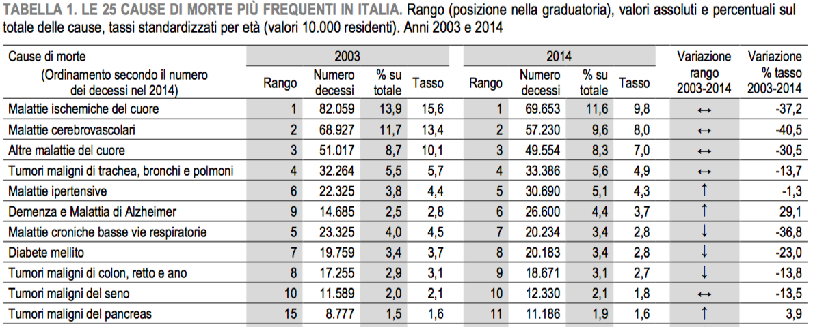


Slide 3
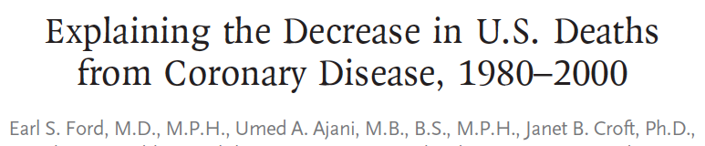
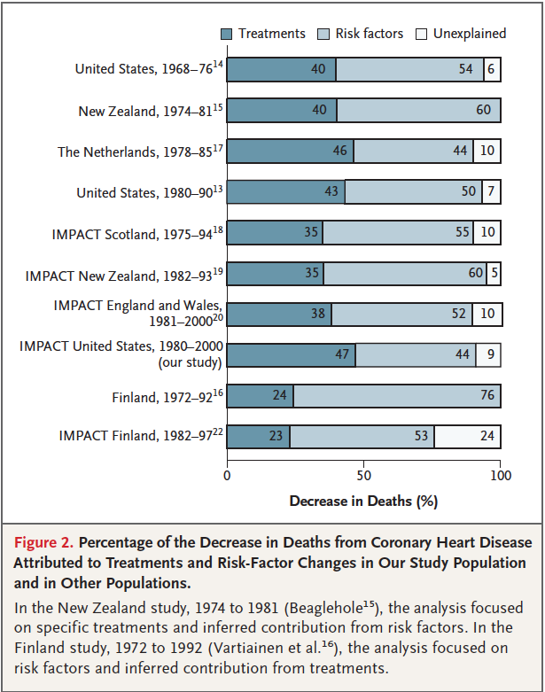
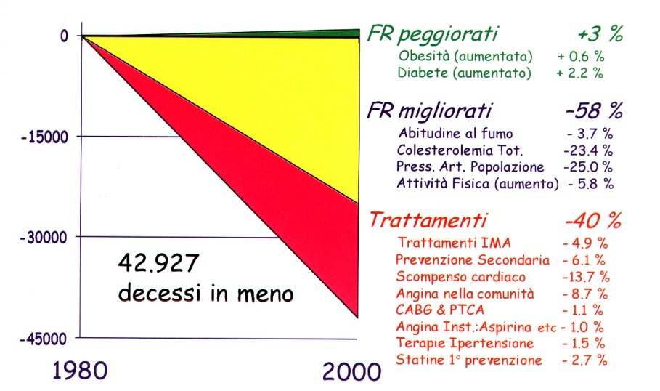
Cardiovascular
Epidemiologic
Observatory
Revascularization in SCAD:
7% reduction
Notes:
In this paper is conversely very well illustrated that almost a half of the mortality reduction of about 40% in the years from 1980 to 2000 is due to major risk factors treatment, while another more 40% is due to evidence based treatment and no more than 7% to revascularization procedures. If you are perplexed, let me show you that in Italy the parallel estimate of the weight of revascularization procedures in reducing CV mortality made by the Cardiovascular Epidemiologic Observatory is 1,1%.

Slide 4
~1 in 5 patients with ACS will have died within 5 years of their index event
GRACE study: Analysis of UK and Belgian patients with ACS^{[Fox} ^{2010]}
Post-discharge deaths occurred in 68%, 86% and 97% of STEMI, NSTEMI and UA patients, respectively.
ACS, acute coronary syndromes; GRACE, Global Registry of Acute Coronary Events; MI, myocardial infarction; NSTEMI, non-ST-segment elevation
myocardial infarction; STEMI, ST-segment elevation myocardial infarction; UA, unstable angina.
Fox KA et al. Eur Heart J 2010;31:2755–2764.
Notes:
ACS patients enrolled in the GRACE registry from the UK and Belgium were included in this analysis
The analysis was designed to test the hypothesis that long-term (5-year) outcomes can be predicted with similar predictive accuracy to short-term outcome, based on presentation characteristics
To determine the occurrence of subsequent MI and death, patients were followed up at ~6 months and at a median of 5 years and up to 10 years
Primary outcome events were cardiovascular death or MI and secondary events included rehospitalisation for ACS
Reference
Fox KA, et al. Eur Heart J 2010;31:2755–2764.

Slide 5
Patients with a history of ischaemic events have a continuous and linear risk of MACE for >3 years
CV risk in REACH registry patients with a history of ischaemic
event (MI or stroke) at baseline (n=21,890)^{[Bhatt} ^{2010]}
18
16
14
12
10
Cumulative incidence of
CV death, MI or stroke (%)
8
6
4
2
0
0
6
12
18
24
30
36
42
48
Time from study enrolment (months)
CV, cardiovascular; MACE, major adverse cardiovascular events; MI, myocardial infarction; REACH, REduction of Atherothrombosis for Continued Health.
Bhatt DL et al. JAMA 2010;304:1350–1357.
Notes:
The REACH registry included patients aged ≥45 years with three or more risk factors for atherosclerosis and patients with established coronary artery disease, peripheral arterial disease or cerebrovascular disease
Risk factors consisted of diabetes, diabetic nephropathy, ankle-brachial index <0.9, asymptomatic carotid stenosis of 70% or more, carotid intima media thickness at least two times that at adjacent sites, systolic blood pressure of 150 mmHg or higher despite treatment, hypercholesterolaemia treated with medication, current smoking of 15 or more cigarettes per day, and age 65 years and older for men or 70 years and older for women
Detailed information was collected at baseline with subsequent annual follow-up at Years 1, 2, 3 and 4
The initial follow-up was planned for up to 2 years and an additional 2-year extension was proposed shortly before the first 2 years were complete
Event rates of CV death, MI, stroke and CV hospitalisation were calculated
A total of 45,227 patients were eligible for inclusion in the 4-year follow-up study and contributed 4-year outcomes data
During the follow-up period, a total of 5481 patients experienced at least one event
Reference
Bhatt DL, et al. JAMA 2010;304:1350–1357.

Slide 6
Approximately 40% of recurrent MIs occur 2–5 years after the index event
Observational study of 307 consecutive patients experiencing
a second MI >1 month after the first event^{[Figueras} ^{2002]}
MI, myocardial infarction.
Figueras J et al. Am J Cardiol 2002;89:1416–1420.
Notes:
This study aimed to determine the annual presentation of a second acute MI as well as the presence of physical and/or psychological stress at the onset of each acute MI
Consecutive patients with a second acute MI >1 month after the first one were included
A total of 307 patients were included in the final analysis
Reference
Figueras J, et al. Am J Cardiol 2002;89:1416–1420.

Slide 7
Prevenzione Secondaria post-SCA
Approccio comportamentale
  Abolizione del fumo
  Riduzione del peso corporeo
  Attività fisica aerobica
Approccio farmacologico
  Controllo della PA
  Controllo LDL
  Terapia antiaggregante

Slide 8
Greater reductions in LDL-C levels are associated with greater reductions in CV event rates
50%
40%
30%
Proportional Reduction in Event Rate (SE)
CTT-meta-analysis
20%
10%
IMPROVE-IT
0%
19
39
58
77
Reduction in LDL-C (mg/dL)
CTTC. Lancet 2005;366:1267–1278. CTTC. Lancet 2010;376:1670–1681.
Cannon et al. N Engl J Med 2015;372:2387 – 2397.
Notes:
The continuous relationship between LDL-C and CV risk is underlined by the recent IMPROVE-IT study, which investigated the effects of adding ezetimibe to simvastatin 40mg.
The figure illustrates a prospective meta-analysis of data from 90,056 participants in 14 statin RCTs, together with the results of the IMPROVE-IT study.^{1–4}
Event rate analysis was performed on major vascular events.¹
LDL-C is strongly recommended as the most important surrogate marker for predicting CV outcomes.³
Background information¹
The 14 RCTs considered were 4S, WOSCOPS, CARE, Post-CABG, AFCAPS/TexCAPS, LIPID, GISSI Prevention, LIPS, HPS, PROSPER, ALLHAT-LLT, ASCOT-LLA, ALERT, CARDS.¹
Major vascular events were defined as the combined outcome of major coronary events including CHD (coronary heart disease) death, MI, and hospitalisation from unstable angina or non-fatal or fatal stroke, or coronary revascularisation. For each outcome, the regression line represents the weighted event rate reduction per mg/dL LDL-C reduction.¹
IMPROVE-IT was a large-scale multicentre RCT (randomised controlled trial) of 18,144 high-risk post ACS (acute coronary syndrome) patients taking ezetimibe 10mg and 40mg simvastatin versus simvastatin alone, with a follow-up of 6 years.⁴ Squares represent a single trial plotted against mean absolute LDL-C reduction at 1 year, with vertical lines corresponding to one SE of unweighted event rate reduction.
References
Cholesterol Treatment Trialists’ Collaborators. Lancet 2005;366:1267–1278.
Cholesterol Treatment Trialists’ Collaboration. Lancet 2010;376:1670–1681.
DiNicolantonio et al. Am J Med 2015;128:914.e1–914.e4.
Bohula et al. Circulation 2015;132:1224–1233.

Slide 9
CHARISMA: benefit of aspirin plus clopidogrel in the subgroup of patients with documented AT
Population
RR
(95% CI)
p value
Documented AT
(n=12153)
0.88
(0.77, 0.998)
0.046
Risk Factors Only
(n=3284)
1.20
(0.91, 1.59)
0.20
Overall Population*
(n=15603)
0.93
(0.83, 1.05)
0.22
0.4
0.6
0.8
1.2
1.4
1.6
Clopidogrel + ASA
Better
Placebo + ASA
Better
*A statistical test for interaction showed marginally significant heterogeneity (p=0.045) in treatment response
for the pre-specified subgroups of symptomatic and asymptomatic patients; AT=Atherothrombosis
Adapted from Bhatt DL et al. NEJM 2006;354:1706-1717

Slide 10
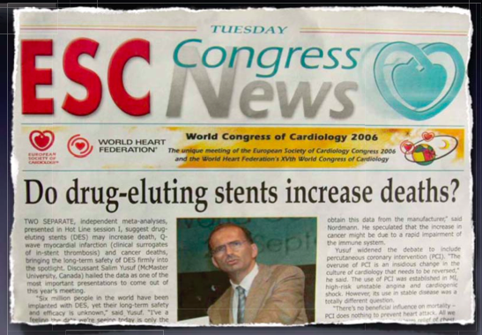
2006: Very Late Stent Thrombosis

Slide 11
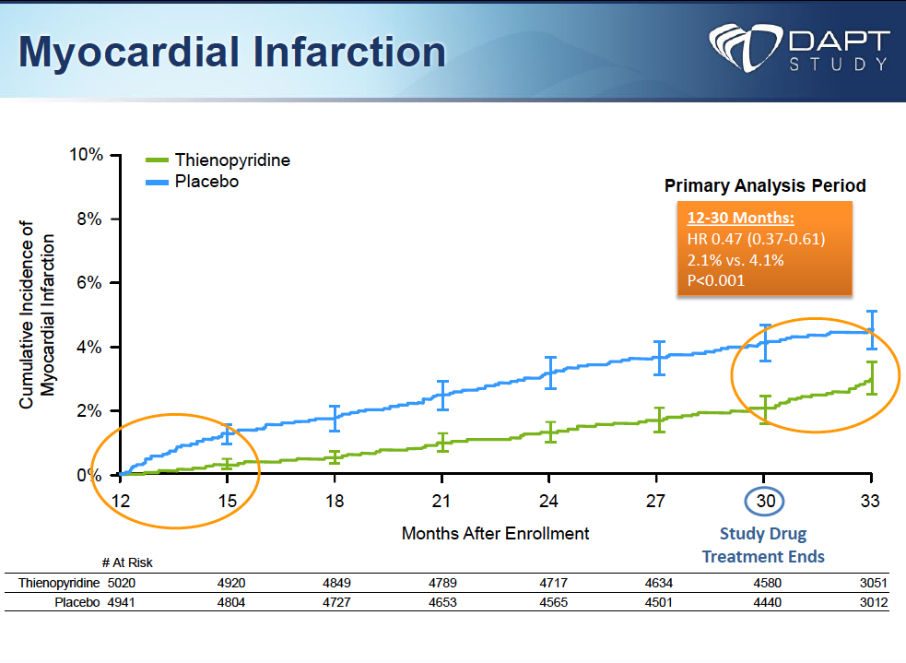
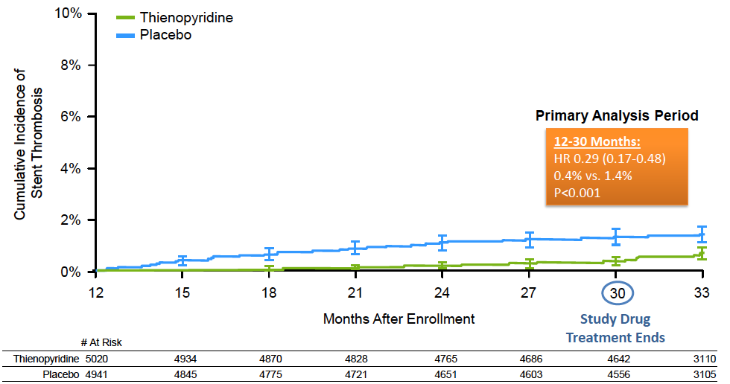
Co-Primary End-Point:
Stent Thrombosis

Slide 12
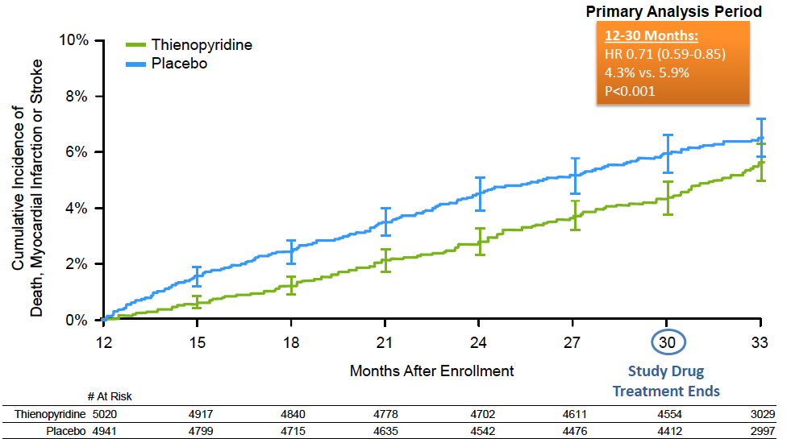
Co-Primary End-Point:
MACCE

Slide 13
Myocardial Infarction

Slide 14
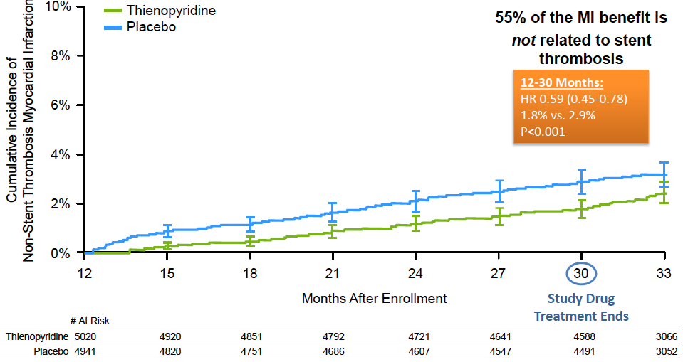
Non-Stent Thrombosis
Myocardial Infarction

Slide 15
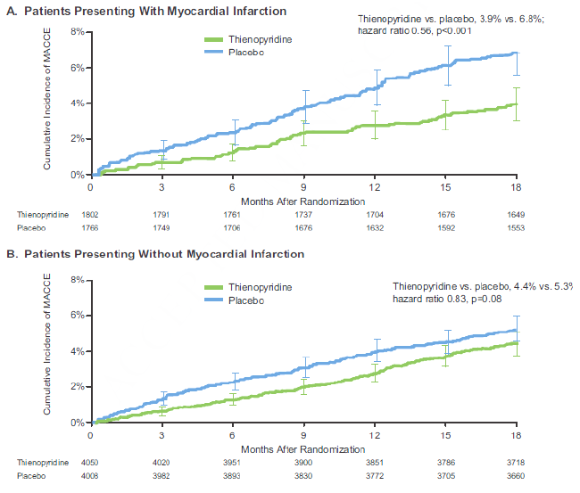
Non-Stent Thrombosis
Myocardial Infarction

Slide 16
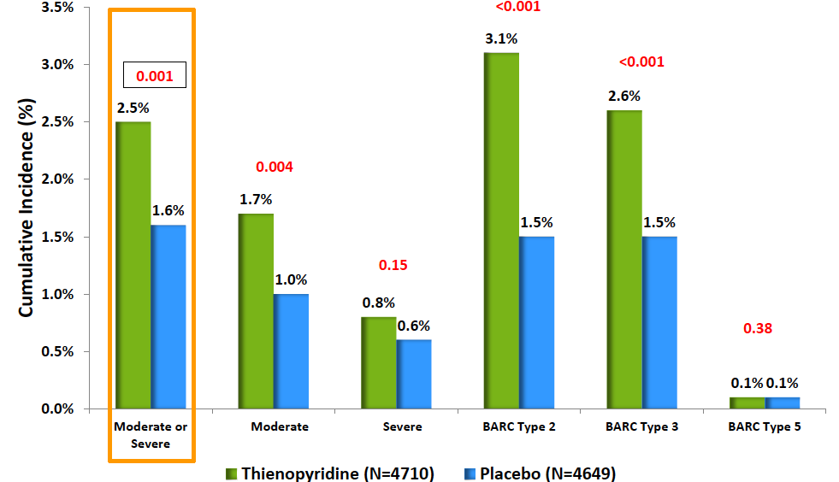
Primary Safety End-Point:
Moderate or Severe Bleedings.

Slide 17
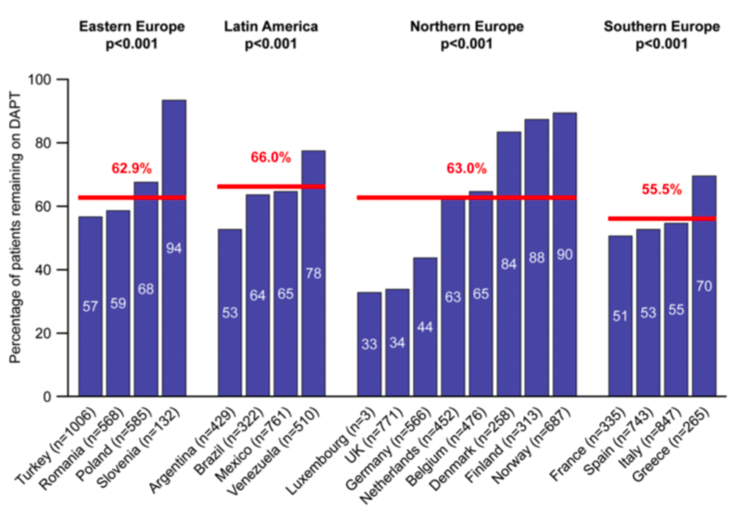
EPICOR
International patterns of dual antiplatelet therapy duration after acute coronary syndromes.
Bueno H, et al. Heart 2017;103:132–138.

Slide 18
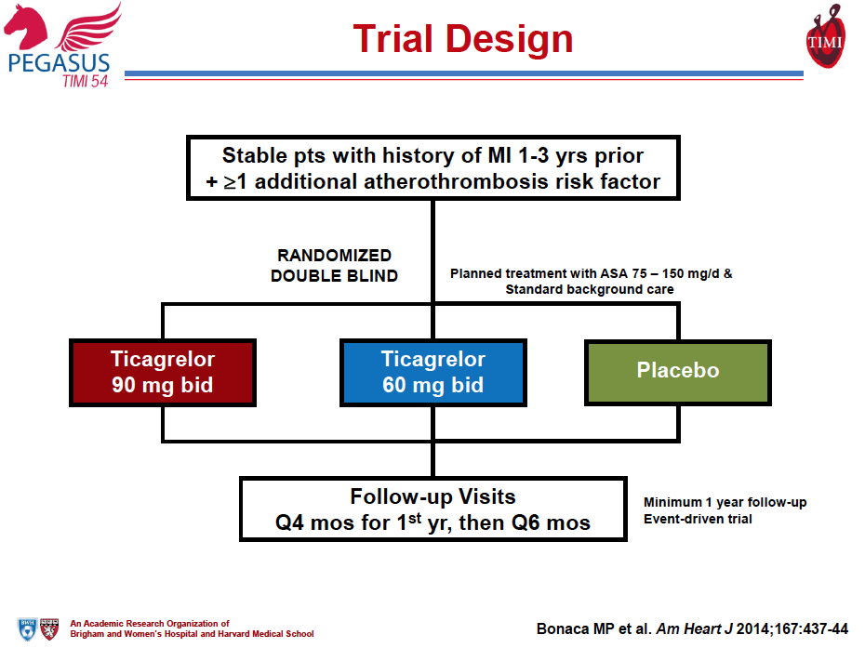

Slide 19
Primary Endpoint
10
21,162 patients with MI 1-3 years prior and treated with low-dose aspirin
9
Placebo (9.0%)
8
Ticagrelor 90 (7.8%)
Ticagrelor 60 (7.8%)
7
6
CV Death, MI, or Stroke (%)
5
Ticagrelor 90 mg
HR 0.85 (95% CI 0.75 – 0.96)
P=0.008
4
3
Ticagrelor 60 mg
HR 0.84 (95% CI 0.74 – 0.95)
P=0.004
2
1
0
0
3
6
9
12
15
18
21
24
27
30
33
36
Months from Randomization
Bonaca MP et al. and Sabatine MS. NEJM 2015;372:1791-800

Slide 20
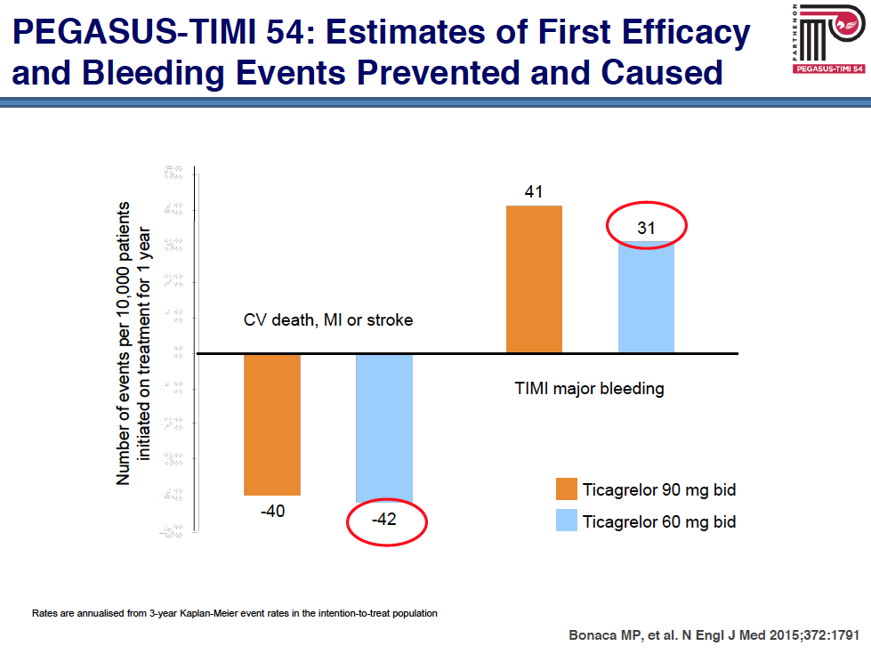
Reduction in CV death, MI or stroke with ticagrelor by time from P2Y₁₂ inhibitor withdrawal
Time from P2Y₁₂ inhibitor withdrawal to randomization
HR (95% CI)
P value
0.70 (0.57, 0.87)
0.75 (0.61, 0.92)
0.73 (0.61, 0.87) <0.001
0.90 (0.72, 1.12)
0.82 (0.65, 1.02)
0.86 (0.71, 1.04) 0.11
0.96 (0.73, 1.26)
1.06 (0.81, 1.38)
1.01 (0.80, 1.27) 0.96
≤30 days
n=7181
27% RRR
>30 days
to 1 year
n=6501
14% RRR
>1 year
n=5079
∅ RRR
P-interaction 0.0097
0.7
0.9
1.1
Ticagrelor 90 mg
Ticagrelor 60 mg
Ticagrelor better
1.0
Placebo better
Pooled

Slide 22
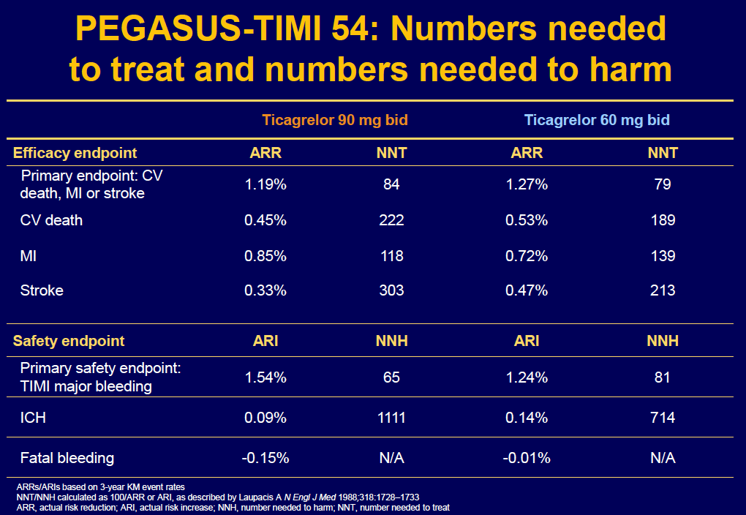

Slide 23
Drug discontinuation for AE by Treatment
Ticagarelor 90 mg twice daily
Ticagrelor 60 mg twice daily
Placebo

Slide 24
Adverse Events Leading to Discontinuation
3 Year KM Rate (%) – p-value for each dose vs. placebo <0.001
Treatment Arm | Any AE | Bleeding | Dyspnea
Ticagrelor 90 | 19.0% | 7.8% | 6.5%
Ticagrelor 60 | 16.4% | 6.2% | 4.6%
Placebo | 8.9% | 1.5% | 0.8%
Number of Patients

Slide 25
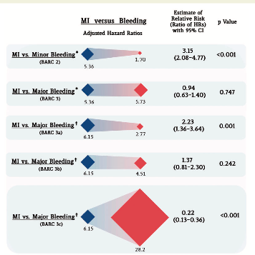
Trade-off of myocardial infarction vs. bleeding types on mortality after acute coronary syndrome: lessons from the TRACER trial.
Valgimigli M et al. European Heart Journal 2016.

Slide 26
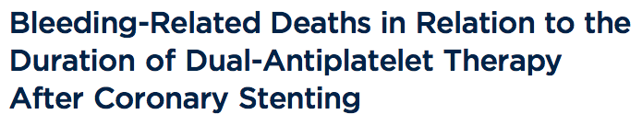
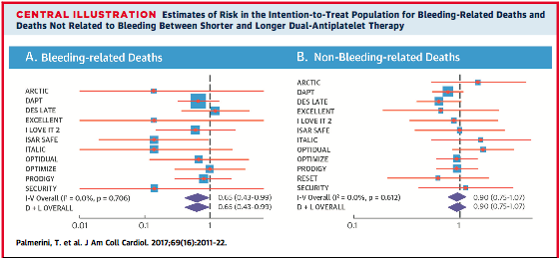

Slide 27
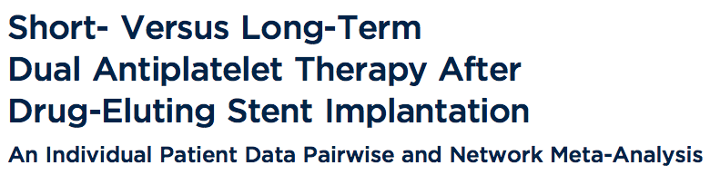
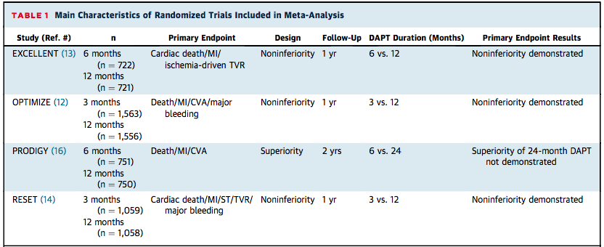
51% SCAD
90% ZES- CrCo EES

Slide 28
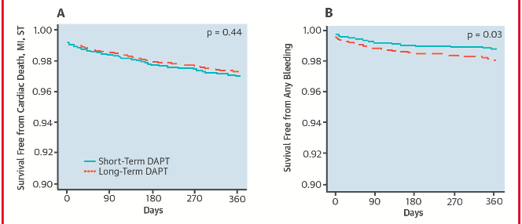
51% SCAD
90% ZES- CrCo EES

Slide 29

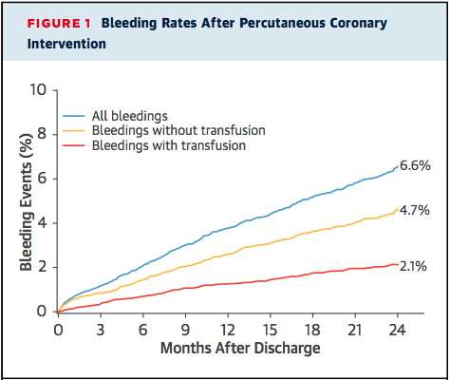
Assessment of Dual Antiplatelet Therapy
With Drug-Eluting Stents [ADAPT-DES]

Slide 30
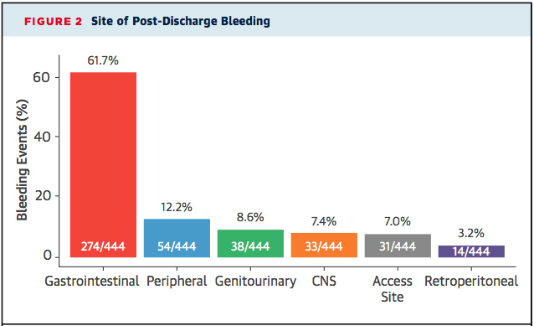
Assessment of Dual Antiplatelet Therapy
With Drug-Eluting Stents [ADAPT-DES]

Slide 31
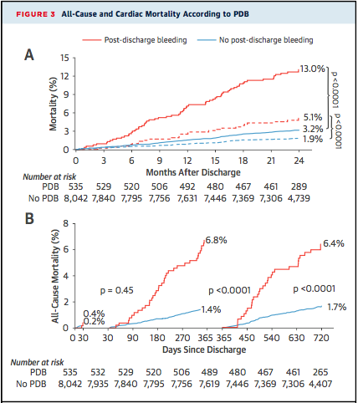
Assessment of Dual Antiplatelet Therapy
With Drug-Eluting Stents [ADAPT-DES]

Slide 32
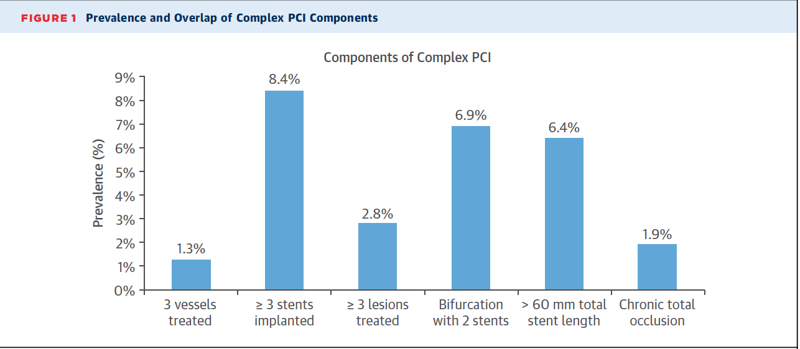
Post hoc patient-level pooled analysis of randomized controlled trials (RCTs) designed to investigate the efficacy and safety of long-term (>1 year) versus short term (3 or 6 months) DAPT in patients undergoing complex or noncomplex PCI
85% of patients received new-generation DES
Giustino G, Palmerini T et al. JACC 2016

Slide 33
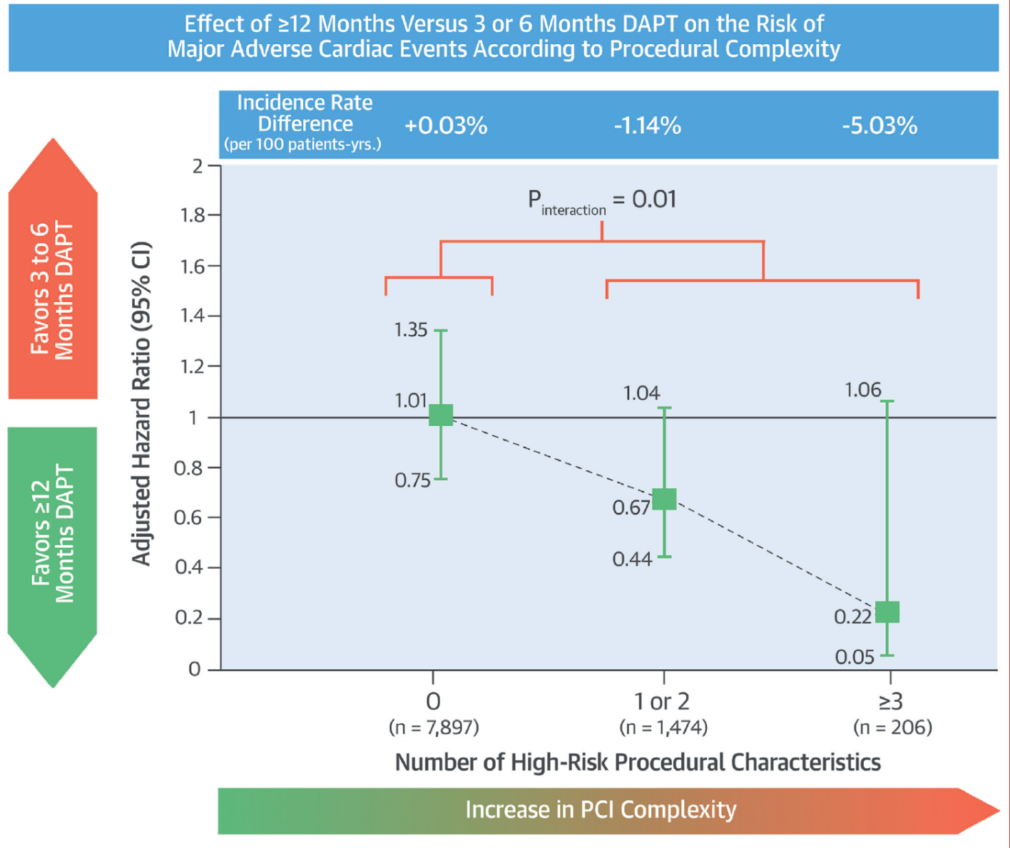
Post hoc patient-level pooled analysis of randomized controlled trials (RCTs) designed to investigate the efficacy and safety of long-term (>1 year) versus short term (3 or 6 months) DAPT in patients undergoing complex or noncomplex PCI
Giustino G, Palmerini T et al. JACC 2016

Slide 34
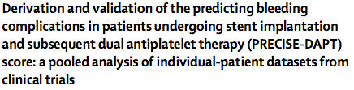
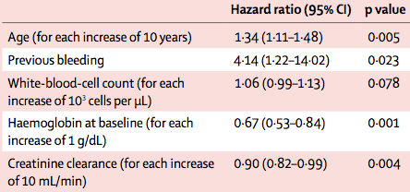
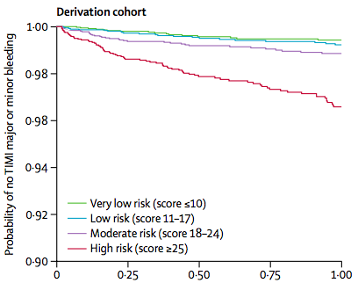
Lancet 2017; 389: 1025–34.
14963 patients with established coronary artery disease, and treated with coronary stent implantation.

Slide 35
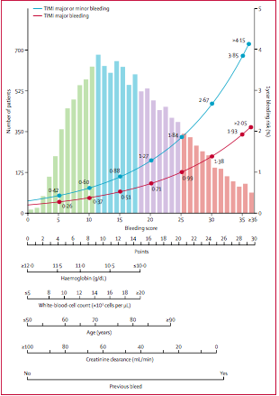
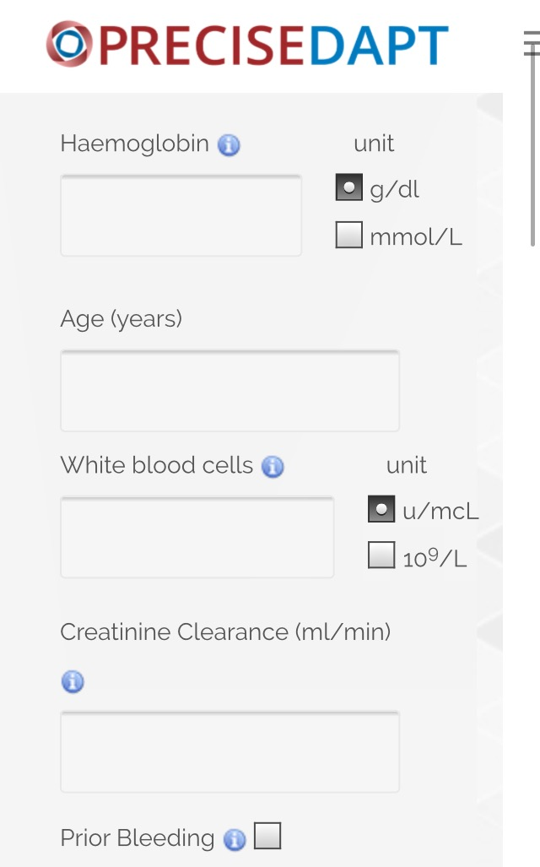
Lancet 2017; 389: 1025–34.

Slide 36
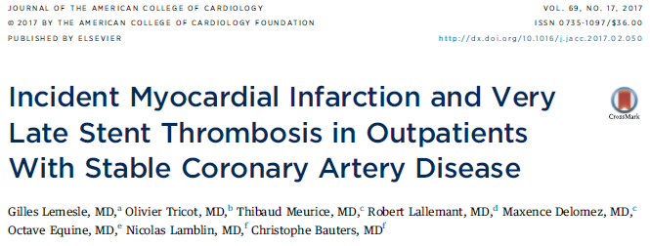
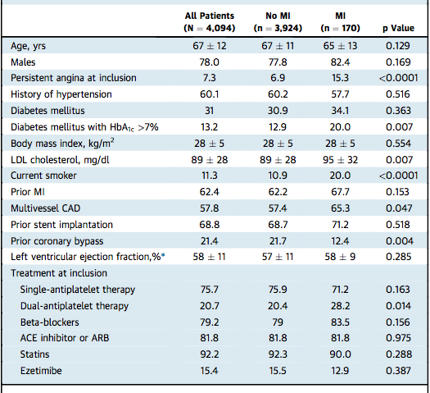
CORONOR
4,184 unselected outpatients with stable CAD (i.e., MI or coronary revascularization >1 year previously).
Five-year follow-up was achieved for 4,094 patients (98%).

Slide 37
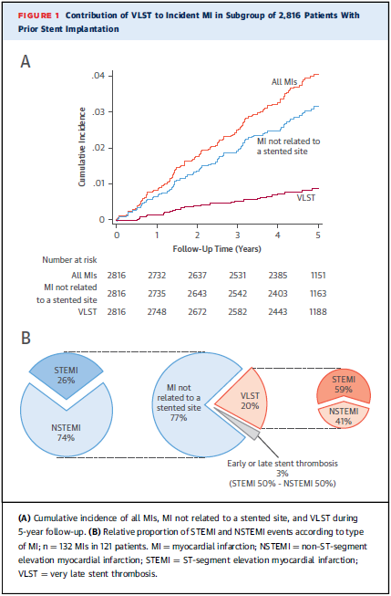

Slide 38
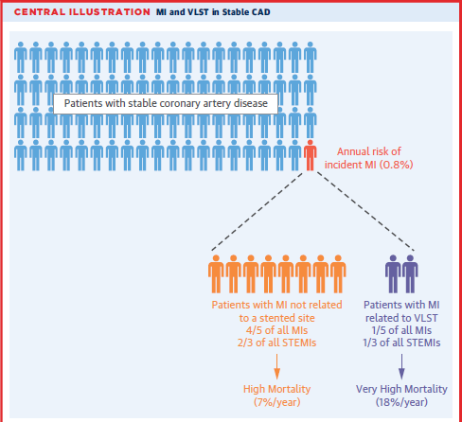

Slide 39
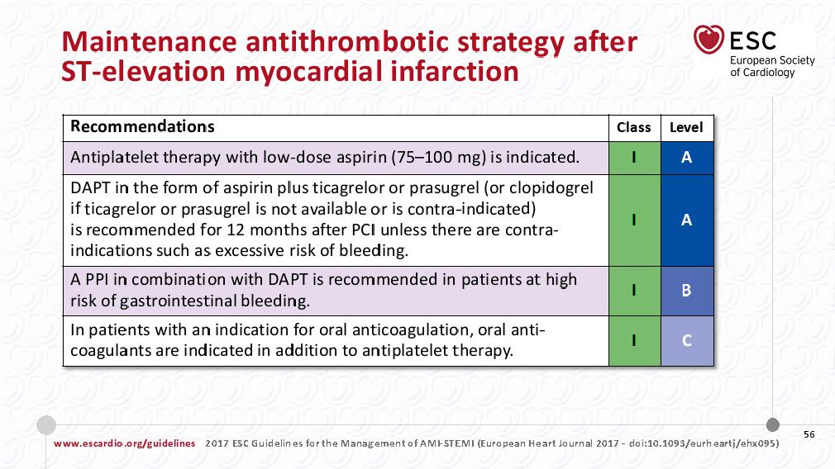

Slide 40
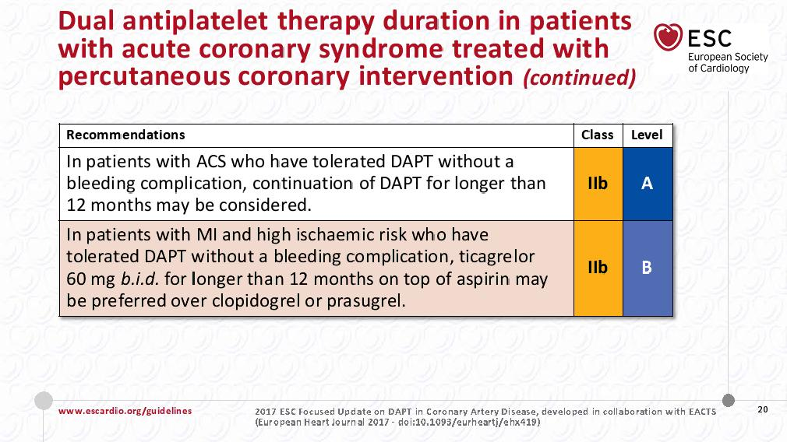

Slide 41
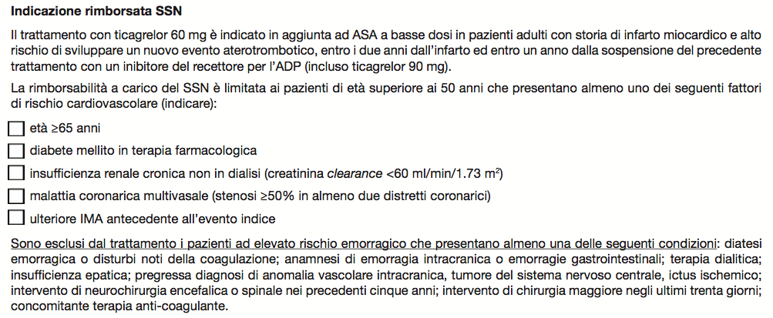
Considerazioni Conclusive:
Selezione dei pazienti.
NNT
NNH
✔
✔
✔
✔
✔

Slide 42
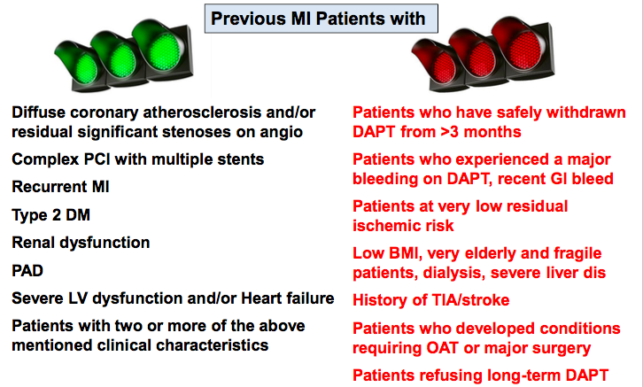

Slide 43
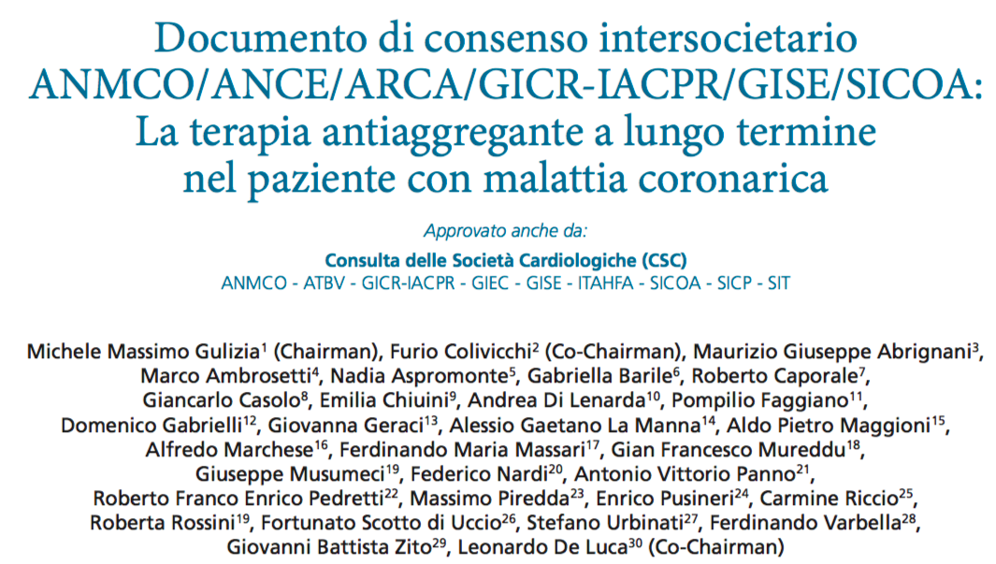
G Ital Cardiol 2018;19(5):263-331

Slide 44
Il paziente con SCA ha completato 12 mesi di DAPT?
NO
Età > 65 anni
Diabete mellito in trattamento
Ulteriore precedente IM
Malattia coronarica multivasale
ClCr<60 mL/min
SI
Il paziente è considerato ad alto rischio di nuovi eventi CV?
NO
SI
Il paziente ha sofferto di TIA/ictus o emorragie?
SI
NO
Si può considerare il prolungamento del trattamento con Ticagrelor 60 mg x 2
Il paziente non è eleggibile al trattamento a lungo termine

Slide 45
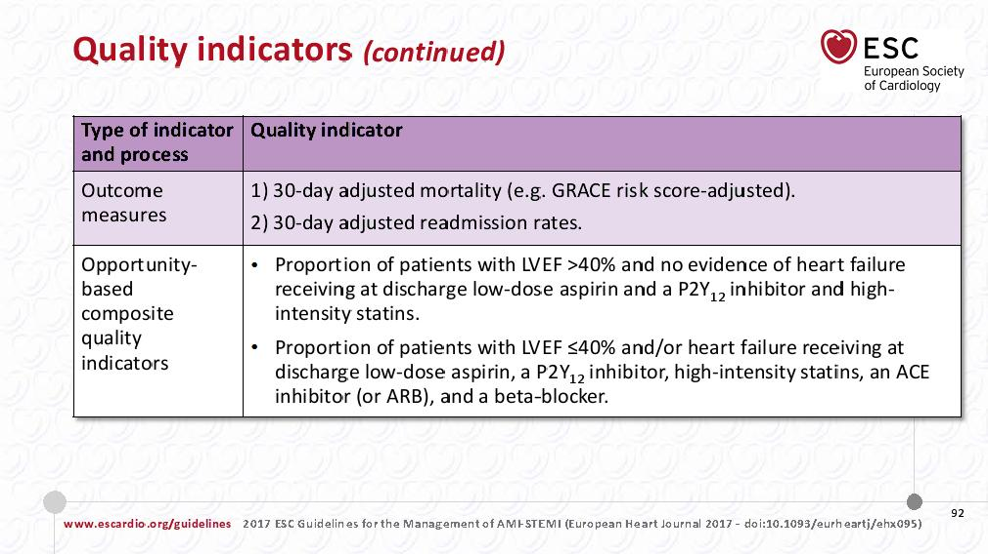

Slide 46


Cruciale è la dimissione ospedaliera, momento nel quale identificare il paziente infartuato ad alto rischio.
Andrebbero pertanto sottolineati nella lettera di dimissione i fattori di rischio coesistenti al fine di guidare il percorso di follow-up del paziente, ad esempio indicando nella suddetta lettera:
«Si raccomanda di valutare il prolungamento della DAPT dopo i primi 12 mesi di terapia nei pazienti con infarto e ulteriori fattori di rischio (età>65 anni, diabete, insufficienza renale cronica, malattia multivasale, precedenti infarti).»

Slide 47
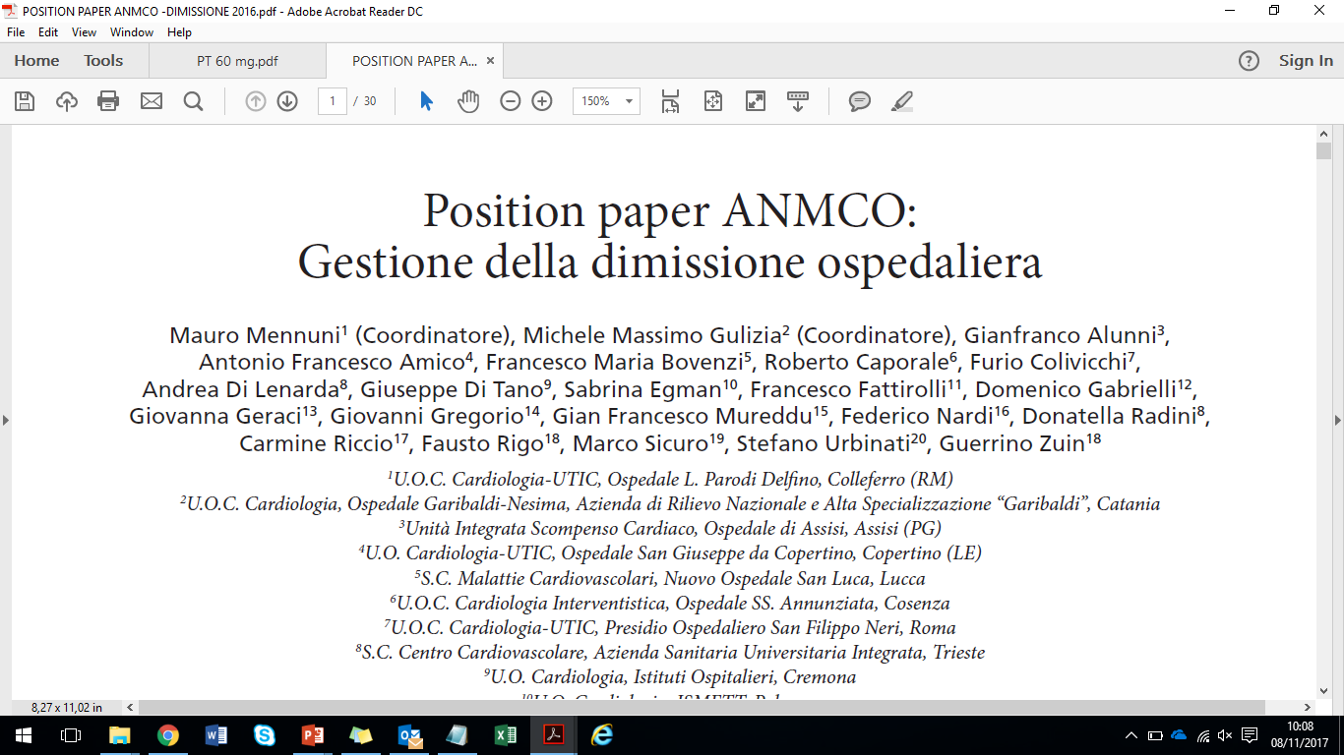
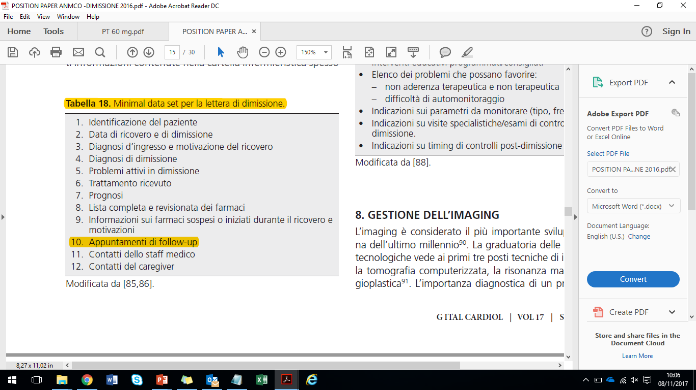
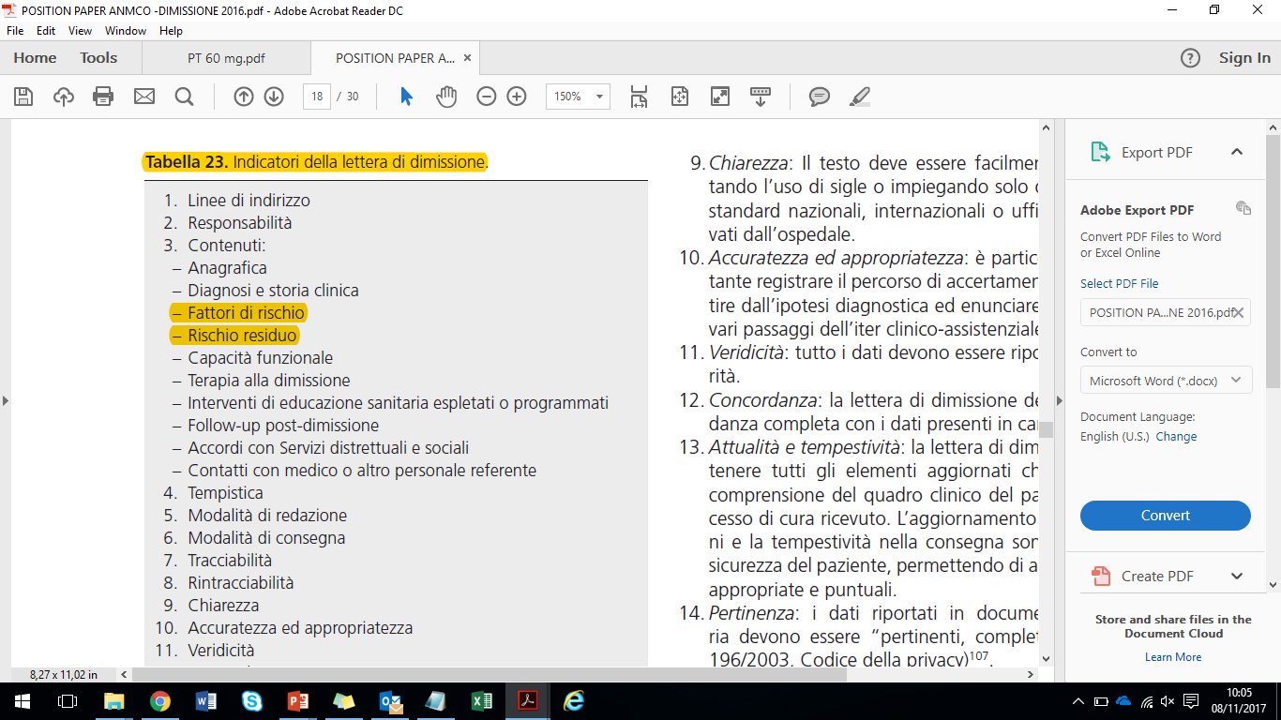
Lettera di Dimissione
Esempio di frase da inserire nella lettera di dimissione:
«Il paziente presenta criteri clinici (e.g. DM) e anatomici (e.g. MVD) che suggeriscono una rivalutazione al 12° mese per un’eventuale prosecuzione della DAPT»
G. Ital. Cardiol. 2016 Sep;17(9):0. doi: 10.1714/2448.25672.

Slide 49
Obiettivi della lettera di dimissione: programmazione dei Test induttivi
Indicare se e quando è necessario programmare test induttivi IN ASSENZA DI SINTOMI, in rapporto alla presenza di:
  Disfunzione ventricolare Sn
  Rivascolarizzazione incompleta/subottimale
  Trattamento di TC, multivaso, biforcazioni, IVA prox
  Diabete mellito

Slide 50
Ricerca di ischemia
  In considerazione della sua attuale condizione, a meno di ricomparsa di sintomi anginosi, (non) è normalmente prevedibile l’esecuzione di un test ergometrico
  tra … mesi
  non prima di … mesi

Slide 51
Obiettivi della lettera di dimissione:
Tx ipolipemizzante
Indicare il target di colesterolo LDL da raggiungere (70 mg/dL o riduzione del 50% rispetto al basale)
Programmare la rivalutazione dei livelli di colesterolo LDL ogni 4-6 settimane sino al raggiungimento del target
Programmare l’up-grading della terapia:
  Statina
    se inefficace o non tollerata:
  (Statina) + Ezetimibe
    se inefficace o non tollerata:
  (Statina) + Ezetimibe + i-PCSK9

Slide 52
Terapia ipolipemizzante
Nel suo caso è molto importante ridurre il livello del colesterolo “cattivo” (LDL) al di sotto di 70 (o target <50%) mg/dl.
In caso di mancato raggiungimento di questo risultato entro 2 mesi con la terapia prescritta che include una statina, è raccomandata l’aggiunta di Ezetimibe 10 mg/die.
Se anche assumendo l’associazione Statina + Ezetimibe il colesterolo LDL risultasse > 100 mg/dL, è opportuno considerare la somministrazione di inibitori della proteina PCSK9 (alirocumab, evolocumab).

Slide 53
Obiettivi della lettera di dimissione:
Tx antiaggregante
Stratificare il rischio ischemico/emorragico alla dimissione
  DAPT score?
  Criteri PEGASUS?
  PRECISE-DAPT?
Programmare la durata MINIMA della DAPT in relazione al tipo di stent/SCA
  Non-SCA: (1 mese BMS,) 3 – 6 mesi DES, 12 mesi BVS
  SCA: 12 mesi tutti, 6 mesi HBR
Programmare la rivalutazione del rischio ischemico/emorragico a 12 mesi e l’eventuale prolungamento della DAPT.

Slide 54
Durata DAPT
Si raccomanda l’accurata assunzione della doppia antiaggregazione con ASPIRINA + …, indicata per (12) mesi dalla dimissione. Ogni riduzione di tale durata minima va attentamente valutata da un cardiologo, poiché la sospensione anticipata può aumentare il rischio di trombosi di stent con conseguenze potenzialmente molto gravi.
È consigliata una valutazione cardiologica a 12 mesi per considerare un eventuale prolungamento di tale terapia, qualora nel periodo intercorso non si verifichino significative emorragie.

Slide 55

Gestione globale del follow-up
Abolizione del fumo
Prolungamento
della DAPT
Attività fisica
PA < 130/80
LDL < 70

Slide 56
Considerazioni Conclusive
La riduzione del rischio residuo post-SCA è un concreto obiettivo
Il rischio residuo è multifattoriale, ed include aspetti comportamentali e trattamenti farmacologici
La riduzione delle LDL è un target terapeutico misurabile, privo di significativi rischi
La durata della DAPT va individualizzata: da 3-6 mesi a tempo indefinito.
La lettera di dimissione dopo un ricovero per SCA è un punto nodale per programmare un follow-up specifico ritagliato sulle caratteristiche del paziente.

